Slide 1
Tracking Maternal Health Progress
Toward SDG 3.1
AI for Sustainability Virtual Internship
1M1B – IBM SkillsBuild & AICTE
Rivan Dsilva | RV Universitty
STU691cae1ca00661763487260

Slide 2
SDG Alignment
SDG 3: Good Health and Well-being
Target 3.1
Reduce global maternal mortality ratio to less than 70 deaths per 100,000 live births by 2030
Why Maternal Health Matters:
• Critical public health indicator
• Reflects healthcare system quality
• Sustainable development requirement

Slide 3
Problem Statement
"How might we use AI and data analysis to track maternal mortality trends and predict future MMR so that progress toward SDG 3.1 can be monitored more effectively?"
Key Challenges:
✓ Maternal mortality needs continuous monitoring
✓ Historical data contains important trends
✓ Manual analysis makes comparison difficult
✓ Future estimation requires advanced methods

Slide 4
Target Users & Impact
Primary Users
Problem Impact
• Public-health analysts
• Difficulty monitoring trends
• Government SDG teams
• Challenges identifying needs
• Healthcare planners
• Manual comparison issues
• Researchers
• Slow progress assessment
• Students & educators
• Limited insights available

Slide 5
Proposed AI Solution
Maternal Health
Dataset
Data Cleaning &
Processing
Analysis &
ML Model
Interactive
Dashboard
System Capabilities:
• Analyzes historical MMR data
• Compares areas and trends
• Tracks SDG 3.1 progress
• Predicts future MMR
• Real-time visualization

Slide 6
Dataset & Data Processing
Data Source:
Government of India's Open Government Data Platform (SDG National Indicator Framework)
Key Indicators:
Processing Steps:
• Maternal Mortality Ratio (MMR)
• Clean missing/invalid values
• Skilled birth attendance
• Extract year from TimePeriod
• Antenatal care coverage
• Convert MMR to numeric
• Filter MMR indicator (3.1.1)
• Group by area and year

Slide 7
AI/Machine Learning Method
Model: Linear Regression
Year +
Historical MMR
Linear
Regression
Model
Predicted
Future MMR
Model Explanation:
• Input: Year (independent variable)
• Output: Predicted MMR (dependent variable)
• Learning: Fits historical yearly MMR trend
• Prediction: Estimates 2030 MMR based on trend

Slide 8
Prototype / System Architecture
CSV Dataset
Python + Pandas
Data Processing
Analysis & ML Model
(Linear Regression)
FastAPI Backend
(REST Endpoints)
HTML/JavaScript Interactive Dashboard
📊 Trends
🔮 Prediction
🎯 SDG Progress

Slide 9
Dashboard
Key Dashboard Sections:
📈 Overview
📊 MMR Analysis
Average MMR, Latest Year, Area Count
Historical trends and area comparisons
🔮 Prediction
🎯 SDG Progress
2030 MMR forecast with confidence
Target achievement status
🏆 Area Rankings
🤖 Model Info
MMR ranking by area
Machine learning methodology

Slide 10
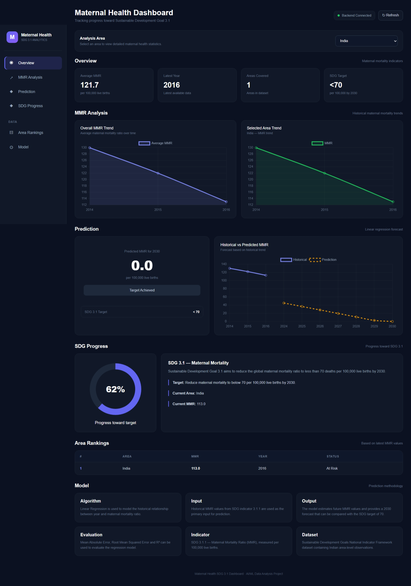
Prototype screenshot

Slide 11
Results & Insights
Dashboard Provides:
✓ Average MMR calculation
✓ Latest MMR by area
✓ Historical MMR trends
✓ Area-wise ranking
✓ Predicted 2030 MMR
✓ SDG target comparison
Key Findings:
The system successfully tracks maternal health progress by analyzing historical data, identifying trends, and predicting future MMR values. This enables stakeholders to monitor SDG 3.1 progress effectively and identify areas requiring targeted interventions.

Slide 12
Responsible AI Framework
Fairness
Transparency
Ethics
Privacy
Avoid biased conclusions from incomplete datasets
Clear explanation of Linear Regression predictions
Predictions are analytical estimates, not medical decisions
Using aggregated/public data, no personal health information

Slide 13
Expected Impact
📊 Social Impact
🎯 Decision Support
• Better MMR trend understanding
• Identify high-need areas
• Easier SDG progress monitoring
• Guide resource allocation
🎓 Educational Impact
📈 Scalability
• Practical AI application
• Extend with more indicators
• Sustainability demonstration
• Add international datasets

Slide 14
Limitations & Future Scope
Current Limitations:
Future Scope:
• Prediction depends on historical data
• Additional health indicators
• Linear Regression has limitations
• Advanced ML models (RF, XGBoost)
• Dataset coverage varies
• International datasets
Data Processing Pipeline:
• Not official forecasts
• Geographic visualization
CSV Load
Clean
Extract MMR
Convert
Analyze
Predict
API
Dashboard

Slide 15
Conclusion
AI + Data + Sustainability → Actionable Insights
The project demonstrates how AI and data analysis support monitoring
of maternal health progress toward SDG 3.1 through trend analysis,
prediction modeling, and interactive visualization

