Slide 1
CREDIT RISK · MACHINE LEARNING
Predicting Loan Default Risk
How machine learning can help identify risky loan applicants earlier and support fairer, faster, more consistent lending decisions.

Slide 2
OVERVIEW
What we'll cover
1
The business problem
2
The data & the challenges
Why predicting default matters
8 tables, 300k+ applicants, messy history
3
Preparing & engineering features
4
Building & testing the model
Turning raw history into signal
Comparing algorithms, handling imbalance
5
Results & what drives them
6
Putting it to work
Performance, cost, explainability
The Streamlit app, recommendations & limits
2

Slide 3
THE BUSINESS PROBLEM
Every loan is a bet on the future
Lenders have to decide, upfront, whether an applicant will repay. Get it wrong in either direction, and it costs the business.
Approve a risky borrower
Reject a good borrower
If a customer who is likely to default is approved, the loan may never be fully repaid - a direct financial loss to the business.
If a creditworthy applicant is turned away, the business loses revenue - and the customer is treated unfairly.
Goal: build a model that estimates each applicant's probability of default, so lending decisions can be faster, more consistent, and better informed.
3

Slide 4
HOW WE GOT HERE
From raw records to a working risk model
1
2
3
4
5
6
Collect
Clean
Engineer
Model
Evaluate
Deploy
8 linked data tables
Fix missing & odd values
Build smarter features
Train & compare algorithms
Test, calibrate, explain
Streamlit app
Each stage lives in its own notebook - data loading, EDA, feature engineering, and model evaluation - so the pipeline is reproducible end to end, from the raw Home Credit tables to the live scoring app.
4

Slide 5
THE DATA
One applicant, eight sources of history
The Home Credit dataset links a customer's loan application to their financial footprint across several kinds of history - most of it many rows per person.
Application
Bureau
Bureau balance
Core applicant & loan info
Credit history at other lenders
Monthly status on those credits
1 row / applicant
many rows / applicant
27M+ rows total
Previous application
POS / cash balance
Credit card balance
Applicant's past Home Credit loans
Monthly point-of-sale & cash loans
Monthly credit card activity
many rows / applicant
many rows / applicant
many rows / applicant
Installments
307,511
Actual vs. expected repayments
training applicants
many rows / applicant
8
48,744
617
27M+
linked data tables
applicants to score
raw features assembled
bureau_balance rows alone
5

Slide 6
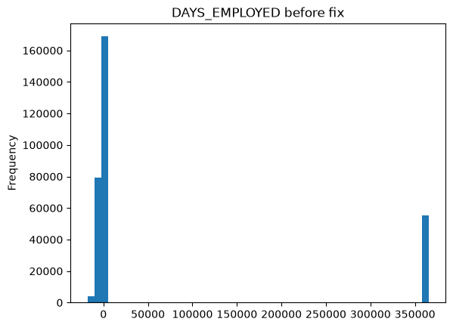
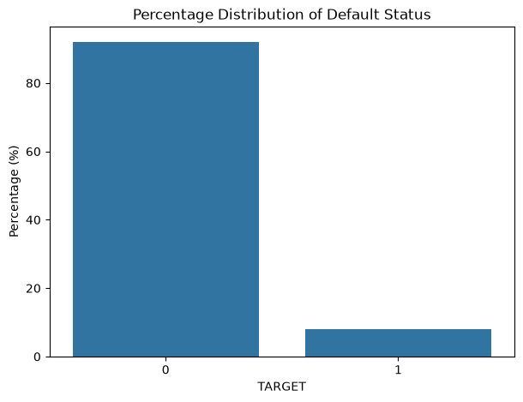
THE DATA
Three challenges before we could model anything
Widespread missing data
%
≠
Severe class imbalance
Placeholder "fake" values
Most applicants repay. Very few default , so the model must not just learn to say "no risk" every time.
562 of 617 features had at least one missing value.
DAYS_EMPLOYED used 365243 (~1,000 years) to mean "not currently employed" instead of a blank value. If Left untouched, this would have badly distorted the model's understanding of employment length.
6
features >90% missing
151
features 50-90% missing
6

Slide 7
PREPARING THE DATA
Cleaning with judgment, not a single blanket rule
Different features needed different treatment, based on what a missing value actually means for that feature.
Fill with zero
Counts, totals & unique-record features (e.g. number of past loans). No history usually means zero activity, not an unknown value.
1
Fill with the median
Day-based and continuous measures, where a missing value doesn't mean "none" - just "unknown."
2
Add a "missing" indicator
Any categorical feature missing for more than 70% of applicants. The absence itself can be a useful signal.
3
Fix known placeholders
Replaced the 365243 placeholder in DAYS_EMPLOYED with a proper missing value, plus a flag marking it happened.
4
Drop constant columns
Removed features with no variation at all - they can't help the model tell applicants apart.
5
7

Slide 8
FEATURE ENGINEERING
Giving the model financial common sense
Raw numbers rarely tell the full story on their own. We combined them into ratios and summaries that reflect how a loan officer actually thinks about risk.
Financial Ratio Features
Family Features
Created five financial ratio features that describe the relationship between an applicant's income, loan amount, repayments, and the value of the financed goods. These relationships provide more meaningful information than the original financial variables alone - the engineered features capture affordability, repayment burden, and borrowing behaviour.
Created four household affordability features that combine income, loan amount, and family composition. The original variables describe these factors separately, but the engineered features capture how they interact. By accounting for household size and number of dependants, they provide a more realistic measure of an applicant's financial capacity and obligations.
Age Features
External Credit Score Features
Created time-based features by converting variables measured in negative days into positive years. In the Home Credit dataset, these variables are stored as the number of days before the loan application date, which makes them difficult to interpret. Converting them into years makes the data more understandable while preserving the same underlying information.
Created summary statistics from the three external credit score variables - EXT_SOURCE_1, EXT_SOURCE_2, and EXT_SOURCE_3 - among the most important predictors in the Home Credit dataset. Rather than using each score independently, this combines them into new features that summarise an applicant's overall external credit profile.
8

Slide 9
FEATURE ENGINEERING
Employment Features
1. EMPLOYMENT_AGE_RATIO = EMPLOYMENT_YEARS / AGE_YEARS
2. REGISTRATION_AGE_RATIO = REGISTRATION_YEARS / AGE_YEARS
Social Risk Features
1. TOTAL_SOCIAL_OBS = OBS_30_CNT + OBS_60_CNT (social circle)
2. TOTAL_SOCIAL_DEF
= DEF_30_CNT + DEF_60_CNT (social circle)
Created two life-stage ratio features by comparing employment duration and registration duration to the applicant's age. These ratios provide context that the original variables cannot capture on their own. Instead of simply measuring how long an applicant has worked or been registered, the features show how significant those periods are relative to the applicant's lifetime.
creates two summary features that measure the overall level of payment difficulties and loan defaults within an applicant's social circle. The original variables capture these events over separate 30-day and 60-day periods, but combining them provides a more comprehensive view of the applicant's social environment.
Loan duration estimate
(LOAN_TERM = AMT_CREDIT / AMT_ANNUITY)
created one financial feature that estimates the loan repayment period by combining the total loan amount and the annual annuity payment. While the original variables describe the loan and its repayments separately, LOAN_TERM captures their relationship in a single, more informative measure.
9

Slide 10
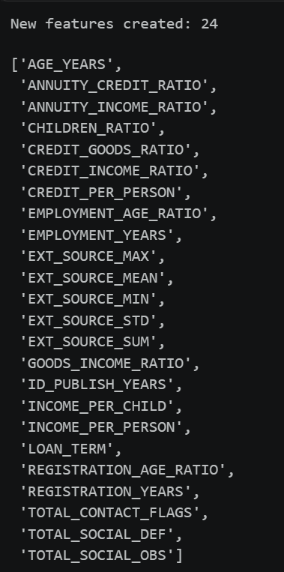
FEATURE ENGINEERING
24 new features, eight themes, one richer dataset
The full list of engineered columns added to the modelling table before moving into model training.
5
Financial ratios affordability & repayment burden
NOTEBOOK OUTPUT
4
Family features household-adjusted income & credit
4
Age features days converted into interpretable years
2
Life-stage ratios employment & registration vs. age
5
External score aggregates EXT_SOURCE mean, max, min, std, sum
1
Loan term estimated repayment duration
2
Social risk combined 30/60-day circle counts
1
Contact accessibility total reachable contact channels
Result: every engineered feature passed validation - no missing, infinite, or degenerate values - and the engineered EXT_SOURCE aggregates outranked every original external score column.
10

Slide 11
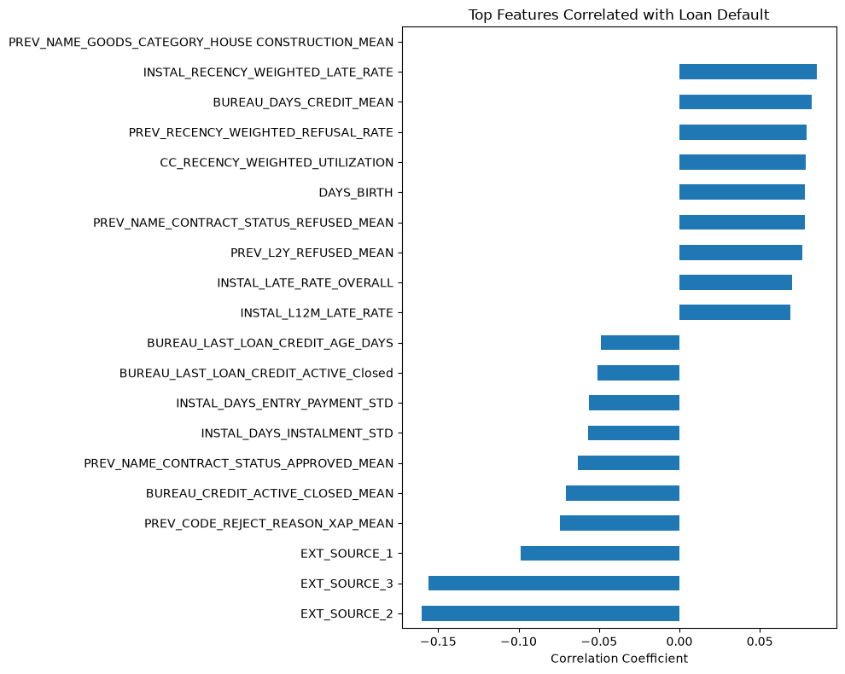
WHAT WE LEARNED FROM THE DATA
No single feature moves the needle alone
Correlation of every raw feature with TARGET, before feature engineering (top 19 by magnitude)
Key takeaways
The strongest raw feature (EXT_SOURCE_2) explains very little on its own - a correlation of only -0.16.
The three external credit scores are the clearest protective signals; everything else clusters much closer to zero.
Weak risk-increasing signals - late-payment history, prior refusals, applicant age, bureau activity - sit in a narrow band of +0.05 to +0.09.
No linear boundary separates defaulters from non-defaulters on any single feature.
This is exactly the pattern tree-based ensembles (Random Forest, XGBoost, LightGBM) are built to exploit: combining many weak, individually unremarkable signals.
11

Slide 12
WHAT WE LEARNED FROM THE DATA
External credit scores stand out - and get stronger through engineering
Correlation with default risk, before vs. after feature engineering (negative = lower risk)
Key takeaways
Combining the three external scores into EXT_SOURCE_SUM / MEAN made the signal noticeably stronger than any single score alone - a 38% larger correlation than the best raw feature.
EXT_SOURCE_MIN and EXT_SOURCE_MAX also both outperform every individual raw score, so the aggregation helps regardless of which summary statistic is used.
Even after engineering, the data is not linearly separable - defaulters and non-defaulters still overlap heavily feature-by-feature.
Other raw signals (late payments, prior refusals, applicant age) stay in the +0.05 to +0.09 range - informative, but individually weak.
Together, this pointed us toward tree-based models (Random Forest, XGBoost, LightGBM, CatBoost) rather than a simple linear model.
+38% stronger signal
EXT_SOURCE_MEAN (-0.221) vs. best single raw score, EXT_SOURCE_2 (-0.160)
12

Slide 13
MODELING
Testing several algorithms, choosing on evidence
Baseline ROC-AUC on the validation set (higher = better at ranking risk)
3 finalists moved forward
Logistic Regression
LightGBM
CatBoost
All five models hit 92% accuracy - misleading, since only 8% of applicants actually default.
Random Forest & XGBoost dropped after cross-validation.
Full baseline metrics - validation set, default 0.50 threshold
Model | Accuracy | Precision | Recall | F1-score | ROC-AUC
LightGBM | 0.9199 | 0.5853 | 0.0256 | 0.0490 | 0.7823
CatBoost | 0.9202 | 0.6596 | 0.0250 | 0.0481 | 0.7803
Logistic Regression | 0.9201 | 0.5676 | 0.0423 | 0.0787 | 0.7786
XGBoost | 0.9188 | 0.4813 | 0.0675 | 0.1184 | 0.7739
Random Forest | 0.9193 | 0.5077 | 0.0066 | 0.0131 | 0.7352
13

Slide 14
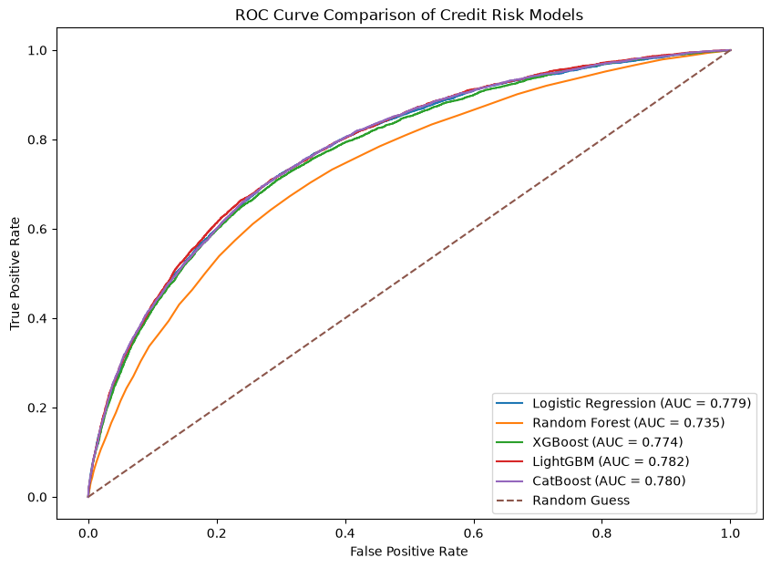
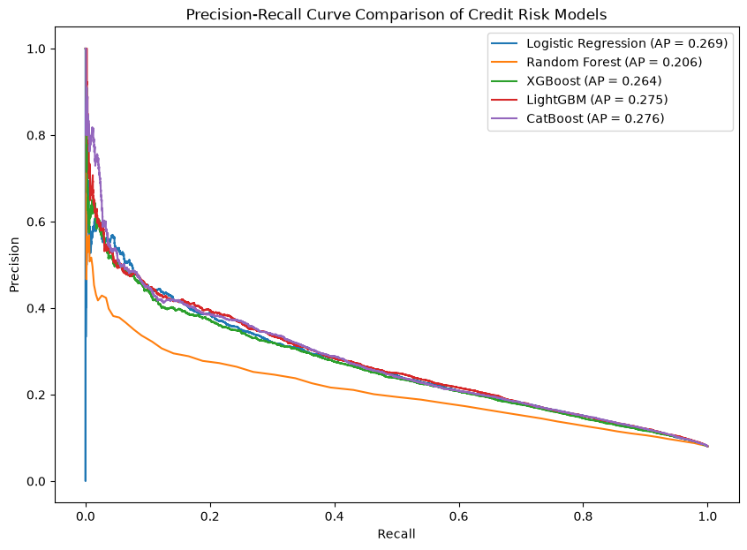
MODELING
Similar ranking ability, different trade-offs
ROC and Precision-Recall curves across all five baseline models
Reading the curves
All five models sit comfortably above the random-guess line. On ROC-AUC, the top four - LightGBM (0.782), CatBoost (0.780), Logistic Regression (0.779), and XGBoost (0.774) - are hard to separate, while Random Forest (0.735) is clearly weaker. Average Precision tells a slightly different story: CatBoost (0.276) edges ahead of LightGBM (0.275), Logistic Regression (0.269), and XGBoost (0.264), with Random Forest again lowest (0.206). Both curves confirm the same trade-off: pushing recall higher comes at the cost of precision - why threshold selection matters as much as model choice.
14

Slide 15
MODELING
Cross-validation confirms the ranking is stable
5-fold stratified CV ROC-AUC - mean across folds (SMOTE applied within each training fold only)
3 finalists confirmed
Logistic Regression
LightGBM
CatBoost
LightGBM stayed on top, but its edge over Logistic Regression (0.0019) is within fold-to-fold noise.
XGBoost dropped - lowest mean CV ROC-AUC and no longer competitive.
Mean ± standard deviation across 5 folds
Model | CV ROC-AUC Mean | CV ROC-AUC Std
LightGBM | 0.7770 | 0.0026
Logistic Regression | 0.7751 | 0.0025
CatBoost | 0.7734 | 0.0027
XGBoost | 0.7655 | 0.0025
Why this matters: small, consistent standard deviations (0.0025-0.0027) show none of the four models got lucky or unlucky on a single split - the single 80/20 ranking above is confirmed, not an artefact of one particular train/validation split.
15

Slide 16
MODELING
Class weighting wins on the full 842-feature set
Defaulter recall, SMOTE vs. class weighting: Logistic Regression, LightGBM, CatBoost
What went wrong with SMOTE
SMOTE invents synthetic "defaulter" examples by interpolating between real ones. With ~790 features spanning very different financial histories, those synthetic points often don't represent realistic customers - so the model learned little about what a real defaulter looks like
SMOTE vs. class weighting - same 3 models, both approaches
Model | Approach | Recall | ROC-AUC
LightGBM | SMOTE | 2.56% | 0.7823
LightGBM | Class-Weighted | 70.90% | 0.7878
CatBoost | SMOTE | 2.50% | 0.7803
CatBoost | Class-Weighted | 70.98% | 0.7854
Logistic Regression | SMOTE | 4.23% | 0.7786
Logistic Regression | Class-Weighted | 70.53% | 0.7781
The fix: class weighting
Instead of inventing data, we kept every real record and simply told the model to penalize missed defaulters more heavily. Recall jumped from ~3% to ~71%, at the cost of some accuracy - a trade the business actually wants.
Full results — all 5 baseline (SMOTE) models plus the 3 class-weighted variants
Model | Accuracy | Precision | Recall | F1-score | ROC-AUC
LightGBM (class_weight) | 72.49% | 18.53% | 70.90% | 0.2938 | 0.7878
CatBoost (class_weight) | 71.99% | 18.25% | 70.98% | 0.2904 | 0.7854
LightGBM | 91.99% | 58.53% | 2.56% | 0.0490 | 0.7823
CatBoost | 92.02% | 65.96% | 2.50% | 0.0481 | 0.7803
Logistic Regression | 92.01% | 56.76% | 4.23% | 0.0787 | 0.7786
Logistic Regression (class_weight) | 71.65% | 17.98% | 70.53% | 0.2866 | 0.7781
XGBoost | 91.88% | 48.13% | 6.75% | 0.1184 | 0.7739
Random Forest | 91.93% | 50.77% | 0.66% | 0.0131 | 0.7352
Bottom line: across every model tested, class weighting is the only approach that gives the business a model capable of actually catching defaulters — that's why it was carried forward into tuning.
16

Slide 17
MODELING
Tuning found better models - it didn't find the right cutoff
Hyperparameter tuning improves ranking ability; it says nothing about where to draw the decision line
1 · After hyperparameter tuning (default 0.50 threshold)
So why not stop here?
Model | CV ROC-AUC | Val. ROC-AUC | Accuracy | Precision | Recall | F1
Tuned CatBoost | 0.7839 | 0.7869 | 0.8752 | 0.2992 | 0.4066 | 0.3447
Tuned LightGBM | 0.7836 | 0.7895 | 0.7350 | 0.1899 | 0.6989 | 0.2986
Tuned Logistic Regression | 0.7757 | 0.7786 | 0.9022 | 0.3489 | 0.2443 | 0.2874
Tuning only optimised ROC-AUC - ranking ability. It never touched the 0.50 cutoff used to turn a probability into a decision. At 0.50, CatBoost still misses 59% of defaulters and LightGBM still misses over 30% of non-defaulters as false alarms. The threshold is a free lever tuning never pulled.
2 · Cost-sensitive threshold search (false positive = 1, false negative = 5)
Lowest-cost threshold per model
CatBoost
threshold 0.50 cost 19,459
Logistic Regression
threshold 0.40 cost 19,987
LightGBM
threshold 0.50 cost 22,278
CatBoost's curve is flattest and lowest; LightGBM's only worsens below 0.50.
Bottom line: hyperparameter tuning picks the best model; threshold tuning decides how that model should actually be used. Skipping step 2 would have left CatBoost catching only 41% of defaulters (0.50) instead of the 44.8% reached later at its calibrated cost-optimal threshold.
17

Slide 18
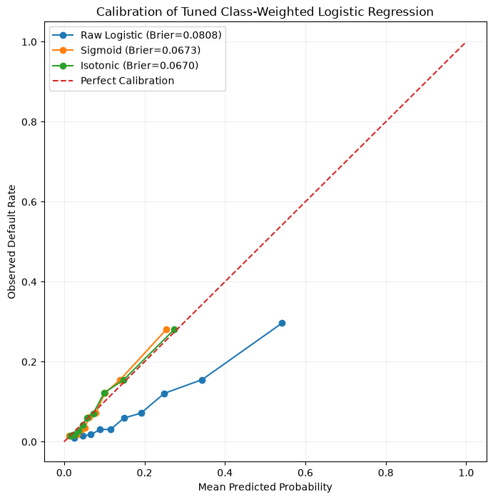
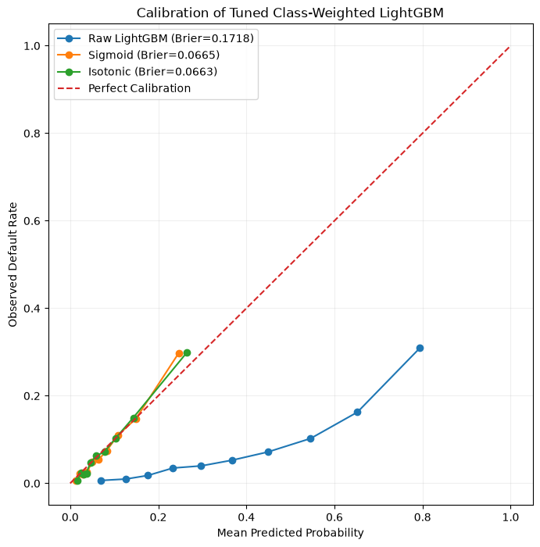
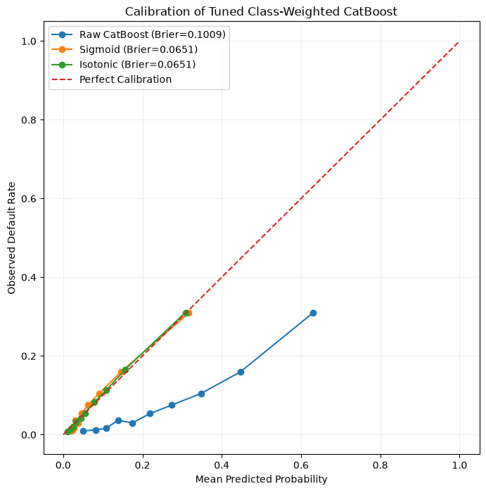
MODELING
Does a "20% risk" score actually mean a 20% chance?
Calibration checks whether the model's predicted probabilities can be trusted at face value — not just whether it ranks risk correctly
In plain terms
The dashed red line is "perfect" - where predicted risk exactly matches what actually happened. Every raw model (blue) sits below that line: it was overestimating risk. After calibration (orange/green), all three models sit almost on top of the line.
LightGBM needed it most - its raw scores were badly overconfident.
Brier score - how far predictions are from reality (0 = perfect, lower is better)
Model | Raw Brier | Raw ROC-AUC | Sigmoid Brier | Isotonic Brier | Winner
Logistic Regression | 0.0808 | 0.7915 | 0.0673 | 0.0670 | Isotonic
LightGBM | 0.1718 | 0.7981 | 0.0665 | 0.0663 | Isotonic
CatBoost | 0.1009 | 0.7971 | 0.0651 | 0.0651 | Isotonic
Calibration alone doesn't fix the decision -recall at 0.50 is still tiny
Conclusion: Calibration did its job - all three models now give honest probabilities (Brier ~0.065–0.067). But it doesn't decide where to draw the line between "safe" and "risky." At the standard 0.50 cutoff, every model still misses over 97% of real defaulters. The next step is to search for a better cutoff, not to trust 0.50 by default.
1.11%
1.31%
2.01%
Logistic Regression
LightGBM
CatBoost
11 of 993 defaulters caught
13 of 993 defaulters caught
20 of 993 defaulters caught
18

Slide 19
MODELING
Finding the cutoff that costs the business the least
Tested on a held-out slice of 12,301 applicants set aside purely for this check - cutoffs from 0.50 down to 0.01, using the calibrated probabilities
How this works, in plain terms
I assumed missing a real defaulter (a "false negative") costs the business 5 times more than wrongly flagging a safe customer (a "false positive"). For each model, I tried 10 different cutoffs and added up the total cost at each one - then picked whichever cutoff produced the lowest bill.
Best cutoff found for each model
Model | Best Cutoff | Precision | Recall | F1 | False Alarms | Defaulters Missed | Total Cost
Tuned CatBoost | 0.15 | 28.11% | 44.81% | 0.3455 | 1,138 | 548 | 3,878
Tuned LightGBM | 0.20 | 33.02% | 31.92% | 0.3246 | 643 | 676 | 4,023
Tuned Logistic Regression | 0.15 | 25.17% | 43.71% | 0.3195 | 1,290 | 559 | 4,085
The pay-off: calibrated probabilities cut the cheapest achievable cost by 5×
Conclusion
Tuned CatBoost at a 0.15 cutoff is the winner. It costs the least (3,878), catches the most defaulters (44.8%), and has the best balance of precision and recall (F1 = 0.346) of the three finalists at their own best cutoffs. LightGBM has fewer false alarms, but it misses more real defaulters - and each miss is assumed 5× more expensive. This choice depends entirely on the 1:5 cost assumption; a real lender should replace it with actual financial figures before deploying.
19

Slide 20
RESULTS
How well does the final model perform?
Tuned, class-weighted CatBoost + isotonic calibration - evaluated on 61,503 held-out applicants, threshold 0.15
86.32%
0.79
44.8%
28.2%
Overall accuracy
ROC-AUC score
Of actual defaulters correctly flagged (recall)
Of flagged applicants who were true defaulters (precision)
Accuracy alone is misleading here with only 8% of applicants defaulting, a model could reach ~92% accuracy just by approving everyone. That's why recall, precision, and ROC-AUC matter more for this problem.
What changed from the baseline
Defaulter recall: ~2.5% → 44.8%
Total business cost (test fold): 19,459 → 3,878 (≈5× lower)
Decision threshold: 0.50 (default) → 0.15 (cost-optimal)
Predicting Loan Default Risk
20

Slide 21
EXPLAINABILITY
How each feature swings the decision
Average SHAP contribution when a feature is Low vs. High -positive pushes risk up, negative pushes it down
Feature | Low value → SHAP | High value → SHAP | Behaviour
EXT_SOURCE_MEAN | +0.274 | -0.377 | Continuous signal
EXT_SOURCE_SUM | +0.194 | -0.240 | Continuous signal
INSTAL_RECENCY_WEIGHTED_LATE_RATE | ≈0 | +0.145 | Warning trigger
CREDIT_GOODS_RATIO | -0.107 | +0.141 | Warning trigger
PREV_DAYS_LAST_DUE (1st version, max) | ≈0 | +0.130 | Warning trigger
AMT_ANNUITY | -0.135 | +0.084 | Continuous signal
Two kinds of features
Continuous signals
External credit scores and annuity size shift risk smoothly across their whole range - every point of improvement helps a little.
Warning triggers
Late-payment rate, over-financing, and prior missed-payment dates stay quiet at low/medium levels, then push risk up sharply once a threshold is crossed.
Why this matters for a credit officer
EXT_SOURCE_MEAN remains the single strongest driver (mean |SHAP| = 0.2371) - a low score alone adds +0.274 to predicted risk, a high score removes -0.377. But the "warning trigger" features are just as useful in practice: they tell a reviewer exactly which behaviour crossed the line — recent lateness, over-financing relative to the goods price, or a troubled prior loan -rather than a vague overall score.
21

Slide 22
BUSINESS IMPACT
The cost of getting it wrong - and why 0.15 wins
Final confusion matrix on 61,503 held-out applicants, threshold 0.15 (false positive = 1, false negative = 5)
Predicted: Non-Defaulter
Predicted: Defaulter
Threshold search (12,301-applicant fold)
50,869
5,669
Total business cost
Threshold | Recall | Precision | Total Cost
0.15 | 44.81% | 28.11% | 3,878
0.20 | 38.17% | 31.07% | 3,911
0.10 | 66.36% | 20.73% | 4,190
5,669 false positives × 1
True Negatives
Correctly approved
False Positives
Unnecessarily flagged
2,742 false negatives × 5
= 19,379 total cost units
71% of this cost comes from missed defaulters (2,742 × 5 = 13,710) - that's why threshold selection favoured recall over precision.
0.15 gives the lowest cost of all ten thresholds tested (0.01–0.50) on this fold - 0.20 lands within 33 cost units of it, so the model isn't fragile to the exact threshold chosen.
2,742
2,223
False Negatives
Defaulters missed
True Positives
Defaulters caught
The business framing
Every False Positive means a good customer gets an extra review - a mild inconvenience. Every False Negative means the business extends credit to someone who won't repay -assumed 5× costlier. At threshold 0.15, roughly 1 in 8 applicants (12.83%) gets flagged for enhanced review, in exchange for catching 44.8% of real defaulters at the lowest total cost found during threshold search.
22

Slide 23
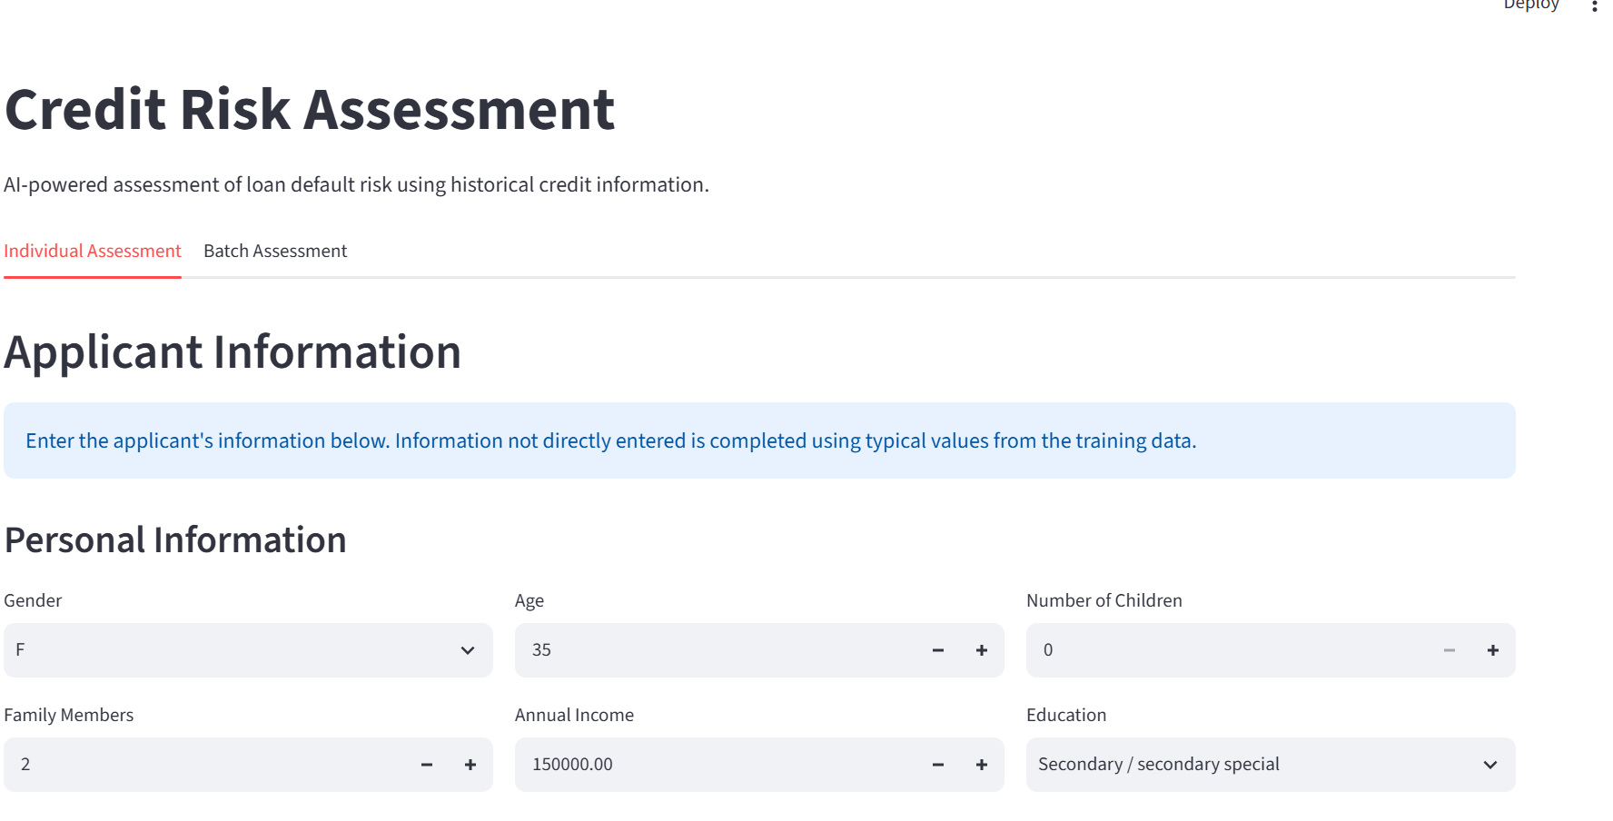
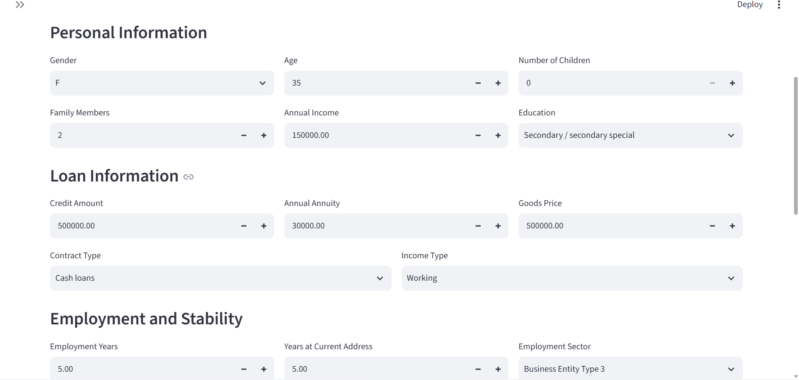
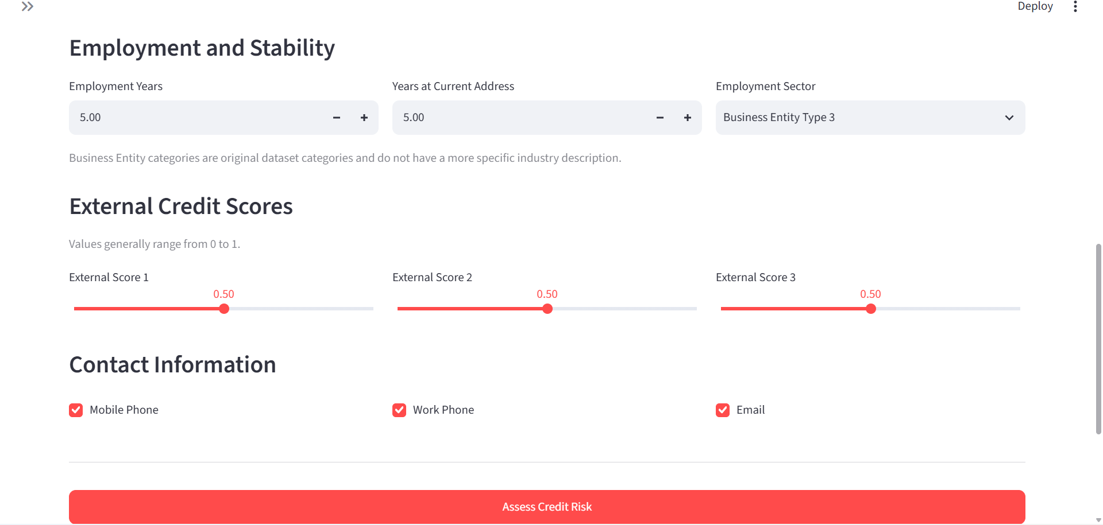
THE APP
Seeing the model in action: the real app
Live Streamlit app (localhost:8501) - same trained CatBoost model, calibration, and 0.15 threshold used throughout this project
What the app walks a credit officer through
Individual Assessment or Batch Assessment
- score one applicant at a time, or upload a file for many at once.
Personal, Loan, Employment & Stability, External Credit Scores, Contact Info
- the same feature groups engineered throughout this project, entered as plain fields and sliders.
Assess Credit Risk - runs the exact preprocessing – CatBoost - isotonic calibration - 0.15 threshold pipeline from this project.
23

Slide 24
PUTTING IT TO WORK
A decision-support tool, not an auto-reject switch
With 28% precision on flagged applicants, high-risk predictions should trigger extra review - not automatic rejection
Low risk
Medium risk
High risk
Standard assessment
Additional verification
Enhanced credit review
Applicant proceeds through the normal approval process.
Extra checks on income, existing obligations, or documentation.
Full manual review by a credit officer before any decision.
Why the threshold is set at 0.15
Threshold | Recall | Precision | Total Cost
0.15 (selected) | 44.81% | 28.11% | 3,878
0.20 | 38.17% | 31.07% | 3,911
0.10 | 66.36% | 20.73% | 4,190
Other recommendations
Review the 0.15 threshold periodically
it depends on assumed costs (1 : 5) that may change over time.
Use SHAP explanations for individual cases
so credit officers can understand and challenge flagged decisions.
Monitor recall, precision, and cost post-deployment
and performance across demographic groups (recall varied by gender and age in testing).
0.15 gives the lowest total business cost (3,878) of all ten thresholds tested from 0.01 to 0.50 on the 12,301-applicant selection fold - 0.20 lands within 33 cost units of it, so the choice isn't hanging on a single fragile number.
24

Slide 25
BEING HONEST ABOUT THE MODEL
What this model doesn't do
!
Misses over half of defaulters
!
Flags some good applicants
At the current threshold, recall is 44.8% - meaning about 55% of true defaulters are still missed.
Precision of 28% means most flagged applicants still turn out to be non-defaulters - a signal, not a verdict.
!
Threshold reflects assumed costs
!
Trained on historical data
The 1:5 cost ratio is a business assumption. Real costs may differ and should be revisited.
Future applicants and economic conditions may not match the patterns in the training data.
Explains patterns, not causes
!
SHAP shows what influences a prediction, not proof that a factor directly causes default.
25

Slide 26
IN SUMMARY
A model that catches real risk -
and explains its reasoning
ROC-AUC 0.79
44.8% recall
Fully explainable
Live in the app
Solid ability to separate risky from safe applicants
Nearly half of all true defaulters correctly flagged
Every score traces back to concrete SHAP factors
Same model & threshold power the Streamlit demo
Business cost at 0.15: 19,379 total cost units on 61,503 applicants - 0.15 was chosen as the lowest-cost of ten thresholds tested (0.01-0.50) on the calibration fold.
Thank you - questions welcome

