Slide 1
Data Base 2 Project
Group 132
Gianluca Ruberto – 10607366
Andrea Prisciantelli - 10618568

Slide 2
Index
Specification
Revision of the specifications (if needed)( Description of any extra hypothesis on the project specifications)
Conceptual (ER) and logical data models
Explanation of the ER diagram (if needed)
Explanation of the logical model (if needed)
Relation model of the database in sql or graphical format
Description of the views, materialized view tables and code of the materialization triggers
ORM relationship design with explanations
Entities code
Interface diagrams or functional analysis of the specifications
List of components
Motivations of the components design (if needed)
UML sequence diagrams (optional, only for salient events)

Slide 3
Specification(da fare) Revision of the specifications (if needed)( Description of any extra hypothesis on the project specifications) (da fare

Slide 4
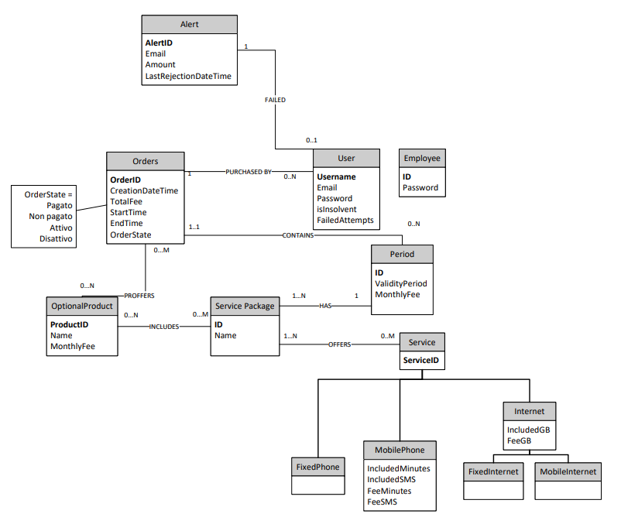
Conceptual (ER) and logical data models(da fare) Conceptual model

Slide 5
Explanation of the ER diagram (if needed) (da fare)

Slide 6
Logical model
Orders(OrderID, CreationDateTime, TotalFee, StartTime, EndTime, OrderState,Username,PeriodID)
User(Username, Email, Password, isInsolvent,FailedAttempts)
Alert(AlertID,Username,Email, Amount,LastRejectionDateTime)
Optional Product(ProductID, Name, MonthlyFee)
Service Package(PackageID,Name)
Period(ID, ValidityPeriod, MonthlyFee, PackageID)
Service(ServiceID, ServiceType, IncludedMinutes,IncludedSMS, FeeMinutes, FeeSMS, IncludedGB, FeeGB)
Employee(ID,Password)

Slide 7
Motivations of the logical design(da finire)
We decided to collapse up the Service classes.
The field ServiceType is an Enum that can be: FixedPhone, MobilePhone, FixedInternet,MobileInternet

Slide 8
Relational model of the database in sql or graphical format(da fare, forse intende il modello logico)

Slide 9
Description of the views, materialized view tables and code of the materialization triggers(da spiegare)

Slide 10
Number of total purchases per package
create table `total_purchases_per_package`(
`packageId` int NOT NULL AUTO_INCREMENT,
`total_purchases` int NOT NULL DEFAULT 0,
PRIMARY KEY (`packageId`),
CONSTRAINT `total_purchases_per_package_servicepackage` FOREIGN KEY (`packageId`) REFERENCES `servicepackage` (`packageId`)
)
DELIMITER $$
create trigger insert_new_total_purchases_per_package after insert ON servicepackage
for each row
begin
insert into total_purchases_per_package(packageId, total_purchases) values (new.packageId, 0);
end$$
DELIMITER ;
DELIMITER $$
create trigger update_total_purchases_per_package after update ON orders
for each row
begin
if not(old.orderState <=> new.orderstate) and new.orderstate <=> "Paid" then
update total_purchases_per_package
set total_purchases = total_purchases + 1
where packageId in (select packageId from period where new.periodId = ID);
end if;
end$$
DELIMITER ;
DELIMITER $$
create trigger insert_paid_total_purchases_per_package after insert ON orders
for each row
begin
if new.orderstate <=> "Paid" then
update total_purchases_per_package
set total_purchases = total_purchases + 1
where packageId in (select packageId from period where new.periodId = ID);
end if;
end$$
DELIMITER ;

Slide 11
Number of total purchases per package and validity period
create table `total_purchases_per_package_validityperiod`(
`periodID` int NOT NULL AUTO_INCREMENT,
`total_purchases` int NOT NULL DEFAULT 0,
PRIMARY KEY (`periodID`),
CONSTRAINT `total_purchases_per_package_validityperiod_period` FOREIGN KEY (`periodID`) REFERENCES `period` (`ID`)
)
DELIMITER $$
create trigger insert_new_total_purchases_per_package_validityperiod after insert ON period
for each row
begin
insert into total_purchases_per_package_validityperiod(periodID, total_purchases) values (new.ID,0);
end$$
DELIMITER ;
DELIMITER $$
create trigger update_total_purchases_per_package_validityperiod after update ON orders
for each row
begin
if not(old.orderState <=> new.orderstate) and new.orderstate <=> "Paid" then
update total_purchases_per_package_validityperiod
set total_purchases = total_purchases + 1
where periodID = new.periodId;
end if;
end$$
DELIMITER ;
DELIMITER $$
create trigger insert_paid_total_purchases_per_package_validityperiod after insert ON orders
for each row
begin
if new.orderstate <=> "Paid" then
update total_purchases_per_package_validityperiod
set total_purchases = total_purchases + 1
where periodID = new.periodId;
end if;
end$$
DELIMITER ;

Slide 12
Total sales per package with and without optional product
create table `total_sales_per_package`(
`packageId` int NOT NULL AUTO_INCREMENT,
`totalSales` int NOT NULL DEFAULT 0,
`totalSalesWithOptionalProduct` int NOT NULL DEFAULT 0,
PRIMARY KEY (`packageId`),
CONSTRAINT `total_sales_per_package_servicepackage` FOREIGN KEY (`packageId`) REFERENCES `servicepackage` (`packageId`)
)
DELIMITER $$
create trigger insert_new_total_sales_per_package after insert ON servicepackage
for each row
begin
insert into total_sales_per_package(packageId, totalSales,totalSalesWithOptionalProduct) values (new.packageId, 0,0);
end$$
DELIMITER ;
DELIMITER $$
create trigger update_sales_purchases_per_package after update ON orders
for each row
begin
declare packageId2 int;
declare monthlyFee2 float;
declare validityPeriod2 int;
select
packageId,
monthlyFee,
validityPeriod
into
packageId2, monthlyFee2, validityPeriod2
from period where new.periodId = ID;
if not(old.orderState <=> new.orderstate) and new.orderstate <=> "Paid" then
update total_sales_per_package
set totalSales = totalSales + monthlyFee2*validityPeriod2,
totalSalesWithOptionalProduct = totalSalesWithOptionalProduct + new.totalFee
where packageId = packageId2;
end if;
end$$
DELIMITER ;
DELIMITER $$
create trigger insert_sales_purchases_per_package after insert ON orders
for each row
begin
declare packageId2 int;
declare monthlyFee2 float;
declare validityPeriod2 int;
select
packageId,
monthlyFee,
validityPeriod
into
packageId2, monthlyFee2, validityPeriod2
from period where new.periodId = ID;
if new.orderstate <=> "Paid" then
update total_sales_per_package
set totalSales = totalSales + monthlyFee2*validityPeriod2,
totalSalesWithOptionalProduct = totalSalesWithOptionalProduct + new.totalFee
where packageId = packageId2;
end if;
end$$
DELIMITER ;

Slide 13
Average number of sales per optional product with each service package
create table `average_sales_optionalproduct_per_servicepackage`(
`packageId` int NOT NULL AUTO_INCREMENT,
`averageOptionalProducts` float NOT NULL DEFAULT 0,
PRIMARY KEY (`packageId`),
CONSTRAINT `average_sales_optionalproduct_per_servicepackage_servicepackage` FOREIGN KEY (`packageId`) REFERENCES `servicepackage` (`packageId`)
)
DELIMITER $$
create trigger insert_new_average_sales_optionalproduct_per_servicepackage after insert ON servicepackage
for each row
begin
insert into average_sales_optionalproduct_per_servicepackage(packageId, averageOptionalProducts) values (new.packageId, 0);
end$$
DELIMITER ;
DELIMITER $$
create trigger update_average_sales_optionalproduct_per_servicepackage after update ON orders
for each row
begin
declare packageId2 int;
declare totalPackage int;
declare newProducts int;
select packageId into packageId2 from period where new.periodId = ID;
select count(*) into totalPackage from orders where periodId = new.periodId;
select count(*) into newProducts from order_optionalproduct where order_Id = new.orderId;
if not(old.orderState <=> new.orderstate) and new.orderstate <=> "Paid" then
update average_sales_optionalproduct_per_servicepackage
set averageOptionalProducts = (averageOptionalProducts * (totalPackage -1) + newProducts)/totalpackage
where packageId = packageId2;
end if;
end$$
DELIMITER ;
DELIMITER $$
create trigger insert_average_sales_optionalproduct_per_servicepackage after insert ON order_optionalproduct
for each row
begin
declare packageId2 int;
declare totalPackage int;
declare newProducts int;
declare newPeriodID int;
declare newOrderState char(20);
select periodId,orderState into newPeriodID, newOrderState from orders where new.order_id = orderId;
select packageId into packageId2 from period where newPeriodID = ID;
select count(*) into totalPackage from orders where periodId = newPeriodID;
select count(*) into newProducts from order_optionalproduct where order_id = new.order_id;
if newOrderState <=> "Paid" then
update average_sales_optionalproduct_per_servicepackage
set averageOptionalProducts = (averageOptionalProducts * (totalPackage -1) + newProducts)/totalpackage
where packageId = packageId2;
end if;
end$$
DELIMITER ;

Slide 14
List of insolvent users
create table `insolvent_users`(
`username` varchar(64) NOT NULL,
PRIMARY KEY (`username`),
CONSTRAINT `insolvent_users_users` FOREIGN KEY (`username`) REFERENCES `users` (`username`)
)
DELIMITER $$
create trigger insert_insolvent_users after update ON users
for each row
begin
if not(new.isInsolvent <=> old.isInsolvent) and new.isInsolvent <=> 1 then
insert into insolvent_users(username) values (new.username);
end if;
end$$
DELIMITER ;
DELIMITER $$
create trigger delete_insolvent_users after update ON users
for each row
begin
if not(new.isInsolvent <=> old.isInsolvent) and new.isInsolvent <=> 0 then
delete from insolvent_users where username = new.username;
end if;
end$$
DELIMITER ;

Slide 15
List of suspended orders
create table `suspended_orders`(
`orderId` int NOT NULL AUTO_INCREMENT,
PRIMARY KEY (`orderId`),
CONSTRAINT `suspended_orders_orders` FOREIGN KEY (`orderId`) REFERENCES `orders` (`orderId`)
)
DELIMITER $$
create trigger insert_suspended_orders after insert ON orders
for each row
begin
if new.orderState <=> "Rejected" then
insert into suspended_orders(orderId) values (new.orderId);
end if;
end$$
DELIMITER ;
DELIMITER $$
create trigger delete_suspended_orders after update ON orders
for each row
begin
if new.orderState <=> "Paid" and old.orderState <=>"Rejected" then
delete from suspended_orders where orderId = new.orderId;
end if;
end$$
DELIMITER ;

Slide 16
List of Alerts
CREATE TABLE `alert` (
`alertId` int NOT NULL AUTO_INCREMENT,
`username` varchar(64) NOT NULL,
`amount` float NOT NULL,
`lastRejectionDateTime` timestamp NOT NULL,
PRIMARY KEY (`alertId`),
CONSTRAINT `username` FOREIGN KEY (`username`) REFERENCES `users` (`username`)
)
DELIMITER $$
create trigger update_failed_attempt after update ON orders
for each row
begin
declare attempts int;
declare email2 varchar(64);
select FailedAttempts,email into attempts,email2 from users where username;
if new.orderState <=> "Rejected" and attempts <=> 2 then
insert into alert(username,amount,lastRejectionDateTime,email) values (new.username,new.totalFee,current_timestamp(),email2);
end if;
if new.orderState <=>"Rejected" then
update users
set FailedAttempts = attempts + 1, isInsolvent = 1 where username = new.username;
end if;
end$$
DELIMITER;
DELIMITER $$
create trigger delete_insolvence after delete ON suspended_orders
for each row
begin
declare username2 varchar(64);
declare unpaid int;
select username into username2 from orders where orderId = old.orderId limit 1;
select count(*) into unpaid from orders where username = username2 and orderState = "Rejected";
if unpaid <=> 0 then
update users
set isInsolvent = 0 , FailedAttempts = 0 where username = username2;
end if;
end$$
DELIMITER ;
DELIMITER $$
create trigger insert_failed_attempt after insert ON orders
for each row
begin
declare attempts int;
declare email2 varchar(64);
select FailedAttempts,email into attempts,email2 from users where username = new.username limit 1;
if new.orderState <=> "Rejected" and attempts <=> 2 then
insert into alert(username,amount,lastRejectionDateTime,email) values (new.username,new.totalFee,current_timestamp(),email2);
end if;
if new.orderState <=>"Rejected" then
update users
set FailedAttempts = attempts + 1, isInsolvent = 1 where username = new.username;
end if;
end$$
DELIMITER ;

Slide 17
Best seller optional product Al momento considero tra i best seller anche gli optional product non pagati
create table `bestseller_optionalproduct`(
`ID` int NOT NULL AUTO_INCREMENT,
`productID` int,
`sales` int,
PRIMARY KEY (`ID`),
CONSTRAINT `bestseller_optionalproduct_optionalproduct` FOREIGN KEY (`productID`) REFERENCES `optionalproduct` (`productID`)
)
DELIMITER $$
create trigger update_bestseller_optionalproduct after update ON order_optionalproduct
for each row
begin
declare optionalproduct_Id2 int;
declare total int;
SELECT optionalproduct_Id, count(*)
into optionalproduct_Id2, total
FROM order_optionalproduct
GROUP BY optionalproduct_Id
ORDER BY count(*) DESC
LIMIT 1;
update bestseller_optionalproduct
set productID = optionalproduct_Id2, sales = total where ID = 1;
end$$
DELIMITER ;
DELIMITER $$
create trigger insert_bestseller_optionalproduct after insert ON order_optionalproduct
for each row
begin
declare optionalproduct_Id2 int;
declare total int;
SELECT optionalproduct_Id, count(*)
into optionalproduct_Id2, total
FROM order_optionalproduct
GROUP BY optionalproduct_Id
ORDER BY count(*) DESC
LIMIT 1;
update bestseller_optionalproduct
set productID = optionalproduct_Id2, sales = total where ID = 1;
end$$
DELIMITER ;

Slide 18
Service activation scheduler service
CREATE TABLE `activation_scheduler_service` (
`activationId` int NOT NULL AUTO_INCREMENT,
`serviceId` int NOT NULL,
`startTime` timestamp NOT NULL,
`endTime` timestamp NOT NULL,
`username` varchar(64) NOT NULL,
PRIMARY KEY (`activationId`),
KEY `activation_scheduler_service_serviceId` (`serviceId`),
KEY `activation_scheduler_service_username` (`username`),
CONSTRAINT `activation_scheduler_service_serviceId` FOREIGN KEY (`serviceId`) REFERENCES `service` (`serviceId`),
CONSTRAINT `activation_scheduler_service_username` FOREIGN KEY (`username`) REFERENCES `users` (`username`)
)
DELIMITER $$
create trigger insert_scheduler_service after insert ON orders
for each row
begin
insert into activation_scheduler_service(serviceId,startTime,endTime,username) select
servicepackage_service.service_id, orders.startTime, orders.endTime, orders.username
from servicepackage_service join period on servicepackage_service.servicepackage_id = period.packageId
join orders on orders.periodId = period.ID where orders.orderState = "Paid" and orders.orderId = new.orderId;
end$$
DELIMITER ;
DELIMITER $$
create trigger update_scheduler_service after update ON orders
for each row
begin
insert into activation_scheduler_service(serviceId,startTime,endTime,username) select
servicepackage_service.service_id, orders.startTime, orders.endTime, orders.username
from servicepackage_service join period on servicepackage_service.servicepackage_id = period.packageId
join orders on orders.periodId = period.ID where orders.orderState = "Paid" and orders.orderId = new.orderId
and old.orderState = "Rejected";
end$$
DELIMITER ;

Slide 19
Service activation scheduler optional product
CREATE TABLE `activation_scheduler_optionalproduct` (
`activationId` int NOT NULL,
`productId` int NOT NULL,
`startTime` timestamp NOT NULL,
`endTime` timestamp NOT NULL,
`username` varchar(64) NOT NULL,
PRIMARY KEY (`activationId`),
CONSTRAINT `activation_scheduler_optionalproduct_productId` FOREIGN KEY (`productId`) REFERENCES `optionalproduct` (`productID`),
CONSTRAINT `activation_scheduler_optionalproduct_username` FOREIGN KEY (`username`) REFERENCES `users` (`username`)
)
DELIMITER $$
create trigger insert_scheduler_optionalproduct after insert ON orders
for each row
begin
insert into activation_scheduler_optionalproduct(productId,startTime,endTime,username) select
servicepackage_optionalproduct.optionalproduct_productID, orders.startTime, orders.endTime, orders.username
from servicepackage_optionalproduct join period on servicepackage_id = period.packageId
join orders on orders.periodId = period.ID where orders.orderState = "Paid" and orders.orderId = new.orderId;
end$$
DELIMITER ;
DELIMITER $$
create trigger update_scheduler_optionalproduct after update ON orders
for each row
begin
insert into activation_scheduler_optionalproduct(productId,startTime,endTime,username) select
servicepackage_optionalproduct.optionalproduct_productID, orders.startTime, orders.endTime, orders.username
from servicepackage_optionalproduct join period on servicepackage_id = period.packageId
join orders on orders.periodId = period.ID where orders.orderState = "Paid" and orders.orderId = new.orderId
and old.orderState = "Rejected";
end$$
DELIMITER ;

Slide 20
ORM relationship design with explanations(da fare)

Slide 21
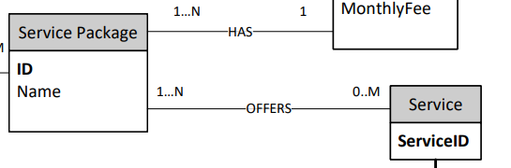
Relationship Service Package “offers” Service
ServicePackage -> Service @ManyToMany is necessary to know what services are offered by a service package.
Service -> ServicePackage @ManyToMany is not requested by the specification, but it is mapped for simplicity and for potential future purpose.

Slide 22
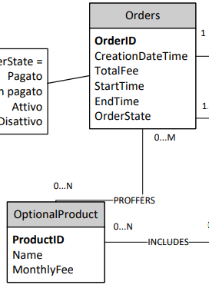
Relationship Orders “proffers” OptionalProduct
Order -> OptionalProduct @ManyToMany is necessary to know what optional product are part of the order.
OptionalProduct -> Order @ManyToMany is requested by the specification.

Slide 23
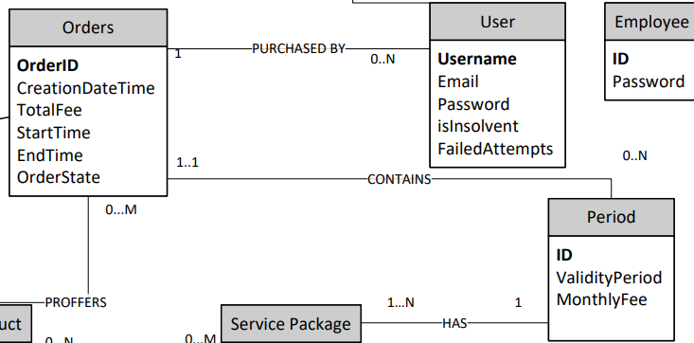
Relationship Orders “contains” Period
Order -> Period @OneToMany is required to know which is the service package offered by the order and with which validity period.
Period -> Order @ManyToOne is requested by the specification.

Slide 24
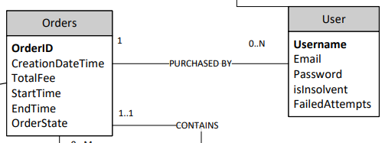
Relationship Orders “purchased by” User
User -> Order @ManyToOne is required to know which orders have been purchased by the user
Order -> User @OneToMany is not requested by the specification, but it is mapped for simplicity and for potential future purpose.

Slide 25
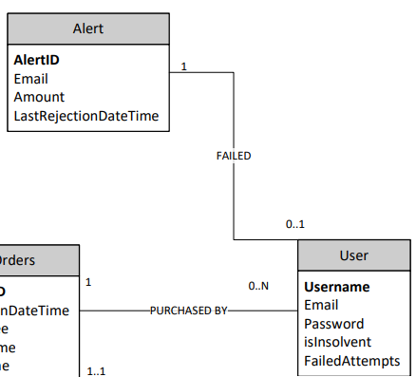
Relationship User “Failed” Alert
User -> Alert @OneToOne is requested by the specification. Alert -> User @OneToOne is not requested by the specification, but it is mapped for simplicity and for potential future purpose.

Slide 26
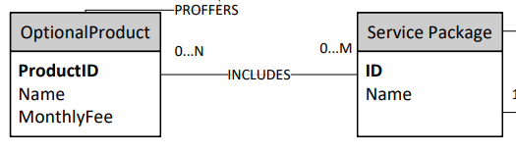
Relationship Service Package “Includes” OptionalProduct
ServicePackage -> OptionalProduct @ManyToMany is requested by the specification. OptionalProduct -> ServicePackage @ManyToMany is not requested by the specification, but it is mapped for simplicity and for potential future purpose.

Slide 27
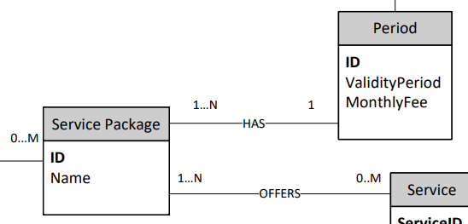
Relationship Service Package “Has” Period
ServicePackage -> Period @ManyToOne is requested by the specification. Period -> ServicePackage @OneToMany is requested by the specification.

Slide 28
Entities code(da fare)

Slide 29
Interface diagrams or functional analysis of the specifications(da fare)

Slide 30
List of components(da fare)

Slide 31
Motivations of the components design (if needed) (da fare)

Slide 32
UML sequence diagrams (optional, only for salient events) (da fare)

