Slide 1

Economic Effects of COVID-19
By Antonio Serrano, Faith Warari, and Priscilla Wong

Slide 2
Motivation and Summary
Assumptions that COVID-19 has caused major and/or long-term disruptions in the US Economy
Evaluating the perceived difference in qualitative vs. quantitative reporting
Selected 3 major areas to explore:
Unemployment rate vs COVID-19 deaths
Real estate
Personal Consumption Expenditure

Slide 3
Questions and Data
How did Covid-19 cases affect:
US unemployment rates:
How correlated are unemployment rates to COVID-19 deaths?
Real estate
How has COVID-19 affected the amount of real estate listings and mortgages?
Personal consumption expenditures
How correlated are personal consumption expenditures and the amount of COVID-19 cases?

Slide 4
Data Cleanup and Exploration
Sources:
COVID Case Rates by Location (CDC)
COVID Death Rates by Age and Place (CDC)
Unemployment Data (BLS)
Personal Consumption by Month (BEA)
Cleanup process:
Pandas: Parsing, column name changes, dropping nulls, normalizing data types
Excel manual manipulation for difficult formatting

Slide 5
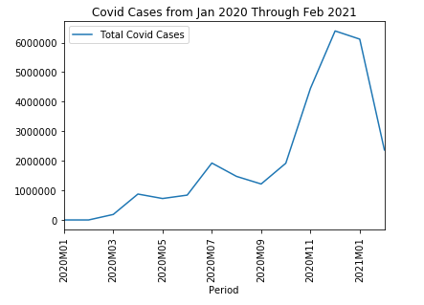
Data Analysis: COVID Case Changes over Time
Increase from Jan 2020 through Feb 2021
Three peaks and one major peak December 2020

Slide 6
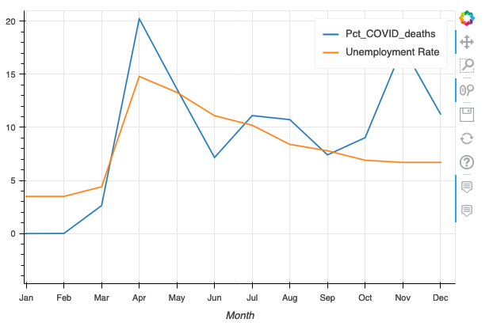

Data Analysis: Unemployment
Unemployment increase from Jan to Dec 2020
Spike in March showing correlation with the effect of COVID across the US
One major peak in April
Depicted in blue is the % or deaths due to COVID vs total deaths in the US. We can see three clear waves across 2020, first one in April, second in July and a third one in November.
In yellow, the evolution of the % of unemployment across the US during 2020

Slide 7
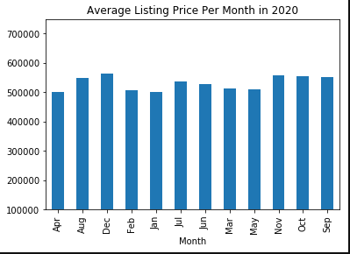
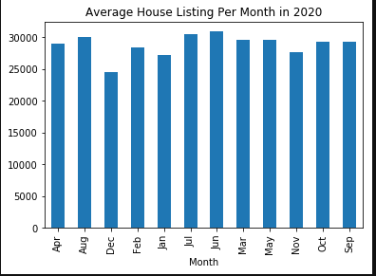
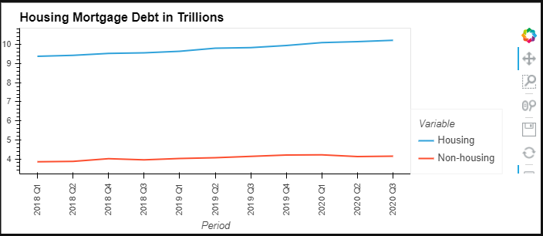
Data Analysis: Real Estate & Mortgage)
Increase in housing listing and prices through out 2020.
Slight decrease in listings through out Dec.
Notable increase in mortgage debt in 2020.

Slide 8
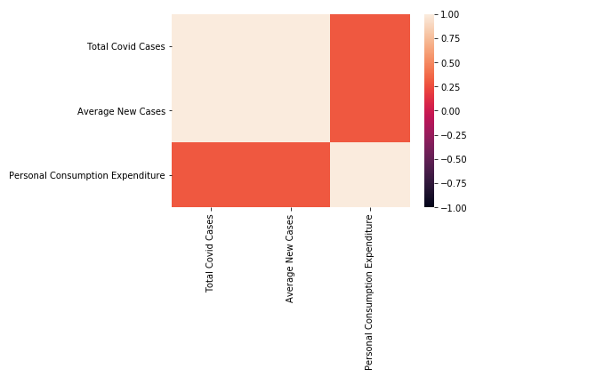
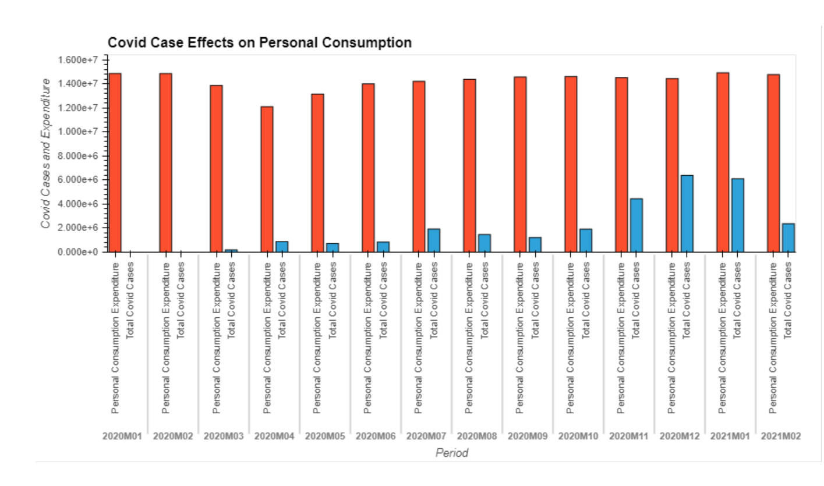
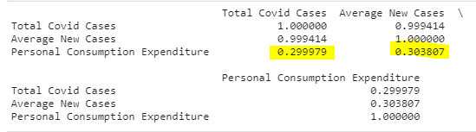
Data Analysis: Personal Consumption Expenditure
Expecting cases to directly cause personal expenditures to decrease as case counts increase
One notable dip in April 2020 when most businesses were forced to shut down
Overall, low positive correlation

Slide 9
Findings and Conclusions
Unemployment:
2020 started with a 3.5% unemployment across all economic sectors in the US and climbed up to 14.8% at the top of the first wave of COVID in April. From that point on, we can appreciate a steady decrease until the end of the year down to 6.7%.
In subsequent waves, unemployment rates did not climb at the same rate as COVID deaths.
Real Estate and Mortgage:
Most changes shown in the real estate analysis were directly impacted by the rules and regulations set by the CDC and the govt to curb the high rising COVID cases as well as protect most individuals from facing evictions and foreclosures due to unpaid rents and mortgages.
Personal Consumption Expenditure:
Did not show long-term decreases as expected or decreases directly related with COVID case counts

Slide 10
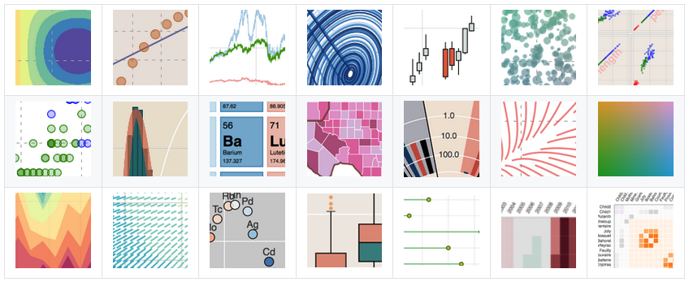

New Python Library Used for This Project
Bokeh is an interactive visualization library for modern web browsers. It provides elegant,
concise construction of versatile graphics, and affords high-performance interactivity over large
or streaming datasets. Bokeh can help anyone who would like to quickly and easily make
interactive plots, dashboards, and data applications.

Slide 11
Postmortem
Difficulties:
Normalizing data to be usable and concatenated
Working with a limited time frame for analysis since COVID only has case history from Dec 2019
Additional questions:
Would personal consumption be more apparent in personal healthcare expenditures?
Reflections:
Compare to other economic disasters such as 2008

Slide 12
Questions?

