Slide 1

Economic Effects of COVID-19
By Antonio Serrano, Faith Warari, and Priscilla Wong

Slide 2
Motivation and Summary
Assumptions that COVID-19 has caused major and/or long-term disruptions in the US Economy
Evaluating the perceived difference in qualitative vs. quantitative reporting
Selected 3 major areas to explore:
Unemployment rate
Real estate
Personal Consumption Expenditure

Slide 3
Questions and Data
How did Covid-19 cases affect:
US unemployment rates:
How correlated are unemployment rates to COVID-19 cases?
Real estate
How has COVID-19 affected the amount of real estate listings and mortgages?
Personal consumption expenditures
How correlated are personal consumption expenditures and the amount of COVID-19 cases?

Slide 4
Data Cleanup and Exploration
Sources:
COVID Case Rates by Location (CDC)
COVID Death Rates by Age and Place (CDC)
Unemployment Data (BLS)
Personal Consumption by Month (BEA)
Cleanup process:
Pandas: Parsing, column name changes, dropping nulls, normalizing data types
Excel manual manipulation for difficult formatting

Slide 5
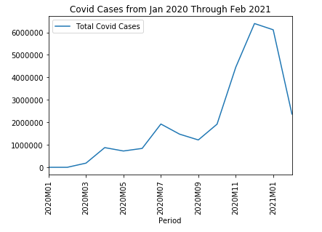
Data Analysis: COVID Case Changes over Time
Increase from Jan 2020 through Feb 2021
Three peaks and one major peak December 2020

Slide 6
Data Analysis: Unemployment

Slide 7
Data Analysis: Real Estate & Mortgage)

Slide 8
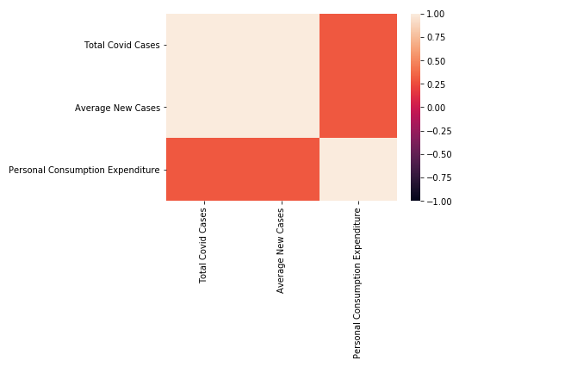
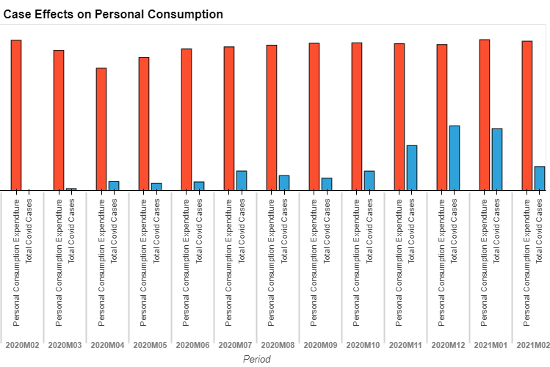
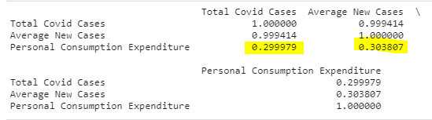
Data Analysis: Personal Consumption Expenditure
Expecting cases to directly cause personal expenditures to decrease as case counts increase
One notable dip in March 2020 when most businesses were forced to shut down
Overall, low positive correlation

Slide 9
Findings and Conclusions
Unemployment:
Real Estate and Mortgage:
Personal Consumption Expenditure:
Did not show long-term decreases as expected or decreases directly related with COVID case counts

Slide 10
Postmortem
Difficulties:
Normalizing data to be usable and concatenated
Working with a limited time frame for analysis since COVID only has case history from Dec 2019
Additional questions:
Would personal consumption be more apparent in personal healthcare expenditures?
Reflections:
Compare to other economic disasters such as 2008

Slide 11
Questions?

