Slide 1
Enhancing IoT Security: Intrusion Detection System Using Machine Learning for Cross-Environment Attack Identification
CSE509 : System Security Project Presentation
Priscilla Kyei Danso, P.A.C. Abisheka, Sagor Sikdar, G M Tasnim Alam

Slide 2
As of 2023, there are approximately 15.14 billion connected Internet of Things (IoT) devices
IoT devices play a crucial role in our life, but how do we know if our device communications are tampered with or not?
Security Project - Final Presentation
Notes:
Talk about how popular IoT devices are - everyone here owns an IoT device
So how can we determine whether the device communications has been tampered with or not? In comes IDS - talk about the 2 types briefly
And why they are not perfect because diversity in networks. Mostly anomaly based -> Research Problem

Slide 3
Network monitoring and anomaly detection using IDS
Secure protocols and encryption
Device authentication and authorization
Etc
Let’s talk about Intrusion Detection Systems
Anomaly Based
Signature Based
Security Project - Final Presentation
Notes:
Signature based only works if the exact signature is already present in the DB
Anomaly based
High False Positive rate
Difficulty in automatically distinguishing between benign and malicious traffic
Difficulty in adapting to dynamic environments especially with ever-changing networks
Most solutions are Machine Learning based where 80% of data is used for training and 20% is used for testing but in the same dataset
These models work very well when the training and test environments are the same
If there is a slight change in the network, the model doesn’t work properly

Slide 4
Research Problem
Due to the diverse nature of networks and network devices and the lack of security measures builtin, it is challenging to identify compromised devices.
Misclassifications commonly arise during the development of artificial intelligence models intended for testing such devices, primarily due to the variation between model training and testing environments.
A gap exists in the availability of a robust intrusion detection system capable of effectively operating across multiple diverse environments.
Security Project - Final Presentation
Notes:
The diversity of devices and communication protocols within IoT networks complicates the task of identifying compromised devices, particularly as the number of connected devices increases. While similar research has been conducted in the past, this study aims to address the challenge of misclassifications when training and testing IDS models in different environments. Our primary objective is to generate robust features that can excel in training and testing environments distinct from one another.

Slide 5

Current State
Security Project - Final Presentation

Slide 6

Anomaly Detection
Anomaly detection, analysis and prediction techniques in iot environment: A systematic literature review by Fahim et al.
Involve training models on normal behavior and identifying anomalies
More precise techniques are imperative for dealing with complex, real-world datasets.
https://www.flaticon.com/free-icon/intrusion_11313734
Security Project - Final Presentation
Notes:
The diversity of devices and communication protocols within IoT networks complicates the task of identifying compromised devices, particularly as the number of connected devices increases. While similar research has been conducted in the past, this study aims to address the challenge of misclassifications when training and testing IDS models in different environments. Our primary objective is to generate robust features that can excel in training and testing environments distinct from one another.

Slide 7

Malware Traffic Classification
Malware Traffic Classification Using Domain Adaptation and Ladder Network for Secure Industrial Internet of Things by Jinhui Ning et al.
Innovative machine learning techniques to classify malwares
The ladder network adds an unsupervised component to the supervised learning objective of a deep forward network
https://www.flaticon.com/free-icon/bulb_3058444
Security Project - Final Presentation
Notes:
The diversity of devices and communication protocols within IoT networks complicates the task of identifying compromised devices, particularly as the number of connected devices increases. While similar research has been conducted in the past, this study aims to address the challenge of misclassifications when training and testing IDS models in different environments. Our primary objective is to generate robust features that can excel in training and testing environments distinct from one another.

Slide 8

Transfer Learning and Adversarial DA
Preparing Network Intrusion Detection Deep Learning Models with Minimal Data Using Adversarial Domain Adaptation by Ankush Singla et al.
Addressing the challenge of limited labeled samples in NID
Empowering organizations to identify new attack families by leveraging existing datasets
https://www.flaticon.com/free-icon/transfer_10657640
Security Project - Final Presentation
Notes:
The diversity of devices and communication protocols within IoT networks complicates the task of identifying compromised devices, particularly as the number of connected devices increases. While similar research has been conducted in the past, this study aims to address the challenge of misclassifications when training and testing IDS models in different environments. Our primary objective is to generate robust features that can excel in training and testing environments distinct from one another.

Slide 9

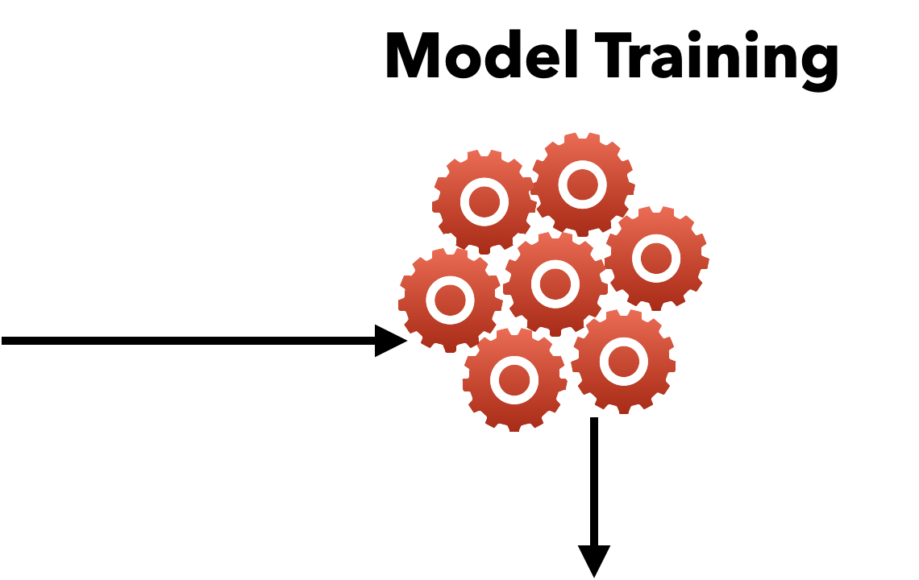

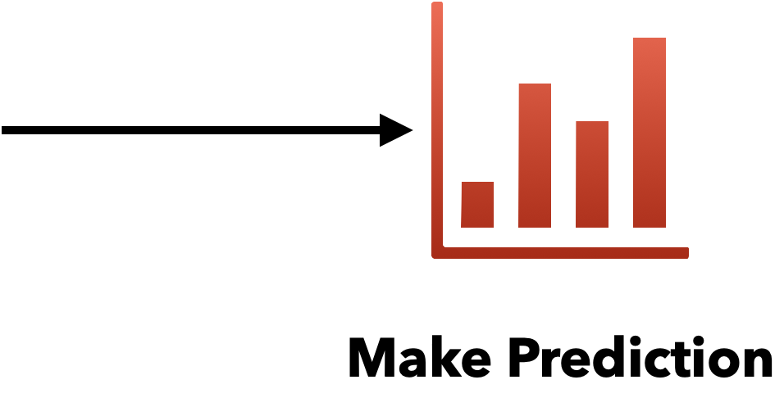


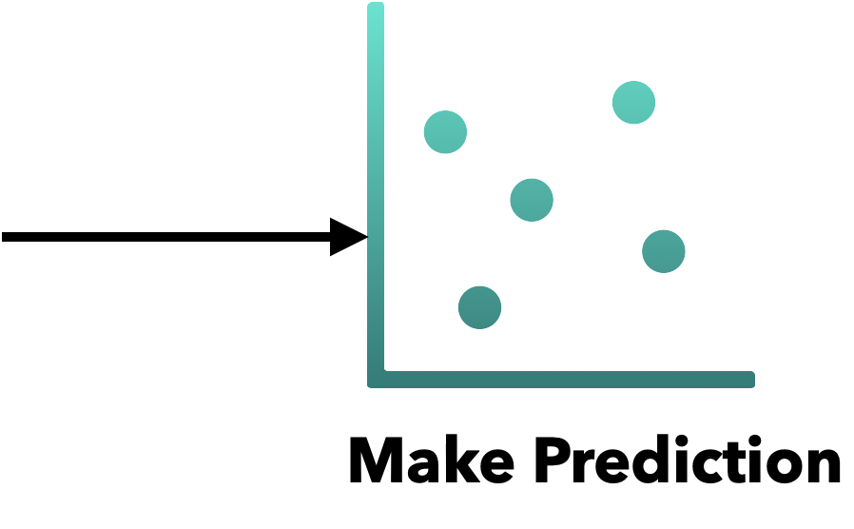


Our Approach
Security Project - Final Presentation

Slide 10

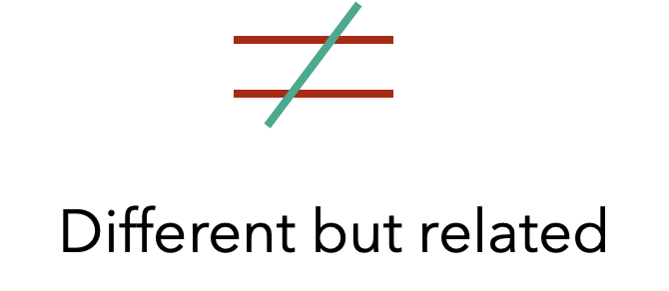
















Our Approach - Underlying concept
Source
Target
D = Data source
The data in both domains are considered different but related
T = Task
Task performed in both domains are equal
Target domain has no label during training
No label in target
Use trained model in source to predict the label in the target domain
Predict Target label
Security Project - Final Presentation

Slide 11
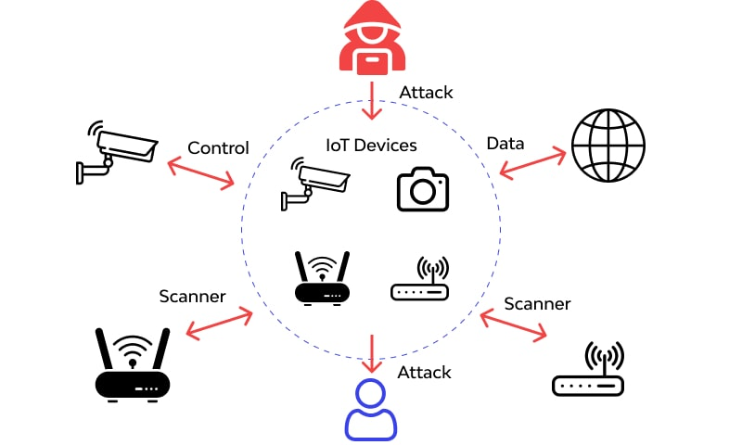
Attack Types
We are working with 4 attack types
Benign
DOS (Syn Flood)
Torii
Mirai
https://www.wallarm.com/what/iot-attack
Security Project - Final Presentation

Slide 12

Benign
A benign cyber activity or entity refers to actions or elements that are non-malicious or pose no threat to a system or network.
It encompasses normal, routine, or harmless activities within cyberspace that do not aim to cause harm or disruption.
Security Project - Final Presentation

Slide 13

DOS (Syn Flood)
It is a type of cyber attack that targets the initiation of a TCP handshake.
It involves overwhelming a server with a flood of connection requests (SYN packets)
The attacker doesn't complete the handshake, leaving the server waiting for confirmation.
This flood of half-open connections exhausts the server's resources
https://www.flaticon.com/free-icon/rejection_2191154
Security Project - Final Presentation

Slide 14

Torii
It is a sophisticated and stealthy IoT botnet malware that targets various architectures, including IoT devices and enterprise servers
It provides attackers with remote control, data exfiltration, and the ability to run arbitrary commands on infected devices
https://www.flaticon.com/free-icon/cyber-attack_9094815
Security Project - Final Presentation

Slide 15

Mirai
Mirai is a type of malware that targets IoT devices
It functions by exploiting weak security measures in these devices, infecting them to form a botnet.
https://www.flaticon.com/free-icon/botnet_2974496
Security Project - Final Presentation

Slide 16

Data Set
CIC IoT Dataset 2023
MedBIoT Dataset
IoT Dataset 2023
IoT Network Intrusion Dataset 2019
https://www.flaticon.com/free-icon/data-warehouse_12663252
Security Project - Final Presentation

Slide 17
CIC IoT Dataset
Created by Canadian Institute of Cyber Security
33 attacks are executed in an IoT topology composed of 105 devices. These attacks are classified into seven categories.
PCAP: Contains the original traffic captured during the attacks as .pcp files
CSV: Contains features extracted from the original files to be used in the Machine Learning (ML) evaluation (.csv files)
Security Project - Final Presentation

Slide 18
MedBIoT
Created by a research group in TALTech
Combination of real and emulated IoT devices in a medium-sized network (i.e., 83 devices).
Actual malware was deployed, providing real malware network data. Three prominent botnet malware were deployed: Mirai, BashLite, and Torii.
This data set is suitable for IoT botnet research in general and intrusion detection systems
Security Project - Final Presentation

Slide 19
IoT Dataset
This dataset was created as part of the Avast AIC laboratory with the funding of Avast Software
It has 20 malware captures executed in IoT devices, and 3 captures for benign IoT devices traffic.
We will be using this dataset as a source for Torii.
Security Project - Final Presentation

Slide 20
IoT NID
Featuring SKT NGU smart home device and an EZVIZ Wi-Fi camera.
The dataset consists of 42 raw network packet files (pcap) at different time points.
The IoTID20 dataset's development led to the final version comprising 83 network features and three label features.
We are going to use this dataset as a target dataset for Mirai and DOS (Syn Flood)
Security Project - Final Presentation

Slide 21
Source & Target
Attack Type | Source | Target
Benign | CIC IoT 2023 | IoT 2023
DOS Syn Flood | CIC IoT 2023 | IoT Network Intrusion 2019
Mirai | CIC IoT 2023 | IoT Network Intrusion 2019
Torii | IoT 2023 | MedBIoT
The baseline model utilized:
62 features
3000 records for each attack type
Security Project - Final Presentation

Slide 22
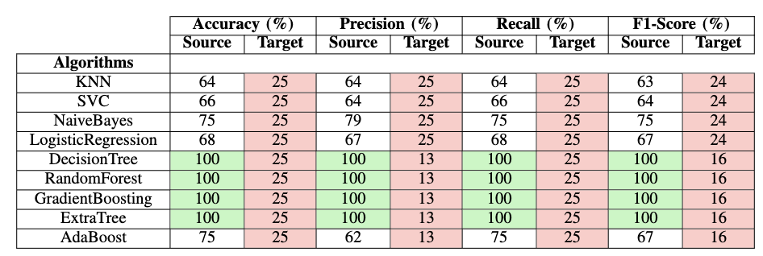
Experimental Results
Security Project - Final Presentation

Slide 23
Deep Learning Approach
1. Train deep learning based methods on the source domain
2. Leverage this pretrained model on the target domain for few shot learning
3. Use PCA for strategic sampling of input from the target domain for few-shot learning
4. Fine-tune the pretrained model for the enhanced domain adaptation
Security Project - Final Presentation

Slide 24
Improved Experimental Results
Deep Learning Approaches | Accuracy(%) | Precision(%) | Recall(%) | F1 Score
LSTM | 31.13 | 30.21 | 31.84 | 31
LSTM + CNN | 33.47 | 32.63 | 33.17 | 32.88
For few shot learning, k = 5 was used.
Security Project - Final Presentation

Slide 25
Contribution and Novelty
Analyze the application ML on when data (training and test) is drawn from the same or different distribution
Employed transductive transfer learning of attack identification
Employed multiple ML algorithms in our study
Improved the results of our baseline model using deep learning
Security Project - Final Presentation

Slide 26
Future Work
Improve classification results
Employ boosting to find out specific information from each model
Conduct experiments in real networks with simulated attacks
Security Project - Final Presentation

Slide 27
Any Questions?
Security Project - Final Presentation

Slide 28
