Slide 1

Amala Vilivalam, Priscilla Chang, Zeina Samra, Juleen Kirols, Riya Chowdawarapu

Slide 2

Our Business Concept
Rest/relaxation area in student centers
Provides commuter students with a place to nap between classes
~6 pods that students can reserve in 30-minute session
- Timers in each pod, monitored by employees
- Premium: book longer sessions
Available on all campuses
Cleaning services + disposable sheets for sanitation
Associated Workshops: yoga/meditation

Slide 3
Customer Value Proposition
SleeepyPods provides students, especially commuters, with designated napping spots on every campus. Each student center would have an area with 4-5 napping pods that students can reserve for 30-minute increments. To help students deal with the awkward gaps between morning and evening classes, they can take breaks as they normally would back in their rooms but at a more convenient location.
This is especially beneficial for the commuter minority at a university, where they are unable to make continuous trips to campus and back home in a day. This is the baseline service our company provides, but we also have a premium service that would involve booking a pod for an extended period.
While there are limits to how long a student can reserve a pod at a time, the program will be available from 10 am – 8 pm and be extended during
finals season. Workshops, such as yoga/meditation/stress relief, will also take place with a focus on mental health.

Slide 4
Our Vision
Instilling peace amidst the rush
Our Mission
Sleeepy Pods aims to provide commuter college students a place to nap and recharge with our technology-enabled nap pods. Located in each of the student centers, our service is designed to provide a convenient resting place without traveling home or for students who have dorms on different campuses. Through short nap sessions, extended premium options, and wellness workshops, SleeepyPods helps recharge both physically and mentally.

Slide 5
Our Core Values
Student Well-Being
We prioritize mental health, rest, and stress reduction as essential components of student success.
Commuter Inclusion
We are committed to meeting the unique needs of Rutgers commuter students by providing nearby, reliable spaces for rest and recovery throughout the day.
Safety and Trust
We maintain high standards for cleanliness, privacy, and security.
Stewardship
SleeepyPods believes humility and service develops character and integrity. Thus, we plan to employ student workers to maintain and oversee nap pods. Students will have firsthand opportunity to serve the rest of the university community and contribute to the wellness of their peers.
Dependable Availability
Each student has an opportunity to get a session as there is a time limit on each session. If a student wants more time, they will have to pay a fee.

Slide 6
Financial Objectives
Strategic Objectives
1. Achieve positive cash flow by the end of 3 years through sale of nap pods.
2. Generate $3 million in profit by the end of the third academic year to support ongoing operations.
3. Maintain operating margins of at least 15% by the end of year 5.
1. Install and operate at least 6 units/student center within the first 12 months of operation with each new school.
2. Expand and operate in all other BIG10 schools within the next 3 years.
3. Host at least two wellness workshops per month with minimum attendance of 20 students for the next 3 years.

Slide 7
Corporate Social Responsibility Key Initiatives
SleeepyPods and its workshops are welcoming and accessible to all students, including commuters, students with disabilities, and students from diﬀerent cultural backgrounds.
Offer longer sessions/hours during midterms and finals season.
Implement environmentally responsible practices, like using biodegradable sheets, energy-efficient pod equipment, and minimal-waste cleaning processes.
Rationale: Helps everyone feel included and valued, which meets student expectations, and supports the university’s goal of creating a fair campus environment.
Rationale: Physical rest is essential for the brain to properly learn. During high-stress periods, students need to rest both physically and mentally to perform their best.
Rationale: Example of environmental responsibility and reduces long-term costs for business.

Slide 8

New Product/Service
Premium Service
Nap pods are typically timed at no more than 30 minutes. Now with the addition of our premium service, the time limit can be extended for up to 3 hours, with a small fee per hour. This service also includes complimentary sleep kits

Slide 9
National Expansion?
Expansion decision/rationale
We chose national expansion as it allows SleeepyPods to grow beyond a single campus, and become a real solution to student burnout at a larger scale. Since student mental health and exhaustion are universal issues across universities, the business model can translate well to other campuses, such as the Big Ten schools.
Approach decision/rationale
Franchise is the most strategic approach for SleeepyPods because it allows for more rapid expansion across a lot of campuses. It does not require substantial amounts of capital from the company. It reduces financial risk while being able to maximize national growth potential and brand awareness.

Slide 10
Global Expansion Details
Selected Country: United Kingdom
Opportunities
Similar culture/work ethic to the United States - reduces adaptation challenges
Strong economy and purchasing power.
High student wellness awareness, strong demand for nap pods.
English-speaking market simplifies operations
Challenges
Smaller total population than other markets.
Potential competition in wellness services
High commercial rent costs in urban campuses
Overall Rationale: The UK offers the best balance of opportunity and risk for SleeepyPods as its first international expansion. The cultural similarities to the United States reduce the need for major service modifications while strong legal protections and a supportive business environment lower the operational risk.

Slide 11
Expansion/Entry Strategies
Expansion Strategy: Global Standard
Our nap pods will be universally accepted
  (not dependent on local preferences/tastes).
Standardization cuts costs, time, and effort.
In the future, the product will automatically adjust itself based on where the user is located.
Entry Strategy: Joint Venture
A local partner in the UK can help navigate university relationships, licensing requirements, and hiring local employees.
The partner’s local knowledge reduces risk and speeds up market entry
Combines the strengths of both organizations and increases the likelihood of successful international expansion.

Slide 12
Job Selected: Pods Operations Attendant
Summary of Responsibilities
Qualifications
Compensation Plan
Advertising Plan
Criteria for Selection
- Ensures pods are used efficiently with little scheduling conflict
- Keeps spaces clean
- Helps students with check-in, troubleshooting, and keeping the environment safe, quiet, and comfortable
- Reports issues to reduce pod downtime
- Gathers feedback
- Strong customer service skills
- Responsible
- Detail-oriented
- Able to follow sanitation protocols
- Experience in campus recreation, hospitality, or healthcare preferred
- CPR/First Aid certification preferred
- $17–$20 per hour
- Performance-based incentives during high-demand periods
- Free Membership
- Flexible scheduling
- Opportunity for leadership promotion (Lead Attendant)
- Rutgers Handshake (or equivalent career platforms for different universities)
- Indeed.com
- Flyers in Student Centers & Libraries
- Instagram & campus student group pages
- Prior experience
- Communication Skills
- Availability during Peak Hours (10am -8pm)
- Positive References

Slide 13
Employee Motivation Initiatives
Employee Training and Development
Train all employees on cleanliness, customer service, safety, and handling conflicts
Provides ongoing training to help employees improve their skills over time
Offer leadership training for higher performers to prepare them for higher roles
Competitive Compensation and Fair Benefits Program
Offer pay that is competitive with other campus jobs
Include benefits like free pods use, wellness benefits, and extra bonuses during exam week.
Appraisal and Feedback System
Conduct performance reviews each semester
Evaluate employees based on attendance, cleanliness, customer service, and teamwork
Give clear feedback to help employees improve and grow
Performance Recognition
Recognize top employees
Reward employees who show strong service and reliability
Encourage positive behavior that supports business goals

Slide 14
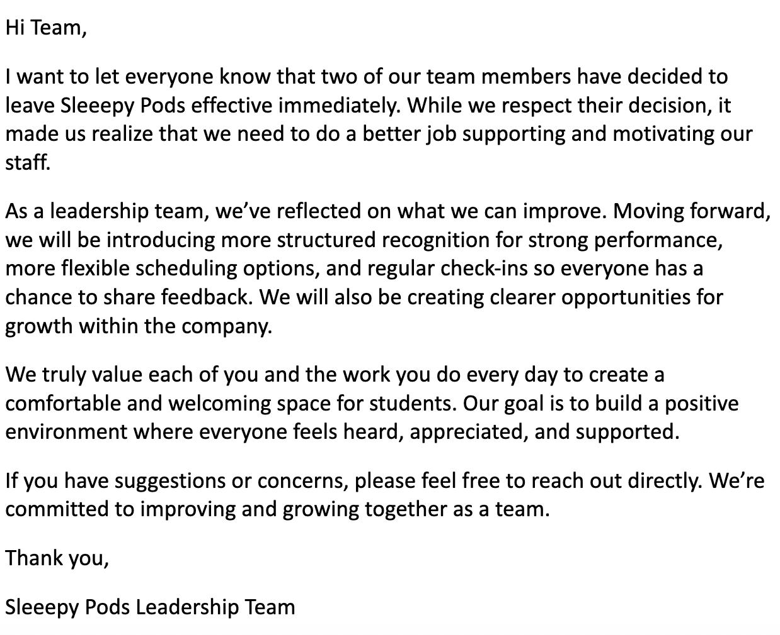
Announcing the Departure of 2 Key Employees
Email template sharing that an employee is leaving, while also reassuring everyone that management is making improvements to prevent future departures. It also encourages employees to provide feedback & stay positive about the company.

Slide 15
Key Actions for Employee Engagement
Transparency -- Company updates, goals, and challenges should be visible and transparent so employees build trust through open communication.
Growth Opportunities -- Create leadership/growth pathways through mentoring, training, and career development. Investing in the people, not just the work, shows the company cares about the development and growth of its people as individuals.
Employee Wellness -- Employees are valued as individuals, not just their performance. Flexible scheduling, reasonable workloads, and access to rest spaces are important to ensure the health and wellness of employees.

Slide 16
SIPOC for Key Process
Suppliers | Inputs | Processes | Outputs | Customers
Pod manufacturers Cleaning staff Scheduling software provide Front desk staff Utility providers | Sleep pods Booking system Staff Cleaning supplies Customer reservations | Customer books pod Check in Pod assigned Customer uses pod Pod cleaned and reset Customer check out and feedback | Rested customer Clean/ready pod Completed booking Customer feedback | Who: Commuter/College students Desired Behavior: repeated visits, positive reviews, referrals Customer Reqs: clean pods, quiet environment, easy booking, affordable price

Slide 17
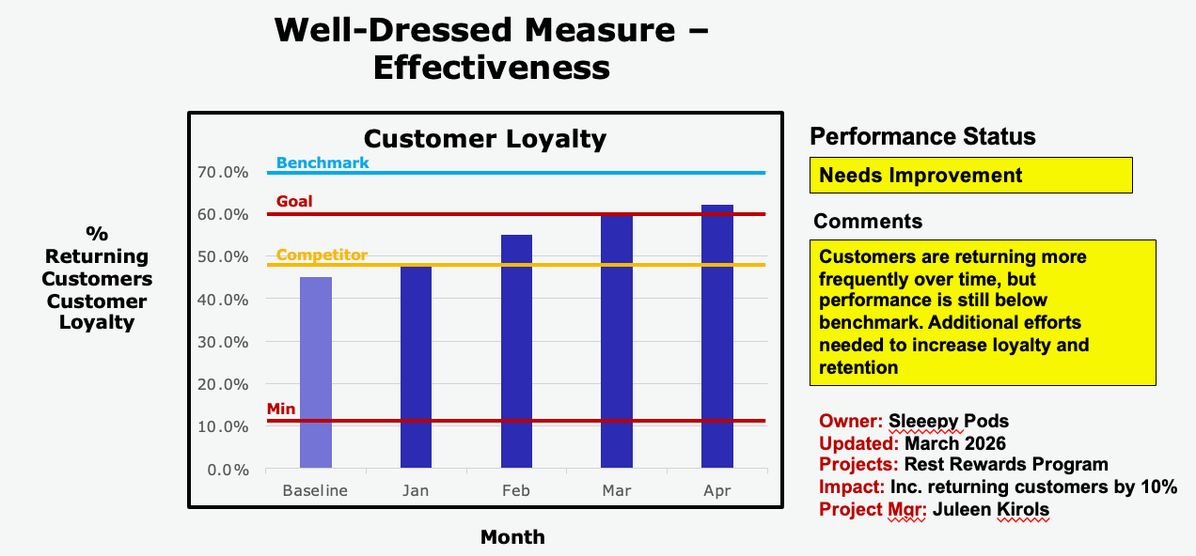
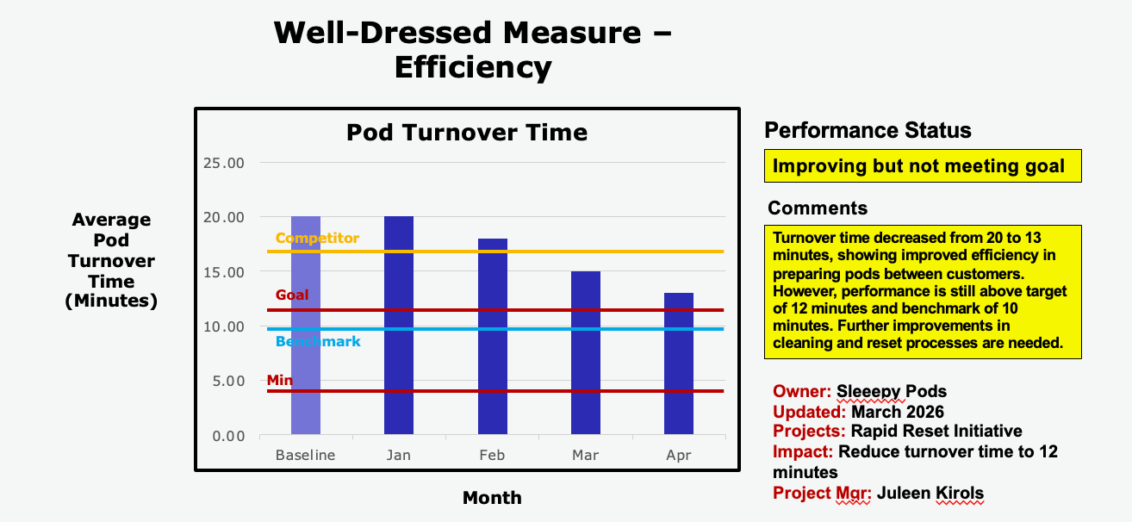
Measurement Charts

Slide 18
Rationale on the Sale of the Business
Recommendation to Sell: No
Long-term growth over short-term profit
  Selling brings immediate financial gain but limits future expansion across more campuses
  Retaining ownership allows us to scale and increase overall company value over time
  A one-time payout is less valuable than sustained, long-term growth potential
Responsibility to employees, customers, and partners
  Selling could create uncertainty for employees and risk job security
  New ownership may prioritize profits over student well-being and product quality
  Strong relationships with universities could be weakened or disrupted
Maintaining control and protecting the brand
  Inexperienced buyers introduce operational and strategic risks
  Risk losing our mission-driven focus on improving student wellness
  Keeping control ensures consistency in quality, vision, and long-term success

Slide 19
Improvement Initiative
Objective:
Increase customer retention from 60% → 70% within 6 months by enhancing service effectiveness
Key Initiative:
Expected Impact:
More convenient and reliable experience
Higher customer satisfaction
Increase repeat visits and referrals
Improve booking experience
Personalized booking reminders
Faster, more user-friendly system
Enhance service efficiency
Streamlined check-in and pod assignment
Reduced wait times and improved session flow
Increase customer value
Bonus incentive: +30 minutes after every 5 sessions
    Encourages repat usage
    Elevate Service Quality
    Staff training for better customer interactions
    Consistent cleaning and preparation standards

Slide 20
A Successful Business
Customer- centered experience
Easy booking system and smooth check-in process
Quiet, hygienic pods with consistent service quality
Focus on rested and refreshed outcomes for students
Efficient & Reliable Operations
Streamlined process from booking → check in → session → reset
Well-maintained pods and standardized cleaning procedures
Strategic Resources & Partnerships
High-quality pod equipment and campus-based locations
Integration of mobile booking and operational systems
    Continuous Improvement Focus
    Implementation of the Rest Rewards Program
    Incentives and service enhancements to drive repeat usage
    Ongoing staff training and process optimization

