Slide 1
TEALS Minecraft Project
Lecture 2: Modding Minecraft Items

Slide 2
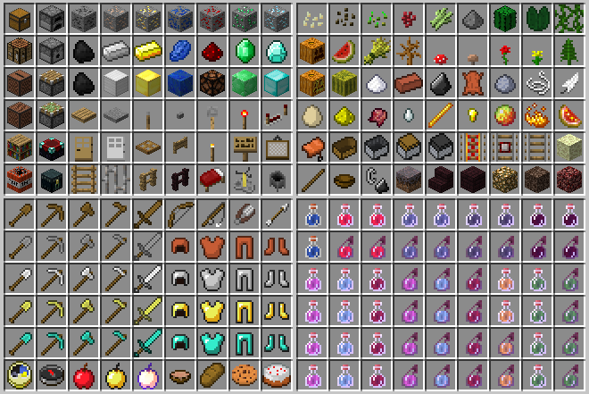
What’s a Minecraft Item?
Items are things like plants, tools, eggs and other objects that can be found in the world.

Slide 3
Minecraft Item Objects
All items extend the Minecraft Item class.
There are multiple base classes that extend the Item class:
ItemArmor: items that the player can wear
ItemFood: items that the player can eat
ItemTool: items that the player can use to modify the world
Items have the following properties:
A maximum stack size → the number of items that can combine in one slot of your inventory.
A creative tab → the location in the creative inventory of the item.

Slide 4
Item Stacks
A player’s inventory has 36 slots. The “hot bar” has nine slots (1–9). Each slot holds an “item stack”.
A stack of items is just a certain number of items of a single type. For example, an item stack of five calculators, or an item stack of 64 sand blocks.
An inventory slot can be empty (null in the code).
The item count is stored in the ItemStack stackSize field.
The inventory pop-up has multiple tabs. These are called “creative tabs”. Each tab holds blocks and items of a certain category.

Slide 5
Creating Custom Items
To create a custom item, you need to
Extend the Item class,
Add code in the Item constructor to
set the maximum stack size with setMaxStackSize(), and
set the desired creative tab with setCreativeTab().
Register the item in your ItemsModule onLoad() method.

Slide 6
Example Item Code Item Class
package tealsmc.mods;
import net.minecraft.creativetab.CreativeTabs;
import net.minecraft.entity.player.EntityPlayer;
import net.minecraft.item.Item;
import net.minecraft.item.ItemStack;
public class AntiBurnItem extends Item {
public AntiBurnItem() {
// Set up item defaults.
setMaxStackSize(16);
setCreativeTab(CreativeTabs.tabDecorations);
}
@Override
public boolean onDroppedByPlayer (ItemStack item, EntityPlayer player) {
// If the player is on fire, stop them from burning.
if (player.isBurning())
player.extinguish();
return super.onDroppedByPlayer (item, player);
}
}
Notes:
Note that the onDroppedByPlayer() function is unimportant – this is only to show the general flow of extending a block.

Slide 7
Example Item Code Module Class
package tealsmc.mods;
import org.tealsk12.tealsmodloader.module.Module;
public class ItemsModule extends Module {
public void onLoad() {
// Create Item Instances
AntiBurnItem antiBurn = new AntiBurnItem();
// Register Instances
parentMod.itemRegistry.newInstance(
"anti_burn_item", antiBurn, "Anti Burn Item");
}
}

Slide 8
Item Lab
For the item lab, we will implement a new Minecraft item: a rock sifter.
The rock sifter item will find all sand blocks in your inventory, and for each one will have a 10% chance of finding a gold nugget. When the sifter is finished, sand blocks in your inventory will be replaced with a random amount of gold nugget items.

