Slide 1
TEALS Minecraft Project
Lecture 3: Blocks 1

Slide 2
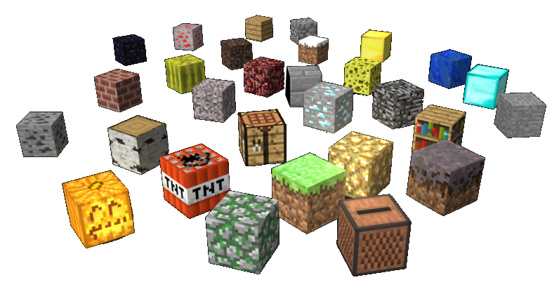
Minecraft Blocks
Blocks form the terrain & buildings in the Minecraft world. Blocks can change appearance, trigger actions, spawn other blocks, and perform many other behaviors in game.

Slide 3
Minecraft Block objects
All blocks extend the Minecraft Block class.
Blocks are created once, but have methods that are called with parameters x, y and z (the location in the Minecraft world) when something happens to that location.

Slide 4
Block Properties
Texture(s)
Visible to the user looking at the block.
parentMod.blockRegistry.newInstance(texture, newBlock, name)
Material
Determines sounds and other properties.
Defined inside the block constructor.
Blast Resistance
How much resistance to nearby explosions from creepers or TNT.
setResistance(float level), where level is a value from 1 to infinity.
Luminance
How much light the block emits.
setLightLevel(float light), where light is a level from 0 to 1.

Slide 5
Block Properties (cont.)
Hardness
How long it takes to mine the block.
setHardness(float hardness), usually 0 to 5, occasionally higher.
Creative Tab
Location in the creative inventory of the block.
setCreativeTab(CreativeTabs.someTab)
Step Sound
The noise the block makes when you walk over it.
setStepSound(Block.soundTypeSomething)

Slide 6
Basic Block Types
A big honkin' table of Minecraft block types…
(from Minecraft.gamepedia.com)

Slide 7
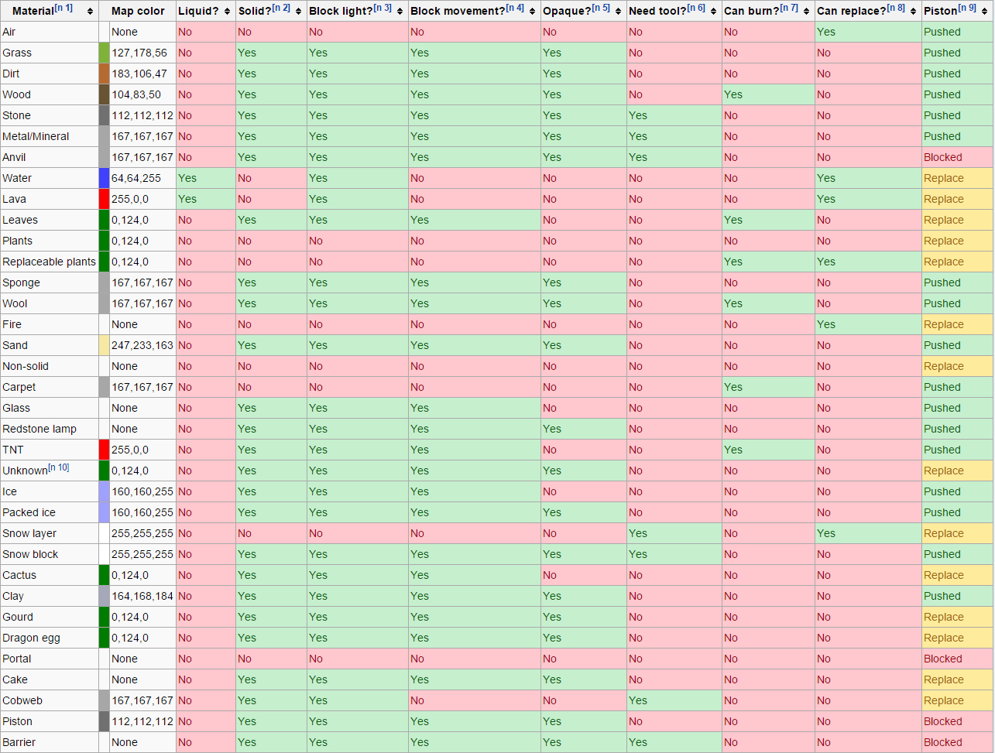

Slide 8
Block Example
Block Class
package tealsmc.mods;
import net.minecraft.block.Block;
import net.minecraft.block.material.Material;
import net.minecraft.creativetab.CreativeTabs;
import net.minecraft.init.Blocks;
import net.minecraft.world.World;
public class BasicBlock extends Block {
public BasicBlock (Material material) {
super (material); // Pass on material to base class.
setCreativeTab (CreativeTabs.tabBlock); // Blocks tab.
setLightLevel (1.0f); // Very bright.
}
public void onBlockAdded (World world, int x, int y, int z) {
// Whenever this block is placed in world, add a stone block on top of it.
world.setBlock (x, y+1, z, Blocks.stone);
}
}

Slide 9
Block Example
Module Class
package tealsmc.mods;
import org.tealsk12.tealsmodloader.module.Module;
public class BlocksModule extends Module {
// This class registers all custom block types.
public void onLoad() {
// Register all custom blocks.
parentMod.blockRegistry.newInstance (
"basic_block", new BasicBlock(Material.rock), "Basic");
}
}

Slide 10
Lab 3: Custom Blocks
Let's make some blocks!

