Slide 1
TEALS Minecraft Project
Lecture 5: Block.onBlockAdded()

Slide 2
Minecraft Coordinates
Recall the Following
Minecraft blocks all have a unique location x, y, and z.
X and Z are parallel to the horizon, and Y is up.
To place a block at an arbitrary location, use this:
world.setBlock(x,y,z, blockType);

Slide 3
Block.onBlockAdded
We'll be using (overriding) a new Block method today:
public void onBlockAdded (World world, int locX, int locY, int locZ)
The Block.onBlockAdded() method is called when a new block is added to the world, at the given location.
In lab 4, we used a crystal-growing block to be the “seed” for a block, and a crystal-growing item to trigger the placement of more blocks to grow the crystal.
For lab 5, we'll use the Block.onBlockAdded() method to build a tree from a block as soon as it is placed in the world.

Slide 4
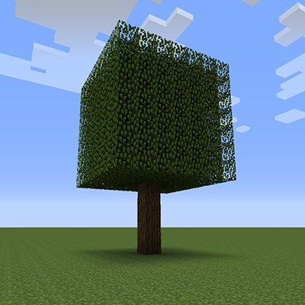
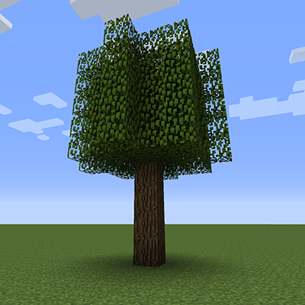
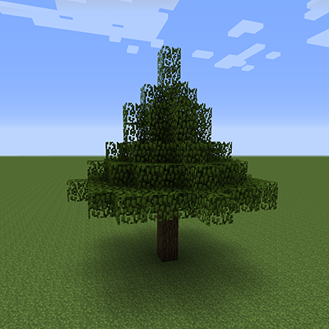
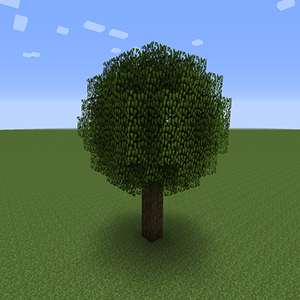
Lab 5: Tree-Growing Blocks
For today's lab, we'll be creating four different kinds of blocks, that grow four different types of trees: cube, cylinder, cone, and sphere (in increasing difficulty).
A BIG WORD OF ADVICE: work out the math & algorithm on paper first before diving into the code! If you have a clear idea on paper, the coding will be much easier.
Everything else you need to know is in the lab write-up.

