Slide 1


Slide 2
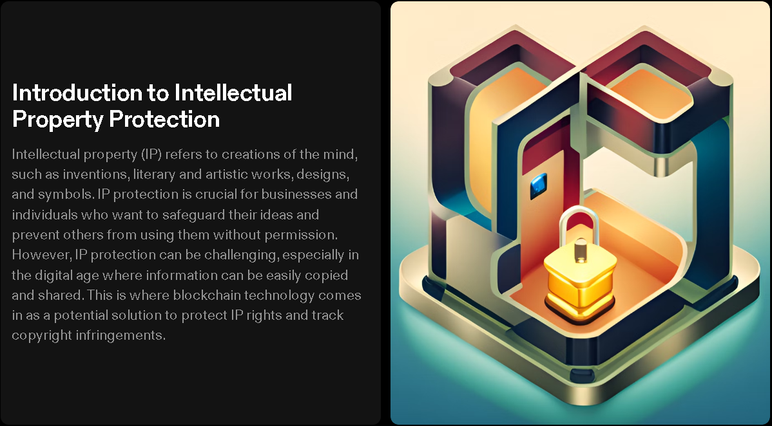

Slide 3
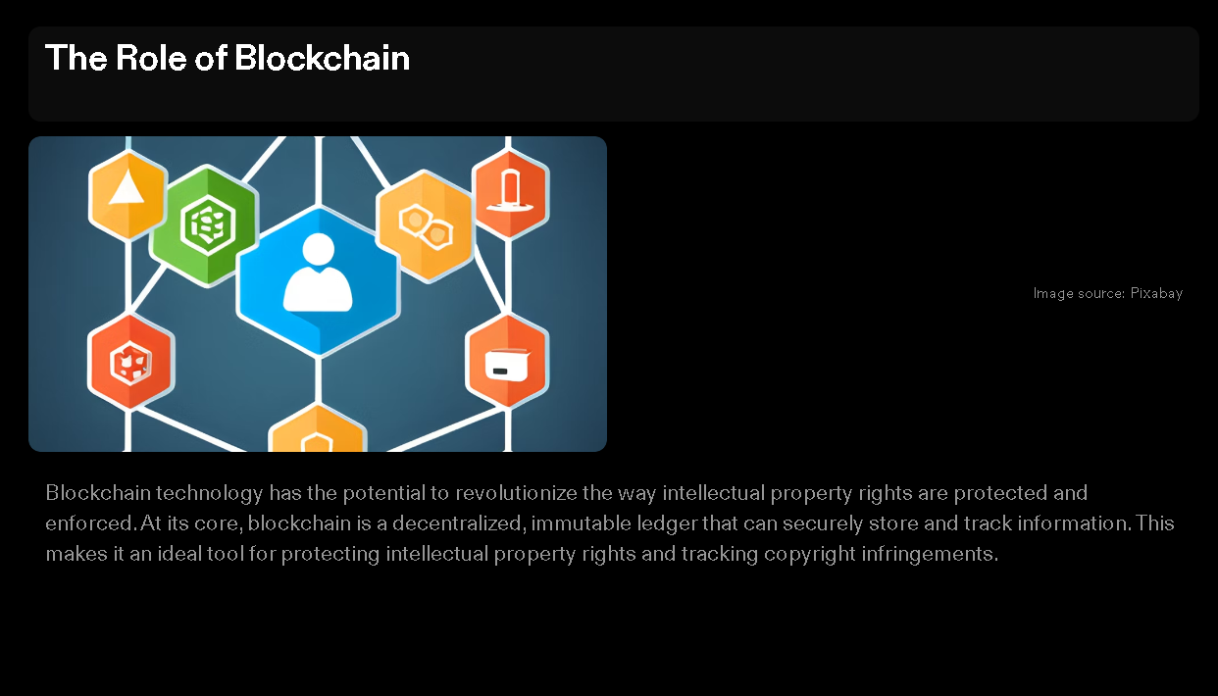

Slide 4
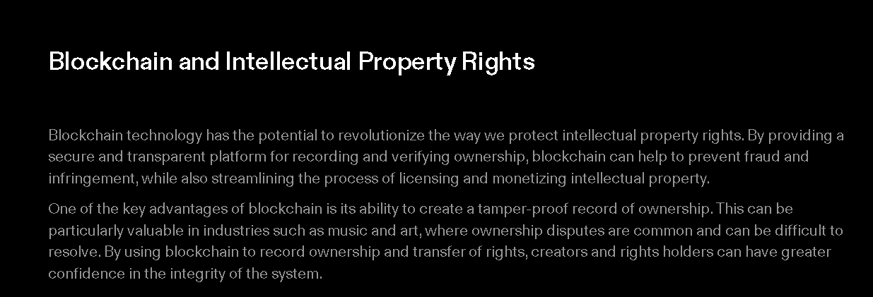
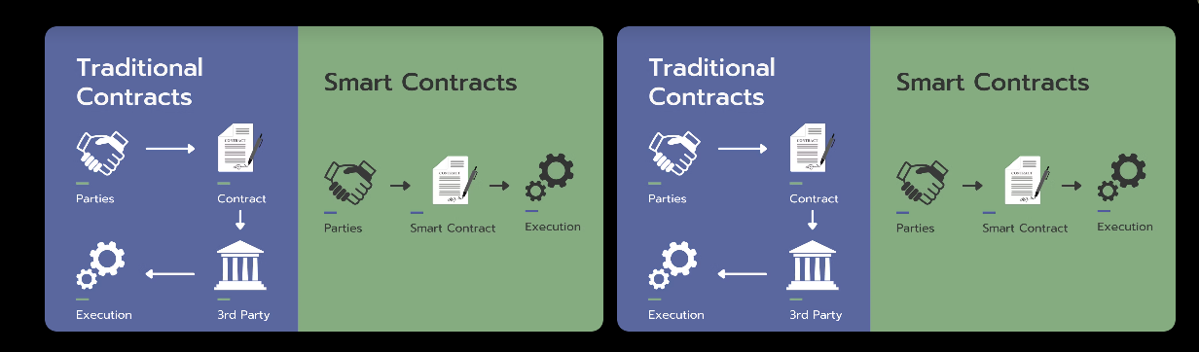
Smart Contracts
Smart contracts are self-executing contracts with the terms of the agreement between buyer and seller being directly written into lines of code. They can be used to automate the process of licensing and monetizing intellectual property, providing a more efficient and transparent system for all parties involved.
Challenges and Opportunities
While blockchain technology has the potential to greatly improve the protection of intellectual property rights, there are also challenges that must be addressed. One of the biggest challenges is ensuring that the system is accessible and affordable for all creators and rights holders, regardless of their resources or technical expertise.
Despite these challenges, the opportunities presented by blockchain for intellectual property protection are significant.

Slide 5
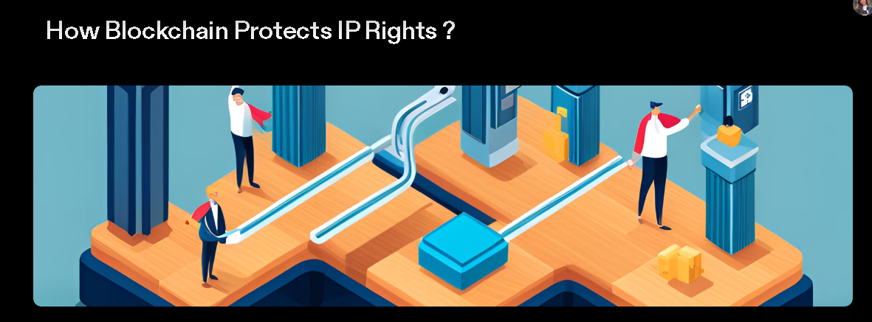
Blockchain technology has the potential to revolutionize the way we protect intellectual property rights. By using a decentralized ledger system, blockchain can provide a secure and transparent way to track and manage IP rights and copyright infringements.
Immutable Records
One of the key features of blockchain technology is its immutability. Once information is recorded on the blockchain, it cannot be altered or deleted. This means that any records related to IP rights and copyright infringements are tamper-proof and can be used as evidence in legal proceedings.
Smart Contracts
Smart contracts are self-executing contracts with the terms of the agreement between buyer and seller being directly written into lines of code. They allow for the automatic transfer of assets and payment when certain conditions are met. In the context of IP protection, smart contracts can be used to automate the licensing and distribution of digital content, ensuring that the rightful owners are compensated for their work.

Slide 6
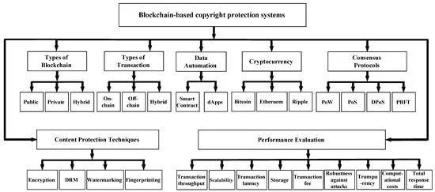
How blockchain tracks copyright infringements?
Blockchain technology can be used to track copyright infringements by providing a transparent and immutable ledger of ownership and transaction history for digital assets, including copyrighted content. Here's how it works:
Timestamping and Provenance: When a creator or copyright holder wants to establish ownership of their work, they can timestamp it on a blockchain. This creates a permanent record of the content's existence at a specific point in time. This timestamp serves as proof of when the content was created or first registered.
Smart Contracts: Smart contracts are self-executing contracts with the terms of the agreement directly written into code. Copyright holders can create smart contracts that specify the conditions under which their content can be used or shared. For example, they can define how royalties should be paid or restrict certain types of usage.
Content Registration: Creators can register their copyrighted content on a blockchain platform designed for intellectual property management. This includes uploading a digital copy of their work along with relevant metadata.
Digital Signatures: Digital signatures can be used to verify the authenticity of the copyright holder and their approval for specific actions related to their content. This ensures that only authorized individuals or entities can make changes to the copyright information or grant permissions for usage.

Slide 7
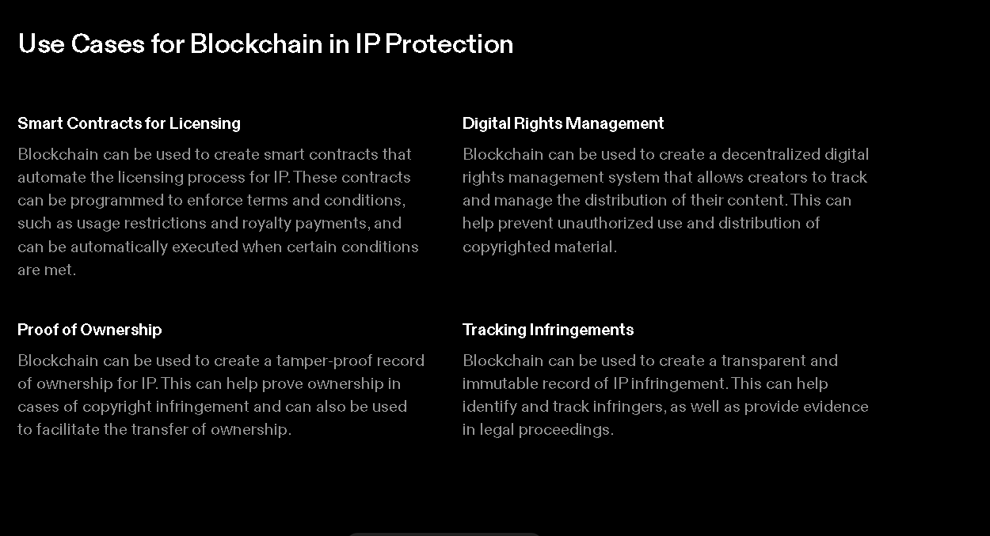

Slide 8
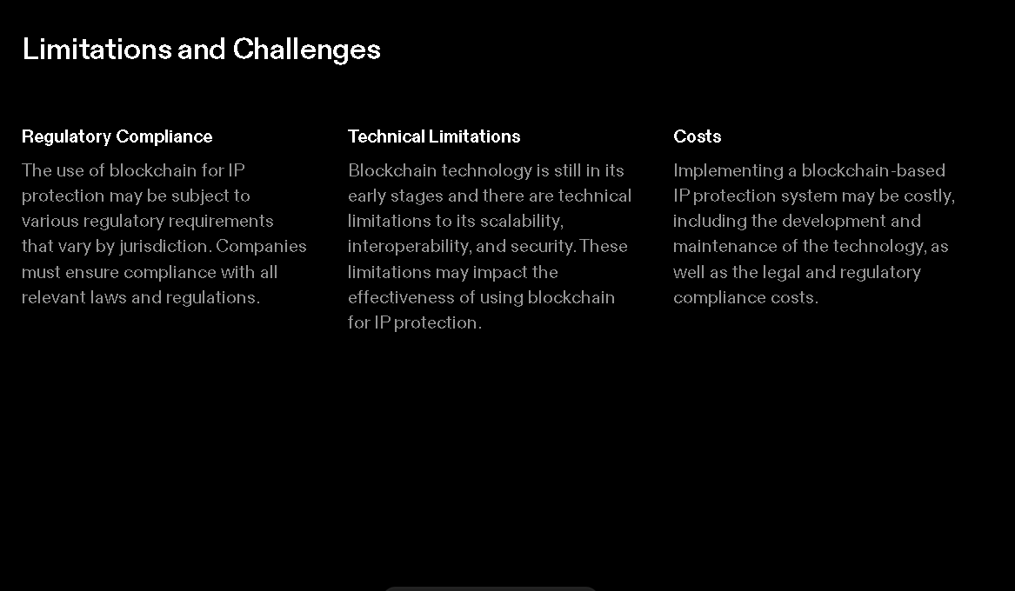




Slide 9
