Slide 1
PRiSM

Slide 2
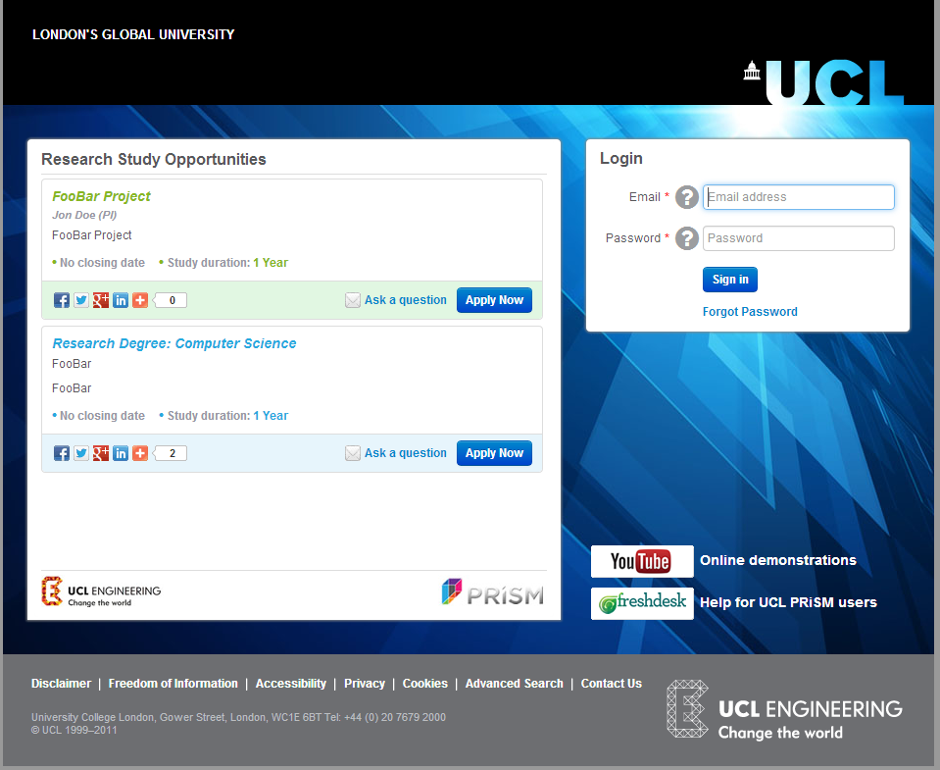

Slide 3
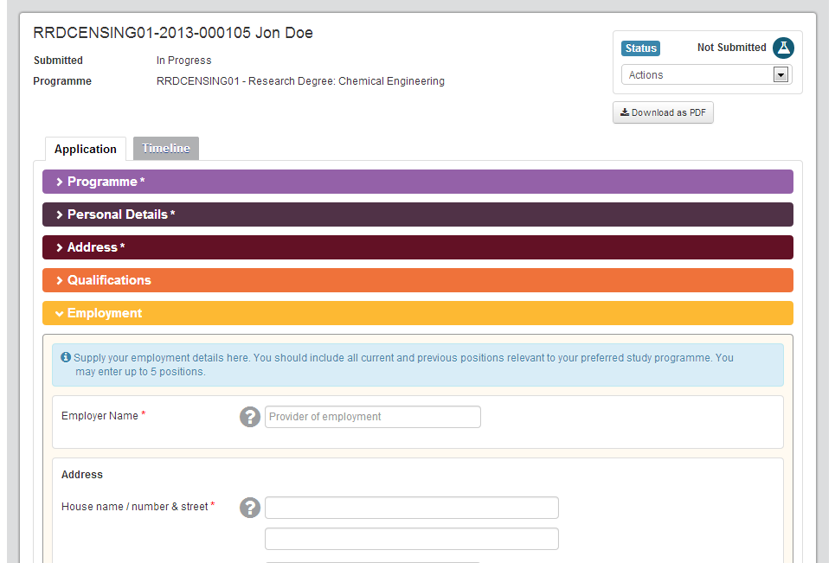
Applicant filling out application

Slide 4
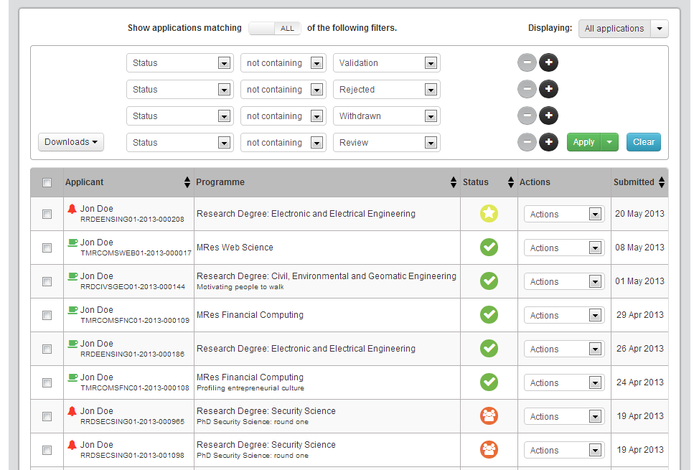
Applications Overview

Slide 5
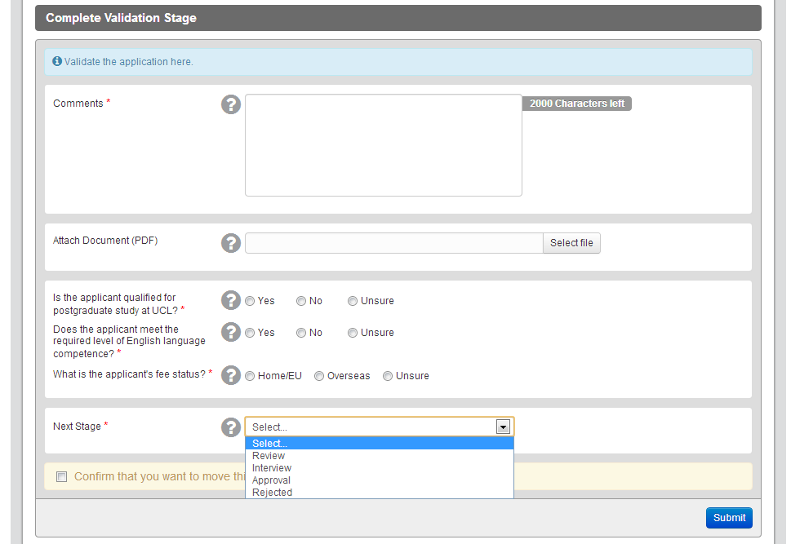
Moving application to a new stage (Completing the Validation stage)

Slide 6
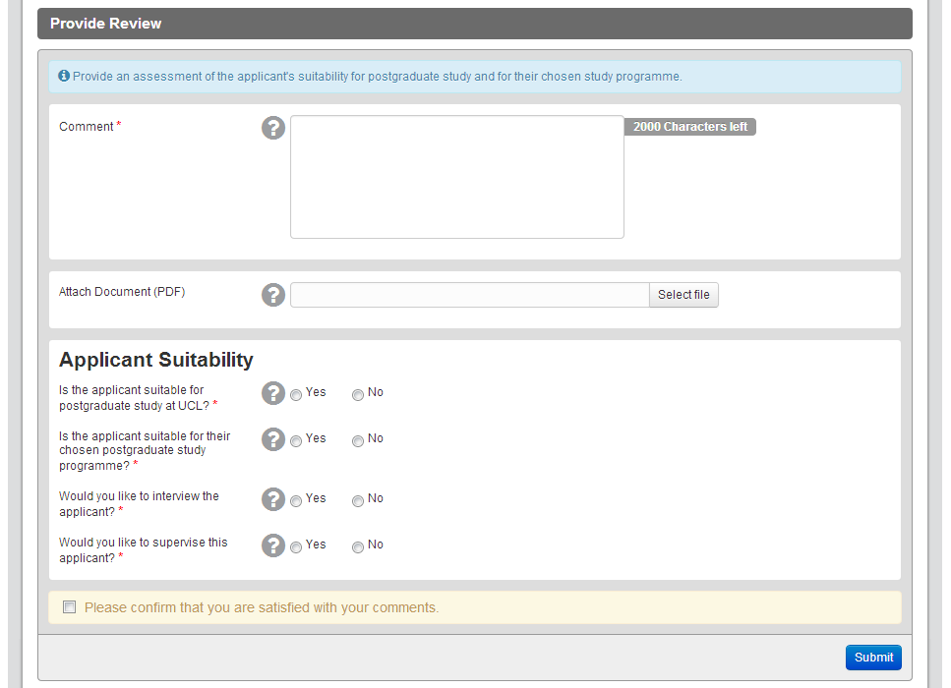
Moving application to a new stage (Completing Review stage)

Slide 7
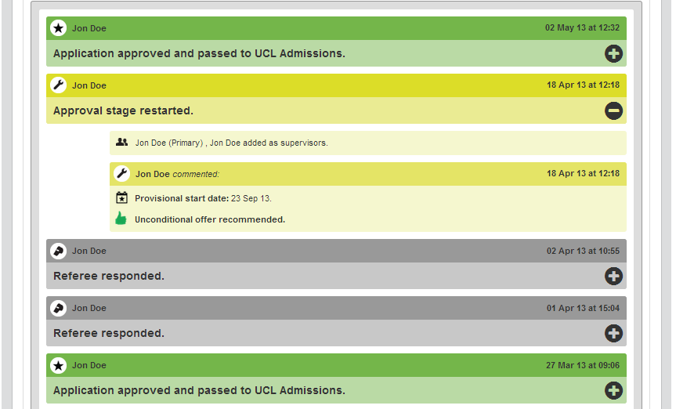
Timeline view of the application

Slide 8
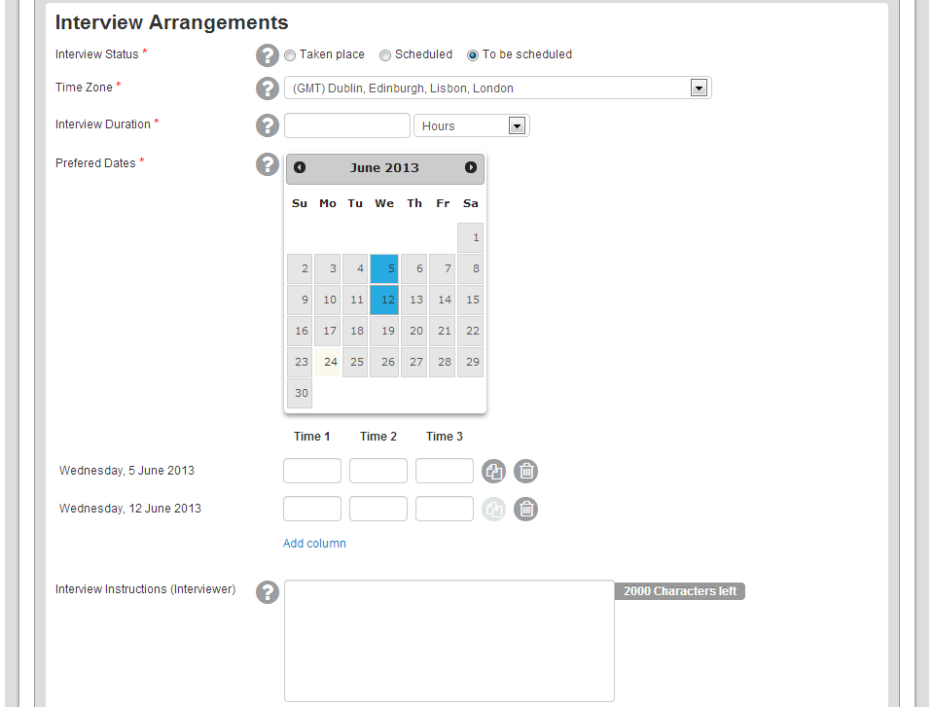
Schedule an interview with the applicant (In the Interview stage)

Slide 9
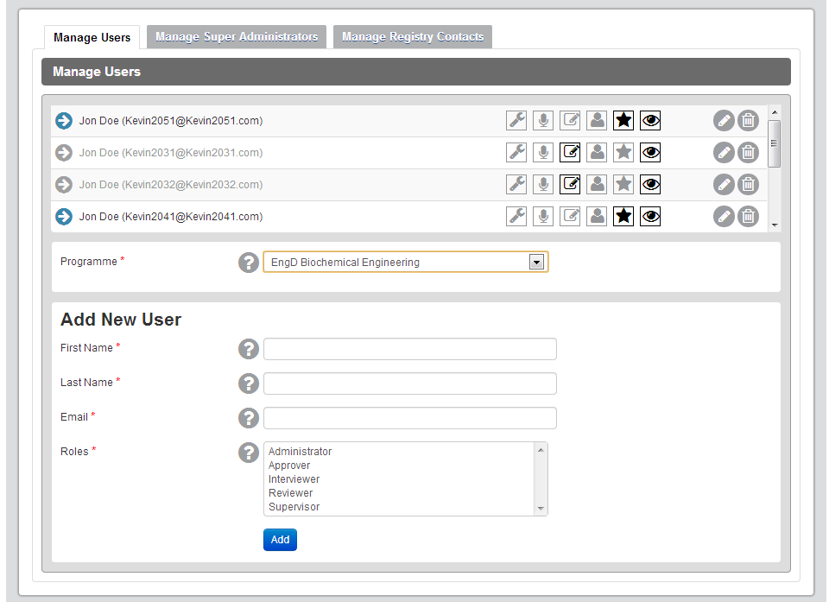
Assign different roles to staff (Programme Admin., Approver, etc.)

