Slide 1
Project Ragnarok:
Post-Quantum Cybersecurity with Lightning data
Team Members: Joanna Zhang, Gianni Bubb,
Aidan Nelappana
Faculty Advisor and Client: Dr. Bhattacharyya
Dr. Amitabh Nag

Slide 2
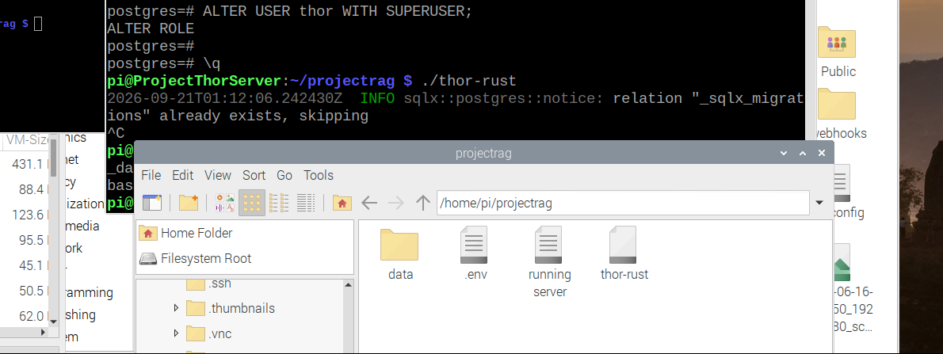
Test Rust server on Raspberry Pi
Run the webserver on the Raspberry Pi and tackle any bugs that could arise while preparing the product.

Slide 3
Integrate data fetchers
Fully integrate the data fetchers of different proposed sources of high entropy data. This data will be prepared for efficient storage and security.
https://drive.google.com/file/d/1lUHyrtamfVBrWXlZb8K-dOrh9ZB6GH-n/view?usp=sharing

Slide 4
Entropy analysis and maximization
Gather enough data in order to ensure statistical accuracy in our minimum entropy results for baseline testing

Slide 5
Gather high entropy data sets
Finalize and implement the entropy analysis and maximization tools for the server; this includes a fast implementation of Toeplitz Hashing and SHA-3.

Slide 6
Minimum entropy calculations
Lightning measurements become usable key material only after conservative entropy estimation and extraction.
1
2
3
4
Lightning data
Min-entropy estimate
Toeplitz extractor
256 near-uniform bits
raw timing + sensor samples
NIST SP 800-90B gives h
2-universal hashing
statistical distance ≤ 2⁻⁶⁴
Entropy accumulation
Leftover hash lemma
Hₘᵢₙ(block) ≈ N h
m ≤ k − 2 log₂(1/ε)
Example: h = 0.25 bits/sample
Target: k = 384 bits, m = 256 bits
N ≥ 384 / 0.25 = 1,536 samples
ε ≈ 2⁻⁽³⁸⁴⁻²⁵⁶⁾ ⁄ ² = 2⁻⁶⁴
This multiplication requires an entropy model that supports accumulation across samples.
The 256-bit output lies within 2⁻⁶⁴ statistical distance of a uniform string.
Near-uniform, not perfectly uniform
The Toeplitz seed must be independent of the lightning input. It may be public and need not be secret.
Notes:
Technical assumptions: H_min(block) ≈ N h requires an entropy model that supports accumulation across samples. Toeplitz hashing forms a 2-universal family when selected with a seed independent of the input. The seed need not be secret.

Slide 7
Milestone 4 Matrix
Task | Completion | Aidan | Gianni | Joanna | To Do
1. Test Rust Server on Raspberry Pi | 90% | 10% | 70% | 10% | Integrate database importation and ensure expected behavior continues
2. Data fetchers | 80% | 80% | 0% | 0% | Finalize automated fetch scripts and error handling for dropped API connections.
3. Entropy analysis and maximization | 50% | 50% | 0% | 0% | Complete statistical randomness testing (NIST SP 800-22 suite) on normalized datasets.
4. Gather high entropy data sets with over 10^6 samples | 100% | 33% | 33% | 33% | Task completed. Datasets stored and formatted for model ingest.

Slide 8
Milestone 5 Task Matrix
Fully implement and secure the Python API using token-based authentication (OAuth2/JWT).
Integrate NIST-approved Post-Quantum Cryptography (PQC) schemes into the key generation pipeline.
Implement end-to-end database security and access control mechanisms for raw lightning telemetry data.

Slide 9
Thank you for your attention.

