Slide 1
Project Ragnarok:
Post-Quantum Cybersecurity with Lightning data
Team Members: Joanna Zhang, Gianni Bubb,
Aidan Nelappana
Faculty Advisor and Client: Dr. Bhattacharyya
Dr. Amitabh Nag

Slide 2
Goal and Motivation
Address weaknesses in pseudo-random number generation
Use natural lightning data for higher entropy
Prepare cryptography for the post-quantum era
Protect modern systems from quantum-assisted attacks

Slide 3
Approach (key features)
1. Post-Quantum-Resistant Encryption Algorithm
The user will have encryption resistant to quantum-assisted attacks
2. Python API for Secure Random Number Access
The user has access to random numbers through a python API. Improving the ease of access and implementation of generated keys. Which includes a continuously updated database.
3. Non-Deterministic Key Generation via Lightning Data
Mathematically prove high entropy in the random numbers and meet NIST standards. Ensuring the project will be of use to computer scientists and cryptography researchers.
Notes:
The user will be able to access random numbers through a python API. The previous project wanted to implement a better way to access their generated keys. The API will improve the ease of accessing and implementation of generated keys. The database will be updated continuously with new data. The previous project implemented an elementary way of entropy maximization without any guaranteed theoretical backing. We want to improve upon the random number generation by using mathematical formulations to prove that these random numbers are truly random, and meet the NIST standards. This will ensure that the project will be of use to computer scientists and cryptography researchers.

Slide 4
Novel Feature
Novel Feature 1: Lightning-Based Entropy Generation
Real-world lightning data as a source of high-entropy randomness while incorporating post-quantum cryptographic principles.
Notes:
By combining natural, non-deterministic entropy with NIST-aligned post-quantum algorithms and mathematically validated randomness, the system goes beyond traditional cryptosystems and prepares secure encryption mechanisms for the emerging quantum computing era.

Slide 5
Algorithms and Tools
Rust
FastAPI
Existing encryption schemes and post-quantum encryption algorithms approved by NIST

Slide 6
Technical Challenges
Understanding cryptographic system design
Measuring and maximizing entropy
Designing secure Python APIs
Securing databases
Building and porting a server to Raspberry Pi

Slide 7
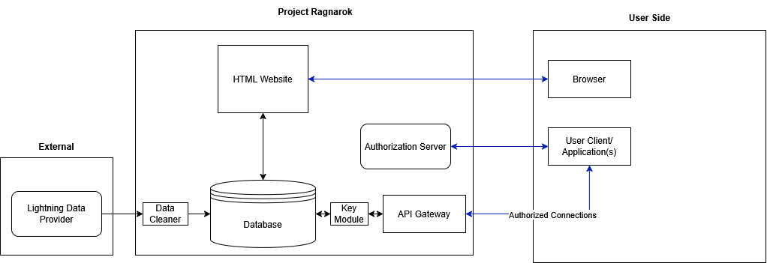
Design

Slide 8
Evaluation Categories
Entropy & Randomness Quality
Ensure non-deterministic, true randomness by following NIST standards and using NIST test suites
Post-Quantum Security
Theoretical verification against known quantum attack models (Shor’s and Grover’s algorithms) matching NIST Security Category 1–5 standards.
System Latency & Throughput
Key generation response time under 500ms via the Python API endpoint running on the Raspberry Pi target hardware.
Reliability
99.5% server uptime over a 7-day continuous run during continuous data ingestion and key generation cycles.
Notes:
Pass 100% of the NIST SP 800-22 and NIST SP 800-90B statistical test suites across $10^6$ sample batches to ensure non-deterministic, true randomness.

Slide 9
Development Progress
Module/feature | Completion % | To do
PQC Encryption Layer | 20% | Implement NIST post-quantum key generation using entropy seeds.
API Backend | 30% | Build Python API routes and token authentication.
Frontend Website | 20% | Design user interface for requesting and managing keys.

Slide 10
Milestone 4
Run the webserver on the Raspberry Pi and tackle any bugs that could arise while preparing the product.
Fully integrate the data fetchers of different proposed sources of high entropy data. This data will be prepared for efficient storage and security.
Finalize and implement the entropy analysis and maximization tools for the server; this includes a fast implementation of Toeplitz Hashing and SHA-3.
Gather enough data in order to ensure statistical accuracy in our minimum entropy results for base line testing

Slide 11
Milestone 4 Task Matrix
Task | Aidan | Gianni | Joanna
1. Test Rust Server on Raspberry Pi | Will assist with any debugging | Lead testing on Raspberry Pi and ensure features work as expected. | Will assist with any debugging
2. Data fetchers | Build and rollout fully integrated high entropy data fetchers and test min entropy | Support with API integration | Support with Server integration and security
3. Entropy analysis and maximization | Will gather 10^6 data points per data set and run NIST 800-90B entropy testing suite | Support with API integration | Support with server integration
4. Gather high entropy data sets with over 10^6 samples | Construct and deploy the data fetchers | Assist wherever needed | Assist wherever needed

Slide 12
Milestone 5
Fully implement and secure the Python API using token-based authentication (OAuth2/JWT).
Integrate NIST-approved Post-Quantum Cryptography (PQC) schemes into the key generation pipeline.
Implement end-to-end database security and access control mechanisms for raw lightning telemetry data.

Slide 13
Milestone 6
Conduct comprehensive benchmark testing (NIST statistical suites, API load testing, and latency checks on the Raspberry Pi).
Conduct security auditing of API authorization and database access roles.
Finalize project documentation, user user guides, and perform final product demonstration.

Slide 14
Thank you for your attention.

