Slide 1
Project Ragnarok: Milestone 5
Post-Quantum Cybersecurity with Lightning data
Team Members: Joanna Zhang, Gianni Bubb,
Aidan Nelappana
Faculty Advisor and Client: Dr. Bhattacharyya
Dr. Amitabh Nag

Slide 2
API authentication and integration
Implemented bearer-token authentication, role checks, and browser login.
Integrated the Python API and fixed Rust/Docker build issues.
Next: complete OAuth2/JWT, rate limiting, and API testing on the Pi.
Notes:
Joanna led authentication and role checks. Aidan integrated browser and application workflows. Gianni developed the Python API and resolved Rust/Docker build issues. Future work: OAuth2/JWT, rate limiting and Pi endpoint verification.

Slide 3
Entropy assessment and extraction
Assessed 1,000,000 lightning events with the NIST non-IID tool to estimate unpredictability.
Timestamp bytes: 7.2621 bits per 8-bit sample. Amplitude bytes: 3.6798. These estimates cannot simply be added.
Implemented SHA3 and Toeplitz extraction. Toeplitz converts 128 source bytes into 256 output bits using a fresh public seed.
Next: validate dependence and joint input entropy, collect restart data, and add source-health tests.
Notes:
Entropy describes how difficult the source is to predict. We assessed one million lightning events before hashing or mixing in operating-system randomness. We tested timestamp low bytes, timestamp low bits and signed-amplitude low bytes separately. The NIST non-IID estimates were 7.2621 bits per 8-bit timestamp sample, 0.8210 bits per 1-bit timestamp sample and 3.6798 bits per 8-bit amplitude sample. These are corpus estimates, not proof of independent samples or a validated secret-key entropy budget.
SHA3 provides deterministic conditioning. Our Toeplitz implementation consumes 128 previously unused source bytes (1,024 input bits) and obtains a fresh 1,279-bit public OS seed to select the matrix for a 256-bit output. We retain the seed, consumed sample range and hashes so the calculation can be reproduced. The seed receives no lightning-entropy credit, and anyone with the complete input and seed can reproduce the result.
Future work is to confirm sensor and timestamp behavior, assess dependence on unseen data, justify a conservative joint entropy bound, collect genuine restart data and calibrate repetition-count/adaptive-proportion health tests. The present per-symbol estimate alone does not guarantee 256 secret output bits.
Sources: Lightning entropy assessment (October 15, 2026); Toeplitz extraction proof and implementation evidence and provisional source model (October 26, 2026).
https://csrc.nist.gov/pubs/sp/800/90/b/final

Slide 4
Database security and Raspberry Pi
Added parameterized queries, input validation, and application access controls.
Loaded the updated application on the Pi and got automatic importers working.
Next: verify DB roles, TLS, telemetry encryption, logs, and full Pi operation.
Notes:
Joanna led database security preparation. Aidan contributed application hardening and integration. Gianni supported Pi deployment and automatic importers. Restricted roles, TLS, telemetry encryption, scrubbed logs and complete hardware operation require verification.

Slide 5
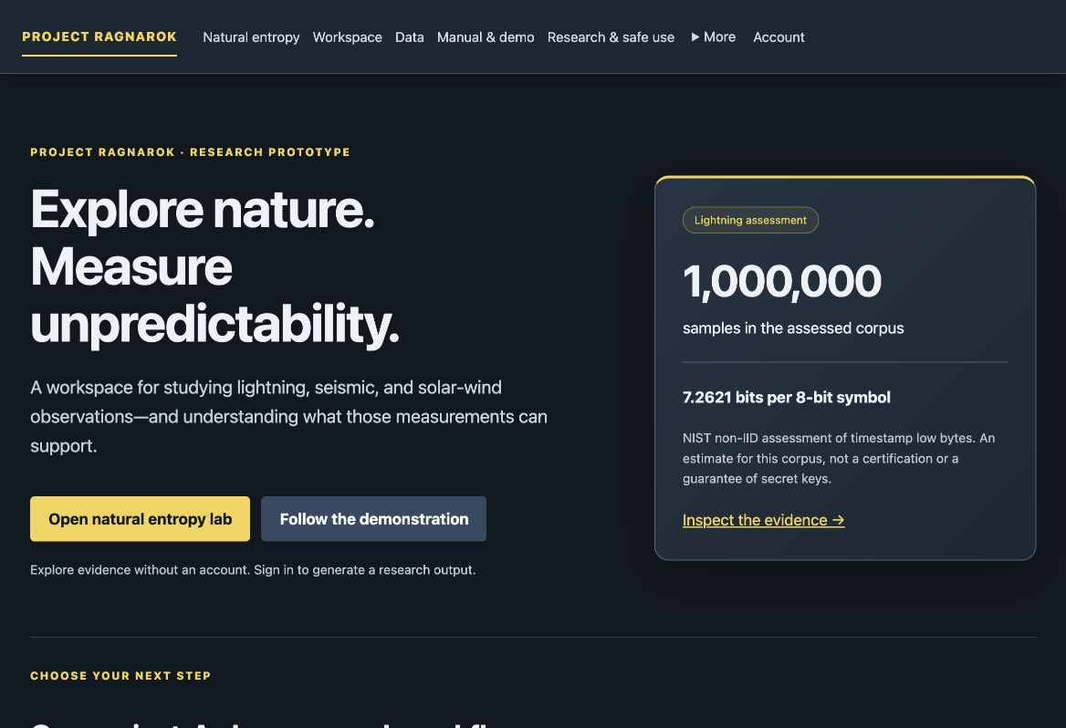
Project website
Notes:
Screenshot of the running Project Ragnarok website, captured October 26, 2026.

Slide 6
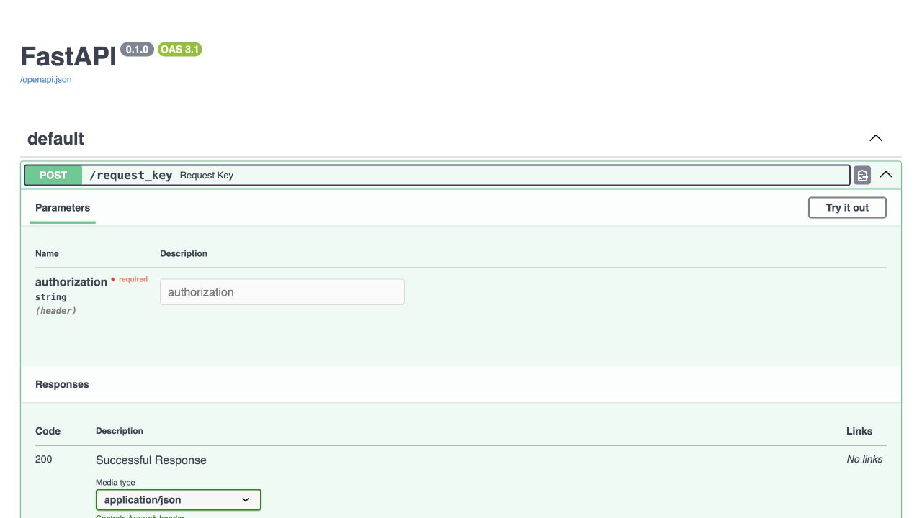
Python API documentation
Notes:
Screenshot of the actual FastAPI documentation. The documented POST /request_key endpoint requires an authorization header. The displayed 200 response is a documentation example, not a captured successful request.

Slide 7
Milestone 5 Matrix
Task / completion | Aidan | Gianni | Joanna | To Do
1. API authentication 70% complete | 15% | 45% | 10% | Complete OAuth2/JWT, rate limiting, and Pi endpoint verification.
2. Entropy assessment and research website 80% complete | 60% | 10% | 10% | Integrate and test a NIST-approved PQC scheme. Extraction is supporting work.
3. Database security and Pi deployment 70% complete | 30% | 20% | 20% | Verify restricted DB roles, TLS, telemetry encryption, and scrubbed audit logs.
Notes:
Completion and member percentages reproduce the evaluation. Task 2 reflects entropy/research supporting work, with NIST-approved PQC integration unfinished.
Source: Milestone 5 Progress Evaluation (October 26, 2026)
https://docs.google.com/document/d/1diCN2Wz454ztZ5JlQbeVHX785ENQ_TKF3QcP85OhsRQ/edit

Slide 8
Milestone 6 Matrix
Task | Aidan | Gianni | Joanna
1. Complete authentication and PQC | Key pipeline/PQC | Python API/JWT | RBAC/auth tests
2. Finalize entropy research and validation | Lead assessment | Pi data collection | Dataset validation
3. Validate Pi deployment and security | Integration fixes | Lead Pi testing | Lead DB security
4. Finish GUI, documentation, and demo | GUI/manual/demo | Setup/runbook | Usability/review
Notes:
All four next-milestone assignments reproduce the evaluation. Acceptance includes authentication/role tests, PQC interoperability, reproducible assessment and stated entropy assumptions, sustained Pi reliability and load/latency measurements, DB security verification, and an end-to-end demo using the guide.
Source: Milestone 5 Progress Evaluation (October 26, 2026)
https://docs.google.com/document/d/1diCN2Wz454ztZ5JlQbeVHX785ENQ_TKF3QcP85OhsRQ/edit

Slide 9
Thank you for your attention.

