Slide 1
Project Ragnarok:
Post-Quantum Cybersecurity with Lightning data Milestone 3 Presentation
Team Members: Joanna Zhang, Gianni Bubb,
Aidan Nelappana
Faculty Advisor and Client: Dr. Bhattacharyya
Dr. Amitabh Nag

Slide 2
Task: Complete backend integration
We have implemented basic backend integration with our python api and are laying the foundation for integration with the NIST 800-90B and open quantum safe libraries

Slide 3
Task: Complete the NIST 800-90B wrapper
Completed the rust wrappers for the nist 800-90B entropy testing suite
Still needs to be published to cargo

Slide 4
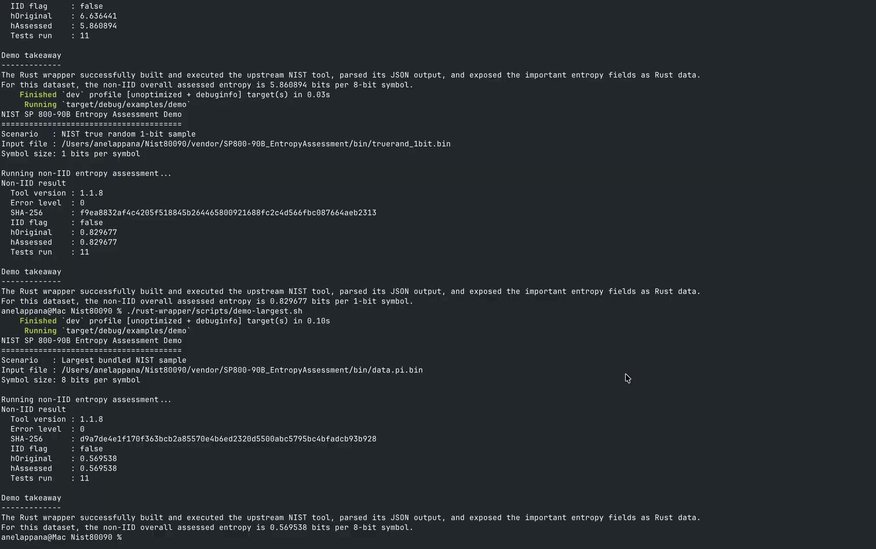
Wrapper Demo

Slide 5
Task: Implement API & routing
Completed integration with Rust server
Requests return successfully in JSON format

Slide 6

Python API Wrapper Demo

Slide 7
Task: Strengthen security controls
Building the frontend authentication layer for an API
Implement hybrid PQ data encryption

Slide 8
Milestone 3 Matrix
Task | Completion % | Aidan | Gianni | Joanna | To Do
1.Complete data fetchers | 40% | 40% | 0% | 0% | Integrate the data fetchers into the API and the database
2.Entropy testing wrappers | 98% | 98% | 0% | 0% | Publish to cargo and integrate with server
3.Finalize API & routing | 90% | 30% | 50% | 0% | More testing and features as necessary
4.Strengthen security controls | 40% | 0% | 0% | 40% | Continue with frontend integration

Slide 9
Milestone 4 Tasks Matrix
Task | Aidan | Gianni | Joanna
1. Test Rust Server on Raspberry Pi | Will assist with any debugging | Lead testing on Raspberry Pi and ensure features work as expected. | Will assist with any debugging
2. Data fetchers | Build and rollout fully integrated high entropy data fetchers and test min entropy | Support with API integration | Support with Server integration and security
3. Entropy analysis and maximization | Will gather 10^6 data points per data set and run NIST 800-90B entropy testing suite | Support with API integration | Support with server integration
4. Gather high entropy data sets with over 10^6 samples | Construct and deploy the data fetchers | Assist wherever needed | Assist wherever needed

Slide 10
Thank you for your attention.

