Slide 1
Project Ragnarok:
Post-Quantum Cybersecurity with Lightning data Milestone 2 Presentation
Team Members: Joanna Zhang, Gianni Bubb,
Aidan Nelappana
Faculty Advisor and Client: Dr. Bhattacharyya
Dr. Amitabh Nag

Slide 2
Rewriting Thor Server
Previous project web server was written with PHP and Python
Rewritten in rust
MySQL to PostgreSQL
Notes:
Due to complication and challenges with the original Project Thor, we were advised to rewrite project thor.

Slide 3
Updated system architecture
Addition of external lightning data provider module
Python API as wrapper clarification
Tackling possible concerns
Handling private keys via API
Project site as vendor vs per-user instances
Notes:
Design Document being updated to match

Slide 4
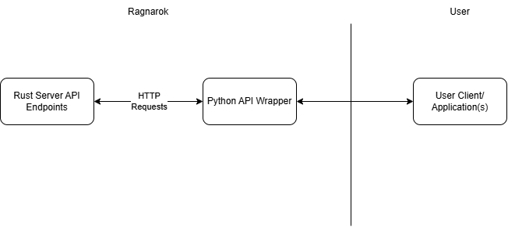
Python API Flow and Architecture

Slide 5
Task: Implement basic Python API
Prototype API written with HTTPX (async HTTP client)
Needs server integration testing

Slide 6
Task: Implement basic Post-Quantum (PQ) algorithms and entropy analysis
Implement wrappers for the NIST 800-90b entropy testing libraries in rust
Implement wrappers for the Open Quantum safe project in python and rust

Slide 7
Task: Database security remediation & fixes
Added authorization
Added input validation
Improved error handling
SQL injection prevention
Notes:
For this task, I focused on improving database security by implementing several key measures. I added proper authorization controls to ensure only the right users could access sensitive data, implemented input validation to prevent invalid or malicious data from entering the system, and enhanced error handling for safer and more reliable operation. Additionally, I worked to prevent SQL injection attacks, strengthening the system against one of the most common security threats.

Slide 8

Demo

Slide 9
Milestone 2 Matrix
Task | Completion % | Aidan | Gianni | Joanna | To Do
1. Migrating Project thor | 100% | 100% | 0% | 0% | Completed migration of all features for the legacy project thor
2.Backend integration | 80% | 40% | 20% | 20% | Resolve async issues and ensure full module communication
3.Entropy analysis and PQ algorithm implementation | 50% | 25% | 25% | 0% | Optimize performance and complete remaining wrappers
4.Database security fixes | 90% | 10% | 10% | 70% | Conduct final testing and validation

Slide 10
Milestone 3 Tasks Matrix
Task | Aidan | Gianni | Joanna
1.Complete backend integration | Finalize API-to-database connections and fix remaining bugs | Assist with debugging and ensure routing stability | Verify secure data handling and validate inputs
2.PQ algorithms and Entropy testing wrappers | Assist with testing and benchmarking | Improve algorithm efficiency | Document performance results and security implications
3.Finalize API & routing | Support endpoint testing and integration | Complete all routes and ensure proper request handling | Perform security testing on endpoints
4.Strengthen security controls | Assist with testing security features | Support implementation of secure practices | Implement additional validation, authorization checks, and system hardening

Slide 11
Thank you for your attention.

