Slide 1

Probabilistic Model Checking
Marta Kwiatkowska
Gethin Norman
Dave Parker
University of Oxford
Part 9 - PRISM

Slide 2
Overview
Tool support for probabilistic model checking
  motivation, existing tools
The PRISM model checker
  functionality, features
  resources
  modelling language
  property specification
PRISM tool demo

Slide 3
Motivation
Complexity of PCTL model checking
  generally polynomial in model size (number of states)
State space explosion problem
  models for realistic case studies are typically huge
Clearly tool support is required
Benefits:
  fully automated process
  high-level languages/formalisms for building models
  visualisation of quantitative results

Slide 4
Probabilistic model checkers
PRISM (this talk)
  DTMCs, MDPs, CTMCs + rewards
ETMCC/MRMC
  DTMCs, CTMCs + reward extensions
MDP tools
  LiQuor: LTL verification for MDPs (Probmela language)
  RAPTURE: prototype for abstraction/refinement of MDPs
Simulation-based probabilistic model checking:
  APMC, Ymer (both based on PRISM language), VESTA
CSL model checking for CTMCs:
  APNN-Toolbox, SMART
Multiple formalism/tool solutions:
  CADP, Möbius

Slide 5
Overview
Tool support for probabilistic model checking
  motivation, existing tools
The PRISM model checker
  functionality, features
  resources
  modelling language
  property specification
PRISM tool demo

Slide 6

The PRISM tool
PRISM: Probabilistic symbolic model checker
  developed at the Birmingham/Oxford University, since 1999
  free, open source (GPL)
  versions for Linux, Unix, Mac OS X, Windows, 64-bit OSs
Modelling of:
  DTMCs, MDPs, CTMCs + costs/rewards
Verification of:
  PCTL, CSL + extensions + costs/rewards
Features:
  high-level modelling language, wide range of model analysis methods, graphical user interface, efficient implementation

Slide 7
Getting PRISM + Other Resources
PRISM website: www.prismmodelchecker.org
  tool download: binaries, source code (GPL)
  on-line example repository (40+ case studies)
  on-line documentation:
    PRISM manual
    PRISM tutorial
  support: help forum, bug tracking, feature requests
    hosted on Sourceforge
  related publications, talks, tutorials, links

Slide 8
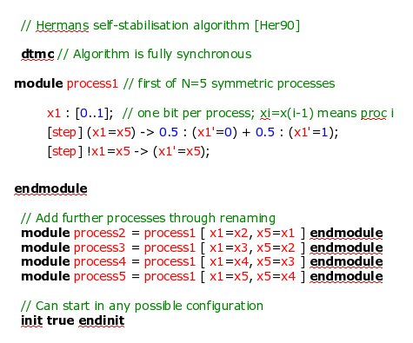
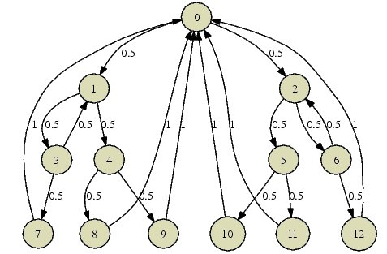
PRISM – Model building
First step of verification = construct full probabilistic model (not always necessary in non-probabilistic model checking)
High-level
model
DTMC, CTMC,
MDP
(PRISM
language)
(matrix,
MTBDD, ...)

Slide 9
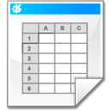

PRISM – Imports and exports
Support for connections to other formats/tools:
Exports:
High-level
model
DTMC, CTMC,
MDP
Imports:
Text
Matlab
PEPA
MRMC
Text
(PRISM
language)
(matrix,
MTBDD, ...)
Dot
In progress:
probabilistic CSP,
pi calculus, SBML,
Probmela, ...

Slide 10
PRISM modelling language
Simple, state-based language for DTMCs/MDPs/CTMCs
  based on Reactive Modules [AH99]
Modules (system components, composed in parallel)
Variables (finite-valued, local or global)
Guarded commands (labelled with probabilities/rates)
Synchronisation (CSP-style) + process-algebraic operators (parallel composition, action hiding/renaming)
  [send] (s=2) -> p_{loss} : (s'=3)&(lost'=lost+1) + (1-p_{loss}) : (s'=4);
  action
  guard
  probability
  update
  probability
  update

Slide 11
PRISM language example
// Herman's self-stabilisation algorithm [Her90]
dtmc // Algorithm is fully synchronous
module process1 // First of N=5 symmetric processes
x1 : [0..1]; // One bit per process; xi=x(i-1) means proc i has a token
[step] (x1=x5) -> 0.5 : (x1'=0) + 0.5 : (x1'=1);
[step] !x1=x5 -> (x1'=x5);
endmodule
// Add further processes through renaming
module process2 = process1 [ x1=x2, x5=x1 ] endmodule
module process3 = process1 [ x1=x3, x5=x2 ] endmodule
module process4 = process1 [ x1=x4, x5=x3 ] endmodule
module process5 = process1 [ x1=x5, x5=x4 ] endmodule
// Can start in any possible configuration
init true endinit

Slide 12
PRISM language example 2 (fragment)
// Embedded control system
ctmc
const int MIN_SENSORS = 2;
const double lambda_p = 1/(365*24*60*60); // MTTF = 1 year
...
module sensors
s : [0..3] init 3; // Number of sensors working
[] s>1 -> s*lambda_s : (s'=s-1); // Failure of a single sensor
endmodule
module proci // (takes data from sensors and passes onto main processor)
i : [0..2] init 2; // 2=ok, 1=transient fault, 0=failed
[] i>0 & s>=MIN_SENSORS -> lambda_p : (i'=0); // Failure of processor
[] i=2 & s>=MIN_SENSORS -> delta_f : (i'=1); // Transient fault
[reboot] i=1 & s>=MIN_SENSORS -> delta_r : (i'=2); // Transient reboot
endmodule

Slide 13
Costs and rewards
Real-valued quantities assigned to model states/transitions
  many possible uses, e.g. time, power consumption, current queue size, number of messages lost, ...
No distinction between costs (“bad”) and rewards (“good”)
  PRISM terminology is rewards
The meaning of these rewards varies depending on:
  the type of property used to analyse the model:
  instantaneous or cumulative

Slide 14
Rewards in the PRISM language
rewards “total_queue_size”
true : queue1+queue2;
endrewards
rewards “time”
true : 1;
endrewards
(instantaneous, state rewards)
(cumulative, state rewards)
rewards “power”
sleep=true : 0.25;
sleep=false : 1.2 * up;
endrewards
rewards "dropped"
[receive] q=q_max : 1;
endrewards
(cumulative, state rewards)
(up = number of operational components)
(cumulative, transition rewards)
(q = queue size, q_max = max queue size)

Slide 15
PRISM property specifications
Based on (probabilistic extensions of) temporal logic
  incorporates PCTL for DTMCs/MDPs, CSL for CTMCs
  also includes: quantitative extensions, costs/rewards
Simple PCTL/CSL example:
  P<0.001 [ true U shutdown ] - “the system eventually shuts down with probability at most 0.001”
Usually focus on quantitative properties:
  P=? [ true U shutdown ] - “what is the probability that the system eventually shuts down?”
  nested probabilistic operators must be probability-bounded

Slide 16
Basic types of property specifications
(Unbounded) reachability:
  P=? [ true U shutdown ] - “probability of eventual shutdown”
Transient/time-bounded properties:
  P=? [ true U[t,t] (deliv_rate < min) ] - “probability that the packet delivery rate has dropped below minimum at time t”
  P=? [ !repair U≤200 done ] - “probability of the process completing within 200 hours and without requiring repairs”
Steady-state properties:
  S=? [ num_sensors ≥ min ] - “long-run probability that an adequate number of sensors are operational”

Slide 17
Cost- and reward-based properties
Two different interpretations of model rewards
  instantaneous and cumulative properties
  reason about expected values of rewards
Instantaneous reward properties
  state rewards only
  state-based measures: “queue size”, “number of operational channels”, “concentration of reactant X”, ...
R=? [ I=t ]
  e.g. “expected size of the message queue at time t?”
R=? [ S ]
  e.g. “long-run expected size of the queue?”

Slide 18
Cost- and reward-based properties
Cumulative reward properties
  both state and transition rewards
  CTMC state rewards interpreted as reward rates
  e.g. “time”, “power consumption”, “number of messages lost”
R=? [ F end ]
  e.g. “expected time taken for the protocol to terminate?”
R=? [ C≤2 ]
  e.g. “expected power consumption during the first 2 hours that the system is in operation?”
  e.g. “expected number of messages lost during...”

Slide 19
Best/worst-case scenarios
Combining “quantitative” and “exhaustive” aspects
Computing values for a range of states
  R=? [ F end {“init”}{max} ] - “maximum expected run-time over all possible initial configurations”
  P=? [ true U≤t elected {tokens≤k}{min} ] - “minimum probability of the leader election algorithm completing within t steps from any state where there are at most k tokens”
All possible resolutions of nondeterminism (MDPs)
  Pmin=? [ !end2 U end1 ] - “minimum probability of process 1 finishing before process 2, for any scheduling of processes?”
  Rmax=? [ F message_delivered ] - “maximum expected number of bits revealed under any eavesdropping strategy?”

Slide 20
Identifying trends and anomalies
Counterexamples (error traces)
  widely used in non-probabilistic model checking
  situation much less clear in probabilistic model checking
  counterexample for P<p [true U error] ? and for P=? [ ... ] ?
  work in progress...
Experiments: ranges of model/property parameters
  e.g. P=? [ true U≤T error ] for N=1..5, T=1..100
  where N is some model parameter and T a time bound
  identify patterns, trends, anomalies in quantitative results

Slide 21
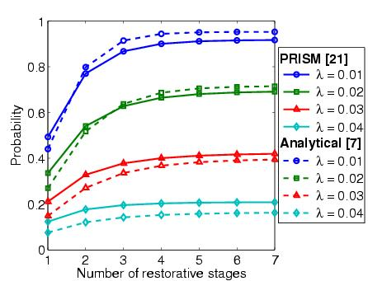
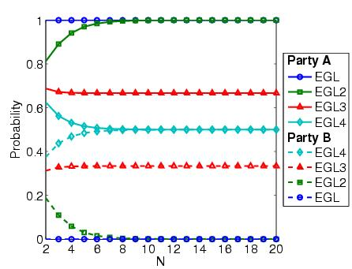
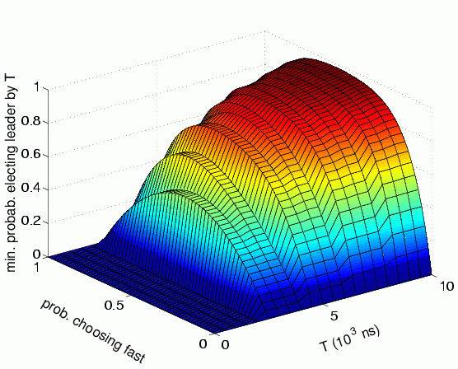
Probability that 10% of gate outputs are erroneous for varying
gate failure rates and numbers of stages
Probability that parties gain unfair advantage for varying numbers of secret packets sent
Optimum probability of leader election by time T for various coin biases

Slide 22
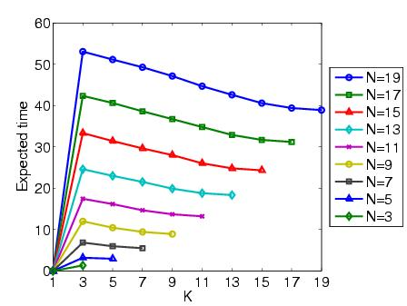
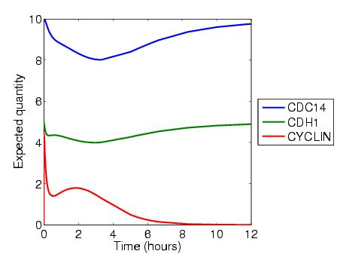
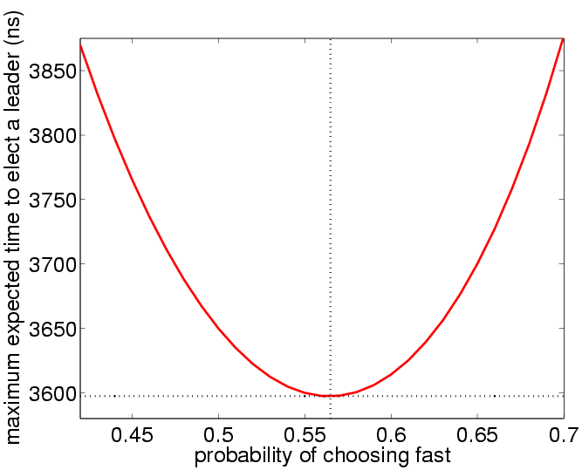
Worst-case expected number of steps to stabilise for initial configurations with K tokens amongst N processes
Expected reactant concentrations over the first 12 hours
Maximum expected time for leader election for various coin biases

Slide 23
PRISM functionality
Graphical user interface
  model/property editor
  discrete-event simulator - model traces for debugging, etc.
  verification of PCTL, CSL + costs/rewards, etc.
  approximate verification using simulation + sampling
  easy automation of verification experiments
  graphical visualisation of results
Command-line version
  same underlying verification engines
  useful for scripting, batch jobs

Slide 24
Overview
Tool support for probabilistic model checking
  motivation, existing tools
The PRISM model checker
  functionality, features
  resources
  modelling language
  property specification
PRISM tool demo

