Slide 1

Probabilistic Model Checking
Marta Kwiatkowska
Dave Parker
Oxford University Computing Laboratory
ESSLLI’10 Summer School, Copenhagen, August 2010

Slide 2
Course overview
5 lectures: Mon-Fri, 11am-12.30pm
  Introduction
  1 – Discrete time Markov chains
  2 – Markov decision processes
  3 – Continuous-time Markov chains
  4 – Probabilistic model checking in practice
  5 – Probabilistic timed automata
Course materials available here:
  http://www.prismmodelchecker.org/lectures/esslli10/
  lecture slides, reference list

Slide 3
Part 2
Markov decision processes

Slide 4
Other probabilistic models
What’s missing from DTMCs?
Nondeterminism
  Markov decision processes (MDPs)…
Real-time
  continuous-time Markov chains (CTMCs)
    exponentially distributed delays
  probabilistic timed automata (PTAs)
    real-valued clocks, discrete probabilistic choice, nondeterminism

Slide 5
Overview (Part 2)
Markov decision processes (MDPs)
Adversaries & probability spaces
PCTL for MDPs
PCTL model checking
Further model checking (LTL, costs & rewards)
Case study: Firewire root contention

Slide 6
Nondeterminism
Some aspects of a system may not be probabilistic and should not be modelled probabilistically; for example:
Concurrency - scheduling of parallel components
  e.g. randomised distributed algorithms - multiple probabilistic processes operating asynchronously
Underspecification - unknown model parameters
  e.g. a probabilistic communication protocol designed for message propagation delays of between d_{min} and d_{max}
Unknown environments
  e.g. probabilistic security protocols - unknown adversary

Slide 7
Markov decision processes
Markov decision processes (MDPs)
  extension of DTMCs which allow nondeterministic choice
Like DTMCs:
  discrete set of states representing possible configurations of the system being modelled
  transitions between states occur in discrete time-steps
Probabilities and nondeterminism
  in each state, a nondeterministic
  choice between several discrete
  probability distributions over
  successor states
{heads}
{init}
s₂
a
1
0.5
a
1
s₀
s₁
c
1
0.7
s₃
a
b
0.5
0.3
{tails}

Slide 8
Markov decision processes
Formally, an MDP M is a tuple (S,s_{init},Steps,L) where:
  S is a finite set of states (“state space”)
  s_{init} ∈ S is the initial state
  Steps : S → 2^{Act×Dist(S)} is the transition probability function
  where Act is a set of actions and Dist(S) is the set of discrete probability distributions over the set S
  L : S → 2^{AP} is a labelling with atomic propositions
Notes:
  Steps(s) is always non-empty,
  i.e. no deadlocks
  the use of actions to label
  distributions is optional
{heads}
{init}
s₂
a
1
0.5
a
1
s₀
s₁
c
1
0.7
s₃
a
b
0.5
0.3
{tails}

Slide 9
Simple MDP example
Modification of the simple DTMC communication protocol
  after one step, process starts trying to send a message
  then, a nondeterministic choice between: (a) waiting a step because the channel is unready; (b) sending the message
  if the latter, with probability 0.99 send successfully and stop
  and with probability 0.01, message sending fails, restart
restart
1
{fail}
s₂
{try}
0.01
s₀
start
s₁
send
1
stop
0.99
s₃
1
1
wait
{succ}

Slide 10
Example - Parallel composition
1
Asynchronous parallel
composition of two
3-state DTMCs
Action labels
omitted here
0.5
t₀
0.5
t₁
t₂
1
1
s₀
0.5
s₀ t₀
0.5
s₀ t₁
s₀ t₂
1
1
0.5
1
0.5
1
0.5
1
0.5
1
s₁
0.5
s₁ t₀
0.5
s₁ t₁
s₁ t₂
1
0.5
0.5
0.5
0.5
1
s₂
0.5
s₂ t₀
0.5
s₂ t₁
s₂ t₂
1
1
1
1
1

Slide 11
Paths and probabilities
A (finite or infinite) path through an MDP
  is a sequence of states and action/distribution pairs
  e.g. s₀(a₀,μ₀)s₁(a₁,μ₁)s₂…
  such that (a_{i},μ_{i}) ∈ Steps(s_{i}) and μ_{i}(s_{i+1}) > 0 for all i≥0
  represents an execution (i.e. one possible behaviour) of the system which the MDP is modelling
  note that a path resolves both types of choices: nondeterministic and probabilistic
To consider the probability of some behaviour of the MDP
  first need to resolve the nondeterministic choices
  …which results in a DTMC
  …for which we can define a probability measure over paths

Slide 12
Overview (Part 2)
Markov decision processes (MDPs)
Adversaries & probability spaces
PCTL for MDPs
PCTL model checking
Further model checking (LTL, costs & rewards)
Case study: Firewire root contention

Slide 13
Adversaries
An adversary resolves nondeterministic choice in an MDP
  also known as “schedulers”, “strategies” or “policies”
Formally:
  an adversary A of an MDP M is a function mapping every finite
  path ω= s₀(a₁,μ₁)s₁...s_{n} to an element of Steps(s_{n})
For each A can define a probability measure Pr^{A}_{s} over paths
  constructed through an infinite state DTMC (Path^{A}_{fin}(s),s,P^{A}_{s})
  states of the DTMC are the finite paths of A starting in state s
  initial state is s (the path starting in s of length 0)
  P^{A}_{s}(ω,ω’)=μ(s) if ω’= ω(a, μ)s and A(ω)=(a,μ)
  P^{A}_{s}(ω,ω’)=0 otherwise

Slide 14
Adversaries - Examples
Consider the simple MDP below
  note that s₁ is the only state for which |Steps(s)| > 1
  i.e. s₁ is the only state for which an adversary makes a choice
  let μ_{b} and μ_{c} denote the probability distributions associated with actions b and c in state s₁
Adversary A₁
  picks action c the first time
  A₁(s₀s₁)=(c,μ_{c})
Adversary A₂
  picks action b the first time, then c
  A₂(s₀s₁)=(b,μ_{b}), A₂(s₀s₁s₁)=(c,μ_{c}), A₂(s₀s₁s₀s₁)=(c,μ_{c})
{heads}
{init}
s₂
a
1
0.5
a
1
s₀
s₁
c
1
0.7
s₃
a
b
0.5
0.3
{tails}

Slide 15
Adversaries - Examples
Fragment of DTMC for adversary A₁
  A₁ picks action c the first time
{heads}
{init}
s₂
a
1
0.5
a
1
s₀
s₁
c
1
0.7
s₃
a
b
0.5
0.3
{tails}
1
0.5
s₀s₁s₂
s₀s₁s₂s₂
1
s₀
s₀s₁
0.5
s₀s₁s₃
s₀s₁s₃s₃
1

Slide 16
Adversaries - Examples
{heads}
Fragment of DTMC for adversary A₂
  A₂ picks action b, then c
{init}
s₂
a
1
0.5
a
1
s₀
s₁
c
1
0.7
s₃
a
b
0.5
0.3
{tails}
0.5
s₀s₁s₀s₁s₂
1
s₀s₁s₀
s₀s₁s₀s₁
0.7
s₀s₁s₀s₁s₃
1
0.5
s₀
s₀s₁
1
0.5
s₀s₁s₁s₂
s₀s₁s₁s₂s₂
0.3
s₀s₁s₁
0.5
s₀s₁s₁s₃
s₀s₁s₁s₃s₃
1

Slide 17
Memoryless adversaries
Memoryless adversaries always pick same choice in a state
  also known as: positional, Markov, simple
  formally, for adversary A:
  A(s₀(a₁,μ₁)s₁...s_{n}) depends only on s_{n}
  resulting DTMC can be mapped to a |S|-state DTMC
From previous example:
  adversary A₁ (picks c in s₁) is memoryless, A₂ is not
{heads}
{heads}
{init}
s₂
{init}
s₂
a
1
0.5
a
a
1
0.5
a
1
1
s₀
s₁
c
1
s₀
s₁
c
1
0.7
s₃
a
s₃
a
b
0.5
0.5
0.3
{tails}
{tails}

Slide 18
Overview (Part 2)
Markov decision processes (MDPs)
Adversaries & probability spaces
PCTL for MDPs
PCTL model checking
Further model checking (LTL, costs & rewards)
Case study: Firewire root contention

Slide 19
PCTL for MDPs
The temporal logic PCTL can also describe MDP properties
Identical syntax to the DTMC case:
  φ ::= true | a | φ ∧ φ | ¬φ | P_{~p} [ ψ ] (state formulas)
  ψ ::= X φ | φ U^{≤k} φ | φ U φ (path formulas)
Semantics are also the same as DTMCs for:
  atomic propositions, logical operators, path formulas
ψ is true with probability ~p
“bounded until”
“next”
“until”

Slide 20
PCTL semantics for MDPs
Semantics of the probabilistic operator P
  can only define probabilities for a specific adversary A
  s ⊨ P_{~p} [ ψ ] means “the probability, from state s, that ψ is true for an outgoing path satisfies ~p for all adversaries A”
  formally s ⊨ P_{~p} [ ψ ] ⇔ Prob^{A}(s, ψ) ~ p for all adversaries A
  where Prob^{A}(s, ψ) = Pr^{A}_{s} { ω ∈ Path^{A}(s) | ω ⊨ ψ }
¬ψ
s
ψ
Prob^{A}(s, ψ) ~ p

Slide 21
Minimum and maximum probabilities
Letting:
  p_{max}(s, ψ) = sup_{A} Prob^{A}(s, ψ)
  p_{min}(s, ψ) = inf_{A} Prob^{A}(s, ψ)
We have:
  if ~ ∈ {≥,>}, then s ⊨ P_{~p} [ ψ ] ⇔ p_{min}(s, ψ) ~ p
  if ~ ∈ {<,≤}, then s ⊨ P_{~p} [ ψ ] ⇔ p_{max}(s, ψ) ~ p
Model checking P_{~p}[ ψ ] reduces to the computation over all adversaries of either:
  the minimum probability of ψ holding
  the maximum probability of ψ holding
Crucial result for model checking PCTL on MDPs
  memoryless adversaries suffice, i.e. there are always memoryless adversaries A_{min} and A_{max} for which:
  Prob^{Amin}(s, ψ) = p_{min}(s, ψ) and Prob^{Amax}(s, ψ) = p_{max}(s, ψ)

Slide 22
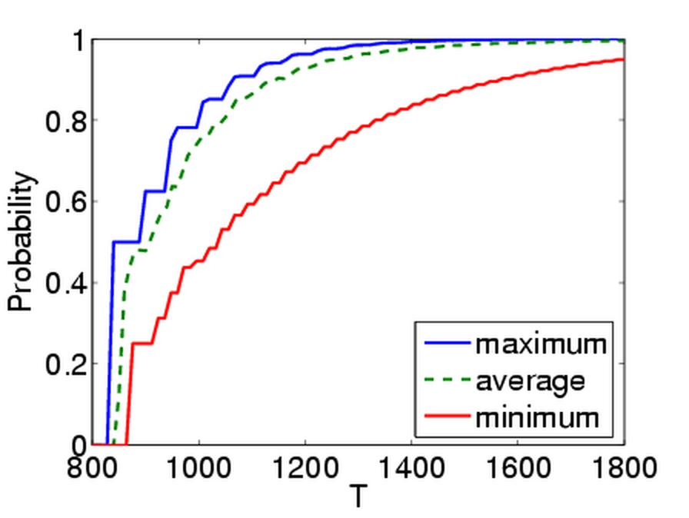
Quantitative properties
For PCTL properties with P as the outermost operator
  quantitative form (two types): Pmin_{=?} [ ψ ] and Pmax_{=?} [ ψ ]
  i.e. “what is the minimum/maximum probability (over all adversaries) that path formula ψ is true?”
  corresponds to an analysis of best-case or worst-case behaviour of the system
  model checking is no harder since compute the values of p_{min}(s, ψ) or p_{max}(s, ψ) anyway
  useful to spot patterns/trends
Example: CSMA/CD protocol
  “min/max probability
  that a message is sent
  within the deadline”

Slide 23
Other classes of adversary
A more general semantics for PCTL over MDPs
  parameterise by a class of adversaries Adv
Only change is:
  s ⊨_{Adv} P_{~p} [ψ] ⇔ Prob^{A}(s, ψ) ~ p for all adversaries A ∈ Adv
Original semantics obtained by taking Adv to be the set of all adversaries for the MDP
Alternatively, take Adv to be the set of all fair adversaries
  path fairness: if a state is occurs on a path infinitely often, then each non-deterministic choice occurs infinite often
  see e.g. [BK98]

Slide 24
Some real PCTL examples
Byzantine agreement protocol
  Pmin_{=?} [ F (agreement ∧ rounds≤2) ]
  “what is the minimum probability that agreement is reached within two rounds?”
CSMA/CD communication protocol
  Pmax_{=?} [ F collisions=k ]
  “what is the maximum probability of k collisions?”
Self-stabilisation protocols
  Pmin_{=?} [ F^{≤t} stable ]
  “what is the minimum probability of reaching a stable state within k steps?”

Slide 25
PCTL model checking for MDPs
Algorithm for PCTL model checking [BdA95]
  inputs: MDP M=(S,s_{init},Steps,L), PCTL formula φ
  output: Sat(φ) = { s ∈ S | s ⊨ φ } = set of states satisfying φ
Basic algorithm same as PCTL model checking for DTMCs
  proceeds by induction on parse tree of φ
  non-probabilistic operators (true, a, ¬, ∧) straightforward
Only need to consider P_{~p} [ ψ ] formulas
  reduces to computation of p_{min}(s, ψ) or p_{max} (s, ψ) for all s ∈ S
  dependent on whether ~ ∈ {≥,>} or ~ ∈ {<,≤}
  these slides cover the case p_{min}(s, φ₁ U φ₂), i.e. ~ ∈ {≥,>}
  case for maximum probabilities is very similar
  next (X φ) and bounded until (φ₁ U^{≤k} φ₂) are straightforward extensions of the DTMC case

Slide 26
Overview (Part 2)
Markov decision processes (MDPs)
Adversaries & probability spaces
PCTL for MDPs
PCTL model checking
Further model checking (LTL, costs & rewards)
Case study: Firewire root contention

Slide 27
PCTL until for MDPs
Computation of probabilities p_{min}(s, φ₁ U φ₂) for all s ∈ S
First identify all states where the probability is 1 or 0
  “precomputation” algorithms, yielding sets S^{yes}, S^{no}
Then compute (min) probabilities for remaining states (S?)
  either: solve linear programming problem
  or: approximate with an iterative solution method
  or: use policy iteration
0.5
{a}
Example:
P_{≥p} [ F a ]
≡
P_{≥p} [ true U a ]
s₁
0.4
s₂
1
0.1
1
1
0.5
1
s₀
s₃
0.25
0.25

Slide 28
PCTL until - Precomputation
Identify all states where p_{min}(s, φ₁ U φ₂) is 1 or 0
  S^{yes} = Sat(P_{≥1} [ φ₁ U φ₂ ]), S^{no} = Sat(¬ P_{>0} [ φ₁ U φ₂ ])
Two graph-based precomputation algorithms:
  algorithm Prob1A computes S^{yes}
    for all adversaries the probability of satisfying φ₁ U φ₂ is 1
  algorithm Prob0E computes S^{no}
    there exists an adversary for which the probability is 0
0.5
{a}
S^{yes} = Sat(P_{≥1} [ F a ])
s₁
0.4
s₂
Example:
P_{≥p} [ F a ]
1
0.1
1
1
0.5
1
s₀
s₃
0.25
0.25
S^{no} = Sat(¬P_{>0} [ F a ])

Slide 29
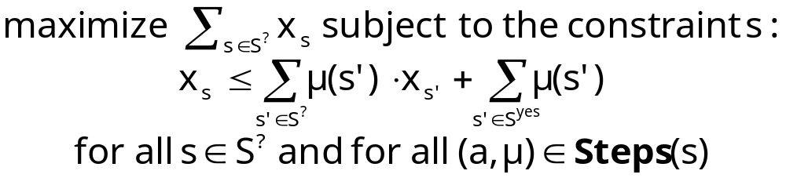
Method 1 - Linear programming
Probabilities p_{min}(s, φ₁ U φ₂) for remaining states in the set S? = S \ (S^{yes} ∪ S^{no}) can be obtained as the unique solution of the following linear programming (LP) problem:
Simple case of a more general problem known as the stochastic shortest path problem [BT91]
This can be solved with standard techniques
  e.g. Simplex, ellipsoid method, branch-and-cut

Slide 30
Example - PCTL until (LP)
0.5
{a}
S^{yes}
Let x_{i} = p_{min}(s_{i}, F a)
S^{yes}: x₂=1, S^{no}: x₃=0
For S? = {x₀, x₁} :
Maximise x₀+x₁ subject to constraints:
  x₀ ≤ x₁
  x₀ ≤ 0.25⋅x₀ + 0.5
  x₁ ≤ 0.1⋅x₀ + 0.5⋅x₁ + 0.4
s₁
0.4
s₂
1
0.1
1
1
0.5
1
s₀
s₃
0.25
0.25
S^{no}

Slide 31
Example - PCTL until (LP)
0.5
{a}
S^{yes}
Let x_{i} = p_{min}(s_{i}, F a)
S^{yes}: x₂=1, S^{no}: x₃=0
For S? = {x₀, x₁} :
Maximise x₀+x₁ subject to constraints:
  x₀ ≤ x₁
  x₀ ≤ 2/3
  x₁ ≤ 0.2⋅x₀ + 0.8
s₁
0.4
s₂
1
0.1
1
1
0.5
1
s₀
s₃
0.25
0.25
S^{no}
x₁
x₁
x₁
1
1
1
  x₀ ≤ x₁
0.8
  x₀ ≤ 2/3
  x₁ ≤ 0.2⋅x₀
  + 0.8
0
x₀
0
x₀
0
x₀
0
1
0
2/3
1
0
1

Slide 32
Example - PCTL until (LP)
0.5
{a}
S^{yes}
Let x_{i} = p_{min}(s_{i}, F a)
S^{yes}: x₂=1, S^{no}: x₃=0
For S? = {x₀, x₁} :
Maximise x₀+x₁ subject to constraints:
  x₀ ≤ x₁
  x₀ ≤ 2/3
  x₁ ≤ 0.2⋅x₀ + 0.8
s₁
0.4
s₂
1
0.1
1
1
0.5
1
s₀
s₃
0.25
0.25
S^{no}
x₁
1
0.8
  Solution:
  (x₀, x₁)
  =
  (2/3, 14/15)
max
x₀
0
x₀
0
2/3
1

Slide 33
Example - PCTL until (LP)
0.5
{a}
S^{yes}
Let x_{i} = p_{min}(s_{i}, F a)
S^{yes}: x₂=1, S^{no}: x₃=0
For S? = {x₀, x₁} :
Maximise x₀+x₁ subject to constraints:
  x₀ ≤ x₁
  x₀ ≤ 2/3
  x₁ ≤ 0.2⋅x₀ + 0.8
s₁
0.4
s₂
1
0.1
1
1
0.5
1
s₀
s₃
0.25
0.25
S^{no}
x₁
1
0.8
  x₁ ≤ 0.2⋅x₀ + 0.8
  x₀ ≤ x₁
  x₀ ≤ 2/3
max
Two memoryless
adversaries
x₀
0
x₀
0
2/3
1

Slide 34
Method 2 – Value iteration
For probabilities p_{min}(s, φ₁ U φ₂) it can be shown that:
  p_{min}(s, φ₁ U φ₂) = lim_{n→∞} x_{s}^{(n)} where:
This forms the basis for an (approximate) iterative solution
  iterations terminated when solution converges sufficiently

Slide 35
Example - PCTL until (value iteration)
0.5
{a}
S^{yes}
Compute: p_{min}(s_{i}, F a)
S^{yes} = {x₂}, S^{no} ={x₃}, S? = {x₀, x₁}
[ x₀^{(n)},x₁^{(n)},x₂^{(n)},x₃^{(n)} ]
n=0: [ 0, 0, 1, 0 ]
n=1: [ min(0,0.25⋅0+0.5),
0.1⋅0+0.5⋅0+0.4, 1, 0 ]
= [ 0, 0.4, 1, 0 ]
n=2: [ min(0.4,0.25⋅0+0.5),
0.1⋅0+0.5⋅0.4+0.4, 1, 0 ]
= [ 0.4, 0.6, 1, 0 ]
n=3: …
s₁
0.4
s₂
1
0.1
1
1
0.5
1
s₀
s₃
0.25
0.25
S^{no}

Slide 36
Example - PCTL until (value iteration)
0.5
{a}
S^{yes}
[ x₀^{(n)},x₁^{(n)},x₂^{(n)},x₃^{(n)} ]
n=0: [ 0.000000, 0.000000, 1, 0 ]
n=1: [ 0.000000, 0.400000, 1, 0 ]
n=2: [ 0.400000, 0.600000, 1, 0 ]
n=3: [ 0.600000, 0.740000, 1, 0 ]
n=4: [ 0.650000, 0.830000, 1, 0 ]
n=5: [ 0.662500, 0.880000, 1, 0 ]
n=6: [ 0.665625, 0.906250, 1, 0 ]
n=7: [ 0.666406, 0.919688, 1, 0 ]
n=8: [ 0.666602, 0.926484, 1, 0 ]
n=9: [ 0.666650, 0.929902, 1, 0 ]
…
n=20: [ 0.666667, 0.933332, 1, 0 ]
n=21: [ 0.666667, 0.933332, 1, 0 ]
≈ [ 2/3, 14/15, 1, 0 ]
s₁
0.4
s₂
1
0.1
1
1
0.5
1
s₀
s₃
0.25
0.25
S^{no}

Slide 37
Example - Value iteration + LP
[ x₀^{(n)},x₁^{(n)},x₂^{(n)},x₃^{(n)} ]
n=0: [ 0.000000, 0.000000, 1, 0 ]
n=1: [ 0.000000, 0.400000, 1, 0 ]
n=2: [ 0.400000, 0.600000, 1, 0 ]
n=3: [ 0.600000, 0.740000, 1, 0 ]
n=4: [ 0.650000, 0.830000, 1, 0 ]
n=5: [ 0.662500, 0.880000, 1, 0 ]
n=6: [ 0.665625, 0.906250, 1, 0 ]
n=7: [ 0.666406, 0.919688, 1, 0 ]
n=8: [ 0.666602, 0.926484, 1, 0 ]
n=9: [ 0.666650, 0.929902, 1, 0 ]
…
n=20: [ 0.666667, 0.933332, 1, 0 ]
n=21: [ 0.666667, 0.933332, 1, 0 ]
≈ [ 2/3, 14/15, 1, 0 ]
x₁
1
0
0
2/3
x₀

Slide 38
Method 3 - Policy iteration
Value iteration:
  iterates over (vectors of) probabilities
Policy iteration:
  iterates over adversaries (“policies”)
1. Start with an arbitrary (memoryless) adversary A
2. Compute the reachability probabilities Prob^{A}(F a) for A
3. Improve the adversary in each state
4. Repeat 2/3 until no change in adversary
Termination:
  finite number of memoryless adversaries
  improvement in (minimum) probabilities each time

Slide 39
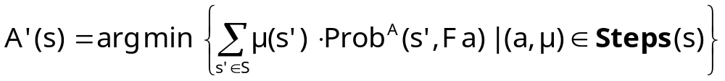
Method 3 - Policy iteration
1. Start with an arbitrary (memoryless) adversary A
  pick some Steps(s) for each state s ∈ S
2. Compute the reachability probabilities Prob^{A}(F a) for A
  probabilistic reachability on a DTMC
  i.e. solve linear equation system
3. Improve the adversary in each state
4. Repeat 2/3 until no change in adversary

Slide 40
Example - Policy iteration
0.5
{a}
S^{yes}
Arbitrary policy A:
Compute: Prob^{A}(F a)
Let x_{i} = Prob^{A}(s_{i}, F a)
x₂=1, x₃=0 and:
x₀ = x₁
x₁ = 0.1⋅x₀ + 0.5⋅x₁ + 0.4
Solution:
Prob^{A}(F a) = [ 1, 1, 1, 0 ]
Refine A in state s₀:
min{1(1), 0.5(1)+0.25(0)+0.25(1)}
= min{1, 0.75} = 0.75
s₁
0.4
s₂
1
0.1
1
1
0.5
1
s₀
s₃
0.25
0.25
S^{no}

Slide 41
Example - Policy iteration
0.5
{a}
S^{yes}
Refined policy A’:
Compute: Prob^{A’}(F a)
Let x_{i} = Prob^{A’}(s_{i}, F a)
x₂=1, x₃=0 and:
x₀ = 0.25⋅x₀ + 0.5
x₁ = 0.1⋅x₀ + 0.5⋅x₁ + 0.4
Solution:
Prob^{A’}(F a) = [ 2/3, 14/15, 1, 0 ]
This is optimal
s₁
0.4
s₂
1
0.1
1
1
0.5
1
s₀
s₃
0.25
0.25
S^{no}

Slide 42
Example - Policy iteration
0.5
{a}
S^{yes}
s₁
0.4
s₂
1
0.1
1
1
0.5
1
s₀
s₃
0.25
0.25
S^{no}
x₁
1
0.8
  x₁ = 0.2⋅x₀ + 0.8
  x₀ = x₁
  x₀ = 2/3
A
A’
x₀
0
x₀
0
2/3
1

Slide 43
PCTL model checking - Summary
Computation of set Sat(Φ) for MDP M and PCTL formula Φ
  recursive descent of parse tree
  combination of graph algorithms, numerical computation
Probabilistic operator P:
  X Φ : one matrix-vector multiplication, O(|S|²)
  Φ₁ U^{≤k} Φ₂ : k matrix-vector multiplications, O(k|S|²)
  Φ₁ U Φ₂ : linear programming problem, polynomial in |S|
  (assuming use of linear programming)
Complexity:
  linear in |Φ| and polynomial in |S|
  S is states in MDP, assume |Steps(s)| is constant

Slide 44
Overview (Part 2)
Markov decision processes (MDPs)
Adversaries & probability spaces
PCTL for MDPs
PCTL model checking
Further model checking (LTL, costs & rewards)
Case study: Firewire root contention

Slide 45
LTL model checking for MDPs
We consider lower/upper bounds for an LTL formula ψ:
  p_{min}(s, ψ) = inf_{A∈Adv} Prob^{A}(s, ψ)
  p_{max}(s, ψ) = sup_{A∈Adv} Prob^{A}(s, ψ)
To model check an LTL formula ψ on an MDP M
  1. Convert problem to one needing maximum probabilities
    p_{min}(s, ψ) = 1 - p_{max} (s, ¬ψ)
  2. Construct product MDP M⊗A
    of MDP M and deterministic Rabin automaton A for ψ (or ¬ψ)
  3. Identify accepting end components (ECs) of M⊗A
    an end component is the analogue of a bottom strongly connected component (BSCC) in a DTMC
  4. Compute maximum probability of reaching accepting ECs
Complexity: doubly exponential in |ψ|, polynomial in |M|

Slide 46
Costs and rewards for MDPs
Can use costs and rewards in similar fashion to DTMCs:
Augment MDPs with rewards (or costs)
  (but often assign to states/actions, not states/transitions)
Extend logic PCTL with R operator
  semantics extended in same way as P operator
  e.g. s ⊨ R_{~r} [ F Φ ] ⇔ Exp^{A}(s, X_{FΦ}) ~ r for all adversaries A
  quantitative properties: Rmin_{=?} […] and Rmax_{=?} […]
Examples:
  “the minimum expected queue size after exactly 90 seconds”
  “the maximum expected power consumption over one hour”
  the maximum expected time for the algorithm to terminate

Slide 47
Model checking MDP reward formulas
Instantaneous: R_{~r} [ I^{=k} ]
  similar to the computation of bounded until probabilities
  solution of recursive equations
Cumulative: R_{~r} [ C^{≤k} ]
  extension of bounded until computation
  solution of recursive equations
Reachability: R_{~r} [ F φ ]
  similar to the case for P operator and until
  graph-based precomputation (identify ∞-reward states)
  then linear programming problem (or value iteration)

Slide 48
Overview (Part 2)
Markov decision processes (MDPs)
Adversaries & probability spaces
PCTL for MDPs
PCTL model checking
Further model checking (LTL, costs & rewards)
Case study: Firewire root contention

Slide 49

Case study: FireWire protocol
FireWire (IEEE 1394)
  high-performance serial bus for networking
  multimedia devices; originally by Apple
  "hot-pluggable" - add/remove
  devices at any time
  no requirement for a single PC (need acyclic topology)
Root contention protocol
  leader election algorithm, when nodes join/leave
  symmetric, distributed protocol
  uses electronic coin tossing and timing delays
  nodes send messages: "be my parent"
  root contention: when nodes contend leadership
  random choice: "fast"/"slow" delay before retry

Slide 50
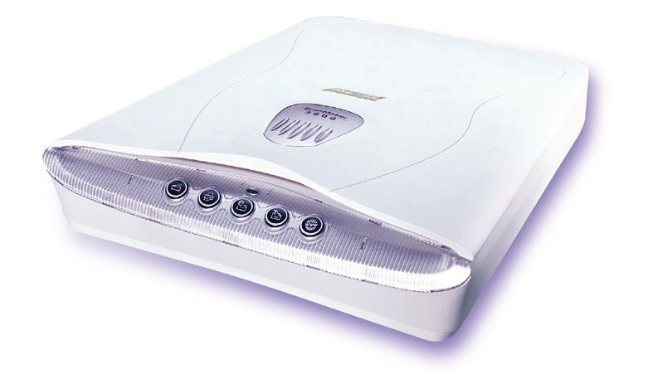


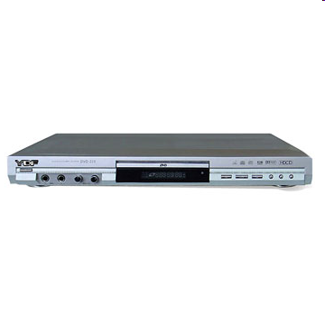



FireWire example
Notes:
PC, video, cable + camcorder
Scanner, PDA, ?
Standardised wire length

Slide 51
FireWire leader election
R

Slide 52
FireWire root contention
Root
contention

Slide 53



FireWire root contention
R
Root
contention

Slide 54
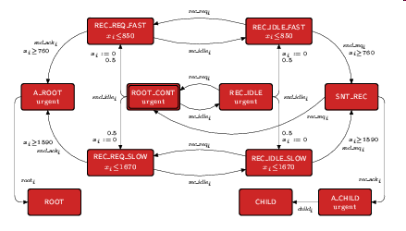
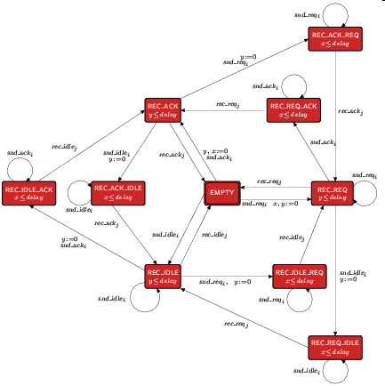
FireWire analysis
Probabilistic model checking
  model constructed and analysed using PRISM
  timing delays taken from standard
  model includes:
    concurrency: messages between nodes and wires
    underspecification of delays (upper/lower bounds)
  max. model size: 170 million states
Analysis:
  verified that root contention always
  resolved with probability 1
  investigated time taken for leader election
  and the effect of using biased coin
    based on a conjecture by Stoelinga

Slide 55
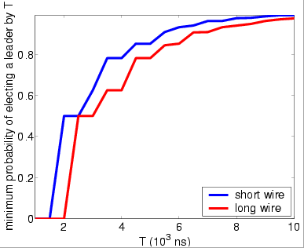
FireWire: Analysis results
“minimum probability
of electing leader
by time T”

Slide 56
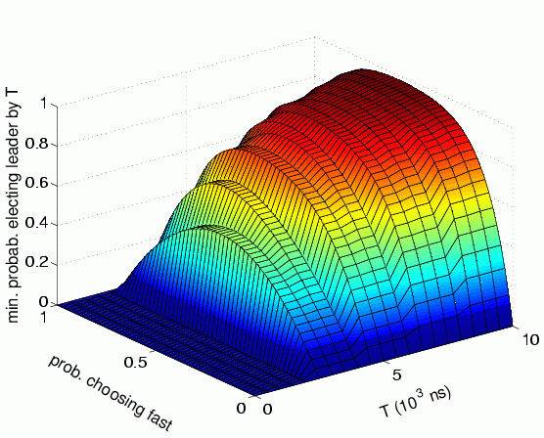
FireWire: Analysis results
“minimum probability
of electing leader
by time T”
(short wire length)
Using a biased coin
Notes:
Kwiatkowska
Polish
Female

Slide 57
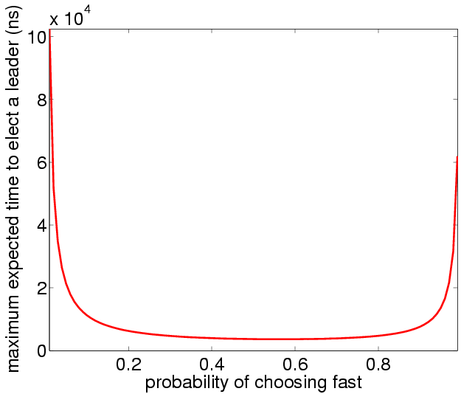
FireWire: Analysis results
“maximum expected
time to elect a leader”
(short wire length)
Using a biased coin

Slide 58
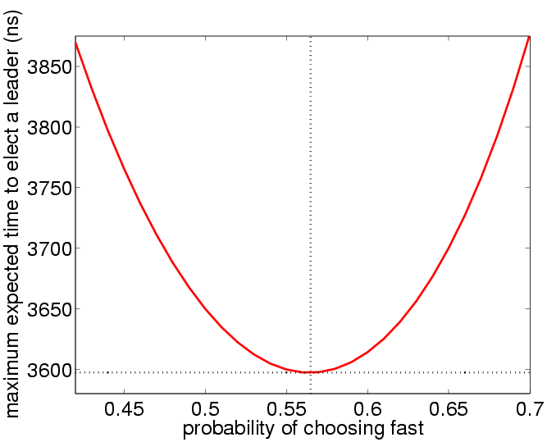
FireWire: Analysis results
“maximum expected
time to elect a leader”
(short wire length)
Using a biased coin
is beneficial!

Slide 59
Summary
Markov decision processes (MDPs)
  extend DTMCs with nondeterminism
  to model concurrency, underspecification, …
An adversary resolve nondeterminism in an MDP
  induce a probability space over paths
  consider minimum/maximum probabilities over all adversaries
Property specifications
  use e.g. PCTL or LTL, as for DTMCs
  but quantify over all adversaries
Model checking algorithms
  covered three basic techniques for MDPs: linear programming, value iteration, or policy iteration
Tomorrow: continuous-time Markov chains (CTMCs)

