Slide 1

Lecture 8
Continuous-time Markov chains
Probabilistic Model Checking Michaelmas Term 2011
Dr. Dave Parker
Department of Computer Science
University of Oxford

Slide 2
Time in DTMCs
Time in a DTMC proceeds in discrete steps
Two possible interpretations:
  accurate model of (discrete) time units
    e.g. clock ticks in model of an embedded device
  time-abstract
    no information assumed about the time transitions take
Continuous-time Markov chains (CTMCs)
  dense model of time
  transitions can occur at any (real-valued) time instant
  modelled using exponential distributions
DP/Probabilistic Model Checking, Michaelmas 2011

Slide 3
Overview
Exponential distribution and its properties
Continuous-time Markov chains (CTMCs)
  definition, examples
  race condition
  embedded DTMC
  generator matrix
Paths and probabilities
  probabilistic reachability
DP/Probabilistic Model Checking, Michaelmas 2011

Slide 4
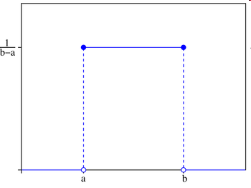
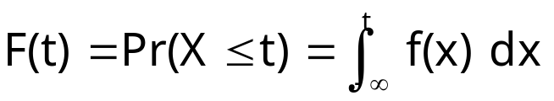
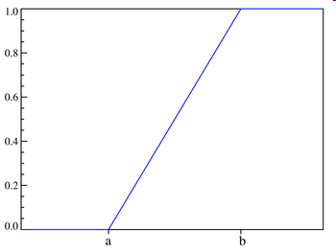
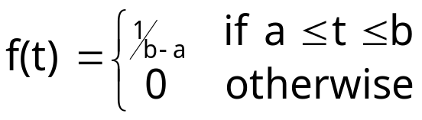
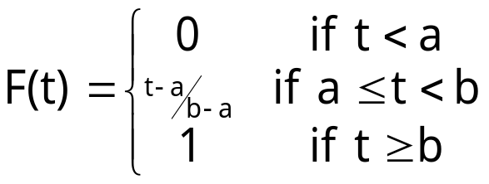
Continuous probability distributions
Defined by:
  cumulative distribution function
  where f is the probability density function
  Pr(X=t) = 0 for all t
Example: uniform distribution: U(a,b)
DP/Probabilistic Model Checking, Michaelmas 2011

Slide 5
Exponential distribution
A continuous random variable X is exponential with parameter λ>0 if the density function is given by:
  we write: X ~ Exponential(λ)
Cumulative distribution function (for t≥0):
Other properties:
  negation:
  mean (expectation):
  variance: Var(X) = 1/λ²
λ = “rate”
DP/Probabilistic Model Checking, Michaelmas 2011

Slide 6
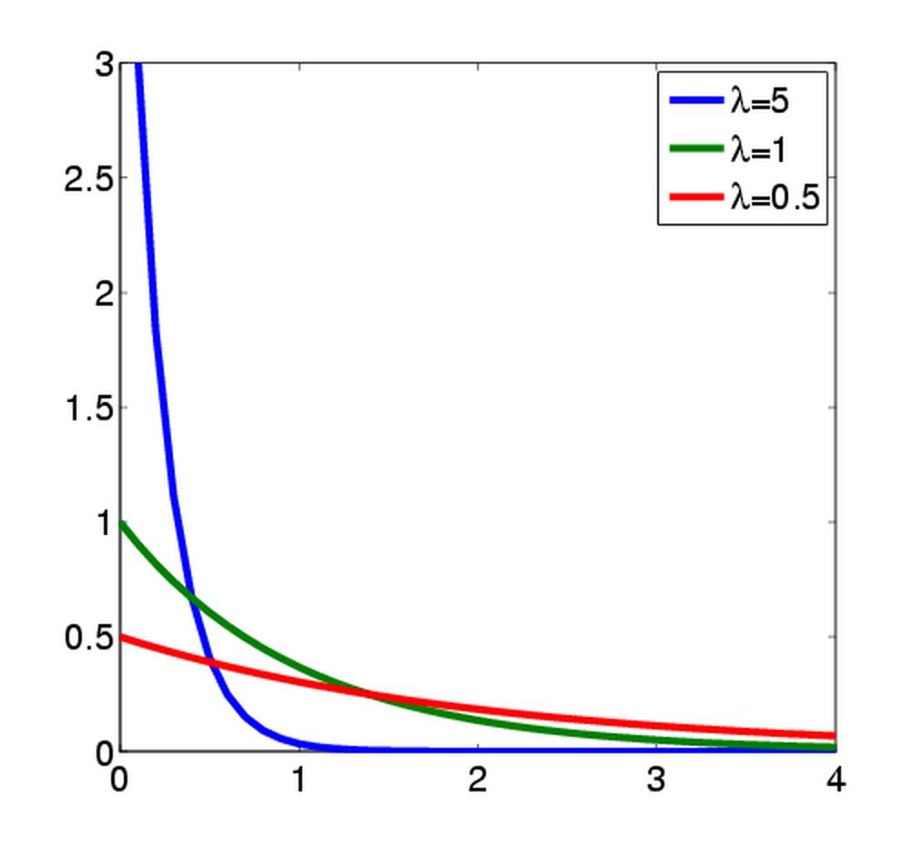
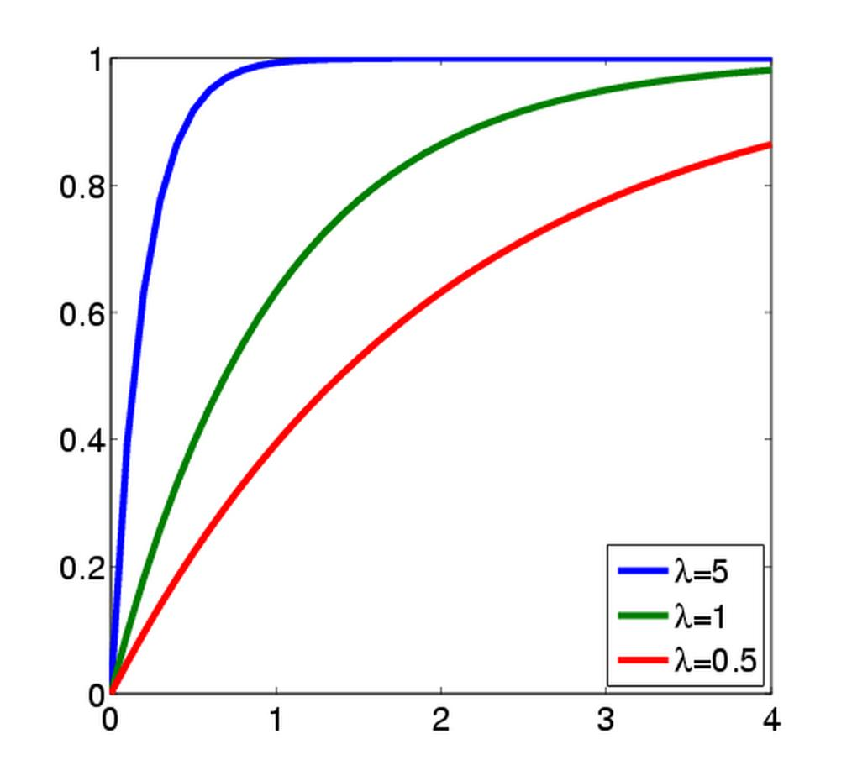
Exponential distribution - Examples
Probability density function
Cumulative distribution function
The more λ increases, the faster the c.d.f. approaches 1
DP/Probabilistic Model Checking, Michaelmas 2011

Slide 7
Exponential distribution
Adequate for modelling many real-life phenomena
  failures
    e.g. time before machine component fails
  inter-arrival times
    e.g. time before next call arrives to a call centre
  biological systems
    e.g. times for reactions between proteins to occur
Maximal entropy (“uncertainty”) if just the mean is known
  i.e. best approximation when only mean is known
Can approximate general distributions arbitrarily closely
  phase-type distributions
DP/Probabilistic Model Checking, Michaelmas 2011

Slide 8
Exponential distribution – Property 1
The exponential distribution has the memoryless property:
  Pr( X>t₁+t₂ I X>t₁ ) = Pr( X>t₂ )
Pr ( X>t₁+t₂ I X>t₁ ) = Pr( X>t₁+t₂ ∧ X>t₁ ) / Pr( X>t₁ )
= Pr( X>t₁+t₂ ) / Pr( X>t₁ )
= e^{-λ⋅(t1+t2)} / e^{-λ⋅t1}
= (e^{-λ⋅t1}⋅ e^{-λ⋅t2}) / e^{-λ⋅t1}
= e^{-λ⋅t2}
= Pr( X>t₂ )
The exponential distribution is the only continuous distribution which is memoryless
  discrete-time equivalent is the geometric distribution
DP/Probabilistic Model Checking, Michaelmas 2011

Slide 9
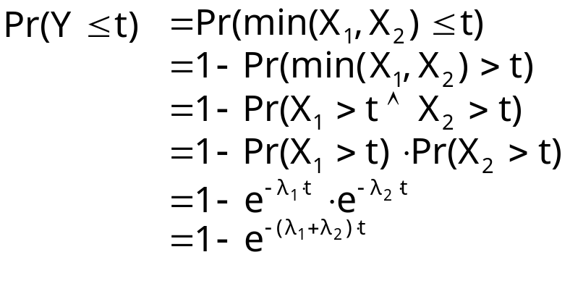
Exponential distribution – Property 2
The minimum of two independent exponential distributions is an exponential distribution (parameter is sum)
  X₁ ~ Exponential(λ₁), X₂ ~ Exponential(λ₂)
  Y = min(X₁,X₂)
  Y ~ Exponential(λ₁+λ₂)
Generalises to minimum of n distributions
DP/Probabilistic Model Checking, Michaelmas 2011

Slide 10
Exponential distribution – Property 3
Consider two independent exponential distributions
  X₁ ~ Exponential(λ₁), X₂ ~ Exponential(λ₂)
  what is the probability that X₁<X₂ ?
  probability that X₁<X₂ is λ₁/(λ₁+λ₂)
Generalises to n distributions
DP/Probabilistic Model Checking, Michaelmas 2011

Slide 11
Continuous-time Markov chains
Continuous-time Markov chains (CTMCs)
  labelled transition systems augmented with rates
  discrete states
  continuous time-steps
  delays exponentially distributed
Suited to modelling:
  reliability models
  control systems
  queueing networks
  biological pathways
  chemical reactions
  ...
DP/Probabilistic Model Checking, Michaelmas 2011

Slide 12
Continuous-time Markov chains
Formally, a CTMC C is a tuple (S,s_{init},R,L) where:
  S is a finite set of states (“state space”)
  s_{init} ∈ S is the initial state
  R : S × S → ℝ_{≥0} is the transition rate matrix
  L : S → 2^{AP} is a labelling with atomic propositions
Transition rate matrix assigns rates to each pair of states
  used as a parameter to the exponential distribution
  transition between s and s’ when R(s,s’)>0
  probability triggered before t time units: 1 – e^{-R(s,s’)⋅t}
DP/Probabilistic Model Checking, Michaelmas 2011

Slide 13
Simple CTMC example
Modelling a queue of jobs
  initially the queue is empty
  jobs arrive with rate 3/2 (i.e. mean inter-arrival time is 2/3)
  jobs are served with rate 3 (i.e. mean service time is 1/3)
  maximum size of the queue is 3
  state space: S = {s_{i}}_{i=0..3} where s_{i} indicates i jobs in queue
{empty}
3/2
3/2
3/2
{full}
1
s₀
s₁
s₂
s₃
3
3
3
DP/Probabilistic Model Checking, Michaelmas 2011

Slide 14

Race conditions
What happens when there exists multiple s’ with R(s,s’)>0?
  race condition: first transition triggered determines next state
  two questions:
  1. How long is spent in s before a transition occurs?
  2. Which transition is eventually taken?
1. Time spent in a state before a transition
  minimum of exponential distributions
  exponential with parameter given by summation:
  probability of leaving a state s within [0,t] is 1-e^{-E(s)⋅t}
  E(s) is the exit rate of state s
  s is called absorbing if E(s)=0 (no outgoing transitions)
DP/Probabilistic Model Checking, Michaelmas 2011

Slide 15
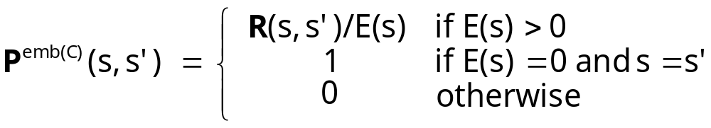
Race conditions…
2. Which transition is taken from state s?
  the choice is independent of the time at which it occurs
  e.g. if X₁ ~ Exponential(λ₁), X₂ ~ Exponential(λ₂)
  then the probability that X₁<X₂ is λ₁/(λ₁+λ₂)
  more generally, the probability is given by…
The embedded DTMC: emb(C)=(S,s_{init},P^{emb(C)},L)
  state space, initial state and labelling as the CTMC
  for any s,s’∈S
Probability that next state from s is s’ given by P^{emb(C)}(s,s’)
DP/Probabilistic Model Checking, Michaelmas 2011

Slide 16
Two interpretations of a CTMC
Consider a (non-absorbing) state s ∈ S with multiple outgoing transitions, i.e. multiple s’ ∈ S with R(s,s’)>0
1. Race condition
  each transition triggered after exponentially distributed delay
    i.e. probability triggered before t time units: 1 – e^{-R(s,s’)⋅t}
  first transition triggered determines the next state
2. Separate delay/transition
  remain in s for delay exponentially distributed with rate E(s)
    i.e. probability of taking an outgoing transition from s within [0,t] is given by 1-e^{-E(s)⋅t}
  probability that next state is s’ is given by P^{emb(C)}(s,s’)
    i.e. R(s,s’)/E(s) = R(s,s’) / Σ_{s’∈S} R(s,s’)
DP/Probabilistic Model Checking, Michaelmas 2011

Slide 17
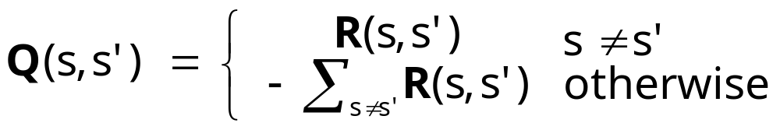
More on CTMCs…
Infinitesimal generator matrix Q
Alternative definition: a CTMC is:
  a family of random variables { X(t) | t ∈ ℝ_{≥0} }
  X(t) are observations made at time instant t
  i.e. X(t) is the state of the system at time instant t
  which satisfies…
Memoryless (Markov property)
  Pr(X(t_{k})=s_{k} | X(t_{k-1})=s_{k-1}, …,X(t₀)=s₀) = Pr(X(t_{k})=s_{k} | X(t_{k-1})=s_{k-1})
DP/Probabilistic Model Checking, Michaelmas 2011

Slide 18
Simple CTMC example…
3/2
3/2
3/2
C = ( S, s_{init}, R, L )
S = {s₀, s₁, s₂, s₃}
s_{init} = s₀
AP = {empty, full}
L(s₀)={empty}, L(s₁)=L(s₂)=∅ and L(s₃)={full}
{empty}
{full}
s₀
s₁
s₂
s₃
1
3
3
3
transition rate matrix
embedded DTMC
infinitesimal generator matrix
DP/Probabilistic Model Checking, Michaelmas 2011

Slide 19
Example 2
3 machines, each can fail independently
  delay modelled as exponential distributions
  failure rate λ, i.e. mean-time to failure (MTTF) = 1/ λ
One repair unit
  repairs a single machine at rate μ (also exponential)
State space:
  S = {s_{i}}_{i=0..3} where s_{i} indicates i machines operational
{high}
3λ
{high}
2λ
{low}
λ
{inactive}
1
s₃
s₂
s₁
s₀
μ
μ
μ
DP/Probabilistic Model Checking, Michaelmas 2011

Slide 20
Example 3
Chemical reaction system: two species A and B
Two reactions:
  reversible reaction under which
  species A and B bind to form AB
  (forwards rate = |A|⋅|B|⋅k₁,
  backwards rate = |AB|⋅k₂)
  degradation of A (rate |A|⋅k₃)
  |X| denotes number of
  molecules of species X
CTMC with state space
  (|A|,|B|,|AB|)
  initially (2,2,0)
k₁
k₃
A + B
AB
A
k₂
4k₁
k₁
2,2,0
k₂
1,1,1
2k₂
0,0,2
2k₃
2k₁
k₃
1,2,0
0,1,1
k₃
k₂
0,2,0
DP/Probabilistic Model Checking, Michaelmas 2011

Slide 21
Paths of a CTMC
An infinite path ω is a sequence s₀t₀s₁t₁s₂t₂… such that
  R(s_{i},s_{i+1}) > 0 and t_{i} ∈ ℝ_{>0} for all i ∈ ℕ
  t_{i} denotes the amount of time spent in s_{i}
or a sequence s₀t₀s₁t₁s₂t₂…t_{k-1}s_{k} such that
  R(s_{i},s_{i+1}) > 0 and t_{i} ∈ ℝ_{>0} for all i<k
  s_{k} is absorbing (i.e. R(s,s’) = 0 for all s’ ∈ S)
  i.e. remain in state s_{k} indefinitely
Path(s) denotes all infinite paths starting in state s
Further notation:
  time(ω,j) = amount of time spent in the jth state, i.e. t_{j}
  ω@t = state occupied at time t:
  see e.g. [BHHK03, KNP07a] for precise definitions
DP/Probabilistic Model Checking, Michaelmas 2011

Slide 22
Recall: Probability spaces
A σ-algebra (or σ-field) on Ω is a set Σ of subsets of Ω closed under complementation and countable union, i.e.:
  if A ∈ Σ, the complement Ω ∖ A is in Σ
  if A_{i} ∈ Σ for i ∈ ℕ, the union ∪_{i} A_{i} is in Σ
  the empty set ∅ is in Σ
Elements of Σ are called measurable sets or events
Theorem: For any set F of subsets of Ω, there exists a unique smallest σ-algebra on Ω containing F
Probability space (Ω, Σ, Pr)
  Ω is the sample space
  Σ is the set of events: σ-algebra on Ω
  Pr : Σ → [0,1] is the probability measure:
  Pr(Ω) = 1 and Pr(∪_{i} A_{i}) = Σ_{i} Pr(A_{i}) for countable disjoint A_{i}
DP/Probabilistic Model Checking, Michaelmas 2011

Slide 23
Probability space
Sample space: Path(s) (set of all paths from a state s)
Events: sets of infinite paths
Basic events: cylinders
  cylinders = sets of paths with common finite prefix
  include time intervals in cylinders
Finite prefix is a sequence s₀,I₀,s₁,I₁,…,I_{n-1},s_{n}
  s₀,s₁,s₂,…,s_{n} sequence of states where R(s_{i},s_{i+1})>0 for i<n
  I₀,I₁,I₂,…,I_{n-1} sequence of of non-empty intervals of ℝ_{≥0}
Cylinder Cyl(s₀,I₀,s₁,I₁,…,I_{n-1},s_{n}) is the set of infinite paths:
  ω(i)=s_{i} for all i ≤ n and time(ω,i) ∈ I_{i} for all i < n
DP/Probabilistic Model Checking, Michaelmas 2011
Notes:
Jump ahead 1 slide to example at this point

Slide 24
Probability space
Define probability measure over cylinders inductively
Pr_{s}(Cyl(s))=1
Pr_{s}(Cyl(s,I,s₁,I₁,…,I_{n-1},s_{n},I’,s’)) equals:
probability of transition from s_{n} to s’ (defined using embedded DTMC)
probability time spent in state s_{n} is within the interval I’
DP/Probabilistic Model Checking, Michaelmas 2011

Slide 25
Probability space - Example
Probability of leaving the initial state s₀ and moving to state s₁ within the first 2 time units of operation
Cylinder Cyl(s₀,(0,2],s₁)
Pr_{s0}(Cyl(s₀,(0,2],s₁))
= Pr_{s0}(Cyl(s₀)) ⋅ P^{emb(C)}(s₀,s₁) ⋅ (e^{-E(s0)⋅0} - e^{-E(s0)⋅2})
= 1 ⋅ P^{emb(C)}(s₀,s₁) ⋅ (e^{-E(s0)⋅0} - e^{-E(s0)⋅2})
= 1 ⋅ 1 ⋅ (e^{-3/2⋅0} – e^{-3/2⋅2})
= 1– e⁻³
≈ 0.95021
{empty}
3/2
3/2
3/2
{full}
s₀
s₁
s₂
s₃
1
3
3
3
DP/Probabilistic Model Checking, Michaelmas 2011

Slide 26
Probability space
Probability space (Path(s), Σ_{Path(s)}, Pr_{s}) (see [BHHK03])
Sample space Ω = Path(s)
  i.e. all infinite paths
Event set Σ_{Path(s)}
  least σ-algebra on Path(s) containing all cylinders sets
  Cyl(s₀,I₀,…,I_{n-1},s_{n}) where:
    s₀,…,s_{n} ranges over all state sequences with R(s_{i},s_{i+1})>0 for all i
    I₀,…,I_{n-1} ranges over all sequences of non-empty intervals in ℝ_{≥0}
    (where intervals are bounded by rationals)
Probability measure Pr_{s}
  Pr_{s} extends uniquely from probability defined over cylinders
DP/Probabilistic Model Checking, Michaelmas 2011

Slide 27
Probabilistic reachability
Probabilistic reachability
  the probability of reaching a target set T⊆S
  measurability:
    union of all basic cylinders Cyl(s₀,(0,∞),s₁,(0,∞),…,(0,∞),s_{n})
    where s_{n} ∈ T
    set of such state sequences s₀s₁…s_{n} is countable
Time-bounded probabilistic reachability
  the probability of reaching a target set T⊆S within t time units
  measurability:
    union of all basic cylinders Cyl(s₀,I₀,s₁,I₁,…,I_{n-1},s_{n})
    where s_{n} ∈ T and sup(I₀)+…+sup(I_{n-1}) ≤ t
    set of such state sequences s₀s₁…s_{n} is countable
    set of rational-bounded intervals is countable
DP/Probabilistic Model Checking, Michaelmas 2011

Slide 28
Summing up…
Exponential distribution
  suitable for modelling failures, waiting times, reactions, …
  nice mathematical properties
Continuous-time Markov chains
  transition delays modelled as exponential distributions
  race condition
  embedded DTMC
  generator matrix
Probability space over paths
  (untimed and timed) probabilistic reachability
DP/Probabilistic Model Checking, Michaelmas 2011

