Slide 1
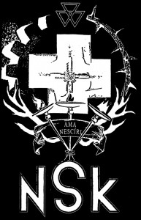
Notes:
Neue Slowenische Kunst (a German phrase meaning "New Slovenian Art"), a.k.a. NSK, is a controversial political art collective that formed in Slovenia in 1984, when Slovenia was part of Yugoslavia. NSK's name, being German, is compatible with a theme in NSK works: the complicated relationship Slovenes have had with Germans. The name of NSK's music wing, Laibach, is also the German name of the Slovene capital Ljubljana. The name created controversy because some felt it evoked memories of the Nazi annexation of Slovenia during the Second World War. It also refers to Slovenia's previous seven centuries as part of the Habsburg Monarchy.

Slide 2
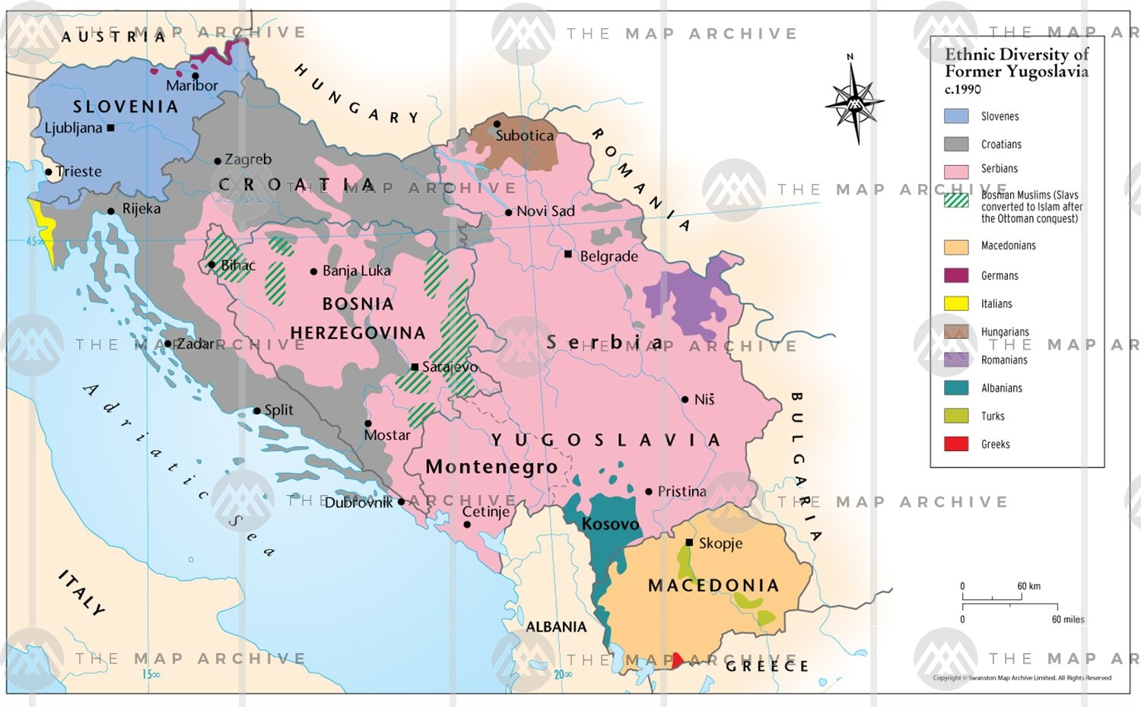
Yugoslavia
Notes:
Yugoslavia, while communist, was a “non-aligned” state and never part of the Eastern Bloc
The economic model there was one in which workers owned the businesses and competed in a free market
After Yugoslavia’s leader, Josip Broz Tito, died in 1980, the region began to de-stabilize
Anti-establishment music gained traction around that time, and was mostly tolerated or supported by authorities

Slide 3
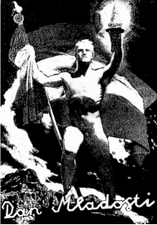
Notes:
NSK was actually comprised of multiple sub-collectives, including “New Collectivism” which was a screen printing and graphic design collective
One of New Collectivism’s most notable projects was the work that set off the so-called poster scandal. a 1987 NSK-designed poster caused a scandal by winning a competition for the Yugoslavian Youth Day Celebration. The poster appropriated a painting by Nazi artist Richard Klein, replacing the flag of Nazi Germany with the Yugoslav flag and the German eagle with a dove. The authorities found out after the poster won, and interpreted it as equating Marshal Josip Broz Tito with Adolf Hitler. It was later reproduced on the cover of Mladina magazine, and that particular issue was subsequently banned.

Slide 4
Laibach
Short doc

