Slide 1
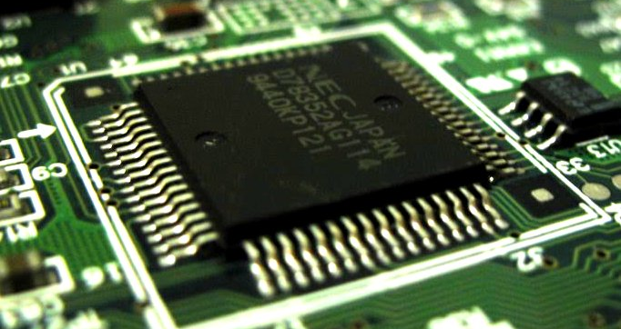
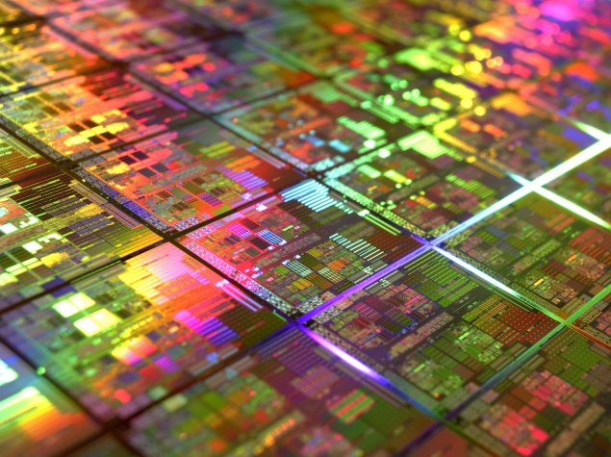
DI22004 Computer Systems 2B
DII CSU
Caches Updating

Slide 2
Revision: the cache
a small but very fast area of memory close to the processor
multi-level
functions automatically, and is invisible to the processor (and OS and user)
main memory is mapped into the cache in some way – usually set-associative
fetches can result in a cache hit (this address already fetched) or miss (not fetched)

Slide 3
Some issues
Usage:
the cache must function automatically
CPU performs more reads than writes
Mapping: the cache is typically <1% of the main memory - so how do we map into it?
Updating: Normally the cache is full - so where do we put new data as we read it in?
Coherence: the cache contains a copy of memory locations, and integrity MUST be maintained in use (with no user intervention)

Slide 4
Cache Updating

Slide 5
Cache sizes
Note that the cache sizes quoted in literature refer only to the data capacity of the cache.
If the cache needs to store tags and other “housekeeping” data, this requires more physical data storage on the silicon, but this is not shown in the quoted cache size.
e.g. 2-way, 256 sets, 128 data bits per way:
quoted size = 256 x 2 x 128 = 8192 bytes = 8K
physical size = 256 x ((2 x (128 + 20)) + 1) = 9504 bytes = “8K”
address tag
LRU

Slide 6
Which way?
In a set-associative cache:
the set to be used is determined by the address being accessed (thus fixed)
a particular address always maps to the same set
the way to be used within that set is determined at run time (dynamic):
initially, the first available empty way in a set will be used, but once all ways are full, we must overwrite existing contents - but which one?

Slide 7
Cache update strategies
When a new item is loaded from memory, it must be placed in the cache (as recent data is the most valuable). However, the cache will (usually) already be full … what do we replace?
Three common strategies are used:
least recently used (LRU): most effective, easily implemented with set-associative
first-in first-out (FIFO): implemented via a circular buffer on each set
least frequently used (LFU): need a hit counter on each way of each set

Slide 8

Which way?
Determining which way to overwrite is done algorithmically i.e. using built-in rules.
To support the operation of the replacement algorithm, the cache must hold some extra “housekeeping” bits, such as LRU bits.
These bits are dynamically updated during cache usage.

Slide 9
Cache Coherence

Slide 10
Multi-level caches
Main Memory
Core 1
L1 Cache
L2 Cache
Core 2
L3 Cache
L1 Cache
L2 Cache

Slide 11
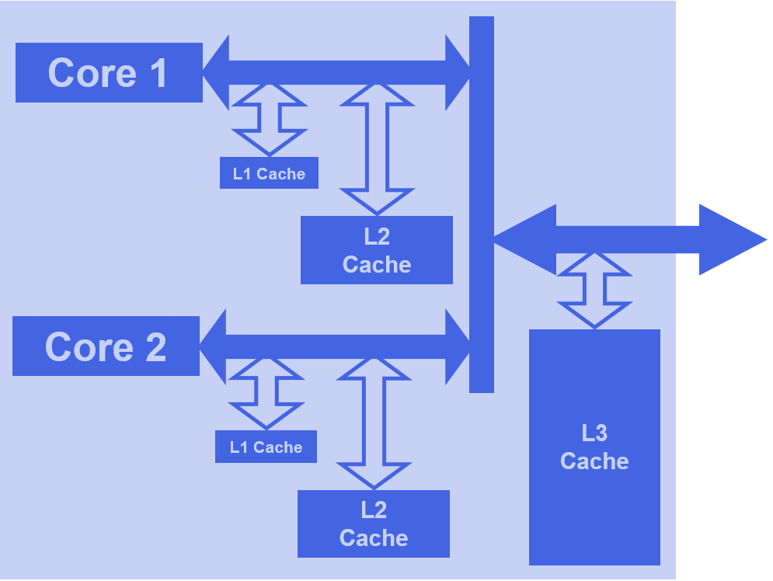
Multi-level caches
CPU 1
Main Memory
CPU 2
L4 Cache
(separate chip)

Slide 12
Cache coherence
The cache stores a copy of certain areas of main memory. If one copy is updated, we have a potential coherence problem (two different versions of the same data) - so we must either:
ensure the cache and main memory are always coherent (contain same data), or:
use appropriate dynamic techniques to prevent coherence differences from causing problems
… and we need to be especially careful with multi‑processor systems … with multiple copies!

Slide 13
Multi-level caches
Multi-level caches can be:
Inclusive: L2 holds a copy of L1 data, plus anything discarded from L1:
hit in L2 – data copied into L1
miss in both – data is fetched and copied into L1 and L2
Exclusive: L2 holds only discards from L1:
hit in L2 – data is switched L1⬄L2
miss in both – data is fetched into L1; L1 data moves to L2, L2 older data discarded

Slide 14
Write-through
With a write-through (or “store-through”) cache, a data write updates the cache and also goes through to update the main memory:
the cache is always coherent
a main memory write cycle is required for every write (slow)

Slide 15
Write-back
With a write-back (or “copy-back” or “store-in”) cache, a data write only updates the cache:
cache and main memory are therefore not coherent after the write is performed
modified cache data is copied to the main memory only when about to be overwritten in the cache (processor can continue)
must record which data have changed
only needs a main memory write cycle when necessary

Slide 16
External coherence
Consideration of coherence between processor cache and main memory is not enough if we have a system with more than one processor or other bus-master (multi-CPU, DMA, etc.).
There are software and hardware protocols to monitor coherence e.g. the MESI protocol, as used in the Pentium and other Intel CPUs.
Processors have to monitor (“snoop”) on reads made by other processors in order to update the status of their own cache(s).

Slide 17
MESI protocol
Stores two bits for each cache way, indicating one of four possible states for that data:
Modified - data in this way is newer than in main memory - must be written back if another processor tries to read that address
Exclusive - data in this way matches main memory and it is the only copy
Shared - data in this way matches main memory but there are other copies
Invalid - data is invalid or empty

Slide 18
Caches in Intel Processors
(processors from other manufacturers have gone through a similar evolution)
You do not need to remember the details

Slide 19

The Pentium Cache
The Intel Pentium has two on-chip caches:
a data cache
an instruction cache
Each cache is 2-way set-associative with 128 sets, each with a way size of 32 bytes.
It is possible for data items down to the size of a byte to be addressed in the cache.
Cache size = line size x # of ways x # of sets (8K)

Slide 20
The Pentium Cache
Write-back is used by default, but can be set to perform write-through caching
Least-recently used (LRU) replacement algorithm is used
A single LRU bit is associated with each set of two ways to indicate which way should be replaced first - stored in a 128-bit table
N.B. LRU and MESI bits are not part of cache size calculations – size is payload only!

Slide 21
Caching History
Memory caching in Intel processors:
80386 (and earlier) - no internal cache
80486 - 8K L1 (unified)
Pentium - 2 x 8K L1 (one for data / one for instructions)
Pentium Pro - 2 x 8K L1, 256K L2 2-way
Pentium II / III - 2 x 16K L1, 512K L2 4-way
Pentium IV - 8K L1, 256K L2 8-way, 12K Execution Trace Cache*
* part of Intel’s NetBurst architecture; not used in later processors

Slide 22
Caching History
In later processors, cache size varies by model and is one of the main distinguishing features between CPU models e.g.
Core i5 650 (2 core) - 2 x 32K L1, 256K L2 per core plus 4MB L3
Core i5 750 (4 core) - 2 x 32K L1, 256K L2 per core plus 8MB L3
Core i5 2500 (4 core) - 2 x 32K L1, 256K L2 per core plus 6MB L3
Core i7 920 (4 core) - 2 x 32K L1, 256K L2 per core plus 8MB L3
Core i7 970 (6 core) - 2 x 32K L1, 256K L2 per core plus 12MB L3

Slide 23

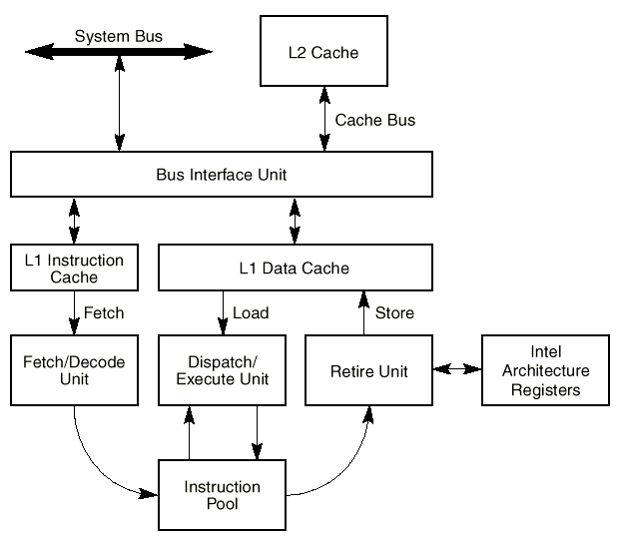
Pentium III Cache

Slide 24
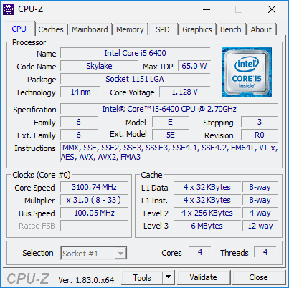
Your Cache

Slide 25
Cache Definition
We can now more clearly define a cache as:
“a small storage area located close to a processing unit, which stores recently-used data taken from a larger, but more distant and slower, storage area”
This definition can apply to the CPU caches, disk caches … and to other caches that we will see later.

Slide 26
BUT REMEMBER …
The cache does not speed up the calculations performed by the CPU
The cache does not speed up the memory
The cache does not speed up memory read or write cycles
The cache does increase the overall speed of the fetch-execute cycle by reducing the number of main memory reads/writes that are required (and it does this automatically)
The cache requires no management by the CPU, OS or user

Slide 27
Summary
We have seen:
cache mapping- how to copy it
cache updating- how to overwrite it
cache coherence - how to maintain it
caches in the Intel processors

Slide 28
dii.csu.edu.cn

