Slide 1
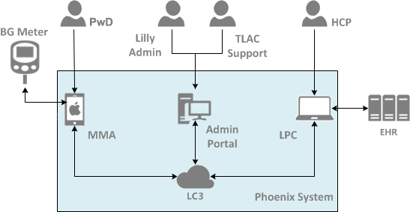
Lilly Connected Care Cloud (LC3)
Hosted on Amazon Web Services cloud (us-east-1)
Single region, multi-availability zone implementation
Docker container-based deployment
AWS Elastic Container Services for scalability and availability
AWS CloudWatch, CloudTtrail for cloud svcs+infrastructure event logging

Slide 2
Lilly Connected Care Cloud (LC3)
Microservices written in Node.js utilizing HAPI + add’l JS frameworks – called by gateway services
Services built as individual Docker containers
Deploying multiple Docker containers (services) per EC2 instance (based on load, complexity, etc)
Running multiple EC2 instances across availability zones for fault tolerance and scalability
Separate instance of Postgres (relational DB) per each microservice – each is separately encrypted
multiple instances of a service share same database instances. Master and standby databases spread across availability zones. Use read replicas for DR.

Slide 3
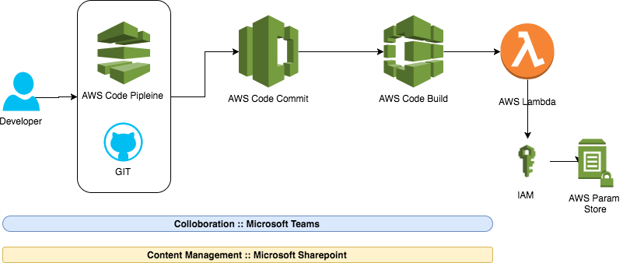
AWS Serverless Deployment Pipeline

Slide 4
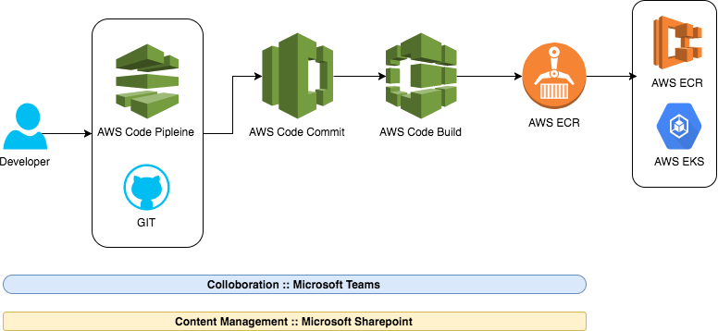
AWS Container Deployment Pipelone

Slide 5
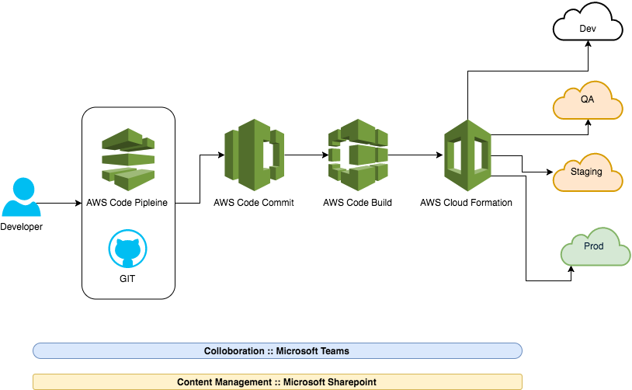
AWS Continuous deployment Pipeline

Slide 6
AWS Server less Pipeline model

Slide 7
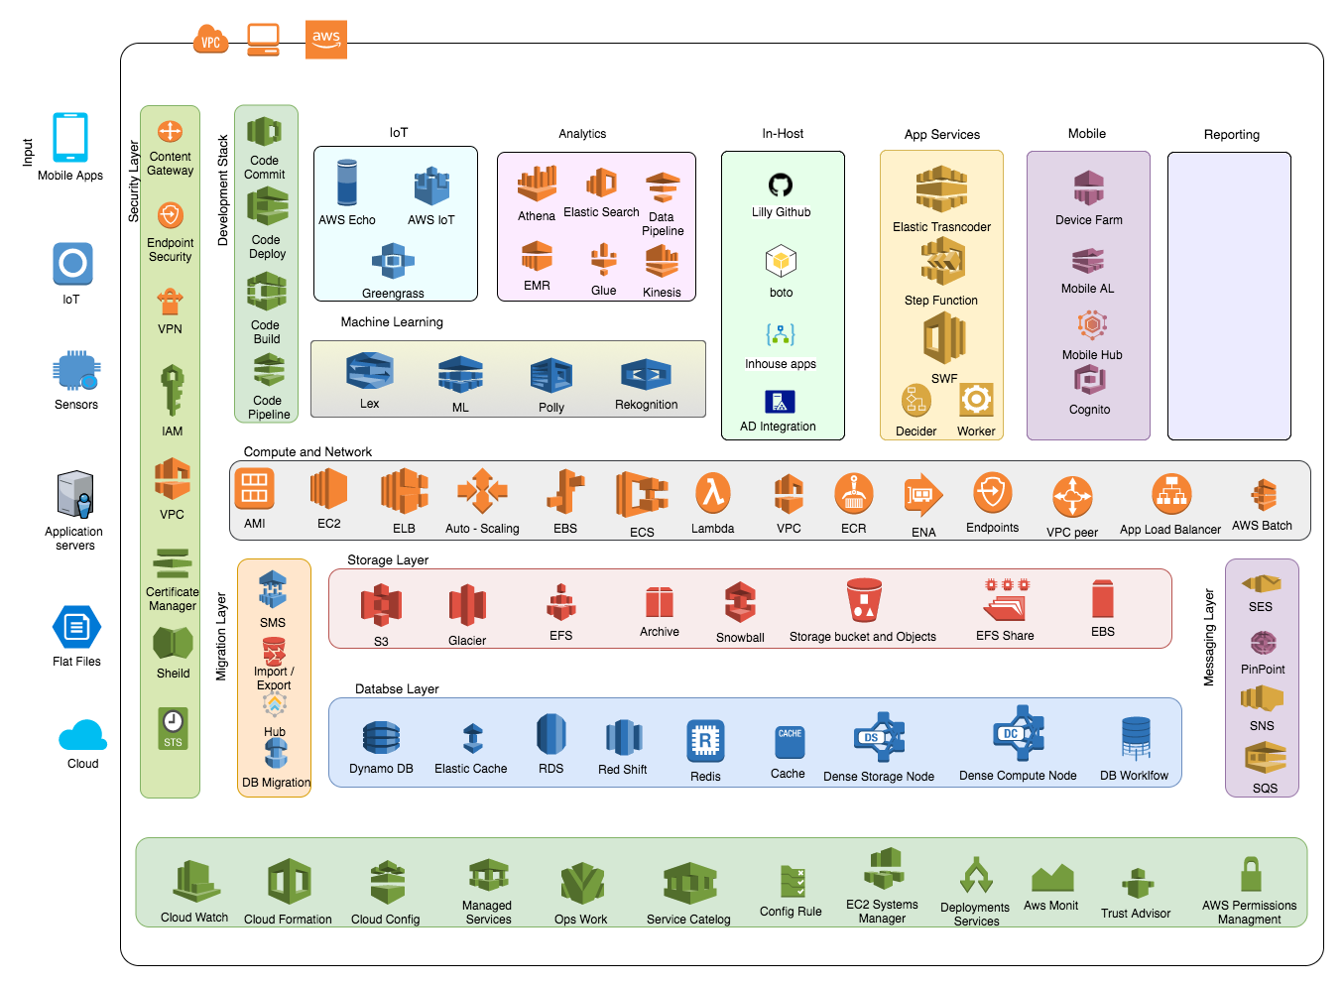
AWS Logical State – Services

Slide 8
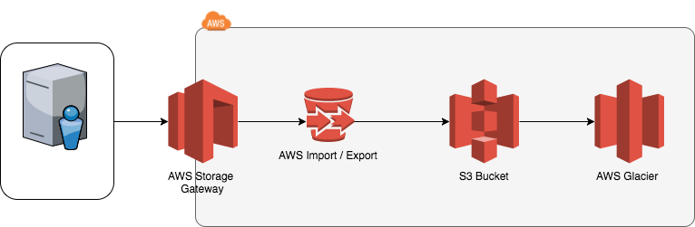
Storage management flow

Slide 9
Marketplace
Mgmt. Tools
Analytics
Dev Tools
Artificial Intelligence
IoT
Mobile
Enterprise Applications
Game Development
The AWS Platform
Business Applications
Monitoring
Query Large Data Sets
DevOps Tools
Auditing
Elastic Search & Kibana stack
IoT Greengrass
Business Intelligence
Service Catalog
Business Analytics
Code quality analyzer
AA Engine
IoT One Click
Account Support
Security
Server Management
Hadoop/Spark
Package Creator
NLP Engine
Rules Engine
Build, Test, Monitor Apps
Document Sharing
Support
Networking
Configuration Tracking
Real-time Data Streaming
Private Git Repositories
Voice & Text Chatbots
Local Compute and Sync
Push Notifications
Email & Calendaring
Managed Services
Database & Storage
Optimization
Analytics Reports
Continuous Delivery
Machine Learning
Device Shadows
Build, Deploy, Manage APIs
Hosted Desktops
Professional Services
SaaS Subscriptions
Resource Templates
Managed Search
Build, Test, and Debug
Text-to-Speech
Device Gateway
Device Testing
Application Streaming
3D Game Engine
Partner Ecosystem
Operating Systems
Automation
Managed ETL
Deployment
Image Analysis
Registry
Identity
Backup
Multi-player Backends
Training & Certification
Migration
Application Discovery
Application Migration
Data Migration
Database Migration
Server Migration
Solution Architects
Hybrid
Data Integration
Integrated Networking
Identity Federation
Resource Management
VMware on AWS
Devices & Edge Systems
Account Management
Application
Services
Transcoding
Step Functions
Messaging
Security & Pricing Reports
Security
Identity & Access
Key Storage & Management
Active Directory
DDoS Protection
Application Analysis
Certificate Management
Web App. Firewall
IoT Device Defender
Technical Acct. Management
Database
Aurora
MySQL
PostgreSQL
Oracle
SQL Server
Data Warehousing
NoSQL
Storage
Object Storage
Archive
Exabyte-scale Data Transport
Block Storage
Managed File Storage
Compute
Virtual Machines
Simple Servers
Web Applications
Auto Scaling
Batch
Containers
Event-driven Computing
Networking
Isolated Resources
Dedicated Connections
Global CDN
Load Balancing
Scalable DNS
Infrastructure
Regions
Availability Zones
Points of Presence

