Slide 1

DevOps Assessment for Royal Bank of Canada

Slide 2

Table of Contents

Slide 3
Puma - Current SDLC State
Release Management
Collaboration/ KM Management
Code Checkout
Code Construction
Unit Testing
Code Review
Code Conflict Management
Version Management
Build
Functional Testing
Deployment – QA/SIT/UAT
Package and Artifact Mngt.
Tag Release
Static/Dynamic Code Analysis
Integration Testing
Security Testing
Performance Testing
User Acceptance Testing
Service Management
Release to
Production
Monitoring
Requirement Management
Observations :
Build is automated but not integrated with test pack.
Adequate code conflict management system is present.
There is no standard package and Artifactory management system in the enterprise.
Release tagging mechanism is missing.
SDLC pipeline is partially automated and integrations between lifecycle is missing.
Standard release automation is non existent.
Rollback testing and automation is absent.
Infrastructure creation and application deployment takes longer time.
CMDB/Change Management
Technologies
Node JS
Angular JS
MSSQL
Linux – SUSE
Manual Task
Test Case/Data Management
Tool driven
Non automated
Out of Scope

Slide 4


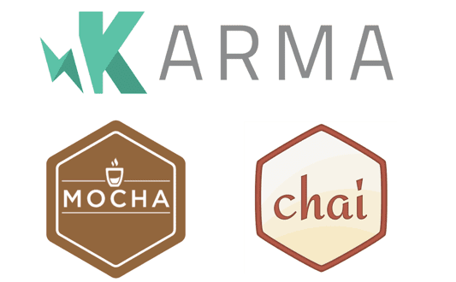








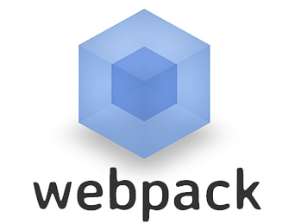
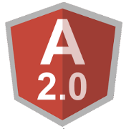


Target CI/CD State – NodeJS & AngularJS Stack -Puma
Code Integration
Code Coverage
Code Quality
Unit Testing
Build
Deployment
QA Testing
Release
Packaging
Finding Bugs Early
Compliance to coding standards
Team Cohesion
Confidence of stakeholders
Reduces bugs in Prod code
Code change and refactoring
Improves the code design
Facilitate documentation
Measure of completion.
Prevent Integration problem
Committing Code frequently
Greater code stability
Compilation error free code
Continuous Deployment
Efficient Testing
Up gradation and Reusability
Consistency
User environment simulation
Increased Test Coverage
Speed up deployment
Reducing errors and failed deployments
Visibility on deployment status of application and environments.
Improved software quality
Reduce Compile and linking time
Minimize broken builds
Improved Traceability
Build on Check-ins

Slide 5

DevOps CI-CD Pipeline (Illustrative)
Update JIRA status using REST API
Artifact Repository (Nexus)
Trigger Build
Update build (code to build traceability)
Pull Artifacts
ALM
(JIRA)
Commit Code
SCM
(Bitbucket)
Pull Code
CI/CD
(Jenkins)
Deploy Artifacts
Infrastructure Provisioning, Environment Configuration &
App Deployment
(Ansible )
On-demand
Dev
Prod
Requirement traceability
QA
Code review comments to SCM traceability
Static Code Analysis
Staging
Reports
SIT/UAT
Code Review
(Crucible)
Code Analysis
(SonarQube)
App
Update status using API
Config
MW, DB
Performance/ Regression testing Tools
(HP UFT)
Dashboard
(JIRA)
Reports
OS
Reports
Logging & Monitoring
(Foglight, ELK)
Reports

Slide 6
Thank You

