Slide 1
DevOps Assessment – RBC
23rd May 2019

Slide 2
Assessment scope and landscape
Portfolio : OTIS
Application Name : EUC File Processer
Team : Development, Test and Release
Infrastructure Landscape: RHEL 6.x and MSSQL
Application Landscape: Java 1.7, Spring and RESTful
Mode of assessment : Meetings, Interviews and questionnaire
In Scope : Development, Build, Testing, Release and Monitor
Out of Scope : Infrastructure management, Environment Management

Slide 3
Current SDLC State
Release Management
Collaboration/ KM Management
Code Checkout
Code Construction
Unit Testing
Code Review
Code Conflict Management
Version Management
Build
Functional Testing
Deployment – QA/SIT/UAT
Package and Artifact Mngt.
Tag Release
Static/Dynamic Code Analysis
Integration Testing
Security Testing
Performance Testing
User Acceptance Testing
Service Management
Release to
Production
Monitoring
Requirement Management
Observations :
Build is automated but not integrated with test pack.
Automated code conflict management system is absent.
There is no standard package and Artifactory management system in the enterprise.
Release tagging mechanism is done manually.
SDLC pipeline is partially automated and integrations between lifecycle is missing.
Unit testing and static code analysis is non existent.
Rollback testing and automation is absent.
End to end release tracking mechanism is manual.
Manual Task
Technologies
Java
Spring
REST api
Linux – RHEL 6.x
ETL
Tool driven
Not Present
Out of Scope
Notes:
Manual Task – Is do

Slide 4
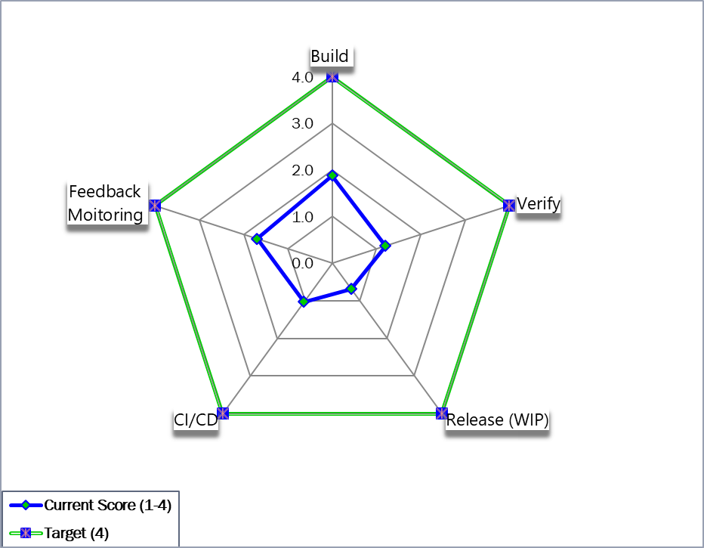
Devops Assessment Score

Slide 5
Gap Analysis
Development
Standard coding guidelines and process are absent.
Code review, Code quality and Static code security mechanism are missing.
Requirement traceability mechanism is manual and insufficient.
Build
Trigger based build will enable CI process.
Build failure notification and automated build issue logging is absent.
Formalized merging, branching and baselining of code is necessary.
Test
End to end bug traceability and automated defect logging is missing.
QA approval process needs to be automated.
Unit testing, data quality and performance testing needs to be enabled.
Enterprise level integrated infrastructure and application services monitoring needs to be implemented.
Data quality and file watch alert mechanism should be in dash boarded.
Release
Monitor
End to end bug traceability and automated defect logging is missing.

Slide 6
Recommendations
Development and Build
1. Need to build coding standards, standardize and enforce code commit, branching and merging mechanism.
2. Code quality, Static code security and automated approval process should be implemented.
3. Code Coverage, Code quality metrics should be defined and metrics should be tracked.
Testing
1. End to end bug and requirement traceability mechanism should be enforced.
2. Test suite integrations should happen via CI/CD tool suite [ Jenkins / UCD ].
3. Automated defect logging mechanism from HP ALM – JIRA should be enabled.
Monitor
1. Enterprise level integrated infrastructure and application services monitoring should be implemented.
2. File watch and data quality monitoring should be enabled and automated via dashboards and tools over email. .
Release
WIP Not assessed waiting for inputs from the team

Slide 7
Current DevOps Model
Update JIRA status using REST API
Artifact Repository (Nexus)
Trigger Build
Update build (code to build traceability)
Pull Artifacts
Environment Management
Service Management
Plan
(JIRA}
Commit Code
SCM
(GIT , Maven )
Pull Code
CI/CD
(Jenkins and IBM UCD)
Deploy Artifacts
App Deployment
(UDC )
On-demand
Dev
Prod
Requirement traceability
QA
Code review comments to SCM traceability
Static Code Analysis
Staging
Reports
SIT/UAT
Code Review
(Crucible)
Code Analysis
(SonarQube)
App
Update status using API
Config
MW, DB
Performance/ Regression testing Tools
(PyRobo)
Dashboard
(JIRA)
Reports
OS
Reports
Logging & Monitoring
(In-house dashboard )
Reports

Slide 8
Recommended DevOps Model
Update JIRA status using REST API
Artifact Repository (Nexus)
Trigger Build
Update build (code to build traceability)
Pull Artifacts
Environment Management
Service Management
Plan
(JIRA}
Commit Code
SCM
(GIT , Maven )
Pull Code
CI/CD
(Jenkins and IBM UCD)
Deploy Artifacts
App Deployment
(UDC )
On-demand
Dev
Prod
Requirement traceability
QA
Code review comments to SCM traceability
Static Code Analysis
Staging
Reports
SIT/UAT
Code Review
(Crucible)
Code Analysis
(SonarQube)
App
Update status using API
Config
MW, DB
Performance/ Regression testing Tools
(PyRobo)
Dashboard
(JIRA)
Reports
OS
Reports
Logging & Monitoring
(In-house dashboard )
Reports

Slide 9
Devops Metrics {Not assessed waiting for inputs from the team}
Metrics | Is it Measured ? | Current value
Reduced Lead time to Release (Cycle Time) or Deploy Code | Not Measured
% Automation or Reusability % | Not Measured
Percentage of Failed Deployments | Not Measured
Improved Environment or Application or Service Availability | NA | NA
Reduced Incident Rate | Not Measured
Mean Time to Resolve | Not Measured
% Tickets Reopened (Level 1) | Not Measured
% Reduction in INFRA Cost | NA | NA
Wait time @ each Step | NA | NA
Environment Provisioning Time | NA | NA

Slide 10
Thank you

