Slide 1
Littlebytes summer ‘18
LittleBytes Summer Academy

Slide 2
Week 1 homework
Select 2 kids to present their work

Slide 3
Week 1 learning goals review
Adding elements to the page in the UI editor
Making a working button
Buttons that open another screen in the app
Styling elements
Text fonts
Image sizes
Coloring and shaping
Live testing
Through the Thunkable app
Exporting our apps
Android APK
iOS E-Mail export

Slide 4
Testing without using a physical device
In computing, an emulator is hardware or software that enables one computer system (called the host) to behave like another computer system (called the guest).
An emulator typically enables the host system to run software or use peripheral devices designed for the guest system that is being emulated.
If we are testing an app using an Android emulator, what is the host, and what is the guest? Why?
Let’s learn how to use BlueStacks to test Android apps, which you should have downloaded on your computer already. If not, download it from bluestacks.com.

Slide 5
Demo: Testing android apps on bluestacks
Go to Thunkable, and open any app. Export it as an “Android App” in the top right corner of screen.
You should now have a file called .apk.
Click on the file, and it should automatically open in BlueStacks. If not, try these options.
Right click and select “open in BlueStacks”
Left click and select “open in BlueStacks”
Drag and drop the .apk file into the BlueStacks window
Your app should run as normal. Do not try to use the fake app store to download the Thunkable app and test that way, because it does not work.

Slide 6
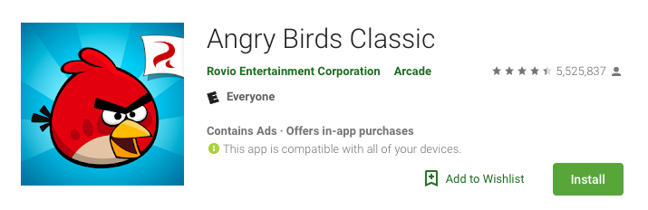
App icon and name in thunkable
This is how Angry Birds appears on the Google Play store online. Let’s identify the App Name and App Icon on this page, and then learn how to set those for Thunkable apps.

Slide 7
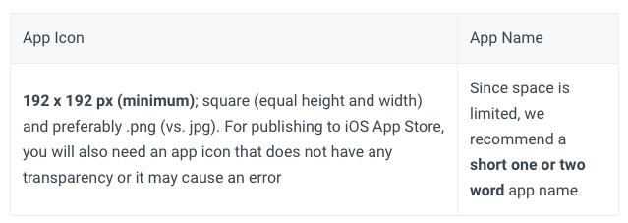
App Icon and name in thunkable
Thunkable supports uploading a separate image file for your custom icon and adding your app name -- the name that appears next to your app icon on your phone (this is different from your project name when you create a new app). These settings are found on Screen1 only.
For the app icon, please make sure the file you upload does not have the same name as one uploaded in your files. This will cause an error.

Slide 8

Test out app icon and name
You have to do this in BlueStacks, the Thunkable live testing app will not allow it to be visible.
If you open the .APK in Bluestacks, the following changes should appear.
App icon shows up in your list of apps
It has the nam that you gave it
My App 101

Slide 9
Spacing and arranging elements
Since mobile phones and tablets are made in all different shapes and sizes, it's not possible to simply drag and drop elements on a screen so that they are positioned on a screen like you would in a Google Slides document, which is set to a fixed height and width.
To position elements of an app in Thunkable, you'll have to manage the spacing between elements with a few powerful properties.

Slide 10
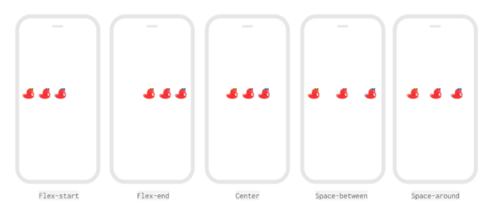
Spacing and arranging elements
You can space elements within a Screen, Row or Column using two powerful properties Justification and Alignment.
Notes:
DEMONSTRATE THIS by adding a few images and showing how these spacing things work.

Slide 11
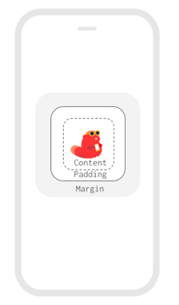
Spacing around a single visible component
To create space around a visible component like an Image, you can use the margin and padding that are found in the Advanced section of the component properties. In most cases, you can add a margin OR padding to create space around an element -- they are interchangeable and can be set both in pixels and percent of the height or width.

Slide 12
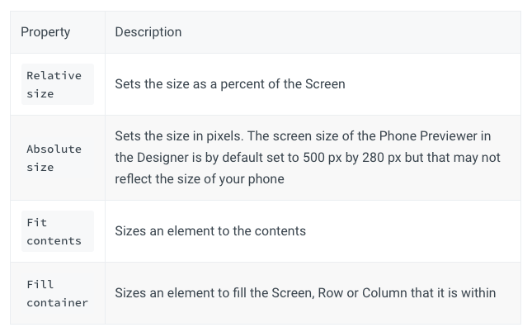
What do all of those sizing options mean?
“Fit contents” or “fit container” will usually be your best bet as they ensure nothing gets cut off the screen.
Notes:
Again, demonstrate this with an actual image.

Slide 13
Let’s work on making form components
Hypothetical situation - we are working for an Italian restaurant and we need to create an order form for the online food delivery app system.
We need to work on making components that allow the user to put in their own inputs.
Button (already learned this)
Text input
List Viewer
Let’s look at each of these components in depth to create our italian restaurant ordering app.

Slide 14
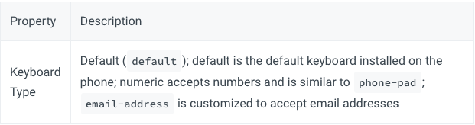
Text input component
The Text Input component allows users to type in text as an input into an app, for anything from filling out forms to passwords. You can set a specific keyboard type.

Slide 15
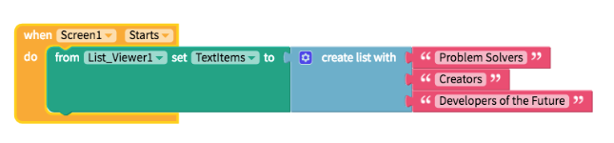
List-picker component
The list viewer gives users the option of selecting a choice from a list of several options. However, setting this up requires us to write some code in the beginning.

Slide 16
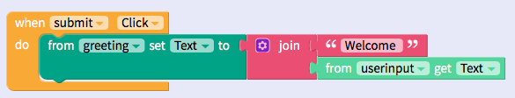
Making the user’s input count
Add a button (named submit), a label (named greeting), and a text-box (named userinput) to the palette and add code.

Slide 17
Go ahead and test the app.
What is the logic behind what just happened?

Slide 18
Now, we are going to finish up making the restaurant app.
Notes:
Go as HARD as you want on this part lol

