Slide 1
Littlebytes summer ‘18
Introduction to App Development

Slide 2
Last week’s review
Gaming introduction
Image sprites vs. Balls
Controlling motion with speed and interval
Ball radius
Properly sizing an image sprite
Rock Paper Scissors
Handling all the possible conditions
Setting up three groups of conditionals
Having a computer pick a random integer choice
Last week’s homework
Making two computers play against each other
Two students can share their solutions
We’ll go over it together

Slide 3
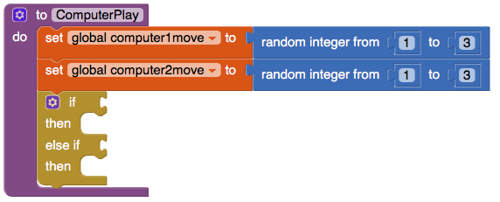
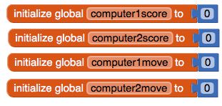
Rock paper scissors - AI vs. AI
Notes:
Hints to get started here

Slide 4
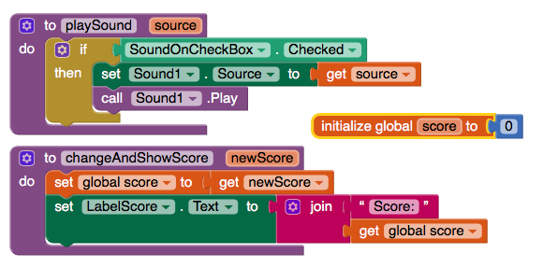
Wrapping up one-player pong

Slide 5
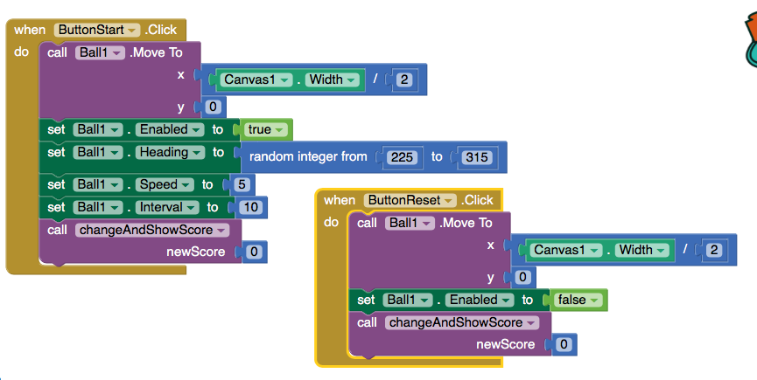

Slide 6
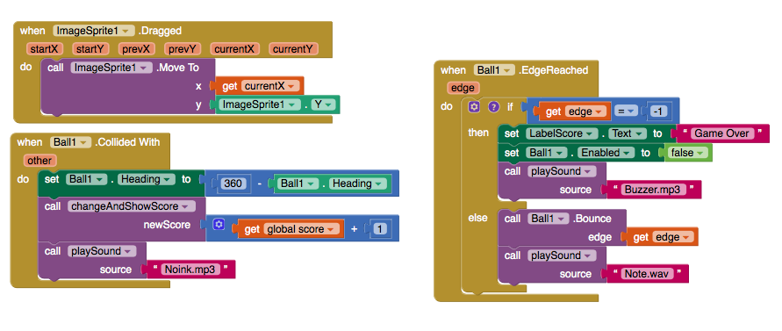

Slide 7
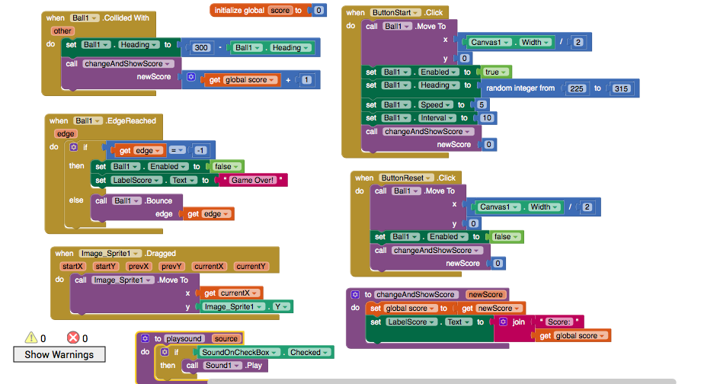
All those blocks

Slide 8
Android studio introduction
Android Studio was first announced at a Google I/O conference in 2013 and was released to the general public in 2014 after various beta versions. Prior to its release, Android development was handled predominantly through Eclipse IDE, which is a more generic Java IDE that also supports numerous other programming languages.
Android Studio makes life significantly easier compared with non-specialist software, but is still has a little way to go before it can claim to be a completely intuitive and smooth experience. For complete beginners, there is an awful lot to learn here and much of the information available – even through official channels – is either out of date or too dense to make head or tails of.

Slide 9
WHAT IS THIS THING?
As an IDE then, Android Studio’s job is to provide the interface for you to create your apps and to handle much of the complicated file-management behind the scenes. The programming language you will be using is Java and this will be installed separately on your machine.
Android Studio is simply where you will write, edit and save your projects and the files that comprise said projects. At the same time, Android Studio will give you access to the Android SDK or ‘Software Development Kit’.
Think of this as an extension to the Java code that allows it to run smoothly on Android devices and take advantage of the native hardware. Java is needed to write the programs, the Android SDK is needed to make those programs run on Android and Android Studio has the job of putting it all together for you.
At the same time, Android Studio also enables you to run your code, either through an emulator or through a piece of hardware connected to your machine. You’ll then also be able to ‘debug’ the program as it runs and get feedback explaining crashes etc. so that you can more quickly solve the problem.

Slide 10
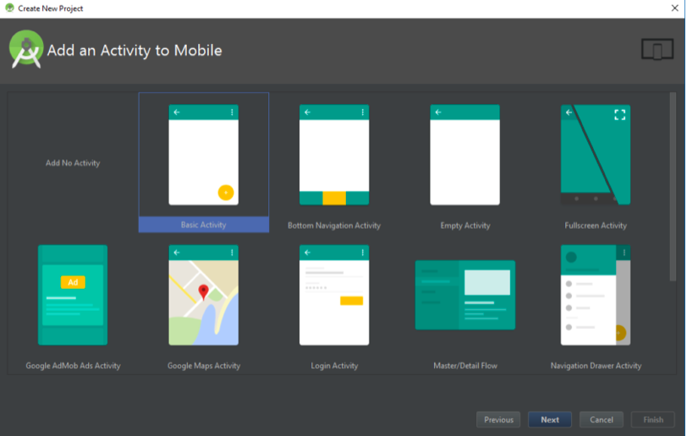
ACTIVITY
You’ll then have the opportunity to choose from a number of different types of activity. Activities are effectively ‘screens’ in an app.
Often you’ll choose a ‘Basic Activity’, which is the default look and feel for a new Android App. This will include a menu in the top right corner, as well as a FAB button – Floating Action Button – which is a design choice that Google is trying to encourage. An ‘Empty Activity’ is the same thing but without the added chrome.

Slide 11
WHAT ARE ALL THESE FILES?
I remember my first time using Android Studio was rather daunting compared with the programming experience I’d had previously. To me, programming meant typing in a single script and then running that script. Android Development is rather different though and involves lots of different files and resources that need to be structured in a specific way. Android Studio exposes that fact, making it hard to know where to start!
The main ‘code’ will be the Java file that has the same name as your activity. By default, this is MainActivity.Java but you may have changed that when you first set up the project. This is where you will enter your Java and where you’ll define the behavior of your apps.
However, the actual layout of your app is handled in another piece of code entirely. This code is the file called activity_main.xml. XML is a markup language that defines the layout of a document – much like HTML which is used for creating websites. It’s not really ‘programming’ but it is a kind of code.

Slide 12
In summary
XML
is like the Thunkable “designer”
JAVA
is like the Thunkable “blocks”
Notes:
Note about how we aren’t going to learn Java rn

Slide 13
Adding some elements + Messing around with android studio
Notes:
https://developer.android.com/training/basics/firstapp/building-ui

Slide 14
Final project planning
Becoming a programmer isn't just about learning the syntax and the concepts of a programming language: it's about figuring out how to use that knowledge to make programs. You've made a bunch of programs in this course, in the challenges and projects, but now you should come up with ideas for new programs - ideas that you're personally really excited about - and try to turn those into actual programs.
You probably won't know everything you need for your program when you start it, and that's totally okay -- you'll be motivated to learn those new things because of how much you want to make your program real. Programmers are constantly learning new things for new projects, and that's part of why we love it so much. Let's step through the process of planning a programming project.

Slide 15
What do you want to make?
When I first started programming, I found myself constantly thinking of new programs to make and writing those down in a list. I was addicted to the power of creation, and there was so much my brain wanted to make. If you're like that, then you probably already have an idea of what you want to make, and perhaps you have your own list.
If you don't already have an idea, then here are some questions to help your brainstorming:
What's your favorite game - arcade game, board game, sports game? Could you make a simplified, digital version of that? Could you mix it up a bit, like give it a different theme or main characters?
What are your other favorite academic fields? If you love art, could you make an art-making program? If you love history, how about an interactive timeline? If you love science, how about a scientific simulation?
What's your favorite movie or TV show? Could you make a digital version of a scene or character from it? Maybe make a game based on it?
What's a real-life gadget that you love? Could you make a simulation of it?

Slide 16
Writing out the planning
Once you've picked an idea, you should write a description of it. For example, if I decided to make a clone of "Breakout", because that's a really cool retro arcade game, I might write:
Breakout: a game where you control a paddle at the bottom of the screen, and you use it to hit a ball upwards and at angles to break bricks. The goal is to break all the bricks, and not let the ball through the ground too many times.
You'll flesh that description out later, but for now, that gives you a good enough idea to keep going in the planning process.

Slide 17
What technologies to use?
In this step, you need to consider which technologies (languages/libraries/environments) you're familiar with or able to learn easily, and which of them are the most well suited for the job. This includes which import statements or APIs you need to use!
If you want to build those things but don't know other technologies, you might want to come up with a new program idea. You can learn a new technology for a new project, but especially if you're just getting started in programming, it's a good idea to get really good at your first language first.
In Python, we usually have to settle for things that are less Graphical, and more logical - using text only.

Slide 18
What features?
This is where we get into the real planning, and where (I think) it gets fun. Your goal in this step is to figure out what you're actually making- what will it look like, what features it will include, what features it won't include.
The first thing you can do is make "mock-ups" - sketches that look like the thing you're making, but without details like coloring or exact sizing. You can make mock-ups on paper, or with online programs.
In Python, it’s easiest to “mock up” a program using just text. What text will the console display to interact with the user?

Slide 19
How to decide what features to use?
If we all had infinite time to make all the programs in our heads, then they'd all include every feature in our list. But we don't, so in this step, you have to decide which features are the most important, and which features you'll do only if we have time. This will also help you figure out which order to implement features in, from most to least important.
To help you figure out the importance of each feature, ask yourself these questions:
If I shared this with a friend, which features would I want to make sure were working?
Which features am I the most excited about building?
Which features are the most unique to my program?
Which features will I learn the most from implementing?
Are there any features that seem too far beyond my current skill level?
Then, go through your feature list from the last step, and either order the list or add a rank to each feature.

