Slide 1
Littlebytes summer ‘18
LittleBytes Summer Academy 2018

Slide 2
Review of last week’s material
Testing apps using an emulator (Bluestacks)
App Settings
Name,Icon, File Name
Spacing and sizing elements
New Components
Checkboxes
Horizontal/Vertical Layouts
List-Picker Element
Activity Buttons
Alignment, aesthetic, UI/UX design tips
Custom fonts from Google Fonts
Making colors using a list block

Slide 3
Warm-up before class
Two kids can share their week 2 assignments.
To start off, create an app in Thunkable (classic Android version is what we will be sticking to from now on), and make two different screens with a button that links them.
Make sure to include both a forward button on one page, and a backwards button on the other page.
We will do it together as a class once everyone has attempted it themselves, but you guys should all know how to use this by now!

Slide 4
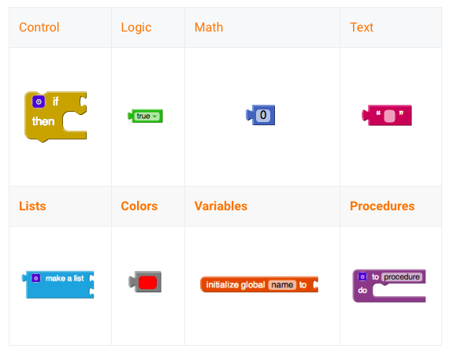
Blocks - a little more in depth explanation
Built-in blocks are available regardless of which components are in your project. In addition to these blocks, each component in your project has its own set of blocks specific to its own events, methods, and properties. This is an overview of all of the Built-In Blocks available in the Blocks Editor.

Slide 5
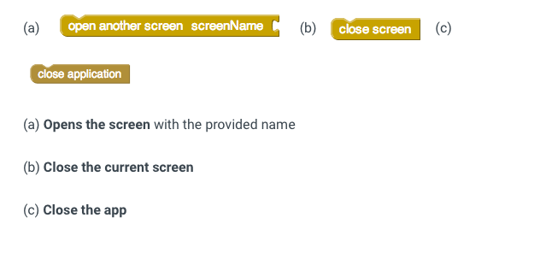
Screen navigator blocks

Slide 6
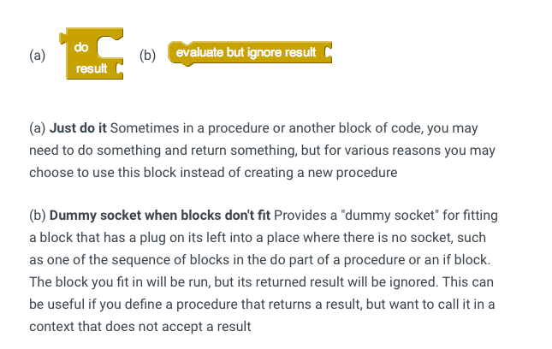
“Just do it” blocks

Slide 7

Repeating a certain event
Repeats event for all items in a list Runs the blocks in the do section for each item in the list. Use the given variable name, item, to refer to the current list item. You can change the name item to something else if you wish.

Slide 8
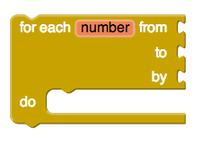
Repeating event a certain amount of times
Repeats an event for a certain number of times Runs the blocks in the do section for each numeric value in the range starting at from and ending at to, incrementing number by the value of by each time. Use the given variable name, number to refer to the current value. You can change the name number to something else if you wish.

Slide 9

Repeating events based on a condition
Stops repeating event if certain condition is true Tests the -test condition. If true, performs the action given in -do , then tests again. When test is false, the block ends and the action given in -do is no longer performed.

Slide 10

If we have conditions...we need logic blocks
(a) True Represents the constant value true. Use it for setting boolean property values of components, or as the value of a variable that represents a condition
(b) False Represents the constant value false. Use it for setting boolean property values of components, or as the value of a variable that represents a condition.

Slide 11
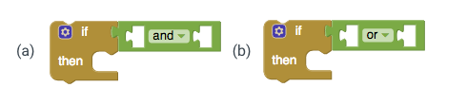
Visual - advanced conditionals

Slide 12
Advanced conditionals
(a) Two conditions must be true Tests whether all of a set of logical conditions are true. The result is true if and only if all the tested conditions are true. When you plug a condition into the test socket, another socket appears so you can add another condition.
(b) Either condition must be true Tests whether any of a set of logical conditions are true. The result is true if one or more of the tested conditions are true. When you plug a condition into the test socket, another socket appears so you can add another condition.

Slide 13
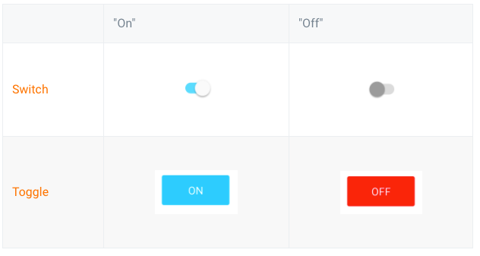
New component - toggles and switches
Toggles and switches are useful buttons for switching a user between two settings or states. They are pretty similar, but easy to get mixed up.

Slide 14
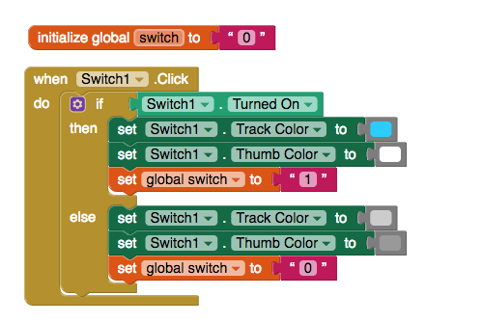
Changing appearance of switch when on and off
This code will allow the switch to change its appearance so that the user can tell the difference between the switch’s on and off state.
Why do we need that “switch” variable?
Notes:
Do this in Thunkable and demo it, and answer the question.

Slide 15
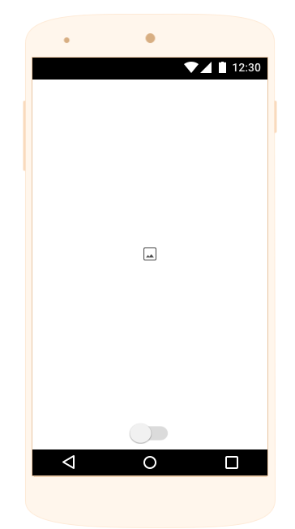
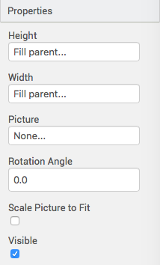
Let’s turn it into a light “switch”
Find an image of a transparent .png lightbulb on Google Images. This is a good one to use.
Put it on Thunkable through “upload assets” in a full-width, full-height image.

Slide 16
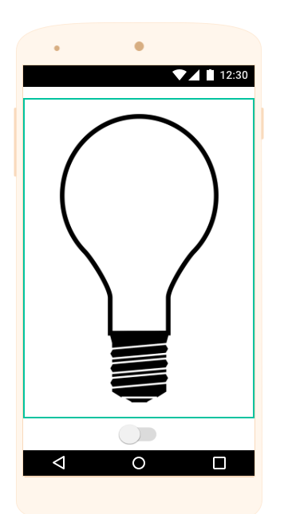
Here’s our result!
We are going to use the code we just wrote to change the background color of the entire page. If it’s yellow, then the bulb is “lit up”. If it’s black, then the bulb is off and you can’t see anything.
Add the following code to your existing “switch1.click” chunk.

Slide 17


Light switch code
Under “if switch on”
Under “else”
Notes:
Do and test all of this!!

Slide 18
Comprehension check
Let’s check our understanding of conditional logic.
If we want the switch to also change the color of the room to a custom color when it is turned on, leaving it black when it is turned off, what do we need to do?
Here’s a hint. Remember how we created custom colors in Thunkable a few classes back? It’s a specific type of element…
Everyone can attempt the solution before we go over it.

Slide 19
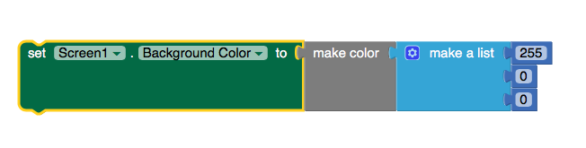
Comprehension check answer

Slide 20
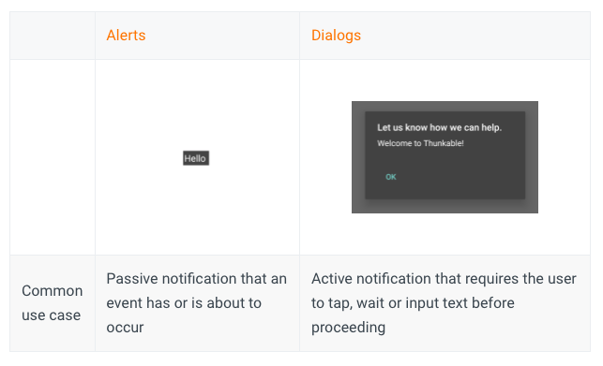
Thunkable Component - notifiers
Notifiers come in two flavors - alerts, which are more passive but whose appearance can be customized and dialogs which default to the Material Design design but prompt users to confirm (Message Dialog), make a choice (Choose Dialog), enter text (Text Dialog) or wait (Progress Dialog) for a certain event before proceeding.

Slide 21
Difference between allerts and dialogs
Alerts require no user confirmation or “OK”, but dialogs require the user to interact with them.
Alerts are useful as passive messages as the user is navigating your app but no action is required such as "Login successful".
Dialogs are useful when a message requires the user's attention and in some cases, a choice before proceeding.
Both are with the “notifier” block.

Slide 22
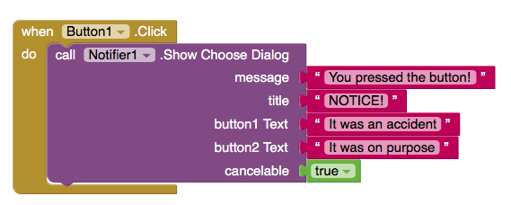
Example with pressing a button - dialogs
What does message, title, button1, and button2 mean?

