Slide 1
Littlebytes summer ‘18
App Development - Week Four

Slide 2
Review of last week’s material
Making forms that actually work in Cloudstitch!
Cloudstitch
Logging in and setting up a new project
“Widget” setting configuration
Modifying and selecting an API endpoint for project
Making requests to the Cloudstitch server
Downloading ListPicker data from Cloudstitch
Using our own endpoint vs. using my endpoint
Homework review
Two students can share their homework from last week!
Demonstrate the Cloudstitch request live, so that we can see if your post request worked or not

Slide 3
Maps, distance, and extensions
Today, we are going to learn about the maps, location, and distance components available on Thunkable, as well as about Extensions, which we can use to put user-made content in.
Maps are used in a wide variety of apps, besides on the Google Maps website. Ever had an app ask your permission to enable location services on your device permanently?
In Thunkable, these components are all located on the left side of the screen, under the “location” folder.
To warm up, let’s make a location sensor and some buttons.

Slide 4
Location sensor component
From the latitude and longitude readings, the location sensor can provide an estimated street address and the speed at which a device may be moving. If available, the Location Sensor also measures altitude but you likely have to be outside for it to work properly.
While location accuracy has significantly improved in recent years, there are times when location is not easy to detect such as indoors.
If you are using an emulator like BlueStacks, location calculations will be accurate, but not very precise.

Slide 5
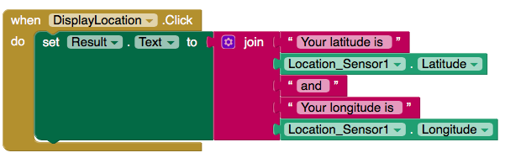
Testing out the location sensor
Create a button called “DisplayLocation” and a Label called “Result” to output the location sensor data.

Slide 6
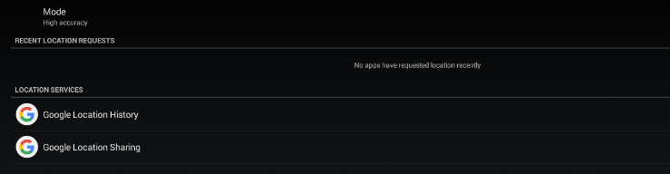
Bluestacks location testing
If you’re testing in BlueStacks, then double-check your settings to make sure location services are enabled.
On a physical device, make sure your regular location services are allowed for the Thunkable app.

Slide 7
Time intervals
The time interval determines the minimum period in milliseconds, that the sensor will try to use for sending out location updates. Location updates will only be received when the location of the phone actually changes, and use of the specified time interval is not guaranteed.
For example, if 1000 is used as the time interval, location updates will never be fired sooner than 1000ms, but they may be fired anytime after.

Slide 8
Distance intervals
The distance interval determines the minimum distance interval, in meters, that the sensor will try to use for sending out location updates.
For example, if this is set to 5, then the sensor will fire a LocationChanged event only after 5 meters have been traversed. However, the sensor does not guarantee that an update will be received at exactly the distance interval.
It may take more than 5 meters to fire an event, for instance.

Slide 9
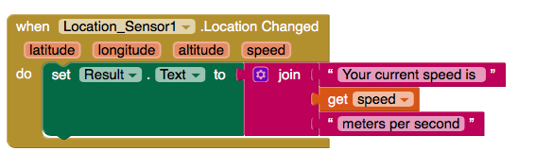
Calculating device speed
Thunkable provides speed (in meters / second) as calculated by the distance between the most recent locations divided by the distance interval.

Slide 10
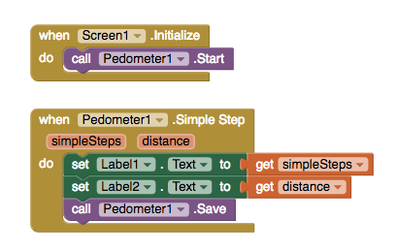
Pedometer function
The Pedometer senses motion via the Accelerometer and attempts to determine if a step has been taken. Using a configurable stride length, it can estimate the distance traveled as well.
What’s a simple step?

Slide 11
Setting up google maps
Let’s pause for a bit to set up our next component, which is Google Maps (located under “visualization” folder).
Create a full size Google Maps component, a menu of three buttons to manipulate, and a navigation button.
This should be done on a new screen, so add the appropriate navigation buttons to go back and forth between this and the last screen.
We will do this individually, then as a group.

Slide 12
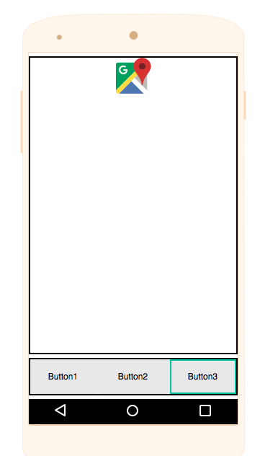
Google maps UI/UX setup
This is what your Google Maps setup should look like.
For the buttons, keep in mind that if you “fill parent” the height and width of all three buttons, then they will automatically take up equal spaces in the horizontal arrangement tab.

Slide 13
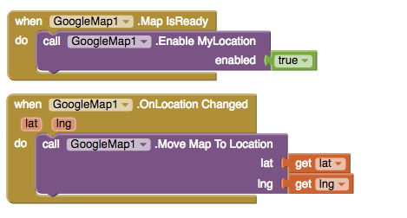
Auto-centering on a user’s location
This code will wait for the map to load from Google, then it will auto-center on the user’s location.

Slide 14
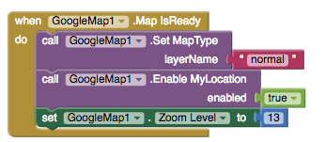
Setting the map type to normal

Slide 15
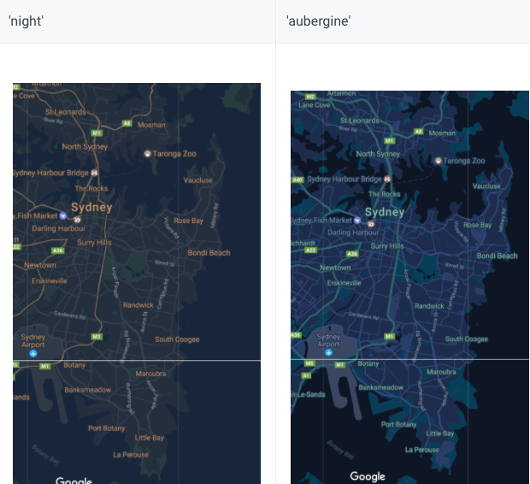
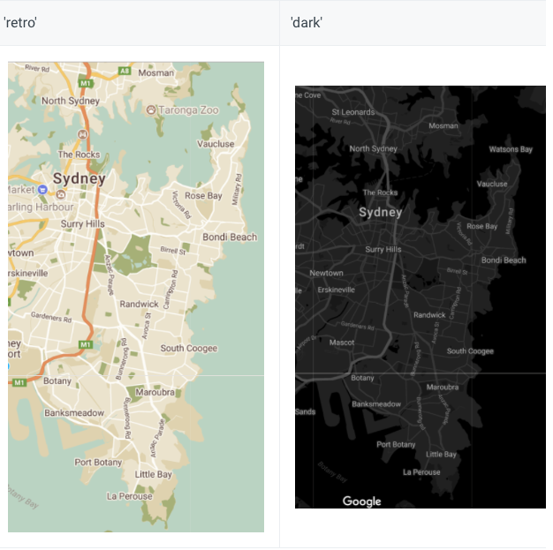
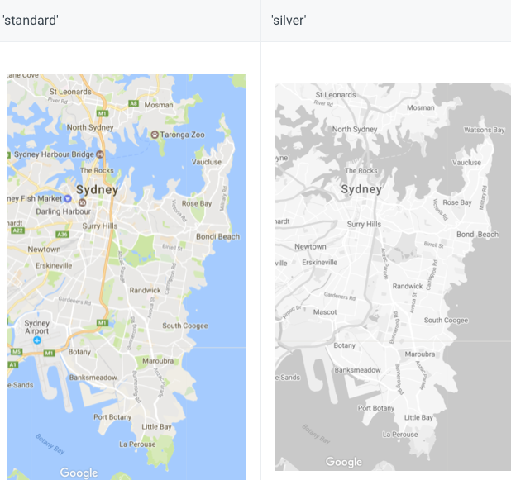
Changing the style of the map
Each button on our menu will change the theme of the map.

Slide 16
Adding a standard marker
When the map is clicked, a marker will be added wherever the user clicked (directly on the map, not a button)

Slide 17
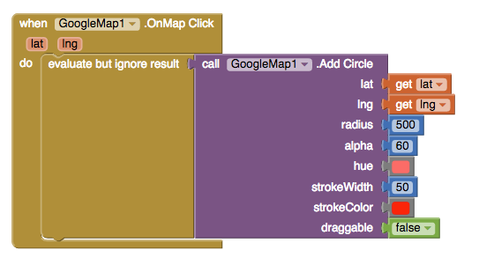
Adding a circle with click
This code will add a circle wherever the user put down their finger on the screen. Delete the previous code first! Why?

Slide 18
Review, questions,or concerns?

