Slide 1
Littlebytes summer ‘18
Introduction to App Development Week 5

Slide 2
Last class review - Maps and location
Location Sensor
Grabbing information from a location sensor
Handling an invisible component
Displaying accurate locations
Google Maps
Setting up a map with no API endpoint required!
Changing the map theme
Centering on user-location in BlueStacks
Changing color scheme
Today
Loading from a spreadsheet
Using the distance extension
Two people can share their week 4 assignment!

Slide 3
Extensions in thunkable
Extensions are components that have been created by our amazing community of Thunkers. While Thunkable cannot guarantee that theplatform will support all extensions, many of them do work wonderfully on Thunkable.
Trusted resources for extensions
​Thunkable Community Forum #Extensions - section of the community forum dedicated completely to posting
​Pura Vida Apps by Taifun - complete list of extensions available for all platforms compatible with App Inventor

Slide 4
How to use extensions
To use an extension in your app,
First download an extension (.aix) it from a trusted resource like Thunkable Community Forum #Extensions​
Import it to the Extensions drawer of your Designer palette
Drag and drop the extension into your app
We are going to be using a distance calculation extension, which we can find at the GitHub link here. Grab the .aix file and upload it into your components!

Slide 5
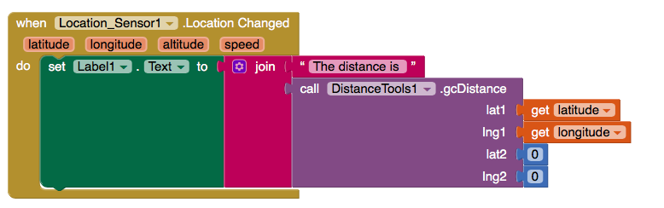
Extensions example
Add a label, the extension, and a location sensor. This example calculates the distance to the absolute center of the earth (latitude and longitude zero).

Slide 6
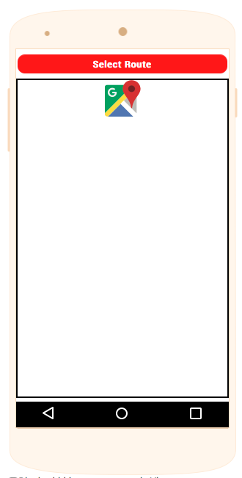
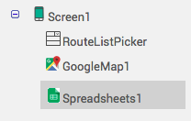
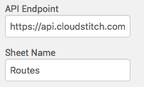
Combining google maps + Spreadsheets
Use https://api.cloudstitch.com/mrching/firstbusmapdhaka as an endpoint for your project. The spreadsheet is visible here. This app is a bus route demonstration for Dhaka.
Notes:
Explain all the parts of this, show all the components etc. GO to blocks and show the code also.

Slide 7
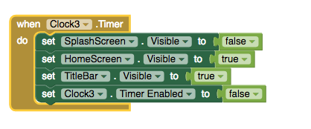
Component - clock
The clock functions both as a timer and as a regular “clock” that displays the time. This example shows how to make a logo screen appear for a few seconds, and then switch to the next screen. Make sure you’re working with Screen1 with just a logo, and Screen2. The timer should be set to a certain number of milliseconds.

Slide 8
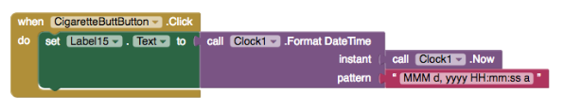
Clocks for time
Clocks can also be used for the regular date and time also. The string results that are returned must be outputted to a label, an automatic text or alert will not come up.

Slide 9
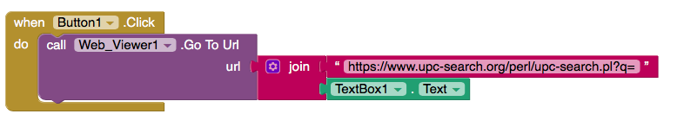
But what if we don’t have a physical device?
Let’s add a functionality to manually type in the UPC code, in case we are testing on BlueStacks and we don’t want to use a physical device with a camera. Start a new screen.
Remember to add navigation buttons between screens!

