Slide 1
Littlebytes summer ‘18
Introduction to App Development

Slide 2
Review of last week’s material - 5 minutes
Extensions
Trusted sources to download extensions from
Deciding what file type to extract
Dragging into app for usage
Example - distance calculator extension
More Maps Features
Changing the theme of a map page
Using buttons to manipulate the map
Connecting an extension to Maps
Homework
Two students can walk the class through last week’s homework
Make sure to simulate in BlueStacks!

Slide 3
Intelligent applications
For our apps to be “intelligent”, they have to have their own way to make decisions on their own - some set of rules, or conditions to help them think independently.
In code, this is called conditional logic, where if a certain test, or condition is true, the program will execute a condition. These conditions can be stacked up to hundreds of different situations, eventually leading to what is known as artificial intelligence (AI).
While we won’t be doing AI, we will be learning conditional logic blocks in Thunkable today.
Notes:
5 min

Slide 4
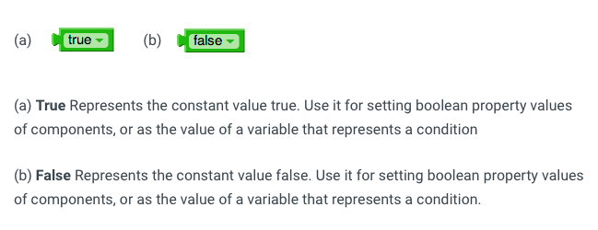
Basic blocks - true and false
Notes:
2-3 min

Slide 5

If-and-then, if-or-then
(a) Two conditions must be true. The result is true if and only if both the tested conditions are true. When you plug a condition into the test socket, another socket appears so you can add another condition. The conditions are tested left to right.
(b) Either condition must be true Tests whether either of a set of logical conditions are true. The result is true if one or more of the tested conditions are true. The conditions are tested left to right, and the testing stops as soon as one of the conditions is true. If there are no conditions to test, then the result is false.
Notes:
5 min

Slide 6
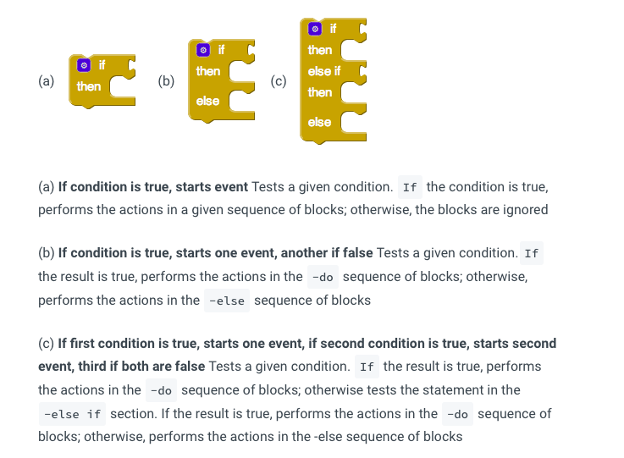
Notes:
5 min

Slide 7
Conditionals example - public vs. private school
This app will display the average cost of public school and private school by having the user put in a 1 for public, and a 2 for private school. We will need a text box, a button, and two labels to display the output here.
1 = Public school cost should be displayed
2 = Private school cost should be displayed
This is a fairly simple conditional for us to start out with.

Slide 8
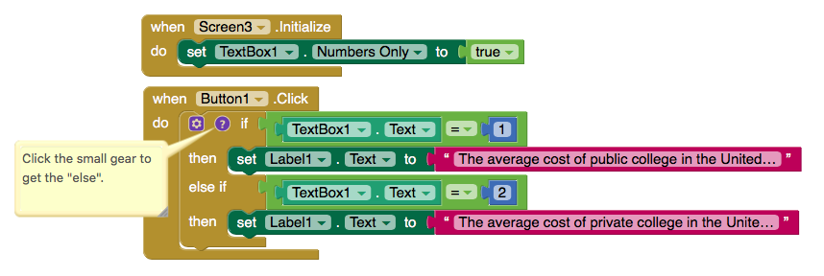
Code - public vs. private school

Slide 9

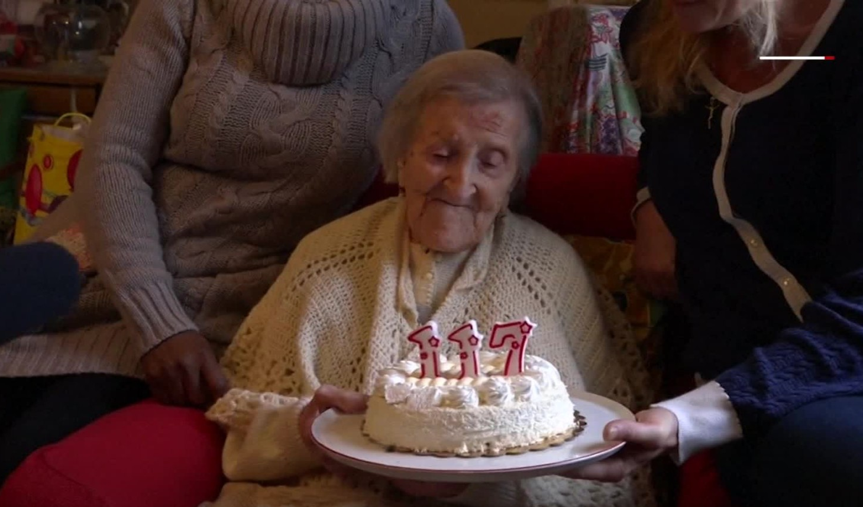
Conditionals example - age validator
Say we are making a registration page for a website. We need to make sure the age of the person is over 13, but less than the age of the oldest living person on Earth, to make sure they are putting in a valid age to register.
We need a text box, a button, and a notifier to do this.
Notes:
5 minutes - explain why we need a conditional for this.

Slide 10
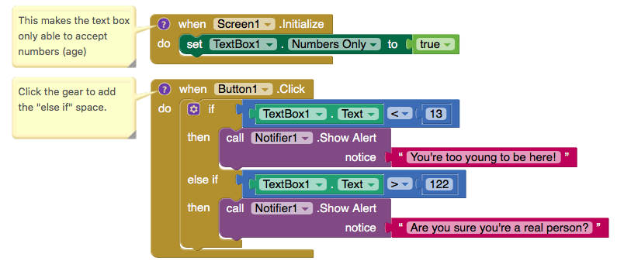
Age validator code
Notes:
Allow as much time as needed. Make sure to explain every step’s purpose.

Slide 11
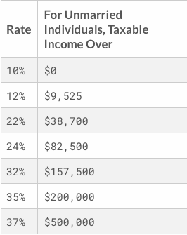
Conditionals example - income tax calculator
In the United States, workers pay a “productivity tax” on their income based on certain brackets that they earn in. We are going to create an income tax calculator that will tell people how much tax they owe on their paycheck. Here is the current administration’s tax plan. We will assume this is for a single individual.
Notes:
Add a new screen withthe The a text box, 2 buttons, and label.

Slide 12
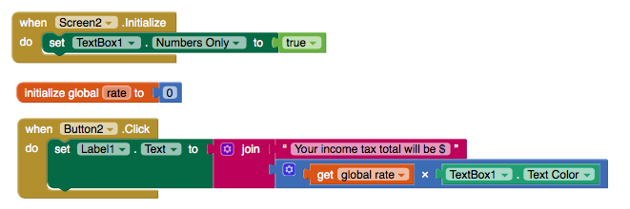
Not the complicated part of the code...

Slide 13
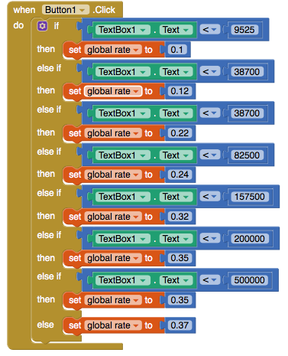
And...Yikes!
Intelligently using the “duplicate” feature is going to benefit you here. Remember that to add all the “else if” and “else” spaces, you need to click on the small gear in the top left corner of the first if block.

Slide 14
discussion - how do conditional statements lead to artificial intelligence?
Notes:
5 min - get them to talk as well, do not be the only one talking.

Slide 15
Preview of next week - microsoft AI APIS
The concept of what defines AI has changed over time, but at the core there has always been the idea of building machines which are capable of thinking like humans.
After all, human beings have proven uniquely capable of interpreting the world around us and using the information we pick up to effect change. If we want to build machines to help us do this more efficiently, then it makes sense to use ourselves as a blueprint. Thunkable has AI components from Microsoft that do image and emotion recognition for images.

Slide 16
Trying out the microsoft apis
https://azure.microsoft.com/en-us/services/cognitive-services/computer-vision/
This website allows you to test out the APIs that make up the blocks that Thunkable provides for these services.
Using the tab below, you can either upload your own images from your computer using “browse”, or you can copy an image URL from Google (“copy image address”)
Notes:
Show them

Slide 17
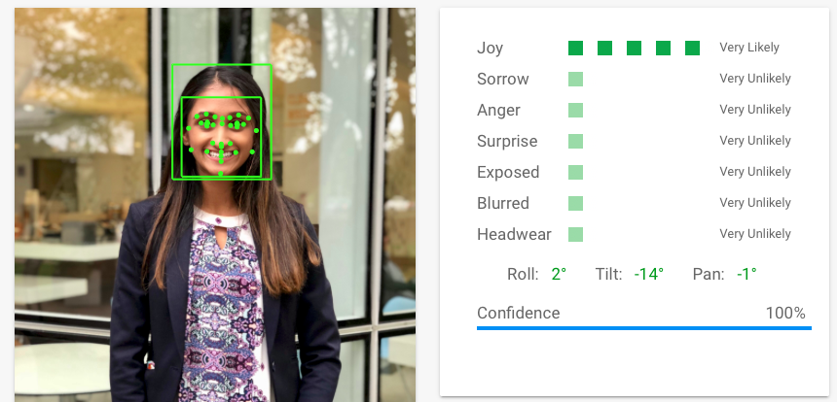
Similar technology - google cloud vision
https://cloud.google.com/vision/. Here are the results.
This is Prianka, but you can use a picture of yourself
Notes:
Show it to them

Slide 18
Let’s review what we learned today. Any comments, concerns, or questions?

