Slide 1
Littlebytes summer ‘18
Introduction to App Development

Slide 2
Last week’s review
Conditional structures
If statements
If-then statements
Clicking the gear to get more conditions
Examples
Age validator
Income tax calculator
Public vs private school
Introduction to artificial intelligence
Microsoft recognition API
Google cloud vision API
Last week’s homework
Two students can share their homework!

Slide 3
Review - microsoft thunkable apis
Artificial intelligence is the idea and fast-charging reality that computers will be able to perform tasks that normally require human intelligence, such as visual perception, speech recognition, decision-making, and translation between languages. So that we can all get ahead of the machines, the Thunkable platform already features a number of components that are powered by the latest in artificial intelligence available today -- with many more to come in the future.
What are some examples of the difference between emotion and image recognition?

Slide 4
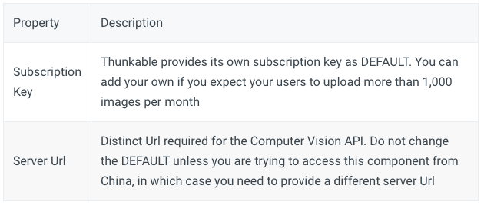
Setting up these apis
Thunkable provides its own API key by default for your convenience but if you expect your users to upload more than 1,000 images per month, please create your own free account. The blocks for image and emotion recognition are found under the Artificial Intelligence folder.

Slide 5
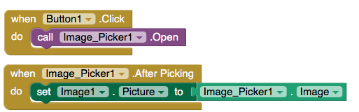
Image picker + camera components
There are two elements to an ImagePicker, a button that opens the ImagePicker and the ImagePicker itself. The button you can customize but the ImagePicker design is the Android default.
selection
Notes:
It says imagepicker1.selection

Slide 6
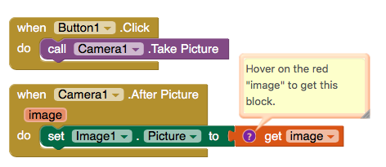
Image picker + camera components
The camera block uses the phone’s built-in camera feature to take an image, temporarily store it, and provide it for usage in an app.

Slide 7
Image recognizer demo
The Image Recognizer returns information about visual content found in an image and provides a set of tags and its best single line description. The sample app Thunkableagram: AI-powered Instagram uses the Image Recognizer to auto-caption images. To test this app for yourself, download the APK and run it like you would any of your own Thunkable projects.
Take a look at the code - how is the image recognizer being used here to generate captions for the images?

Slide 8
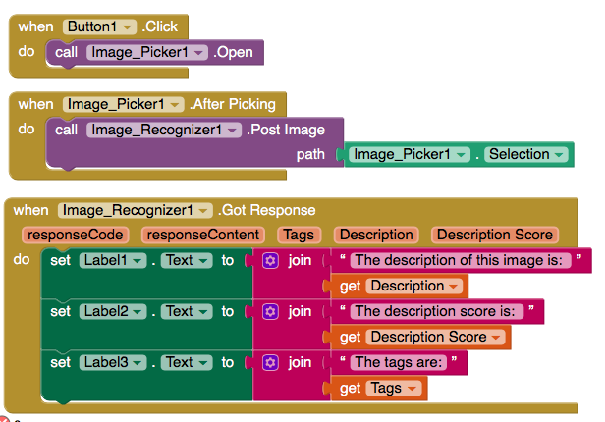
Image recognizer code
This code lets the user select an image, then it outputs information about the image based on the API’s response content.

Slide 9
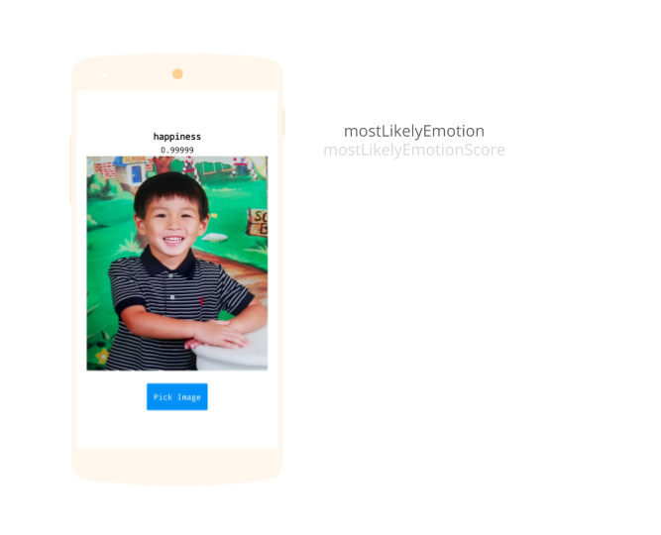
Emotion recognizer code
The Emotion Recognizer detects emotions from images containing a single face. The emotions detected are anger, contempt, disgust, fear, happiness, neutral, sadness, and surprise. These emotions are understood to be cross-culturally and universally communicated with particular facial expressions.

Slide 10
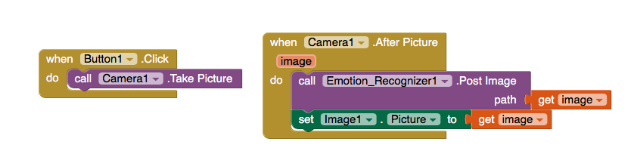
Emotion recognizer code

Slide 11
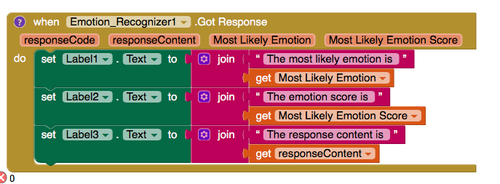
More emotion recognizer code

