Slide 1
Littlebytes summer ‘18
App Development - Week 8

Slide 2
Last week’s review
Image/Media components
Picking an image from the camera roll
Taking a new image with the camera component
Setting a new image to be displayed
What are image paths, why do we need them?
Artificial Intelligence
Microsoft image and emotion recognition APIs
Pulling results from the APIs
Displaying the request’s output
Adding images to BlueStacks for testing
Looking up result types online
Picking good input for the API
Homework
Two students can share their week 7 assignments!
Today’s class - voice and voice recognitions

Slide 3
Class syllabus
Voice component settings in BlueStacks
Playing and recording sound
Speech Recognizer component
Text to Speech feature
Translation with the Yandex API
Storing audio files online with Cloudinary
Cloudinary
What is a database?
How do online databases work?
Setting up an account and endpoint
Next week preview
Graphics, drawing and games (2 weeks)
Notes:
https://docs.thunkable.com/thunkable-classic-android/create/components/voice

Slide 4
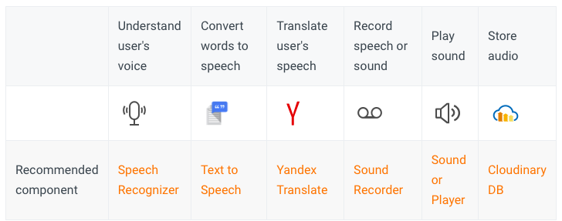
Why do we need this?
For many users, smartphones are not the ideal device for typing into. Fortunately, every smartphone has a microphone and recent breakthroughs in speech recognition technology has made our voices a natural and increasingly popular way of interacting with our devices.
In places without strong data connections, voice and audio is a much more efficient medium to work with than images or video.

Slide 5
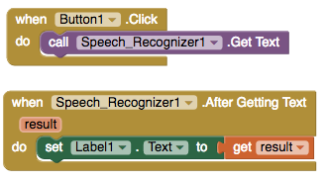
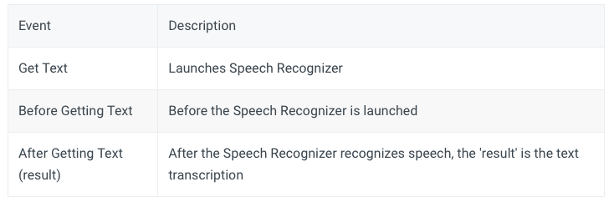
Speech recognizer

Slide 6
Text to speech
You can also change the pronunciation of words (not the actual language spoken) by supplying a language or country code. For example, setting the language to French and speaking English text will sound like someone speaking English (en) with a French accent. Setting the country code to British English (GBR) will sound different from US English (USA) and not every country code will affect every language
The languages and countries available depend on the particular device, and can be listed with the Available Languages and Available Countries properties.

Slide 7
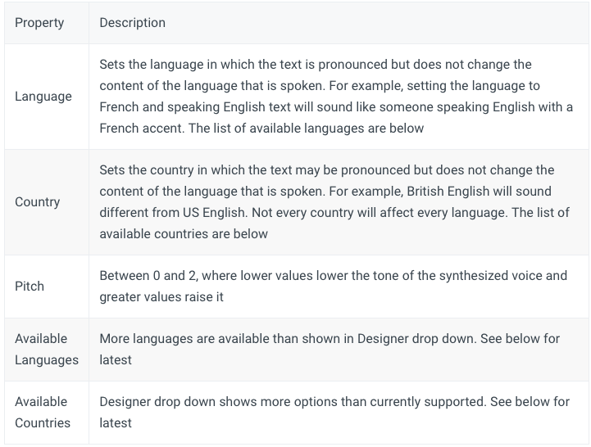
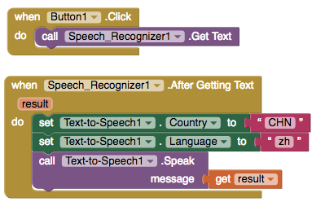
Speak text with a Mandarin Chinese pronunciation
Notes:
https://en.wikipedia.org/wiki/Google_Text-to-Speech - Available languages

Slide 8
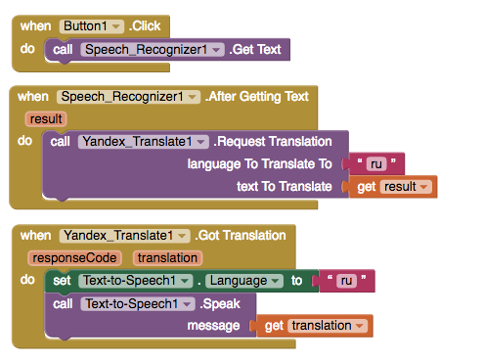
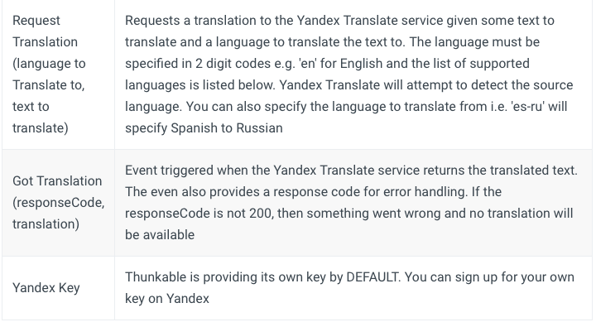
Yandex translator
Notes:
https://tech.yandex.com/translate/doc/dg/concepts/api-overview-docpage/#languages - available languages

Slide 9
Sound playing and recording
https://docs.thunkable.com/thunkable-classic-android/create/components/voice/sound-recorder
https://docs.thunkable.com/thunkable-classic-android/create/components/voice/sound-+-player

Slide 10
Next week preview, questions, concerns?

