Slide 1
Littlebytes summer ‘18
Introduction to App Development

Slide 2
Last week’s review
Another type of AI - voice
Text to speech recognizer
The reverse - speech to text
Yandex translation API
Playing, storing, and recording sounds
Player vs. Sound
Player is for long noises, like songs
Sound is for short noises, like effects
Last week’s homework
Translating a song to a different language
Two students can share their homework
My solution - the “happy birthday” translator
To Spanish!

Slide 3
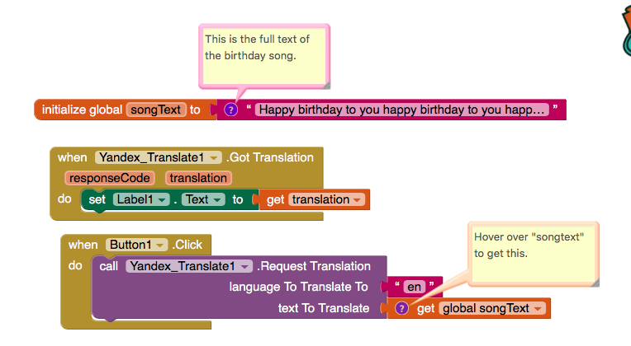
The happy birthday translator
Notes:
Label, button, translation

Slide 4
Setting up a drawing app
We are going to be making a sketchbook app today to demonstrate the functions of the Thunkable canvas element.
Set up an app with a menu of buttons inside of a horizontal or vertical arrangement. Let’s do five buttons for now.
The buttons should either be full width or full height, depending on if you did a horizontal or vertical arrangement. Why is this true?
Take five minutes to set this up on your own. There should be adequate space left for a large canvas element to fill up the screen as well. We will learn about the Canvas element.

Slide 5
Thunkable canvas
The canvas is a two-dimensional touch-sensitive rectangular panel on which drawing can be done and sprites can be moved.
The BackgroundColor, PaintColor, BackgroundImage, Width, and Height of the Canvas can be set in either the Designer or in the Blocks Editor. The Width and Height are measured in pixels and must be positive.
Any location on the Canvas can be specified as a pair of (X, Y) values, where
X is the number of pixels away from the left edge of the Canvas
Y is the number of pixels away from the top edge of the Canvas
There are events to tell when and where a Canvas has been touched or a Sprite (ImageSprite or Ball) has been dragged. There are also methods for drawing points, lines, and circles.
Add a full width, full height canvas to your app. You may also benefit from changing the orientation of Screen1 to landscape.

Slide 6
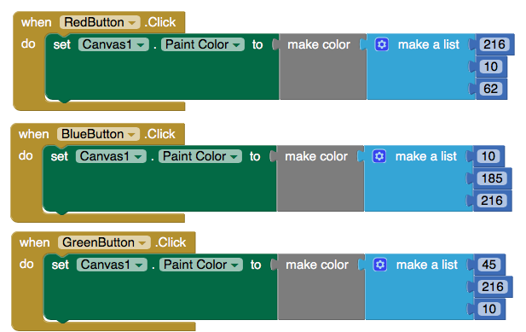
Assigning button functions
The purpose of the first four buttons will be to change the color of the pen on the canvas - the last button will clear the screen so the user can start drawing again.
Notes:
Style each of the buttons to match their function - changing the color to red, saying “Red” as the Text on the Button, etc

Slide 7
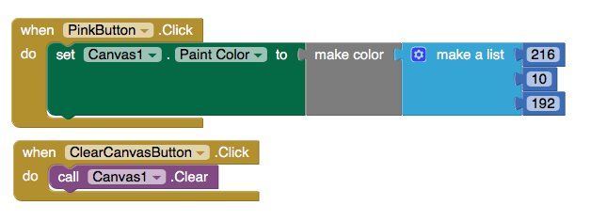
Assigning button functions, continued

Slide 8
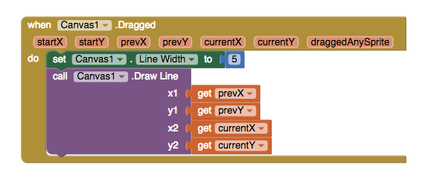
Adding the drawing functionality
What happens when prevX, prevY, currentX, currentY are called? What points do those variables represent?
Notes:
At this point, it should be tested.

Slide 9
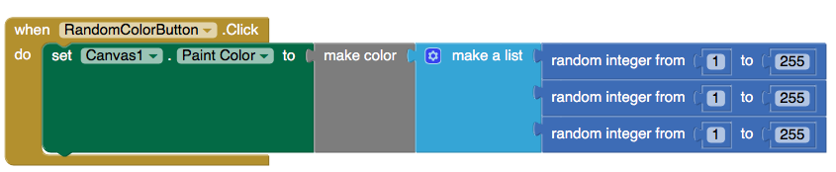
Sneak surprise feature - generating a random color
Add another button to the screen - this button will generate a random color for the user’s pen every time they click it!
All RGB colors have three values in between 0 and 255 (0,0,0 is pitch black), so if we generate a random value for each of the R, G, B, we end up with a randomized color.
Notes:
Test again after adding random functionality.

Slide 10
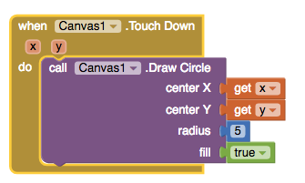
Add a circle each time the canvas is touched
Every time the canvas is “touched down”, or firmly tapped, a circle will be drawn on the screen. You can modify the size of the circle using the radius element as well.

Slide 11
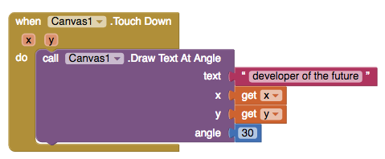
Adding text to the screen
Remove the previous code. This new code will write "developer of the future" angled at 30 degrees with each touch of the canvas.
Notes:
Modify this with different angles, font sizes, etc.

Slide 12
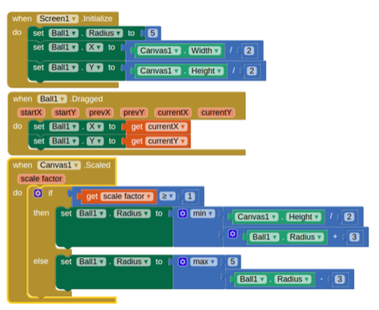
Scalable shapes
When the user pinches open (or close) on a selected Canvas item (ball, image sprite), the item scales by the scale factor. The scale factor increases as the pinch opens and decreases as the pinch narrows.

Slide 13
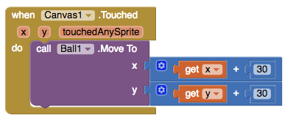
Interacting with ball/sprite
When the user touches the canvas and then immediately lifts finger.
The (x,y) position of the touch is relative to the upper left of the canvas.
TouchedSprite is a boolean value which is true if the same touch also touched a sprite.

Slide 14
intro to next week’s material
Next week, we will be creating Thunkable Pong, a simple, single-player game where the user can paddle the ball and make sure it doesn’t hit the ground, to get points.
How does the Canvas apply to Pong construction?
Dynamic ball component
Adding shapes instantly
Many colors, text, etc are available
What else can you think of?
Any questions, comments or concerns?

