Slide 1
LittleBytes Summer ‘18
Python - Week 1

Slide 2
Instructor introduction
Name, where are you from, and what do you do?
Programming experiences in the past
Recommendations for being a successful coder

Slide 3
Class Logistics
Class is at the same time every week
Instructors will change throughout the session to introduce you to different teaching styles
There will be weekly homework assignments!
Office Hours
Optional, extra help sessions free of charge
Just e-mail littlebytesprogramming@gmail.com to schedule
Homework help or on other projects
12 weeks long, 2 hour sessions each week

Slide 4
What is python?
Python is an interpreted, object-oriented, high-level programming language with dynamic semantics.
What does this mean? Let’s break that sentence down.
Interpreted
How the computer processes our instructions
Object-oriented
Centered around a piece of information called an “object”
High-level
The code looks almost like English
Semantics
The way a language is typed on the screen
It’s a great language for beginners!

Slide 5
What is computing logic?
To operate independently, a computer needs to function using its “brain” with instructions we give it.
The four main components of computing logic are:
Variables
Conditionals
Functions
Loops
Let’s take a brief overview of what each one of these terms means using simple language.
For example, the conditional is the foundation for a very popular topic in technology today called artificial intelligence - you may have heard of it before.
Notes:
Explain each one independently

Slide 6
How do these combine?
We type instructions to the computer using the Python programming language and it executes them
Most elements of coding require using different elements of logic to make intelligent programs
Common uses of Python
What is scientific computing?
Why is Python useful for data analysis?
Why is Python good for beginners?
Now, we will set up our development environment.
A development environment consists of all the programs and applications that we use to code in Python.

Slide 7
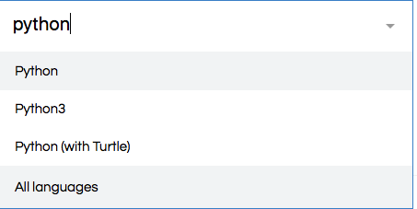
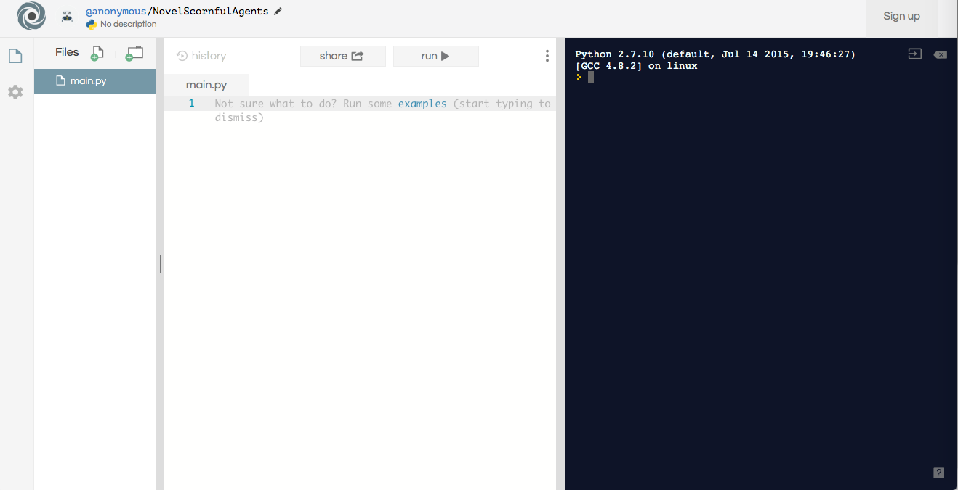
Learning our tools
We will be using a website called repl.it to code
Select Python and it will take you to the home screen

Slide 8
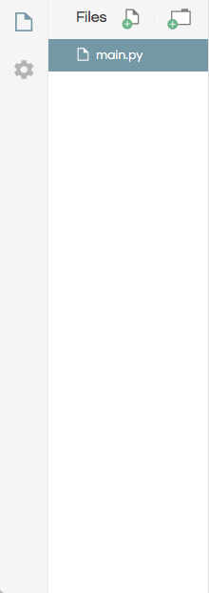
Let’s break down the screen!
This part on the left of the screen is where all of our files in the project are
If you want to save your files, then you can sign up for an account later
Python files are ending in .py
Make sure you are in Python, not Python 3 or Python with Turtle
These are all slightly different from each other
They have different functions so they don’t operate in the same exact methods
Let’s all stay on the same page!

Slide 9
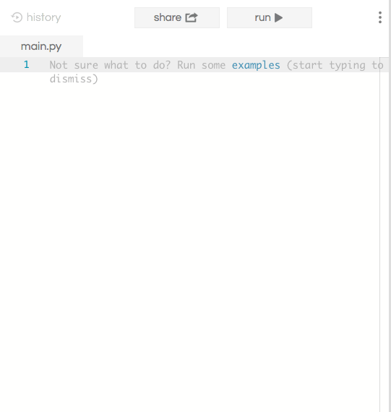
Center screen - coding area
This is where the code will go during development
You can copy paste, or cut and paste from this field
Click on “examples”, and we will run some sample Python programs using the “run” button at the top of this section. Look on the right to see what happens with each one!

Slide 10
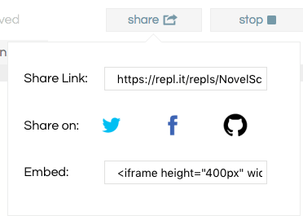
How to submit your class assignments
At the top of the screen, there is a “share button”
All you need to do is copy and paste the link into Google Classrooms for your teachers to give you a grade
Don’t attach any .py files in Classrooms! It’s not needed when you can just use repl.it

Slide 11
5 minutes
Independent exploration and questions so far

Slide 12

Let’s start coding in python!
A running joke with coders is that the first program you write when you are learning a language should be the “Hello, World!” program. HelloWorld is kind of a meme!
Type the following in your terminal:
print(“Hello, World!”)

Slide 13
What did we just do?
print(“text”) is a built in command in Python
It allows us to print out some text in the terminal
A few things to notice here
We only had to type one line of code
Anything could go in the quotation marks
The “print” part was not included - only the quotation marked words
Now, test out the following WRONG code.
Print (“Hello, World!”)

Slide 14
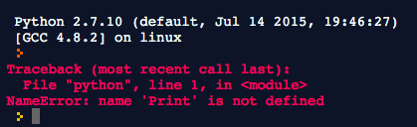
We got an error in our terminal! Make sure you are careful when you are typing in a programming language. Python is case sensitive, and even one wrong letter will mess up the entire thing and the computer can’t understand what you said.

Slide 15
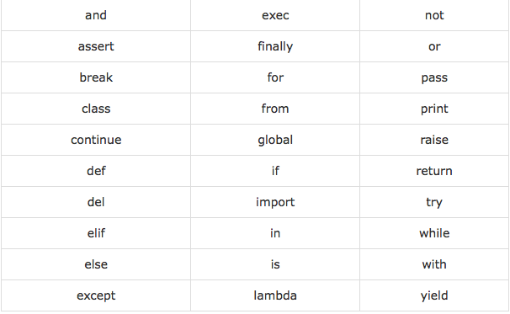
Reserved words in python - what are they?
What is a reserved word?
The following list shows the Python keywords. These are reserved words and you cannot use them as constant or variable or any other identifier names. All the Python keywords contain lowercase letters only.
Notes:
Explain the concept of reserved words and what happens if we use them

Slide 16
Python applications
(link)

