Slide 1
Littlebytes summer ‘18
Python Logic Fundamentals Week 11

Slide 2
Last week’s review
Hexagonal color star example
Truly randomized colors with RGB values
Making functions for drawing
Computer AI tic-tac-toe game
Encapsulating within gaming functions
Developing a simple “AI” for computer
Processing user input correctly
Handling every possible board layout
Displaying the board in ASCII characters
Last week’s homework
Would anyone like to share their Rock Paper Scissors solution?
We will go over the canonical solution afterwards.
Open up a new REPL window and get ready!
Notes:
Solution (Python3) -

Slide 3


RPS - Getting started
First, we import randint from the random module. This is how our computer opponent will play.vThen we create a list of play options. There are three possible plays you and the computer can make on each turn, “Rock”, “Paper” and “Scissors”.
Next we setup our players, the computer and you. We assign a random play to the computer using our list, t, and the randint function. Why (0,2)? Remember that computers start counting at 0. So “Rock” is in the 0 position, “Paper” is in the 1, and so on. The computer isn’t cheating or anything, it’s picking randomly - just like a human.

Slide 4
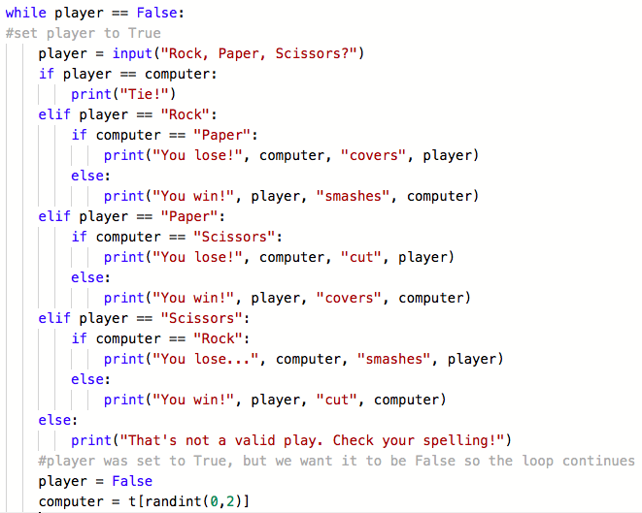
Continued RPS
We set you, the player, to False. Why? I’m glad you asked. Let’s take a look at the body of our program the while loop. Once the while loop starts, the computer will patiently wait for you to make a play. As soon as you take your turn, your status changes from False to True because any value assigned to the variable player makes player True.

Slide 5
Explanation, continued
We use the input() function to pass the new value to the variable player. Your input will determine which statement is triggered below.
Using nested if/elif/else statements, we check every possible outcome of the game and return a message stating the winner, a tie, or an error.
We use else at the end to catch anything that isn’t “Rock”, “Paper” or “Scissors”. Finally we reset the player value to False to restart the while loop.
Another way we could have done this (if we wanted to make a more complex game) is allowing for no case sensitivity - so “ROCK”, “rock”, “PaPeR” would all be valid inputs. The way we can do that is do input.lower() which converts the whole thing to lowercase before the program processes it.

Slide 6
Tweepy - twitter for developers
Python is a great language for all sorts of things. Our very active developer community creates many libraries which extend the language and make it easier to use various services, such as Twitter.
One of those libraries is tweepy. Tweepy is open-sourced, hosted on GitHub and enables Python to communicate with the Twitter platform and use its API.
Tweepy is a LIBRARY, meaning it has functions, objects, and classes that we can use. Think of it like a physical library, where we can check things out.
Why is Tweepy a library, and not an API or framework?

Slide 7
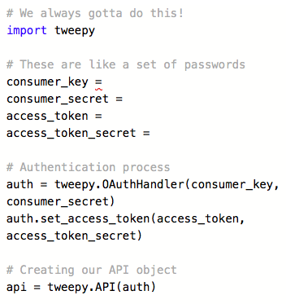
Getting started with tweepy
The first thing we have to do is authenticate, or clear the online security, for Twitter. We are going to use my (Prianka’s) Twitter credentials, but to make your own (it requires a Twitter account) - read the tutorial here.
And of course, we need to import the library before we can begin, as well!
All of the authentication variables are STRINGS and should be in quotation marks, or else an error.
Notes:
Prianka’s twitter credentials (copy and paste, don’t make the kids type the long numbers):
Consumer key - "5JoTvjZbFAWD17OXA6KPF8fOj"
Consumer secret - "1OvHHg86CVTSCaec6CRiSeJy7AYmNIA4aWNTNNKoftYZX0C4sL"
Access token - "970370854499610625-mC7oXed5vMR8v80gMDZLo1VVAsmEJc7"
Access token secret - "mRdpzT219AbqrtC42d5aJNUmQo231g90Dj35cJCs7SkUq"

Slide 8
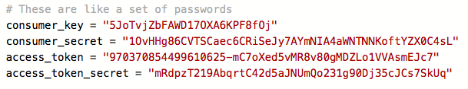
Your authentication variables should end up looking like this.

Slide 9

Loading the user’s Tweets
This example will download your home timeline tweets and print each one of their texts to the console.
I made this Twitter account just for lesson purposes, and I only have around ten tweets.
Want to double check to see if my tweets are printing properly? Check out my Twitter @priankacodes
https://twitter.com/priankacodes/with_replies

Slide 10
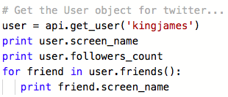
Invoking other users
Let’s find out some information about Lebron James! You can try this out with any other twitter user too - try out @barackobama, @sundarpichai, @indranooyi, or @marissamayer
Notes:
Give them a few mins to try this out

Slide 11
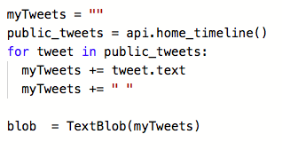
Combining two libraries together
We are now going to combine the powers of TextBlob, which we learned last week, and Tweepy, which we learned today. To get started, write this code, which makes a TextBlob out of all of our tweets.
Notes:
Now you can use whatever textblob features you want.

Slide 12
GUI development in python
Tkinter is the standard GUI library for Python. Python when combined with Tkinter provides a fast and easy way to create GUI applications. Tkinter provides a powerful object-oriented interface to the Tk GUI toolkit.
Creating a GUI application using Tkinter is an easy task. All you need to do is perform the following steps −
Import the Tkinter module.
Create the GUI application main window.
Add one or more of the above-mentioned widgets to the GUI application.
Enter the main event loop to take action against each event triggered by the user.

Slide 13
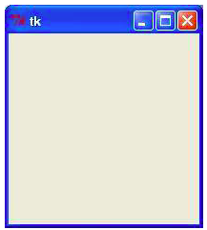

Getting started with tkinter
To create a window, or an environment to simply display variables from our GUI code, use the above code snippet. Note that this needs to be done in the IDLE that we downloaded a few classes back, NOT REPL!
Notes:
If someone doesn’t have IDLE, they can download it at https://www.python.org/downloads/release/python-2710/.

Slide 14
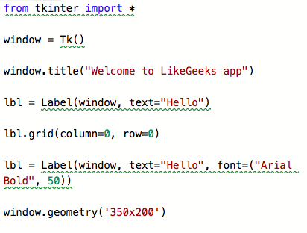
TKinter Widgets
Tkinter provides various controls, such as buttons, labels and text boxes used in a GUI application. These controls are commonly called widgets. There are currently 15 types of widgets in Tkinter. Let’s add a Label widget to our screen and modify its appearance.
Type these commands one after another into the Python Shell to see what happens.

Slide 15
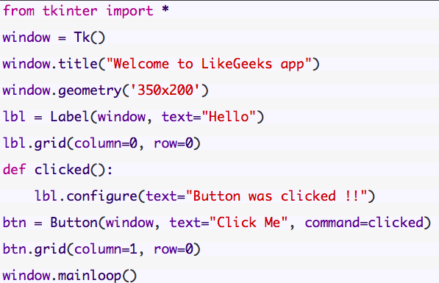
Adding event handling
We looked briefly at the concept of event handling when we worked with APIs last week.
Here, we set up an event handler that changes the text displayed by the label when a specific button has been clicked.

Slide 16
Final project planning
Becoming a programmer isn't just about learning the syntax and the concepts of a programming language: it's about figuring out how to use that knowledge to make programs. You've made a bunch of programs in this course, in the challenges and projects, but now you should come up with ideas for new programs - ideas that you're personally really excited about - and try to turn those into actual programs.
You probably won't know everything you need for your program when you start it, and that's totally okay -- you'll be motivated to learn those new things because of how much you want to make your program real. Programmers are constantly learning new things for new projects, and that's part of why we love it so much. Let's step through the process of planning a programming project.

Slide 17
What do you want to make?
When I first started programming, I found myself constantly thinking of new programs to make and writing those down in a list. I was addicted to the power of creation, and there was so much my brain wanted to make. If you're like that, then you probably already have an idea of what you want to make, and perhaps you have your own list.
If you don't already have an idea, then here are some questions to help your brainstorming:
What's your favorite game - arcade game, board game, sports game? Could you make a simplified, digital version of that? Could you mix it up a bit, like give it a different theme or main characters?
What are your other favorite academic fields? If you love art, could you make an art-making program? If you love history, how about an interactive timeline? If you love science, how about a scientific simulation?
What's your favorite movie or TV show? Could you make a digital version of a scene or character from it? Maybe make a game based on it?
What's a real-life gadget that you love? Could you make a simulation of it?

Slide 18
Writing out the planning
Once you've picked an idea, you should write a description of it. For example, if I decided to make a clone of "Breakout", because that's a really cool retro arcade game, I might write:
Breakout: a game where you control a paddle at the bottom of the screen, and you use it to hit a ball upwards and at angles to break bricks. The goal is to break all the bricks, and not let the ball through the ground too many times.
You'll flesh that description out later, but for now, that gives you a good enough idea to keep going in the planning process.

Slide 19
What technologies to use?
In this step, you need to consider which technologies (languages/libraries/environments) you're familiar with or able to learn easily, and which of them are the most well suited for the job. This includes which import statements or APIs you need to use!
If you want to build those things but don't know other technologies, you might want to come up with a new program idea. You can learn a new technology for a new project, but especially if you're just getting started in programming, it's a good idea to get really good at your first language first.
In Python, we usually have to settle for things that are less Graphical, and more logical - using text only.

Slide 20
What features?
This is where we get into the real planning, and where (I think) it gets fun. Your goal in this step is to figure out what you're actually making- what will it look like, what features it will include, what features it won't include.
The first thing you can do is make "mock-ups" - sketches that look like the thing you're making, but without details like coloring or exact sizing. You can make mock-ups on paper, or with online programs.
In Python, it’s easiest to “mock up” a program using just text. What text will the console display to interact with the user?

Slide 21
How to decide what features to use?
If we all had infinite time to make all the programs in our heads, then they'd all include every feature in our list. But we don't, so in this step, you have to decide which features are the most important, and which features you'll do only if we have time. This will also help you figure out which order to implement features in, from most to least important.
To help you figure out the importance of each feature, ask yourself these questions:
If I shared this with a friend, which features would I want to make sure were working?
Which features am I the most excited about building?
Which features are the most unique to my program?
Which features will I learn the most from implementing?
Are there any features that seem too far beyond my current skill level?
Then, go through your feature list from the last step, and either order the list or add a rank to each feature.

