Slide 1
Littlebytes summer ‘18
Python and Logic Fundamentals - Week 2

Slide 2
Review of last week’s material (5 mins)
Printing out text in the terminal
Using repl.it to code and submit assignments
Mathematical statements
Multiplying strings by numbers
Adding strings together
The modulus (%) operator
Multiplication and division
PEMDAS - why in Python?
Applications of Python in real life
Data scientists - what do they do?
Scientific and research applications
Statistics and business
Small games and applications

Slide 3
Random selection time! One student can share their homework (5 min)

Slide 4
What is a function in programming? (5 min)
Functions "encapsulate" a task. They combine many instructions into a single line of code.
Most programming languages provide many built in functions that would otherwise require many steps to accomplish, for example computing square roots.
In general, we don't care how a function does what it does, only that it "does it"!
When a function is "called" the program "leaves" the current section of code and begins to execute the first line inside the function.
Notes:
Explain using analogies, vocabulary terms, anything you can to get the concept across!

Slide 5
Built in python functions (5 mins)
Python has some built in default functions of its own. One of them is called the abs() function.
For integers - integer absolute value is returned
For floating numbers - floating absolute value is returned
For complex numbers - magnitude of the number is returned
Why would we use built-in functions instead of our own?
Notes:
Demonstrate the example in repl.it. Explain how we can use Python functions without rewriting them ourselves.

Slide 6
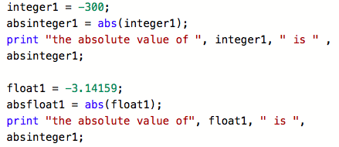
Abs() function example (5 minutes)

Slide 7
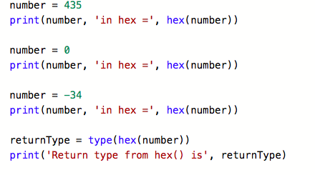
hex() function example (5 minutes)
What are hexadecimal numbers? This Python default function converts regular integers to hexadecimal format.

Slide 8
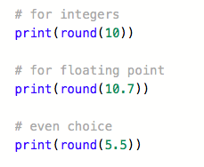
Round() function example (5 minutes)
The round() default function does exactly what it sounds like it does. It will find the nearest integer to the given number. If two multiples are really close, rounding is done toward the even choice, rather than the odd choice.
Notes:
Demonstrate in repl.it as always!

Slide 9

What is in the anatomy of a function? (10 minutes)
In Python a function is defined using the def keyword. To call a function, use the function name followed by parenthesis. The body of a function must be indented under its name.

Slide 10
Anatomy of a function, continued
Information can be passed to functions as parameters.
Parameters are specified after the function name, inside the parentheses. You can add as many parameters as you want, just separate them with a comma.
The following example has a function with one parameter (fname). When the function is called, we pass along a first name, which is used inside the function to print the full name.

Slide 11
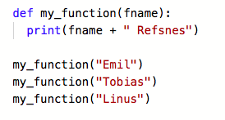
Anatomy of a function, continued (example)

Slide 12
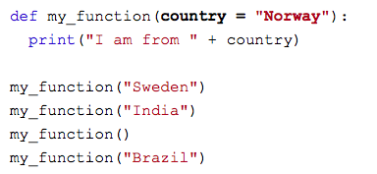
Function anatomy, once again!
The following example shows how to use a default parameter value. If we call the function without parameter, it uses the default value, which has been specified as Norway.

Slide 13
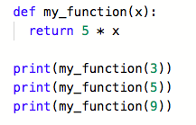
Return statements
To let a function return a value, use the return statement.

Slide 14
A tricky, spooky, challenge topic: lambda functions
In python, the keyword lambda is used to create what is known as anonymous functions.
These are essentially functions with no pre-defined name. They are good for constructing adaptable functions, and thus good for event handling.
Lambda defined functions can have more than one defined input, which is shown in the next example.
The power of lambda is better shown when you generate anonymous functions at run-time, as shown in the following example.

Slide 15
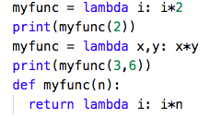
Lambda example - don’t get overwhelmed!

Slide 16
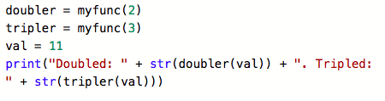
okay...Maybe it gets a little scarier...
This is a lambda function that gets executed and created in run-time, which demonstrates how powerful these can be.

Slide 17
Progress check! Let’s try a sample problem
Remember the example we did last time with even numbers? Well, let’s do a slightly modified problem.
Write a function that does the following.
Does a modulus (%) of 2 with any inputted number x
Prints out the answer to the modulus
Name it “modulating_unicorn_nyancat” just for fun
We will go over it after everyone makes an attempt!
Notes:
Call on some kids, let them work through it, and then EXPOSEEEEE the answer!!

Slide 18
A few examples of writing our own functions
Area of a circle
Sphere volume
Right triangle area (two inputs)
Circle calculation combination + print
Positive or negative?
Notes:
Write the following functions, explain your thought process to them.
One that finds the area of a circle with radius r.
One that finds the volume of a sphere with radius r.
Area of a right triangle with base b and height h.
Given a single radius, calculate the sphere volume, circle radius, and circle circumference and states all of it in a print statement.
Determines if a function is positive or negative using abs() and prints out the result.

Slide 19
Now that we have talked about a lot of code...
Let’s talk about some vocabulary terms for this week.
Functional programming
Encapsulation
Lambda functions
Run-time execution

