Slide 1
Littlebytes summer ‘18
Introduction to Logic and Python - Week 3

Slide 2
Review of last week’s material
Functions
Structure of a function
Using return statements vs. no return
Built in Python functions
Abs()
Hex()
Sqrt()
Parameters
Using parameters as user input
Processing parameters like a variable
Calculations and operations with user input
Scary Stuff
Functional programming
Lambda functions

Slide 3
2 students can share their homework for the week 2 assignment!

Slide 4
Input in python
We have already learned how to use parameters in functions as a sort of way for a programmer to specify inputs.
However, what about inputs for the user, involving no code?
We can use special input functions in Python that will be able to sort of ask the user questions about what input they want to use. Of course, these inputs can be turned into a parameter, which we will look at with some older examples.
Inputs allow a Python program to have a conversation!

Slide 5
Input function types
There are two functions in Python that you can use to read data from the user: raw_input and input.
You can store the results from them into a variable.
raw_input is used to read text (strings) from the user, while input is used to read integers.
If you haven’t understood it previously, Strings refer to all forms of text and characters, while integers refer to numbers.

Slide 6

Raw_ input example with names
Let’s identify the processes that just happened here on the first three lines. We asked the user for a string input, then we stored it in a variable called “name”, which we then printed back out to them.

Slide 7

Input example with processing integers
This example is pretty much the same as the last one, the only difference is that we are taking an integer input now.

Slide 8
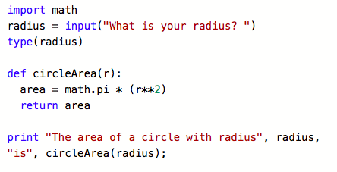
Integer Inputs with functions
Last week, we learned how to find the area of a circle with functions. What if we want the user to specify the radius?

Slide 9
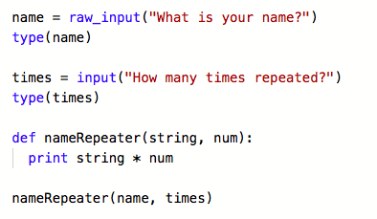
String inputs with functions
The nameRepeater() function will print out a user’s name a specific amount of times, which they also have to specify. Notice how we have two inputs AND two parameters here.

Slide 10
Comprehension check
Write and demonstrate a function that will print out a user’s age and name in the following format.
Hi, name, you are age years old today!
You can put everything in one function and run it, or you can split it into input blocks and the function to process them like we did in the examples.
We will attempt it individually, then solve it together.

Slide 11
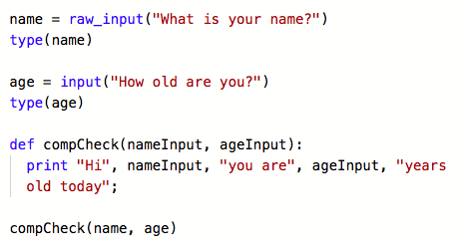
Comprehension check answer

Slide 12
What are conditionals?
Under certain conditions some decisions are sometimes in normal life inevitable, as we can can see in our photo. It's the same for every program, which has to solve some useful problem.
In programming and scripting languages, conditional statements or conditional constructs are used to perform different computations or actions depending on whether a condition evaluates to true or false
The if-then construct (sometimes called if-then-else) is common across many programming languages, but the syntax varies from language to language.

Slide 13
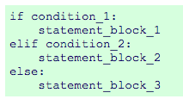
Introduction to the if statement
If the condition "condition_1" is True, the statements in the block statement_block_1 will be executed. If not, condition_2 will be executed. If condition_2 evaluates to True, statement_block_2 will be executed, if condition_2 is False, the statements in statement_block_3 will be executed.

Slide 14
Example - dog years algorithm
It's a generally accepted belief, to assume that one year in the life a dog corresponds to seven years in the life of a human being. But apparently there are other methods to calculate this haunting problem.
A one year old dog roughly corresponds to a fourteen year old child
A dog who is two years old corresponds to a 22 year old human
Every further dog year corresponds to five human years
Let’s look at this Pythonified!

Slide 15
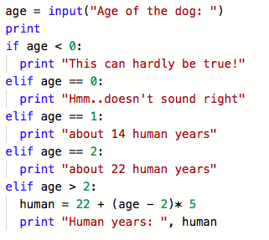
Dog years algorithm
Notice how we lumped everything under one big “print” statement?

Slide 16
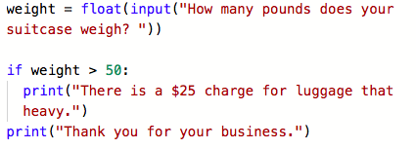
Another if example - suitcase charges

Slide 17
Nested if statements
There may be a situation when you want to check for another condition after a condition resolves to true. In such a situation, you can use the nested if construct.
In a nested if construct, you can have an if...elif...else construct inside another if...elif...else construct.
In this situation, the if statements will be evaluated by the computer from up to down. Nested if statements are interdependent on each other.

Slide 18
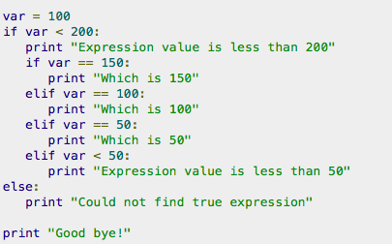
Nested if example

Slide 19
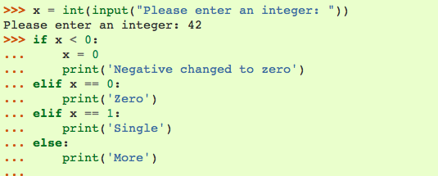
Example #1

Slide 20
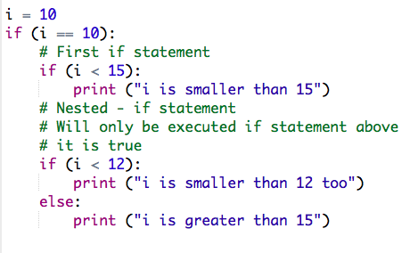
Example #2

Slide 21
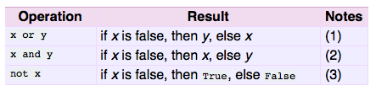
Boolean operators

Slide 22
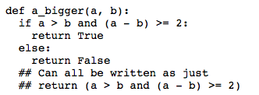
Booleans example
Python boolean operators are spelled out as the words "and" "or" "not", instead of the && syntax in other languages. The following a_bigger() function should return True if the int parameter a is larger than b by 2 or more.

Slide 23
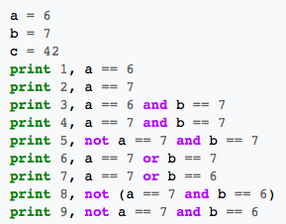
Another booleans example
What is the output for each line going to be?
Predict, then type out this code to check your answers.
Pay attention to the order that the statements on each line appear.

Slide 24
Father’s day required assignment!
For the end of class, write a program that does the following to show to your dad!
Takes a raw_input string asking the user for their name
If the name is your father’s name (keep everything lowercase for accuracy!), then put a fun message for father’s day.
If it’s not your father’s name, say “sorry” or some other type of message. Make sure to show your dad this!

Slide 25
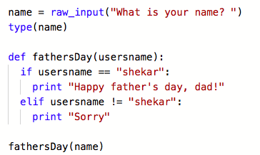
Father’s day assignment example solution

Slide 26
Review of today’s class - conditionals
Notes:
Briefly go over what each of the things we learned are

