Slide 1
Littlebytes summer ‘18
Python Logic Fundamentals - Week 4

Slide 2
Review of last class
Last class, we covered algorithmic decision making.
Syntax in Python
If statements
Elif statements
Nested ifs
Using indentation
Examples we went over
Father’s day code project
Dog years calculator
Syntaxless pseudocode examples
Since we just started doing logical problems, we will go over the solutions as a class together.

Slide 3
Problem 1: CIgar party
When squirrels get together for a party, they like to have cigars. (This is weird. Codingbat problems are weird.)
A squirrel party is successful when the number of cigars is between 40 and 60, inclusive. Unless it is the weekend, in which case there is no upper bound on the number of cigars.
Return True if the party with the given values is successful, or False otherwise.

Slide 4
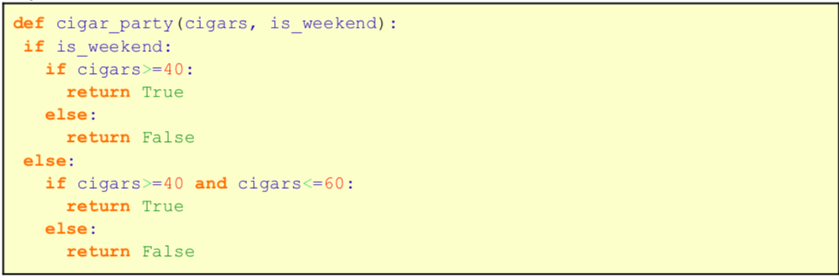
Cigar party solution

Slide 5
Problem 2: Caught speeding
You are driving a little too fast, and a police officer stops you. Write code to compute the result, encoded as an int value: 0=no ticket, 1=small ticket, 2=big ticket.
If speed is 60 or less, the result is 0. If speed is between 61 and 80 inclusive, the result is 1. If speed is 81 or more, the result is 2.
Unless it is your birthday -- on that day, your speed can be 5 higher in all cases.

Slide 6
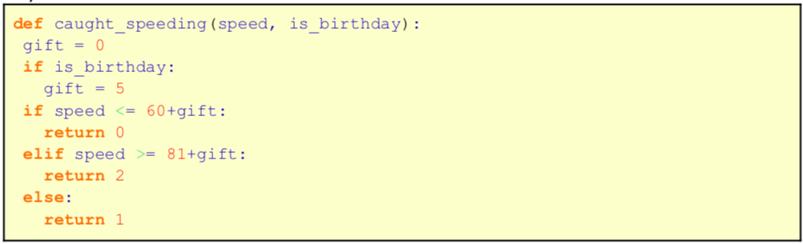
Caught speeding solution

Slide 7
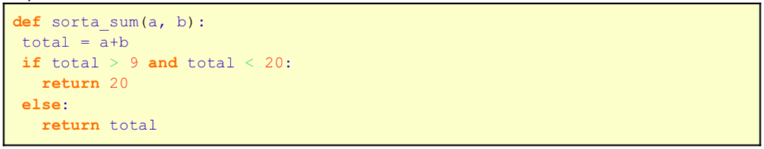
Problem 3: Sorta sum
This problem is easy. If you didn’t do the homework, this is a problem you can literally do in your head.
Given 2 ints, a and b, return their sum. However, sums in the range 10..19 inclusive, are forbidden, so in that case just return 20.

Slide 8
Today, we are going to learn about loops!
In computer programming, a loop is a sequence of instruction s that is continually repeated until a certain condition is reached.
Typically, a certain process is done, such as getting an item of data and changing it, and then some condition is checked such as whether a counter has reached a prescribed number.
Loops allow us to avoid re-writing code hundreds, or even thousands of times, and instead specifying repetition time.

Slide 9
The For loop
The for loop that is used to iterate over elements of a sequence, it is often used when you have a piece of code which you want to repeat "n" number of times.
Some examples of when you want to use a for loop are:
Printing out “hello world” 100 times
Making a graphic move 10 times
Multiplying two numbers 3 times
What do all of these procedures have in common?

Slide 10
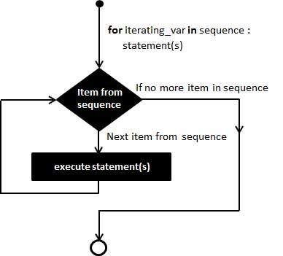
Logical flow of a for loop
Let’s take a look at the logic sequence behind a for loop.
Where does the “number of times” to execute the loop come in?
What happens after the loop is completed?

Slide 11
For loop analogies - finite repetition
A dental checkup. There are a finite number of teeth, and the dentist checks each one in turn for cavities.
Checking your email in the morning, treating each item of mail in the inbox as an item to be dealt with.
Take an egg box with one row of eggs, then take them out one at a time and crack them (into a jug).

Slide 12
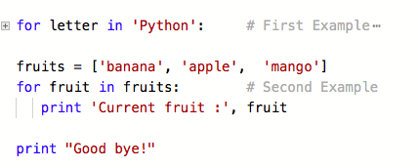
For loop string examples

Slide 13

Simple integer for loop example

Slide 14
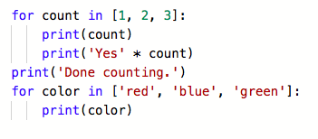
Slightly more complicated version

Slide 15
Comprehension check
Write a for loop that gives the following output.
P
E
A
C
H
Notes:
Show them the answer afterwards (iterating through the string)

Slide 16
Another kind of loop - while loops
A while loop statement in Python programming language repeatedly executes a target statement as long as a given condition is true.
Here, statement(s) may be a single statement or a block of statements. The condition may be any expression, and true is any non-zero value. The loop iterates while the condition is true.
When the condition becomes false, program control passes to the line immediately following the loop.

Slide 17
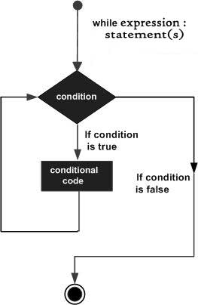
While loop - flow of control logic
Here, we are using a while loop because we don’t know how many times we need to execute the code. Since we do not know, we test a condition every time to see if the code needs to be executed one more time.
What is different in this logical flow when compared to the last

Slide 18
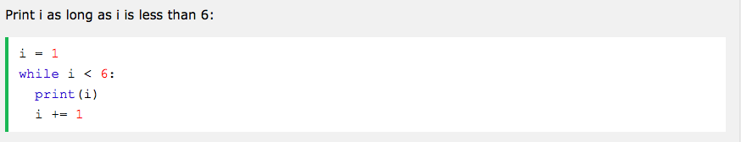
While loop example
Where is the condition that is being checked here?
What does “i += 1” mean? Why do we use this?
What would happen if we didn’t have “i += 1”?

Slide 19
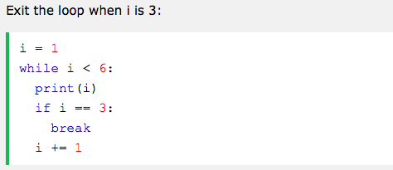
The break statement
With the break statement we can stop the loop even if the while condition is true.

Slide 20
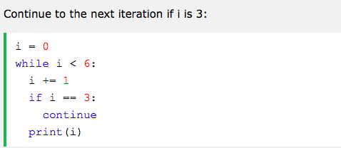
The continue statement
With the continue statement we can stop the current iteration, and continue with the next.

Slide 21
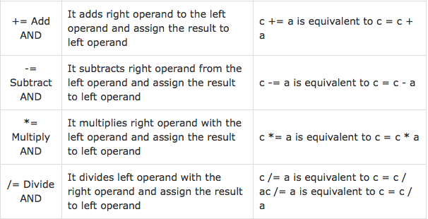
Decrement and increment
These operators perform an operation on a variable, then re-assign the value of the variable to the result.

Slide 22
Example: string_times
Given a string and a non-negative int n, return a larger string that is n copies of the original string.
You know how to do this without a loop, but since we learned loops today, use a for loop to solve this problem.
string_times('Hi', 2) → 'HiHi'
string_times('Hi', 3) → 'HiHiHi'
string_times('Hi', 1) → 'Hi'

Slide 23
String_times: the simple answer
def string_times(str, n): result = "" for i in range(n): # range(n) is [0, 1, 2, .... n-1] result = result + str # could use += here return result
What’s the advantage of using a loop to do this instead of just multiplying the string several times?
*Note, this is actually a codingbat problem!

Slide 24
Example: counting nines
Given an array of ints, return the number of 9's in the array.
array_count9([1, 2, 9]) → 1
array_count9([1, 9, 9]) → 2
array_count9([1, 9, 9, 3, 9]) → 3
This requires the use of a conditional as well.

Slide 25
Counting nines example
def array_count9(nums): count = 0 # Standard loop to look at each value for num in nums: if num == 9: count = count + 1 return count

Slide 26
Let’s review what we learned today. Questions?

