Slide 1
Littlebytes summer ‘18
Python Logic Fundamentals

Slide 2
Last week review
Loops and their usage
While loops
For loops
Difference between while and for loops
While - While the party is still going on, the baker needs to keep decorating cookies for the guests
For - For an order of 100 cookies, the baker needs to repeat the same decorating sequence
Any other real life loop examples?
Last week’s assignment
Two students can share their solution
We will go over the canonical solution

Slide 3
What is a ‘canonical solution’?
In mathematics and computer science, a canonical, normal, or standard form of a mathematical object is a standard way of presenting that object as a mathematical expression. The distinction between "canonical" and "normal" forms varies by subfield.
In plain English, all that means is if we have an infinite or very large number of ways to solve a puzzle or a problem, the canonical solution is simply one of these many, many ways to go about it.
Canonical solutions aren’t always the best or fastest ways.

Slide 4
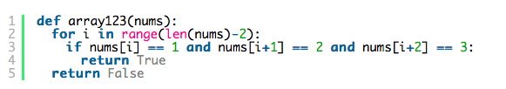
Array123 canonical solution
Given an array of ints, return True if the sequence of numbers 1, 2, 3 appears in the array somewhere.

Slide 5
Today’s topic - data structures in python
Data structures are a way of organizing and storing data so that they can be accessed and worked with efficiently. They define the relationship between the data, and the operations that can be performed on the data.
There are many various kinds of data structures defined that make it easier for the data scientists and the computer engineers, alike to concentrate on the main picture of solving larger problems rather than getting lost in the details of data description and access.
Python has two extensive data structures we have seen before, without actually knowing their name.
Notes:
It’s the list

Slide 6
Python lists vs. arrays
All the entries in an array must be of the same data type. However, arrays are not all that popular in Python, unlike the other programming languages such as C++ or Java. In Python, arrays are supported by the array module and need to be imported.
Lists in Python are used to store collection of heterogeneous items. These are mutable, which means that you can change their content without changing their identity. You can recognize lists by their square brackets [ and ] that hold elements, separated by a comma ,. Lists are built into Python: you do not need to invoke them separately.
Notes:
Reiterate the difference between the two as this is complex language.

Slide 7


Real life examples - arrays vs. lists
Someone who is going to the grocery store should use a List, because each item is of a different type, although some items may be of the same type as each other.
Someone who is going to the shoe store should use an Array, since it is guaranteed that all of their objects will be of the same type.

Slide 8
List manipulation methods
We already know that lists can be declared using a regular variable assignment, brackets, and commas.
Python provides many methods to manipulate and work with lists. Adding new items to a list, removing some items from a list, sorting or reversing a list are common list manipulations. Let's see some of them in action.

Slide 9
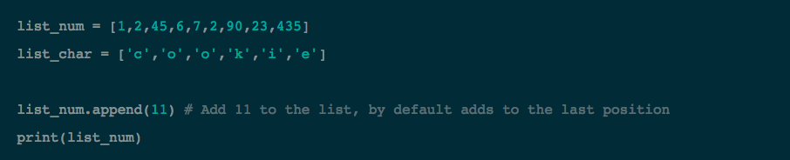
append()
Add 11 to the list_num list with append(). By default, this number will be added to the end of the list.

Slide 10

insert()
Use insert() to insert 11 at index or position 0 in the list_num list. Position ‘0’ refers to indexes.
What happens when we try different indexes? 3? 4?
What if we insert it outside of its bounds?
Notes:
Demonstrate the last two bullets in the same fashion (inserting and printing)

Slide 11


remove()
Remove the first occurence of 'o' from list_char with the help of remove()
Remove the item at index -2 from list_char

Slide 12


Some more list function examples
We can also sort the lists (by numerical or alphabetical order), or we can reverse the current order of the list.

Slide 13
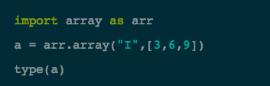
Arrays - how to create them
Now that you have seen lists in Python, you maybe wondering why you need arrays at all. The reason is that they are different in terms of the operations one can perform on them. With arrays, you can perform an operations on all its item individually easily. The data type is specified during the array creation and specified using a type code, which is a single character like the I you see in the example below.

Slide 14
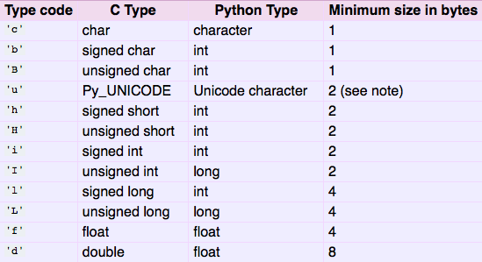
Array types and what they mean
This table shows a few possible type codes to create arrays. The most important are integer and string array types.

Slide 15
Nested lists
The elements of an array can be other arrays. This concept is called nested lists, or sometimes “two-dimensional” arrays. These can be thought of as a list of lists.
A good real-life analogy for this is a spreadsheet. The rows and columns combine to make what is essentially an array full of arrays. To do this syntactically, all we have to do is insert the list inside another list.
var two_dimensional = [3, [3, 5, 6], [4, 1], 13]
Why can’t we do the above with an array, and just a list?

Slide 16
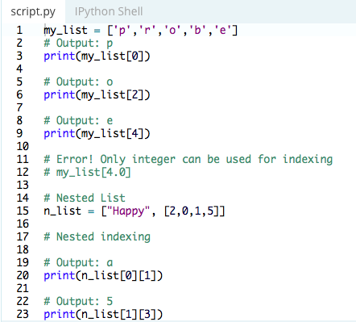
Some list manipulation examples
Here, we perform some operations with both a regular list, and a set of nested lists.
There is an example of new syntax on lines 20 and 23.
What does it mean when we use the double-accessor [][] syntax with a list?
Notes:
Lines 20 etc need to be explained (why we are doing [ ] [ ] )

Slide 17
Logical problems with lists
Given a string, return a new string made of every other char starting with the first, so "Hello" yields "Hlo".
string_bits('Hello') → 'Hlo'
string_bits('Hi') → 'H'
string_bits('Heeololeo') → 'Hello'
Try to solve this individually, then we will go over the solution together.

Slide 18
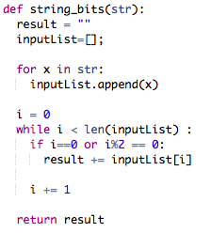
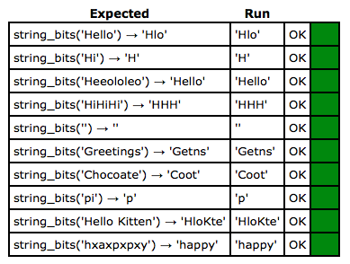
String_bits solution (Littlebytes wrote this)

Slide 19
Another problem - first_last6
Given an array of ints, return True if 6 appears as either the first or last element in the array. The array will be length 1 or more.
first_last6([1, 2, 6]) → True
first_last6([6, 1, 2, 3]) → True
first_last6([13, 6, 1, 2, 3]) → False

Slide 20
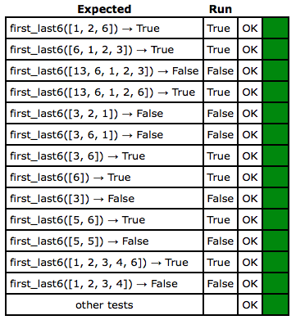

First_last6 solution
This is a relatively easy solution. The key concept is using len() to figure out the length, and knowing the last value is one less than len().

Slide 21
Last example - has23
Given an int array length 2, return True if it contains a 2 or a 3.
has23([2, 5]) → True
has23([4, 3]) → True
has23([4, 5]) → False

Slide 22
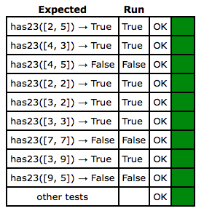
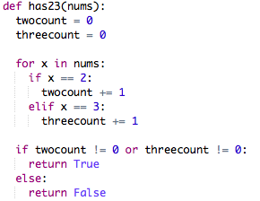
Has23 solution

Slide 23
Next week’s introduction- turtle
Turtle graphics is a popular way for introducing programming to kids. It was part of the original Logo programming language developed by Wally Feurzig and Seymour Papert in 1966. Imagine a robotic turtle starting at (0, 0) in the x-y plane. After an import turtle, give it the command turtle.forward(15), and it moves (on-screen!) 15 pixels in the direction it is facing, drawing a line as it moves. Give it the command turtle.right(25), and it rotates in-place 25 degrees clockwise. By combining together these and similar commands, intricate shapes and pictures can easily be drawn.

