Slide 1
Littlebytes summer ‘18
Python Logic Fundamentals - Week 7

Slide 2
Last week’s class review
Data Structures
Difference between Arrays and Lists
Built in functions to manipulate them
Indexes, sub-indexes, sub-strings
Potential data structure errors
Logic problems
String Bits
First Last 6
Has 23
Introduction to Turtle Graphics
Week 6 Homework
Two students can share their solution
Did anybody get a gold star on Coding Bat?

Slide 3
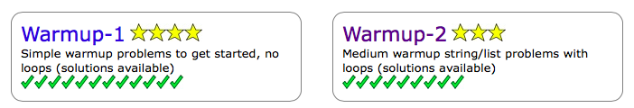
A cool coding bat tip
If you make an account, it will show you progress for your problems and solutions. These check boxes and stars indicate finished problem sets.
You should be able to do most of the problems on coding bat, up to List-1 and List-2 Python on your own now!

Slide 4
Review - what is turtle graphics?
Turtle graphics is a popular way for introducing programming to kids. It was part of the original Logo programming language developed by Wally Feurzig and Seymour Papert in 1966. Imagine a robotic turtle starting at (0, 0) in the x-y plane. After an import turtle, give it the command turtle.forward(15), and it moves (on-screen!) 15 pixels in the direction it is facing, drawing a line as it moves. Give it the command turtle.right(25), and it rotates in-place 25 degrees clockwise.
By combining together these and similar commands, intricate shapes and pictures can easily be drawn.

Slide 5
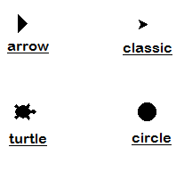
Getting started with turtle
Normally, we would have to import the turtle library, since it’s not built into Python by default, but REPL has an option for us to select “Python with Turtle” as a development environment.
You’ll notice our development environment looks different now. Instead of just a console, we also have a “result” tab. Think of this like a canvas for our Turtle to roam around!
The “turtle” looks like this.

Slide 6
Turtle moving functions
By calling these functions, the turtle can be made to move around the screen. Imagine the turtle holding a pen down on the ground and drawing a line as it moves around. The turtle's position is two numbers: the X coordinate and Y coordinate.
The forward() function moves the turtle distance number of steps in the current direction.
The backward() function moves the turtle distance number of steps in opposite direction the current direction.
What happens when distance() in either of these cases is a negative number?

Slide 7
Turtle rotation functions
The right() function will change the current direction clockwise by angle degrees. If you imagine being above the turtle looking down, the turtle turning right looks like it is turning clockwise. The turtle will not move; it will only change the direction it is facing.
The left() function will change the current direction counter-clockwise or anti-clockwise by angle degrees. If you imagine being above the turtle looking down, the turtle turning left looks like it is turning counter-clockwise or anti-clockwise. The turtle will not move; it will only change the direction it is facing.

Slide 8
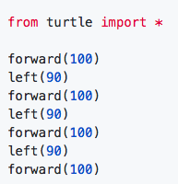
Square example
The instructions in your program tell the "turtle" how to move. The turtle draws a line behind it as it moves. This program draws a square. The steps given to the program are:
Move forward 100 steps. (In the beginning, the turtle is facing to the right.)
Turn 90 degrees to the left.
Move forward 100 steps.
Turn 90 degrees to the left.
Move forward 100 steps.
Turn 90 degrees to the left.
Move forward 100 steps. The turtle has ended up where it started.
Notes:
You don’t have to code this one out. Just explain it

Slide 9
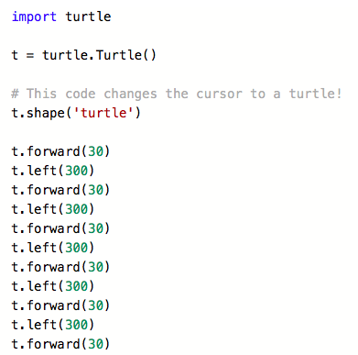
drawing a hexagon example
This code will change the shape of the Turtle cursor to an actual “turtle”, and then it will draw a Hexagon. What do the “forward” and “left” commands mean? Watch the motion of the Turtle carefully to figure out.
What steps does it take to draw a Hexagon?

Slide 10
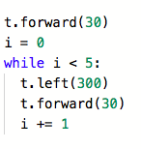
Hexagon example, rewritten in loop form
We can also use a while loop to write the same Hexagon code. Just because we introduced a new framework doesn’t mean that we can’t use regular Python structures and syntax! Writing it in a loop will have the same exact result as before.

Slide 11
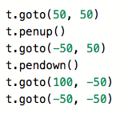
Turtle goto()
The goto() function will immediately move the turtle to the given x and y coordinates. If the pen is down, a line will be drawn from the previous coordinates to the new coordinates.
This example moves the to several x and y coordinates while drawing a line behind it.
What happens with penup() and pendown()?

Slide 12
Pen color and size
The pensize() function sets the width of the line that the turtle draws as it moves.
The pencolor() function sets the color of the line that the turtle draws. The pencolor() function can be passed a string of the color, such as 'red' or 'black'.
Or, the pencolor() function can be passed an "RGB color tuple", which includes a set of three numbers that represent the brightness of red, green, and blue in that individual color. For example, the tuple (1.0, 0, 0) represents red, because R (red) is set to full brightness. The color purple is half-bright red and half-bright blue, so it is represented by the RGB color tuple (0.5, 0.0, 0.5).

Slide 13
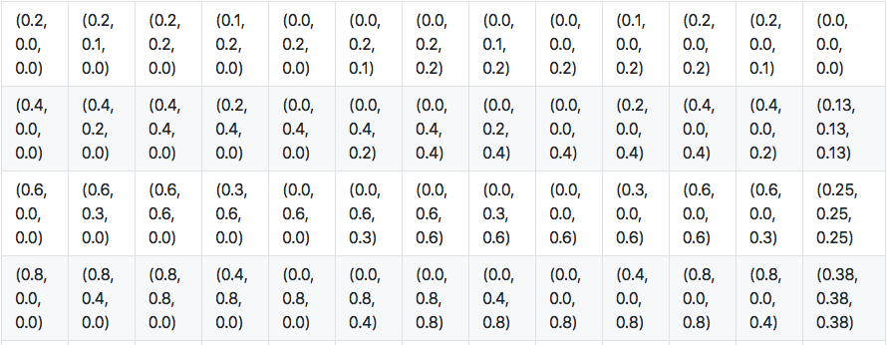
Some random rgb tuples

Slide 14
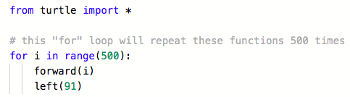
Example 1 - Subtle angle changes
Just four lines of code is going to create a really intense geometrical design, using the power of a loop. Play around with the numbers in this example - try negatives, different distances, and angles, and see what results you get.
Notes:
Give them 5 mins to modify as they please

Slide 15
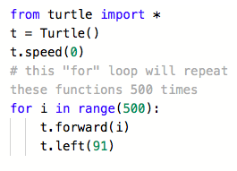
What if we want to make the example go faster?
You can speed up or slow down the turtle’s animation speed. (Animation controls how quickly the turtle turns and moves forward). Speed settings can be set between 1 (slowest) to 10 (fastest). But if you set the speed to 0, it has a special meaning — turn off animation and go as fast as possible.
The .speed method changes the speed of a Turtle.

Slide 16
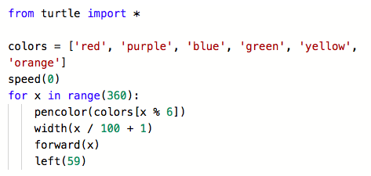
Example 2 - colorful hexagons
Notes:
This one needs to be explained in depth - explain how that loop is creating the color

Slide 17
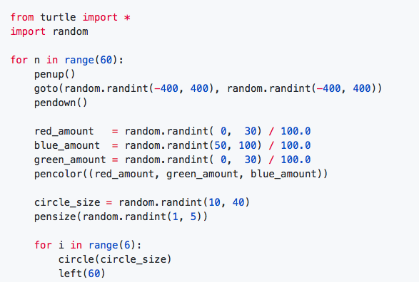
Example 3 - blue flowers
What is the use of the “random” class in this program? Will any two outputs look alike? Feel free to modify the speed.

Slide 18
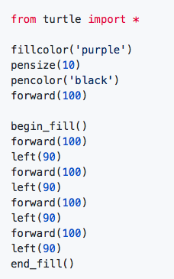
Filling in shapes
The turtle can draw the outline of a shape and then fill it in with color using the fill functions.
The filling process starts when the begin_color() function is called. The turtle can move around as normal.
When the end_fill() function is called, the shape the turtle was drawing will be filled with the fill color. The fill color is separate from the pen color.

Slide 19

Snowman example
Unfortunately, it’s not going to look like this.
Notes:
https://github.com/prisubs/littlebytes-things/blob/master/snowman.py - Don’t do this unless you have time. Make sure to select “python with Turtle” in repl.it

