Slide 1
Littlebytes summer ‘18
Python Logic Fundamentals

Slide 2
Last week’s review
Python Turtle framework
History and purpose of Turtle
Setting up Objects and import statements
Changing shape of the turtle
What is a tuple? Why do we need tuples?
Color string parameters
Drawing, coordinates, “pen”
Randomization
Importing the Random class
Generating random numbers in a range
Last week’s homework
Combining graphics with randomization
Two students can share their animation!

Slide 3

Snowman example
Unfortunately, it’s not going to look like this.
Notes:
https://github.com/prisubs/littlebytes-things/blob/master/snowman.py - This is a sample solution to the homework. This needs to be coded out. Make sure to select “python WITH turtle” as the language in repl.

Slide 4

Randomization - in depth
Using the random module, we can generate pseudo-random numbers. The function random() generates a random number between zero and one [0, 0.1 .. 1]. Numbers generated with this module are not truly random but they are enough random for most purposes.
We can generate a (pseudo) random floating point number with this small code.

Slide 5
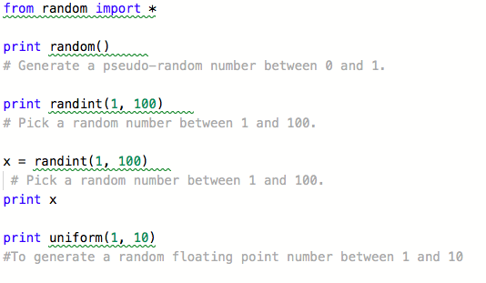
Randomization example code

Slide 6
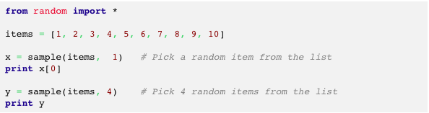
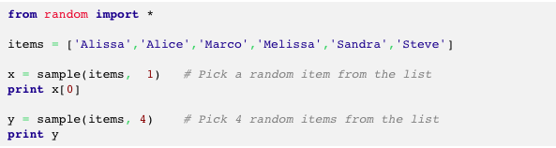
Randomization with lists

Slide 7
USA computing olympiad - challenge problem
Question:
Write a program which will find all such numbers which are divisible by 7 but are not a multiple of 5,
between 2000 and 3200 (both included).
The numbers obtained should be printed in a comma-separated sequence on a single line.
Hints:
Consider use range(#begin, #end) method

Slide 8
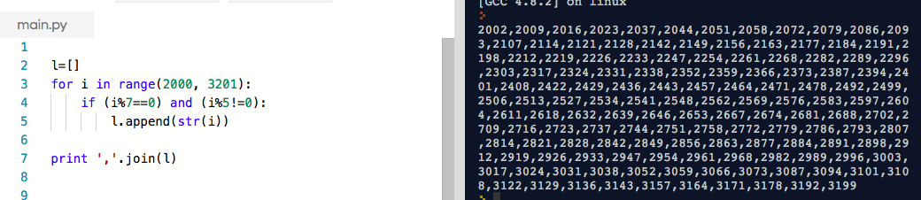
Challenge problem solution
Did anyone come up with a different solution? Why do we need to use the modulus in this problem? What does join() do?

