Slide 1
Littlebytes summer ‘18
Python Logic Fundamentals - Week 9

Slide 2
Last week’s review
Snowman graphics example
RGB coloring
Graphic function collections
Randomizations
Importing the random class
Random integers vs. random decimals
Objects - IMPORTANT
__init__ and not _init_
Used widely in APIs
Last week’s homework
Creating a class and using it
Pretty straightforward, so we won’t be sharing

Slide 3
APIs in python
Application Programmable Interfaces, or APIs, are commonly used to retrieve data from remote websites. Sites like Reddit, Twitter, and Facebook all offer certain data through their APIs. To use an API, you make a request to a remote web server, and retrieve the data you need.
APIs are hosted on web servers. When you type www.google.com in your browser's address bar, your computer is actually asking the www.google.com server for a webpage, which it then returns to your browser.
APIs work much the same way, except instead of your web browser asking for a webpage, your program asks for data. This data is usually returned in JSON format, or JavaScript Object Notation.

Slide 4
Why an api, and not a data set?
The data is changing quickly. An example of this is stock price data. It doesn't really make sense to regenerate a dataset and download it every minute -- this will take a lot of bandwidth, and be pretty slow.
You want a small piece of a much larger set of data. Reddit comments are one example. What if you want to just pull your own comments on Reddit? It doesn't make much sense to download the entire Reddit database, then filter just your own comments.
There is repeated computation involved. Spotify has an API that can tell you the genre of a piece of music. You could theoretically create your own classifier, and use it to categorize music, but you'll never have as much data as Spotify does.

Slide 5
API requests
APIs are hosted on web servers. When you type www.google.com in your browser's address bar, your computer is actually asking the www.google.com server for a webpage, which it then returns to your browser.
APIs work much the same way, except instead of your web browser asking for a webpage, your program asks for data. This data is usually returned in JSON format.
In order to get the data, we make a request to a webserver. The server then replies with our data. In Python, we'll use the requests library to do this. In this class, we will be using Python version 3, because the APIs we are using are compatible with it.

Slide 6
API requests
There are many different types of requests. The most commonly used one, a GET request, is used to retrieve data. We can use a simple GET request to retrieve information from the OpenNotify API.
OpenNotify has several API endpoints. An endpoint is a server route that is used to retrieve different data from the API. For example, the /comments endpoint on the Reddit API might retrieve information about comments, whereas the /usersendpoint might retrieve data about users. To access them, you would add the endpoint to the base url of the API.
The first endpoint we'll look at on OpenNotify is the iss-now.json endpoint. This endpoint gets the current latitude and longitude of the International Space Station. As you can see, retrieving this data isn't a great fit for a dataset, because it involves some calculation on the server, and changes quickly.
Notes:
Open Notify is an open source project to bring digital notifications into the physical world. The software is used to monitor real world events and use them as a means of turning an LED light on and off. The API can track events such as when the International Space Station flies over a particular location, the current location of the International Space Station and a current top down view of the solar system with interplanetary spacecraft positions. The API uses RESTful calls and responses are formatted in JSON.

Slide 7
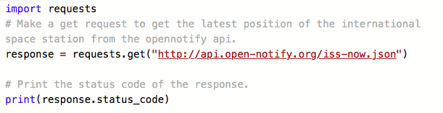
Making our first request
The request we just made had a status code of 200. Status codes are returned with every request that is made to a web server. Status codes indicate information about what happened with a request. The next slide shows some codes that are relevant to GET requests.

Slide 8
API RESPONSE CODES
200 -- everything went okay, and the result has been returned (if any)
301 -- the server is redirecting you to a different endpoint. This can happen when a company switches domain names, or an endpoint name is changed.
401 -- the server thinks you're not authenticated. This happens when you don't send the right credentials to access an API (we'll talk about authentication in a later post).
400 -- the server thinks you made a bad request. This can happen when you don't send along the right data, among other things.
403 -- the resource you're trying to access is forbidden -- you don't have the right permissions to see it.
404 -- the resource you tried to access wasn't found on the server.

Slide 9

Example - failed response
We'll now make a GET request to http://api.open-notify.org/iss-pass, an endpoint that doesn't exist, per the API documentation.
iss-pass wasn't a valid endpoint, so we got a 404 status code in response. We forgot to add .json at the end, as the API documentation states.

Slide 10

What if we make a typo?
iss-pass wasn't a valid endpoint, so we got a 404 status code in response. We forgot to add .json at the end, as the API documentation states.
We'll now make a GET request to http://api.open-notify.org/iss-pass.json.
You'll see that in the last example, we got a 400 status code, which indicates a bad request. If you look at the documentation for the OpenNotify API, we see that the ISS Pass endpoint requires two parameters.

Slide 11
Adding parameters
The ISS Pass endpoint returns when the ISS will next pass over a given location on earth. In order to compute this, we need to pass the coordinates of the location to the API. We do this by passing two parameters -- latitude and longitude.
We can do this by adding an optional keyword argument, params, to our request. In this case, there are two parameters we need to pass:
lat -- The latitude of the location we want.
lon -- The longitude of the location we want.
We can make a dictionary with these parameters, and then pass them into the requests.get function. A dictionary is a set of value pairs.

Slide 12
Python dictionaries
It is best to think of a dictionary as a set of key: value pairs, with the requirement that the keys are unique (within one dictionary). A pair of braces creates an empty dictionary: {}. Placing a comma-separated list of key:value pairs within the braces adds initial key:value pairs to the dictionary; this is also the way dictionaries are written on output.
The main operations on a dictionary are storing a value with some key and extracting the value given the key. It is also possible to delete a key:value pair with del. If you store using a key that is already in use, the old value associated with that key is forgotten. It is an error to extract a value using a non-existent key.

Slide 13
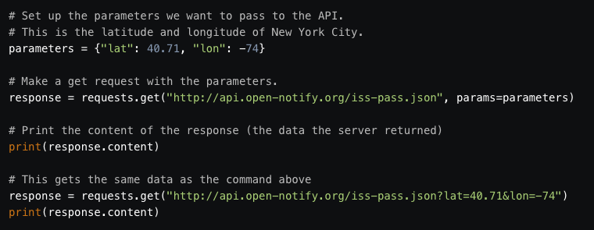
NYC request
We'll make a request using the coordinates of New York City, and see what response we get.

Slide 14
JSONs
You may have noticed that the content of the response earlier was a string (although it was shown as a bytes object, we can easily convert the content to a string using response.content.decode("utf-8")).
Strings are the way that we pass information back and forth to APIs, but it's hard to get the information we want out of them. How do we know how to decode the string that we get back and work with it in Python? How do we figure out the altitude of the ISS from the string response?
Luckily, there's a format called JavaScript Object Notation (JSON). JSON is a way to encode data structures like lists and dictionaries to strings that ensures that they are easily readable by machines. JSON is the primary format in which data is passed back and forth to APIs, and most API servers will send their responses in JSON format.

Slide 15
JSON functions
Python has great JSON support, with the json package. The json package is part of the standard library, so we don't have to install anything to use it. We can both convert lists and dictionaries to JSON, and convert strings to lists and dictionaries. In the case of our ISS Pass data, it is a dictionary encoded to a string in JSON format.
The json library has two main methods:
dumps -- Takes in a Python object, and converts it to a string.
loads -- Takes a JSON string, and converts it to a Python object.
You can see that these methods would definitely be useful for interpreting the choppy, almost indistinguishable response provided by the API.

Slide 16
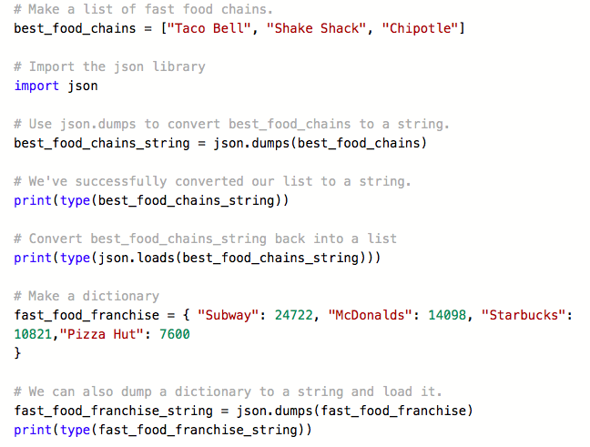
JSON EXAMPLE CODE
This example demonstrates the functionality of JSON, and why we’d need to use it for converting between object notation types.

Slide 17
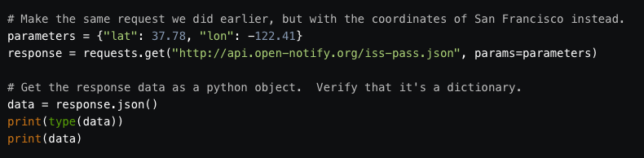
Getting JSON from an API request
You can get the content of a response as a python object by using the .json() method on the response.

Slide 18
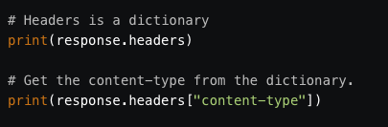
Content type
The server doesn't just send a status code and the data when it generates a response. It also sends metadata containing information on how the data was generated and how to decode it. This is stored in the response headers. In Python, we can access this with the headers property of a response object.
The headers will be shown as a dictionary. Within the headers, content-type is the most important key for now. It tells us the format of the response, and how to decode it. For the OpenNotify API, the format is JSON, which is why we could decode it with the json package earlier.

Slide 19
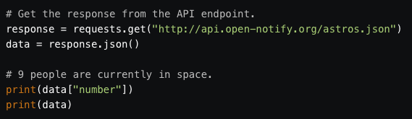
People who are in space
OpenNotify has one more API endpoint, astros.json. It tells you how many people are currently in space. The format of the responses can be found here.

Slide 20
Vocabulary nuances
A library is a collection of functions / objects that serves one particular purpose. you could use a library in a variety of projects. (Various specialized services in our case)
An API is an interface for other programs to interact with your program or library without having direct access. ( giving specifications for our need to various vendors in our case)
A framework is a collection of patterns and libraries to help with building an application. ( The master plan laid down by our architect for building a house )
We just used an API in our code. We are about to learn a library called TextBlob, which requires using different syntax.

Slide 21
Vocabulary nuances
An architect (application developer) wanted to build a house(a computer program), so he prepared for all its aspects including structure, plumbing, wiring, decorations, etc (different libraries). He can’t do all of the stuff himself so he took help from various experts in those fields, who are really good at doing what they do.
But he needed to communicate his needs and requirements face to face or via mail (invoking API )so that they can cater to his needs and provide the asked service.
After some time a fellow Architect came and wanted to accomplish a similar task but with a few add on features, like a swimming pool (a new library). He can conveniently use the framework provided by our architect and add new features invoking any new service.

Slide 22
What’s textblob?
TextBlob is a Python (2 and 3) library for processing textual data. It provides a simple API for diving into common natural language processing (NLP) tasks. Some examples of these NLP tasks are below.
Part-of-speech tagging - detecting nouns, verbs, adjectives in a given “blob” of text which we specify at the beginning of the program
Noun phrase extraction - pulling only nouns from the blob
Sentiment analysis - detecting the “feeling” or “mood” of text
Classification - putting words into different categories
Translation - translation to different languages
To begin with any library, we type an import statement at the beginning.
from textblob import TextBlob

Slide 23
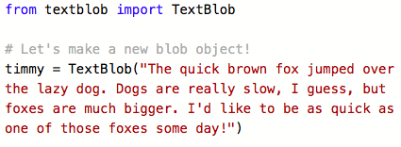
Getting started with textblob
You first have to define a “text blob” object. The _init_ constructor is hidden somewhere in those files that we imported into our file at the beginning.
Notes:
https://textblob.readthedocs.io/en/dev/quickstart.html#quickstart - Demonstrate as many features as you can with the time remaining

