Slide 1
Littlebytes summer ‘18
Python Logic Fundamentals - Week 10

Slide 2
Last week’s review
Snowman - slightly more complex graphics example
More on randomization
Random integers vs. random decimal values
Randomizing tuples for colors
How do we add randomization to graphics?
In what ways do we do this?
Objects
Object notation
Using pre-existing objects to write code
Accessor and Mutator methods (get and set)
Object constructors
Why we need objects?
Object methods + variables setup
School student example
Employee example

Slide 3
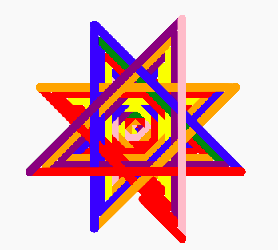
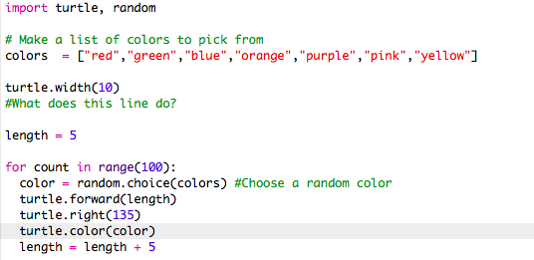
Another simple random graphics example
This draws a randomized color star.

Slide 4
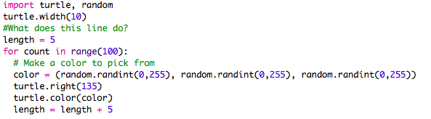

Another way to do the same example
This is a cooler way to do the same exact thing. Here, the colors are randomized using RGB color tuples (another way to do colors in Python). If a tuple is invalid, no color exists

Slide 5
Artificial Intelligence
You may have heard of artificial intelligence, or AI, a lot recently in the news. AI is just a term used to refer to any “intelligent” decisions that a computer makes on its own. If statements are the most basic form of artificial intelligence.
We are going to use artificial intelligence to make a tic-tac-toe game, where a user can play against the computer, who is making decisions using randInt(). Although these are not intelligent, or informed decisions, they are still independent decisions and therefore considered AI.
Disclaimer - our example is from a real coding class at the University of Michigan. Don’t get frustrated too easily.

Slide 6
ASCII Art and graphics
We learned about Turtle graphics, but there is another, more primitive way to make art on a computer screen using only the terminal. This is called ASCII graphic design.
Have you ever seen a stick figure made of just keyboard letters? That’s an example of ASCII graphics. We are going to use ___ and ||||| to make a tic-tac-toe board.
------(- - )--------
| ←----- This is a feeble attempt at ASCII art.

Slide 7
tic tac toe - getting started
First, you must figure out how to represent the board as data in a variable. On paper, the Tic Tac Toe board is drawn as a pair of horizontal lines and a pair of vertical lines, with either an X, O, or empty space in each of the nine spaces.
In the program, the Tic Tac Toe board is represented as a list of strings. Each string will represent one of the nine spaces on the board. To make it easier to remember which index in the list is for which space, they will mirror the numbers on a keyboard’s number keypad, as shown in Figure 10-2.
The strings will either be 'X' for the X player, 'O' for the O player, or a single space ' ' for a blank space.
So if a list with ten strings was stored in a variable named board, then board[7] would be the top-left space on the board. board[5] would be the center. board[4] would be the left side space, and so on. The player will enter a number from 1 to 9 to tell the game which space they want to move on.

Slide 8
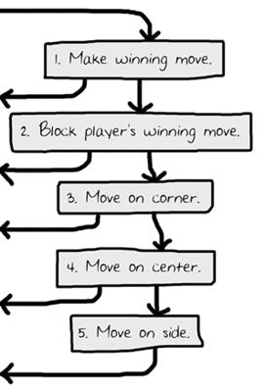
AI algorithm rules
The AI’s algorithm will have the following steps:
1. First, see if there’s a move the computer can make that will win the game. If there is, take that move. Otherwise, go to step 2.
2. See if there’s a move the player can make that will cause the computer to lose the game. If there is, move there to block the player. Otherwise, go to step 3.
3. Check if any of the corner spaces (spaces 1, 3, 7, or 9) are free. If so, move there. If no corner piece is free, then go to step 4.
4. Check if the center is free. If so, move there. If it isn’t, then go to step 5.
5. Move on any of the side pieces (spaces 2, 4, 6, or 8). There are no more steps, because if the execution reaches step 5 the side spaces are the only spaces left.

Slide 9
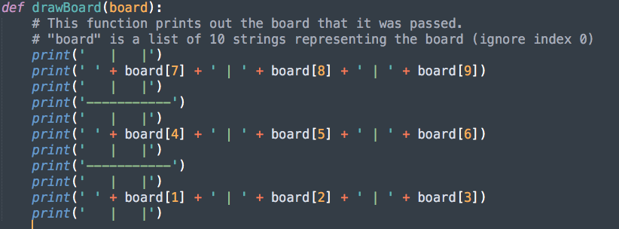
Set-up
Import random, and then define a function to print the board.

Slide 10
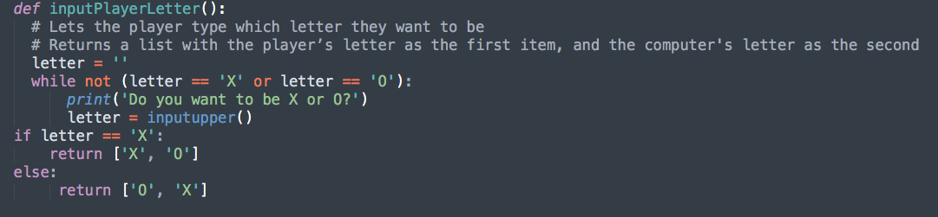
Choosing a player
The inputPlayerLetter() function asks if the player wants to be X or O. It will keep asking the player until the player types in an X or O. Line 27 automatically changes the string returned by the call to input() to uppercase letters with the upper() string method.

Slide 11

Who goes first?
The whoGoesFirst() function does a virtual coin flip to determine whether the computer or the player goes first. The coin flip is in calling random.randint(0, 1). If this function call returns a 0, the whoGoesFirst() function returns the string 'computer'. Otherwise, the function returns the string 'player'. The code that calls this function will use the return value to know who will make the first move of the game.

Slide 12

Makin’ moves
The makeMove() function is simple and only one line. The parameters are a list with ten strings named board, one of the player’s letters (either 'X' or 'O') named letter, and a place on the board where that player wants to go (which is an integer from 1 to 9) named move.

Slide 13
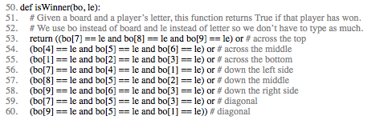
Who won the game?
Lines 53 to 60 in the isWinner() function are actually one long return statement. The bo and le names are shortcuts for the board and letter parameters. These shorter names mean you have less to type in this function. Remember, Python doesn’t care what you name your variables.
There are eight possible ways to win at Tic Tac Toe. You can have a line across the top, middle, and bottom rows. Or you can have a line down the left, middle, or right columns. Or you can have a line over either of the two diagonals.

Slide 14
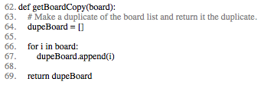
Board duplication
The getBoardCopy() function is here so that you can easily make a copy of a given 10-string list that represents a Tic Tac Toe board in the game. There are times that you’ll want the AI algorithm to make temporary modifications to a temporary copy of the board without changing the original board. In that case, call this function to make a copy of the board's list. The new list is created on line 64, with the blank list brackets [].

Slide 15

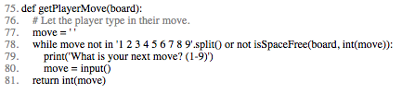
checks and balances
This is a simple function that, given a Tic Tac Toe board and a possible move, will return if that move is available or not. Remember that free spaces on the board lists are marked as a single space string. If the item at the space’s index is not equal to, then the space is taken.
The getPlayerMove() function asks the player to enter the number for the space they want to move on. It also checks that the space entered isn’t already taken, given the Tic Tac Toe board passed to the function for the board parameter.

Slide 16
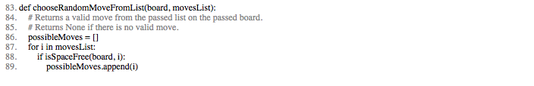

starting the ai algorithm
The chooseRandomMoveFromList() function is useful for the AI code later in the program. The board parameter is a list of strings that represents a Tic Tac Toe board. The second parameter movesList is a list of integers of possible spaces from which to choose. For example, if movesList is [1, 3, 7, 9], that means chooseRandomMoveFromList() should return the integer for one of the corner spaces.

Slide 17

Writing the ai
The getComputerMove() function contains the AI’s code. The first argument is a Tic Tac Toe board for the board parameter. The second argument is letter for the computer either 'X' or 'O' in the computerLetter parameter. The first few lines simply assign the other letter to a variable named playerLetter. This way the same code can be used whether the computer is X or O.
The function will returns an integer from 1 to 9 representing the computer’s move.

Slide 18
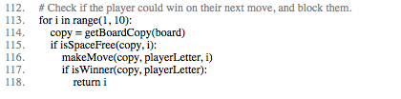
can we win on one move?
More than anything, if the computer can win in the next move, the computer should make that winning move immediately. The for loop that starts on line 105 iterates over every possible move from 1 to 9. The code inside the loop will simulate what would happen if the computer made that move.
The first line in the loop (line 106) makes a copy of the board list. This is so the simulated move inside the loop doesn’t modify the real Tic Tac Toe board stored in the board variable. The getBoardCopy() returns an identical but separate board list value.
Line 107 checks if the space is free and if so, simulates making the move on the copy of the board. If this move results in the computer winning, the function returns that move’s integer.
If none of the spaces results in winning, the loop will finally end and the program execution continues to line 113.

Slide 19
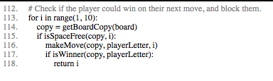
can the human win on one move?
Next, the code will simulate the human player moving on each of the spaces. The code is similar to the previous loop except the player’s letter is put on the board copy. If the isWinner()function shows that the player would win with this move, then the computer will return that same move to block this from happening. If the human player cannot win in one more move, the for loop will eventually finish and execution continues to line 121.

Slide 20
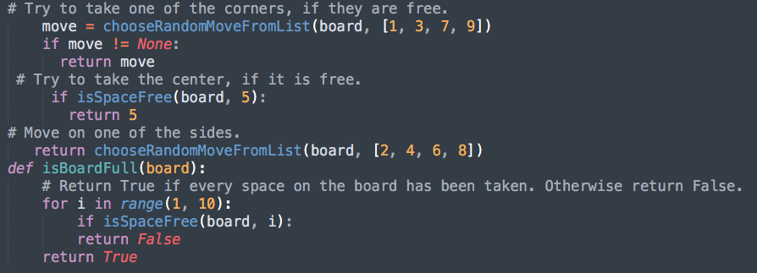
putting the ai together

Slide 21
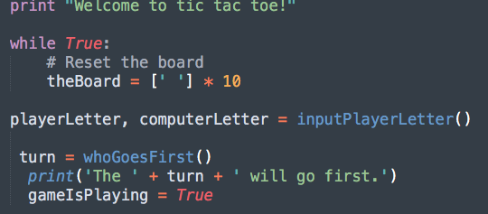
Starting game play
Line 142’s while loop has True for the condition and will keep looping until the execution encounters a break statement. Line 144 sets up the main Tic Tac Toe board in a variable named theBoard. It is a 10-string list, where each string is a single space ' '. The inputPlayerLetter() function lets the player type in whether they want to be X or O. The whoGoesFirst() function randomly decides who goes first, and returns either the string 'player' or the string 'computer' and line 147 tells the player who will go first. The gameIsPlayingvariable keeps track of whether the game is still being played or if someone has won or tied.

Slide 22
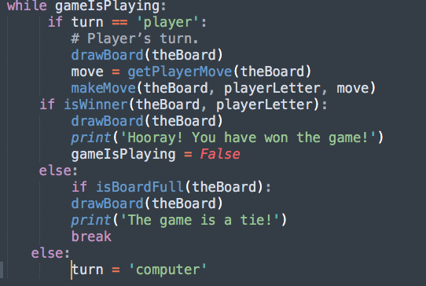
Running the player’s turn - code

Slide 23
running the player’s turn - explanation
Line 150’s loop will keep going back and forth between the code for the player’s turn and the computer's turn, as long as gameIsPlaying is set to True. The turn variable was originally set by the whoGoesFirst() call on line 146. It is set either to 'player' or 'computer'. If turn equals 'computer', then line 151’s condition is False and execution jumps to line 169.
Line 153 calls drawBoard() and passes the theBoard variable to print the Tic Tac Toe board on the screen. Then the getPlayerMove() function lets the player type in their move (and also makes sure it is a valid move). The makeMove() function adds the player’s X or O to theBoard.
Now that the player has made their move, the computer should check if they have won the game with this move. If the isWinner() function returns True, the if-block’s code displays the winning board and prints a message telling them they have won. The gameIsPlaying variable is also set to False so that execution doesn’t continue on to the computer's turn.
If the player didn’t win with their last move, maybe their move filled up the entire board and tied the game. In this else-block, the isBoardFull() function returns True if there are no more moves to make. In that case, the if-block starting at line 162 displays the tied board and tell the player a tie has occurred. The execution breaks out of the while loop and jumps to line 186.

Slide 24
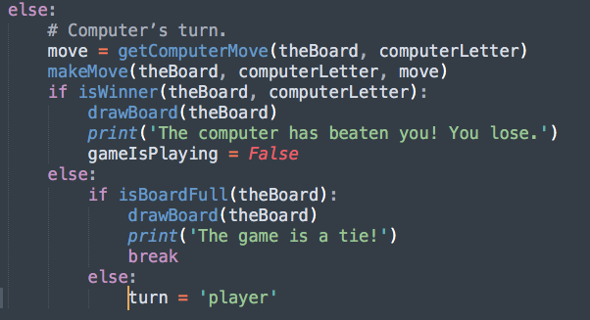
running the computer’s turn - code

Slide 25
running the computer’s turn - explanation
If the turn variable wasn’t 'player' for the condition on line 151, then it must be the computer's turn. The code in this else-block is similar to the code for the player’s turn.
Lines 170 to 184 are almost identical to the code for the player’s turn on lines 152 to 167. The only difference is this the code uses the computer’s letter and calls getComputerMove().
If the game isn’t won or tied, line 184 sets turn to the player’s turn. There are no more lines of code inside the while loop, so execution would jump back to the while statement on line 150.
Lines 186 and 187 are located immediately after the while-block started by the while statement on line 150. gameIsPlaying is set to False when the game has ended, so at this point the game asks the player if they want to play again.
If playAgain() returns False, then the if statement’s condition is True (because the not operator reverses the Boolean value) and the break statement executes. That breaks the execution out of the while loop that was started on line 142. But since there are no more lines of code after that while-block, the program terminates.

Slide 26
Well? What now?
Go ahead and test your game out!
If you need to check for mistakes/errors, the full source code is located on the last few slides of this document, or hosted on our tutorial here.
Enjoy playing your artificially engineered game of Tic-Tac-Toe!

