Slide 1
What is css? (5 minutes)
CSS stands for Cascading Style Sheets
Not technically a programming language
Describes how HTML elements should be displayed
Describes the style of an HTML document, not the elements
Core Questions
Why do we need CSS?
Website with CSS - http://buzzfeed.com
Website without CSS - http://www.guha.com/cv.html

Slide 2
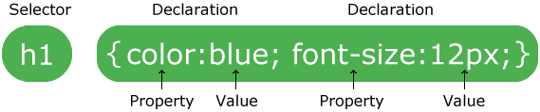
Css syntax i (5 minutes)
The selector points to the HTML element you want to style.
The declaration block contains one or more declarations separated by semicolons.
Each declaration includes a CSS property name and a value, separated by a colon.
A CSS declaration always ends with a semicolon, and declaration blocks are surrounded by curly braces.
In the following example all <p> elements will be center-aligned, with a red text color.

Slide 3
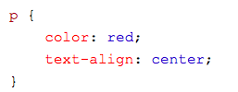
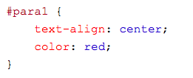
CSS Syntax II (5 minutes)
Let’s identify some examples of CSS Syntax.

Slide 4
HTML Classes and IDs (20 minutes)
The id attribute specifies a unique id for an HTML element (the value must be unique within the HTML document).
The id attribute is most used to point to a style in a style sheet, and by JavaScript (via the HTML DOM) to manipulate the element with the specific id.
The class attribute specifies one or more classnames for an element.
The class attribute is mostly used to point to a class in a style sheet. However, it can also be used by a JavaScript (via the HTML DOM) to make changes to HTML elements with a specified class.

Slide 5
Big idea
Classes and ids are used to identify and separate html elements

Slide 6
Classes and Ids code examples (sublime text)
<h1 class="intro">Header 1</h1>
<p>A paragraph.</p>
<p class="important">Note that this is an important paragraph. :)</p>

Slide 7
ID example with some javascript
<h1 id="myHeader">Hello World!</h1>
<button onclick="displayResult()">Change text</button>
<script>
function displayResult() { document.getElementById("myHeader").innerHTML = "Have a nice day!";
}
</script>
Don’t worry too much about that JavaScript yet, that’s later!

Slide 8
Class/id selectors in css
The id selector uses the id attribute of an HTML element to select a specific element.
The id of an element should be unique within a page, so the id selector is used to select one unique element!
To select an element with a specific id, write a hash (#) character, followed by the id of the element.
The style rule below will be applied to the HTML element with id="para1":

Slide 9
Class/id selectors in css
The class selector selects elements with a specific class attribute.
To select elements with a specific class, write a period (.) character, followed by the name of the class.
Why might we need selectors in CSS?

Slide 10
INLINE CSS VS. LINKED CSS
You can put CSS inside of an HTML document using the <style> tag or the style = “” attributes.
This is called inline CSS because it is in the HTML.
However, we can also use an external CSS file.
Linked CSS is a good method for when there is a lot of CSS and we don’t want to make our HTML document too long.
Let’s try an example of inline and linked CSS.

Slide 11
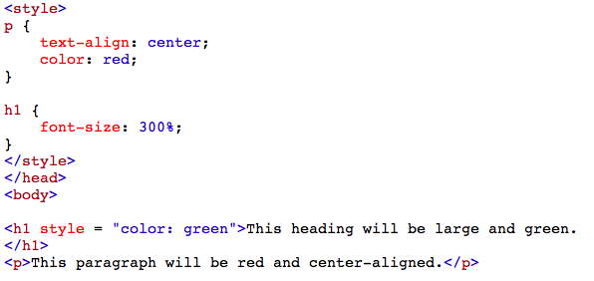
Inline CSS Example

Slide 12
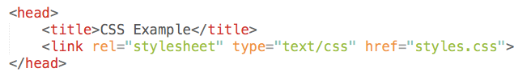
Linked css example
Create two files in the same folder.
index.html
Styles.css
In the CSS file, copy and paste the same CSS that was in your <style> tags from the previous example.
Add the appropriate link within the <head> of HTML.

Slide 13
Both of these turn out the same! Why might one method be better in some cases?

Slide 14

Customizing css attributes
Colors are specified using predefined color names, or RGB, HEX, HSL, RGBA, HSLA values. Color is with the color = “” attribute.
#f45f42
OR
rgb(244, 95, 66)

Slide 15
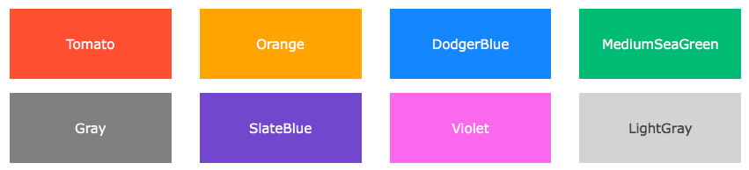
Predefined Colors in HTML
There are many pre-defined color names in HTML. You have to look these up on an internet resource, though, or else they color name you type in may not be a valid one.

Slide 16
Use the google color picker tool (just search color picker) to create a paragraph with a certain color. Any one you choose! Use inline css. One person will be picked to present.
Class comprehension checkpoint time!

Slide 17
Solution
<p style = “#53f441”> This is a green paragraph </p>

Slide 18
Fonts in CSS - default vs custom
Similarly to colors, there are some built in HTML/CSS font styles as well which can be found online.
This is a limited selection, so we need an external source to get more creative, unique fonts.
To use a default font, we use the font-family property.
Let’s look at an example that utilizes IDs and default fonts.

Slide 19
Default Fonts - example
p {
font-family: "Times New Roman", Times, serif;
}
Notice how TNR is recognized!

Slide 20
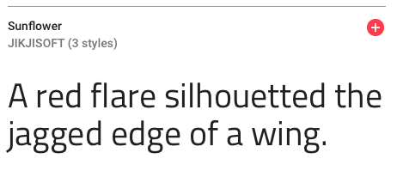
Customized FOnts - Example
Let’s use “Sunflower” from Google Fonts.
Go to fonts.google.com and find “Sunflower”

Slide 21
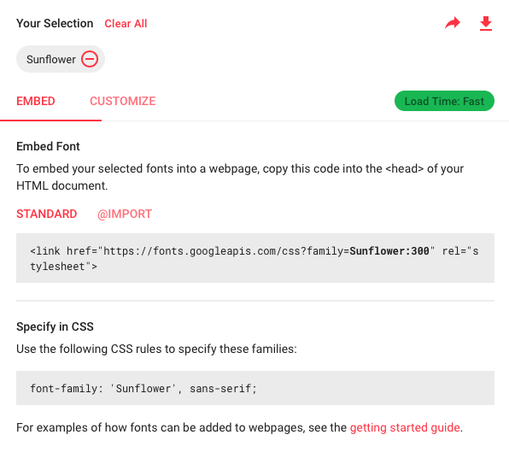
Customized fonts - example continued
Add the <link> to the <head> section of your HTML and use the “specify in CSS” rules to use this font in your projects on your computer. The <link> allows you to import the font from Google Fonts.

Slide 22
Wrap up and next week preview - bootstrap
By the end of today, you should have an understanding of CSS syntax, IDs, classes, fonts, and colors. You should be able to implement both inline and external CSS code.
Let’s have a brief introduction to Bootstrap!
Bootstrap is a free front-end framework for faster and easier web development. Bootstrap includes HTML and CSS based design templates for typography, forms, buttons, tables, navigation, modals, image carousels and many other, as well as optional JavaScript plugins.

