Slide 1
Let’s get our brains ready for class this week
As a warm-up, let’s set up an HTML document with an external CSS file in repl.it. Try it on your own, then we will go through it together.
Notes:
Wait until everyone did it on their own, then show them how to do it.

Slide 2
Your code should look like this!
<!DOCTYPE html>
<html>
<head>
<title> Week 3 Notes - LittleBytes</title>
<link rel="stylesheet" type="text/css" href="styles.css">
</head>
<body>
</body>
</html>
Notes:
Type out the example in repl.it, and show them why you do each step.

Slide 3
Concept introduction - Bootstrap
Bootstrap is a free front-end framework for faster and easier web development. Bootstrap includes HTML and CSS based design templates for typography, forms, buttons, tables, navigation, modals, image carousels and many other, as well as optional JavaScript plugins.
We are going to look at two different uses of Bootstrap today. We will write Bootstrap code ourselves, and we will also look at a pre-made Bootstrap template that we can put our own modifications to change it up.

Slide 4
What are frameworks and how do we use them?
A Framework is a word that refers to any type of external code, libraries, or software that we use in our own projects. Frameworks help us avoid re-writing lines of code that somebody else already developed beforehand.
To use a Framework, we have to follow a specific set of instructions to link its CSS/JS files to our own HTML file. Usually, we will need to put something in the <head> section and then something else at the bottom of <body>.
Why is using Frameworks not a form of code plagiarism?

Slide 5
Adding bootstrap to our HTML file - CSS in <head>
<head>
<title>Week 3 Notes - LittleBytes</title>
<!-- Latest compiled and minified CSS →
<link rel="stylesheet" href="https://maxcdn.bootstrapcdn.com/bootstrap/3.3.7/css/bootstrap.min.css" integrity="sha384-BVYiiSIFeK1dGmJRAkycuHAHRg32OmUcww7on3RYdg4Va+PmSTsz/K68vbdEjh4u" crossorigin="anonymous">
<link rel="stylesheet" type="text/css" href="styles.css">
</head>

Slide 6
Adding bootstrap javascript plug-ins
<body>
<!-- Latest compiled and minified JavaScript -->
<script src="https://maxcdn.bootstrapcdn.com/bootstrap/3.3.7/js/bootstrap.min.js" integrity="sha384-Tc5IQib027qvyjSMfHjOMaLkfuWVxZxUPnCJA7l2mCWNIpG9mGCD8wGNIcPD7Txa" crossorigin="anonymous"></script>
</body>

Slide 7
What did we just do?
We added the Bootstrap framework to our own HTML code using <link> tags. They will refer to code that other programmers wrote that is stored somewhere on the internet, but can be accessed by our HTML document.
*Warning* Make sure to type your <body> above your JavaScript, not under it, or else issues occur.
Now, we can access Bootstrap features, which are available to us through classes and IDs that are already pre-specified in CSS code that we just added.
We will also see that our own CSS can override Bootstrap CSS later on.

Slide 8
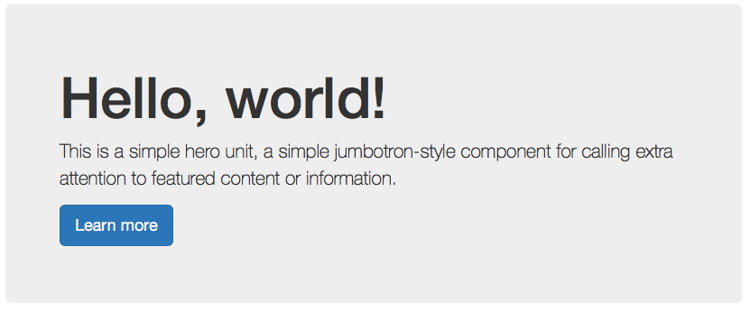
Bootstrap component - the jumbotron
A jumbotron is a lightweight, flexible component that can optionally extend the entire viewport to showcase key content on your site.

Slide 9
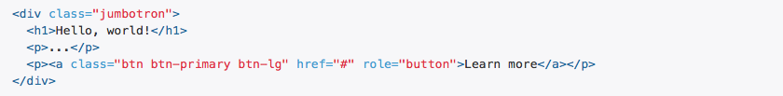
Jumbotron code - notice the classes!
The classes “jumbotron” and “btn btn-primary btn-lg” are used by the Bootstrap code to help apply its default formatting to your website.
If you notice, the jumbotron is styled, colored, and has certain fonts in it already. What if we want to change it?

Slide 10
Overriding css with the jumbotron
Remember the styles.css file we made at warm-up time?
Let’s add the following code and see what happens to our jumbotron. There should be a color change that occurs.
h1 { text-color: red;}

Slide 11
Overriding css with jumbotron
Our code means that ALL <h1> elements in our HTML code will be displayed as red, instead of the neutral Bootstrap colors that they were previously.
Why is Bootstrap overridden in this case?
Well, take a look at the order that we put our stylesheets. Bootstrap came first, and then the custom CSS came second. This is because of how <html> documents are read - from beginning to end.
The Bootstrap CSS is processed before the Custom CSS!

Slide 12

Bootstrap element - image shapes
Not all Bootstrap features are elements. Some are ways to modify regular elements you already had in regular HTML!
Notes:
Use any random Image URL from google to demo this, nyan-cat-01-625x450.jpg if you wanna be cool and hip

Slide 13
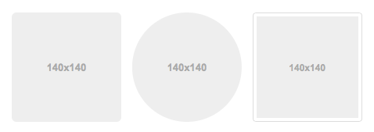
Overriding bootstrap - resizing the images
By default, the images are 140x140, but we can modify the “img-rounded”, “img-circle”, and “img-thumbnail” classes to make these images larger or smaller pixel sizes.

Slide 14
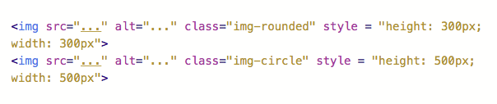
Resizing using some inline css
Let’s keep this inline for simplicity’s sake!

Slide 15
Bootstrap element: Containers
Grid systems are used for creating page layouts through a series of rows and columns that house your content. Here's how the Bootstrap grid system works.
There are rows and columns, which can either be fluid (moving, changing size) or fixed (static) size. We are going to learn how to get three images to be side-by-side next to each other using the Bootstrap column system.
In the following example, our columns will also be responsive, meaning that they stack on top of each other when you make your browser window smaller.

Slide 16
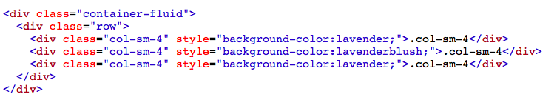
Three columns, side by side
Let’s keep this inline for simplicity’s sake! Technically, we didn’t override any CSS here, however, because if we did not specify background-colors, we would have three plain white text fields that say “.col-sm-4” right next to each other.

Slide 17
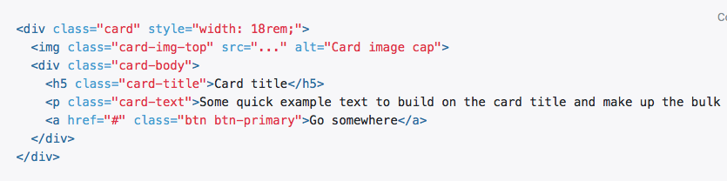
One more cool element - cards

Slide 18
Bootstrap template demonstration
There are a wide variety of free Bootstrap templates available on the internet. Let’s look at how we can modify HTML and CSS in a template to customize it for our own needs.
Copy and paste the template from the link to get it to work. We can change the images, text, as well as what elements are there and what are not.
We will be filling out a fake resume with our own details.
Notes:
Spend some time with this. Click on the link and show them images and overriding CSS, especially.

Slide 19
Comprehension check
Visit the Bootstrap documentation here. Select a component of your choice and implement it on our HTML boilerplate that we already created for ourselves.
Some fun suggestions - progress bars, labels, or icons are cool to utilize.
If you finish early, try overriding the existing CSS.
We will pick two people to share afterwards.

Slide 20
Next week preview - Javascript to change the page
JavaScript is the language of web development. HTML controls what elements appear, CSS controls how these elements display on the screen, but JavaScript controls how elements act. You define a page’s behavior with this language.
What can you do with JavaScript that you can’t do with other languages? A few examples include calculations, changing colors, animations, and even internet games.
Next week, we will make a JavaScript/HTML/CSS calculator.

