Slide 1
Warm-up for today’s lesson
Today we are adding JavaScript to our knowledge of web development programming languages.
We need to set up three files that our website will be made up of in repl.it. Set up the following three files.
index.html
styles.css
activity.js
You should also know how to link the CSS to your HTML file.

Slide 2
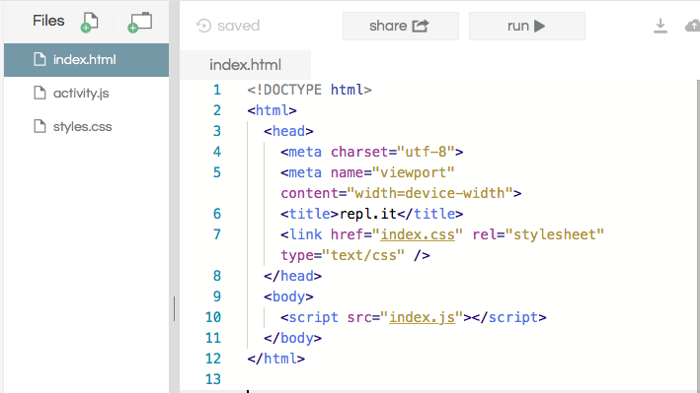
What the set-up should look like

Slide 3
What is javascript?
JavaScript is a programming language for the web. It is supported by most web browsers including Chrome, Firefox, Safari, internet Explorer, Edge, Opera, etc. Most mobile browsers for smart phones support JavaScript too.
It is primarily used to enhance web pages to provide for a more user friendly experience. These include dynamically updating web pages, user interface enhancements such as menus and dialog boxes, animations, 2D and 3D graphics, interactive maps, video players, and more. This mode of JavaScript usage in the web browser is also referred to as client-side javascript.

Slide 4
Why do we need this “javascript” thing?
JavaScript is one of the 3 languages all web developers must learn:
1. HTML to define the content of web pages
2. CSS to specify the layout of web pages
3. JavaScript to program the behavior of web pages
Web pages are not the only place where JavaScript is used. Many desktop and server programs use JavaScript. Node.js is the best known. Some databases, like MongoDB and CouchDB, also use JavaScript as their programming language.

Slide 5

getelementbyid() Method
Javascript can change the content of an HTML page.
This example uses the method to "find" an HTML element (with id="demo") and changes the element content (innerHTML) to "Hello JavaScript". JavaScript accepts both double and single quotes.

Slide 6


JavaScript can change html attribute values
For the following “bulb on, bulb off” example, you need to use the following two images (which can be easily uploaded to repl.it with the file upload button)

Slide 7
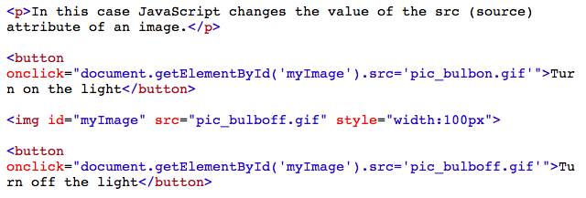
Changing the image of the bulb

Slide 8

Using javascript to change up the css
What is onclick() and what is it being used for in the button example shown above?

Slide 9
Where does javascript go?
In HTML, JavaScript code must be inserted between <script> and </script> tags.
A JavaScript function is a block of JavaScript code, that can be executed when "called" for. For example, a function can be called when an event occurs, like when the user clicks a button.
You can place any number of scripts in an HTML document. Scripts can be placed in the <body>, or in the <head> section of an HTML page, or in both.
Placing scripts at the bottom of the <body> element improves the display speed, because script compilation slows down the display.
Scripts can also be placed in external files. To use an external script, put the name of the script file in the src (source) attribute of a <script> tag, like <script src = “activity.js”> </script>

Slide 10
Why would you use external js?
Placing scripts in external files has some advantages:
It separates HTML and code
It makes HTML and JavaScript easier to read and maintain
Cached JavaScript files can speed up page loads
Usually, for the size of the files we make in these smaller projects, JS loading size and file size isn’t a big deal, so you can pick your own personal preference in this.

Slide 11
Ways to output information with javascript
JavaScript can "display" data in different ways:
Writing into an HTML element, using innerHTML.
Writing into the HTML output using document.write().
Writing into an alert box, using window.alert().
Writing into the browser console, using console.log()
Let’s look at an example for window.alert.

Slide 12
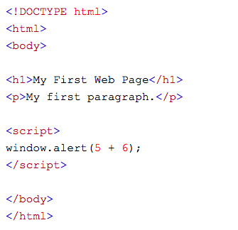
Window alert example
What happens once you go click on the screen?
Why is there no content displayed on the page here?
Try out a few more mathematical operations on the alert window.

Slide 13
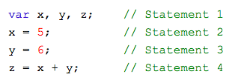
Javascript statement example
A computer program is a list of "instructions" to be "executed" by a computer.
In a programming language, these programming instructions are called statements.
A JavaScript program is a list of programming statements.

Slide 14

Comments in javascript
Not all JavaScript statements are "executed".
Code after double slashes // or between /* and */ is treated as a comment.
Comments are ignored, and will not be executed.

Slide 15
Let’s do a more complex example
Let’s make a calculator!
It will have four functions
Multiplication
Division
Subtraction
Addition
We will use the same files as we set up in the beginning of class to write these, so make sure to clean them out.
* Instructor note - Code Files are attached.
Notes:
https://github.com/prisubs/html-calculator

Slide 16
Questions to review
Why do we need JavaScript?
Why couldn’t we have made a calculator using just HTML/CSS?
Notes:
If you have run out of time, then end the class. If you have more time, take a swing at anything from here.

