Slide 1
What is github?
Git is a version control system, but what does that mean? When developers create something (an app, for example), they make constant changes to the code, releasing new versions up to and after the first official (non-beta) release.
Version control systems keep these revisions straight, storing the modifications in a central repository. This allows developers to easily collaborate, as they can download a new version of the software, make changes, and upload the newest revision. Every developer can see these new changes, download them, and contribute.
In short, GitHub is like Google Drive for coding documents.

Slide 2
Github vocabulary - repos and forking
A repository (usually abbreviated to “repo”) is a location where all the files for a particular project are stored. Each project has its own repo, and you can access it with a unique URL.
“Forking” is when you create a new project based off of another project that already exists. This is an amazing feature that vastly encourages the further development of programs and other projects. If you find a project on GitHub that you’d like to contribute to, you can fork the repo, make the changes you’d like, and release the revised project as a new repo. If the original repository that you forked to create your new project gets updated, you can easily add those updates to your current fork.

Slide 3
Github vocabulary - pull requests
You’ve forked a repository, made a great revision to the project, and want it to be recognized by the original developers—maybe even included in the official project/repository. You can do so by creating a pull request. The authors of the original repository can see your work, and then choose whether or not to accept it into the official project.
Whenever you issue a pull request, GitHub provides a perfect medium for you and the main project’s maintainer to communicate.

Slide 4
How do we use github?
There are ways to upload and modify code with GitHub that involve using your computer’s terminal (since GitHub is based on Linux), but we are going to use the website version of GitHub instead. Go to www.github.com.
Once everyone is done creating an account, let’s take a look at a sample repository on GitHub. What are some things you notice? How is the repository organized? Why might this be better than repl.it for storing information?
The repository we will be looking at is here.
Notes:
Explain all the parts of this repo. Show them how to fork it.
This slide please

Slide 5
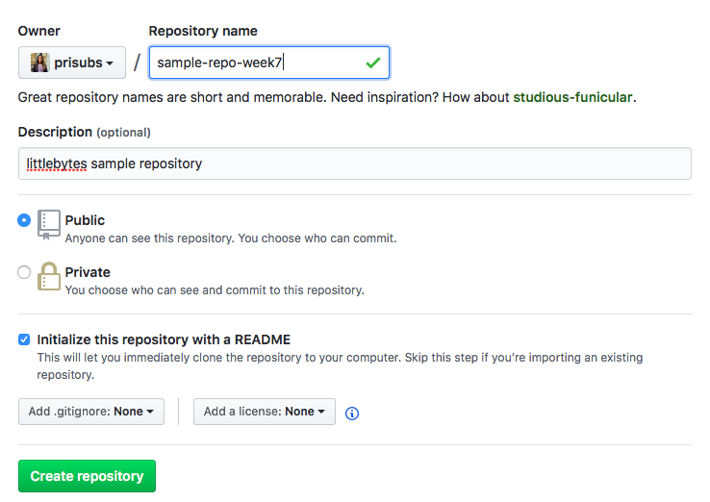
Creating a new repository
Create a repository of your own using the following settings.
Make sure to select “initialize this repository with a readme”.
Once created, fill out the readme.md file with information.

Slide 6
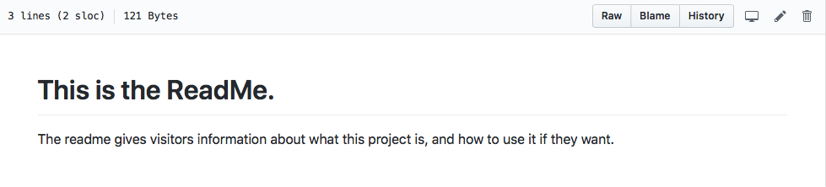
Readme.md - what is this?
Click on the readme.md file, then click on the pencil in the top right corner. Then, you will be able to modify the README.md file according to what your own project is all about.

Slide 7
What is github pages?
GitHub Pages is a static site hosting service designed to host your personal, organization, or project pages directly from a GitHub repository.
You can create and publish GitHub Pages sites online using the Jekyll Theme Chooser. Or if you prefer to work locally, you can use GitHub Desktop or the command line.
GitHub Pages is a static site hosting service and doesn't support server-side code such as, PHP, Ruby, or Python.

Slide 8
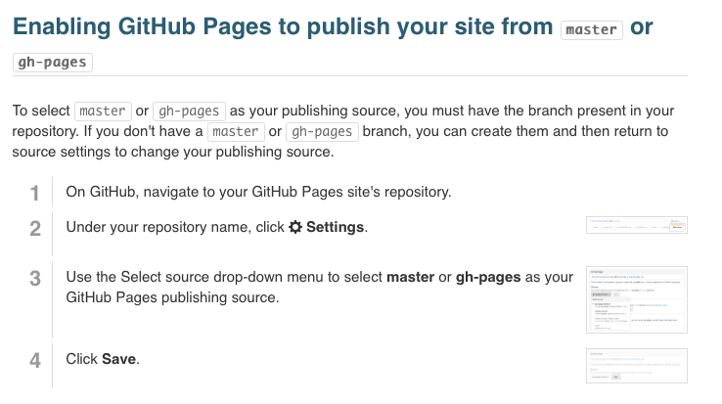
Making a github pages website
Notes:
The HTML file MUST BE NAMED index.html.
Please do this

Slide 9
HTML <canvas> element
The HTML <canvas> element is used to draw graphics, on the fly, via scripting (usually JavaScript). The <canvas> element is only a container for graphics. You must use a script to actually draw the graphics. Canvas has several methods for drawing paths, boxes, circles, text, and adding images. The <canvas> element must have an id attribute so it can be referred to by JavaScript. The width and height attribute is necessary to define the size of the canvas.
Tip: You can have multiple <canvas> elements on one HTML page.

Slide 10
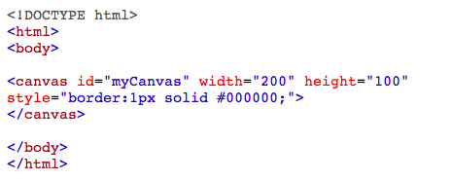
Creating a canvas
This code sets up a canvas with a solid border of one pixel, in black, and a width and height of 200 by 100 pixels.

Slide 11
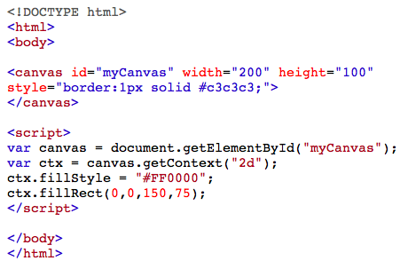
Using javascript to draw on canvas
Notes:
Explain each step as you are typing

Slide 12
Canvas coordinates
The HTML canvas is a two-dimensional grid. The upper-left corner of the canvas has the coordinates (0,0).
In the previous example, you saw this method used: fillRect(0,0,150,75). This means: Start at the upper-left corner (0,0) and draw a 150x75 pixels rectangle.
To draw a straight line on a canvas, use the following methods: moveTo(x,y) - defines the starting point of the linelineTo(x,y) - defines the ending point of the line
To actually draw the line, you must use one of the "ink" methods, like stroke().

Slide 13
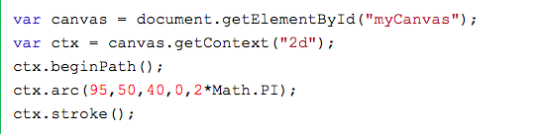
Drawing circles
To draw a circle on a canvas, use the following methods:
beginPath() - begins a path
arc(x,y,r,startangle,endangle) - creates an arc/curve. To create a circle with arc(): Set start angle to 0 and end angle to 2*Math.PI. The x and y parameters define the x- and y-coordinates of the center of the circle. The r parameter defines the radius of the circle.

Slide 14
Canvas gradients
Gradients can be used to fill rectangles, circles, lines, text, etc. Shapes on the canvas are not limited to solid colors.
Once we have a gradient object, we must add two or more color stops. The addColorStop() method specifies the color stops, and its position along the gradient.
Gradient positions can be anywhere between 0 to 1. To use the gradient, set the fillStyle or strokeStyle property to the gradient, then draw the shape (rectangle, text, or a line).
Both linear gradients and radial (circular) gradients exist.

Slide 15
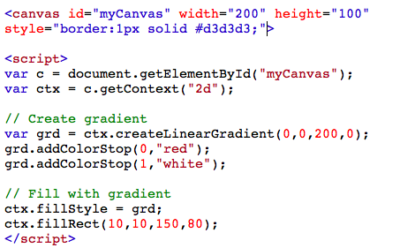
Gradients example - linear gradient

Slide 16
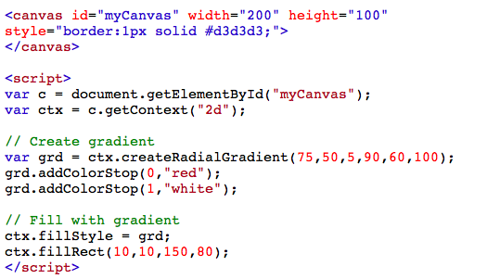
Gradients example - radial gradient

Slide 17
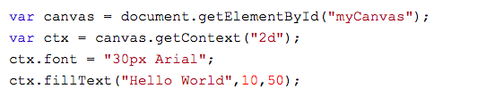
Drawing canvas text
To draw text on a canvas, the most important property and methods are:
font - defines the font properties for the text
fillText(text,x,y) - draws "filled" text on the canvas
strokeText(text,x,y) - draws text on the canvas (no fill)

