Slide 1

Canvas drawing example - stick man
As a warm up, set up an HTML document with a <canvas> element on your own, and link a javascript file.
Remember to give the canvas element an ID, to reference it.
Let’s get started with our JavaScript.

Slide 2
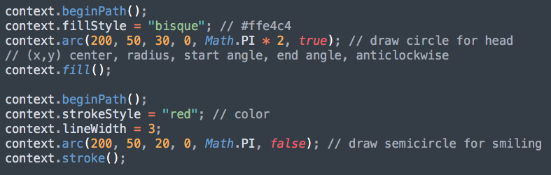
Beginning the shape

Slide 3
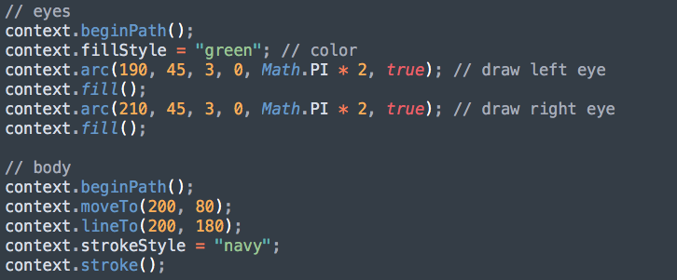
Eyes and body

Slide 4
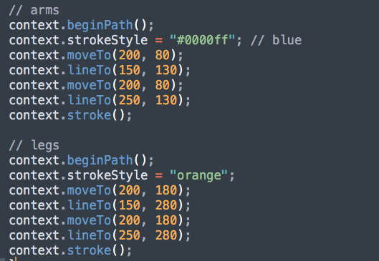
Arms and legs

Slide 5
Creating an html drawing app
Our web paint application is based off of HTML5’s canvas. We’ll be making a “whiteboard” that draws whenever you move your mouse while clicked. We’ll also implement an input box where we can specify what hex color we want.
Since our app is basically a plain screen where we can draw, we don’t need to style anything (no CSS file needed).
Therefore, we just need two files. index.html - for our markup, and app.js - for our function(s).

Slide 6
Getting started with the whiteboard
Our html will have all the usual tags (head, meta viewport, title, etc) but we do need to add an input tag to let the user specify a hex color, and a canvas tag for our canvas.
We will also need to set ids for both. The <input> tag specifies an input field where the user can enter data. <input> elements are used within a <form> element to declare input controls that allow users to input data.
An input field can vary in many ways, depending on the type attribute.

Slide 7
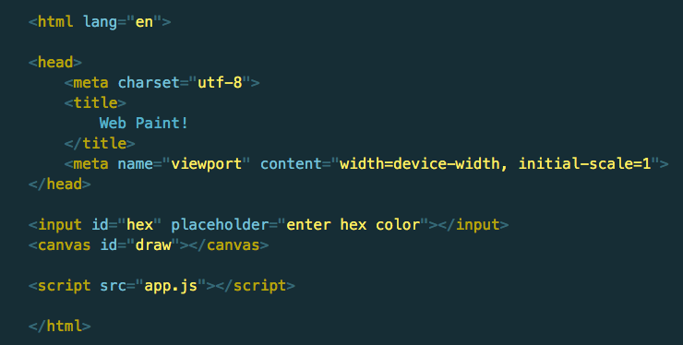
Whiteboard setup code

Slide 8
Javascript setup
In our app.js file, we need to assign our canvas id, draw, to a variable. Then, we’ll need to set another variable to the .getContext(’2d’) of that canvas variable so we can draw within it.
In addition, we’ll need to write a small resize function so that we can set the canvas’s width and height to the window’s width and height.
This way the canvas will take over the whole browser window.

Slide 9
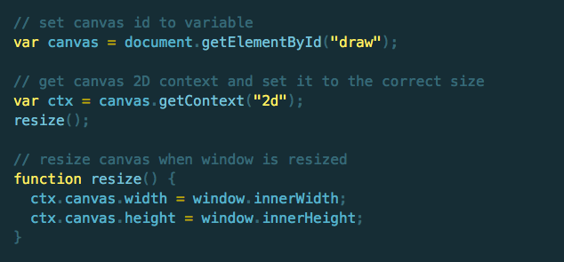
Javascript setup code

Slide 10
Event listeners
HTML events allow JavaScript to register different event handlers on elements in an HTML document. Events are normally used in combination with functions, and the function will not be executed before the event occurs (such as when a user clicks a button). Our app needs four event listeners.
a window event listener to trigger the resize function when window is resized
a document event listener to trigger the draw() function when mouse is moved
a document event listener to trigger the setPosition() (user’s mouse current position) function when mouse is clicked
a document event listener to trigger the setPosition() (user’s mouse current position) function when mouse is moved

Slide 11
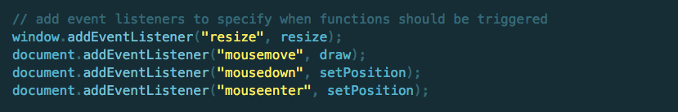
More on events
HTML events are "things" that happen to HTML elements. When JavaScript is used in HTML pages, JavaScript can "react" on these events. An HTML event can be something the browser does, or something a user does.
Often, when events happen, you may want to do something.
JavaScript lets you execute code when events are detected. HTML allows event handler attributes, with JavaScript code, to be added to HTML elements.

Slide 12
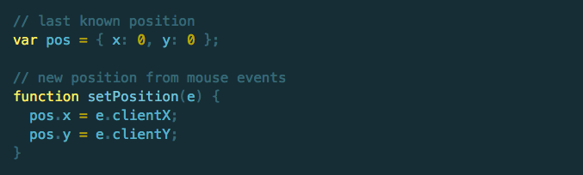
Adding drawing functions
The drawing function of this project depends on the position of the mouse. Since we’ll be moving from one position to another one whenever the mouse is clicked or when the mouse is moved over the canvas, we’ll need to create a setPosition() function that sets variables to the user’s x & y position coordinates. We can then use those variables in our draw function.

Slide 13
Finishing it up
At last, we come to our draw() function. Our function will need a closure followed by the following:
in the function, we need to have an if statement to make sure it runs only when mouse is clicked
set a variable to our input id’s value
write ctx.beginPath() to start a drawing path
specify the line width
specify the lineCap
specify the strokeStyle (color of line), which is set to our variable with the input id value
add the from(moveTo) and to (lineTo)functions for the line based on the position coordinates
begin the drawing path(stroke) of the line

Slide 14
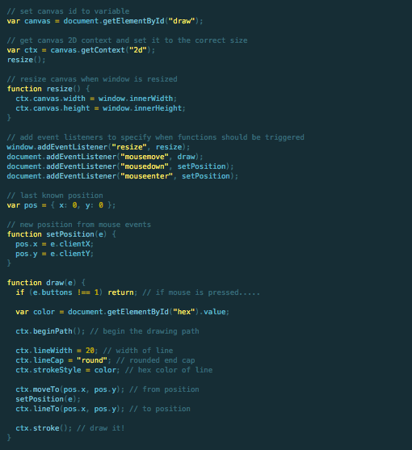
All of the javascript
Zoom in to read the code. Let’s take a few minutes to double check our work before testing out the drawing app!
Type any HEX color (the ones we find on Google Color Picker) and you will be able to draw in that color.

