Slide 1
What is jquery? (pronounced like j-fairy)
jQuery is a lightweight, "write less, do more", JavaScript library.
The purpose of jQuery is to make it much easier to use JavaScript on your website.
jQuery takes a lot of common tasks that require many lines of JavaScript code to accomplish, and wraps them into methods that you can call with a single line of code.
jQuery also simplifies a lot of the complicated things from JavaScript, like AJAX calls and DOM manipulation (which are just fancy ways of saying “downloading information from an online API”.
The jQuery library contains the following features:
CSS manipulation
HTML event methods
Effects and animations
AJAX
Utilities
Tip: In addition, jQuery has plugins for almost any task out there.

Slide 2
Why would we need jquery instead of javascript?
There are lots of other JavaScript frameworks out there, but jQuery seems to be the most popular, and also the most extendable.
Many of the biggest companies on the Web use jQuery, such as:
Google - for the “instant search” feature where recommendations pop up in the search bar
Microsoft - for their online version of Excel and Word, which needs to instantly save every second
IBM - for core processing, and other inner-computer functions
Netflix - to quickly load video without a lot of code
What about browser compatibility? The jQuery team knows all about cross-browser issues, and they have written this knowledge into the jQuery library. jQuery will run exactly the same in all major browsers.

Slide 3
Jquery getting started
There are two ways to start using jQuery on your web site. You can:
Download the jQuery library from jQuery.com
Include jQuery through a link in the <head> of your website
We’re picking option 2 so that we don’t have to deal with downloads and imports.
To use jQuery from Google or Microsoft, use one of the following links at the top of your <head>.
<script src="https://ajax.googleapis.com/ajax/libs/jquery/3.3.1/jquery.min.js">
<script src="https://ajax.aspnetcdn.com/ajax/jQuery/jquery-3.3.1.min.js"></script>
Notes:
The code is plain-text and can be copy-pasted.

Slide 4
Why is the link method better?
Many users already have downloaded jQuery from Google or Microsoft when visiting another site.
As a result, it will be loaded from cache (meaning the computer’s temporary web browsing memory) when they visit your site, which leads to faster loading time.
Also, most of these JQuery hosting services will make sure that once a user requests a file from it, it will be served from the server closest to them, which also leads to faster loading time.
More obviously, downloading files introduces “dependencies” on other code for your project. A dependency makes the file larger and clunkier to store.

Slide 5
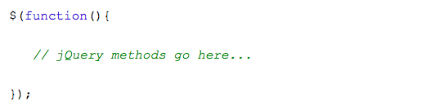
JQUERY Syntax
With jQuery you select (query) HTML elements and perform "actions" on them.
A basic example of syntax is: $(selector).action()
A $ sign to define/access jQuery, and specify that it is not JavaScript
A (selector) to find specific HTML elements
A jQuery action() function to be performed on the element(s)
The image shows standard JQuery setup in a JavaScript file.

Slide 6
JQuery selectors
jQuery selectors allow you to select and manipulate HTML element(s).
jQuery selectors are used to "find" (or select) HTML elements based on their name, id, classes, types, attributes, values of attributes and much more. It's based on the existing CSS Selectors, and in addition, it has some own custom selectors.
All selectors in jQuery start with the dollar sign and parentheses: $(“”). You can select all <p> elements on a page by writing $(“p”).
There are also class and ID selectors, similar to the CSS ones. For example, $(“.tester”) selects all elements with class “tester”, and $(“#input”) selects all elements with the ID name of “input.

Slide 7
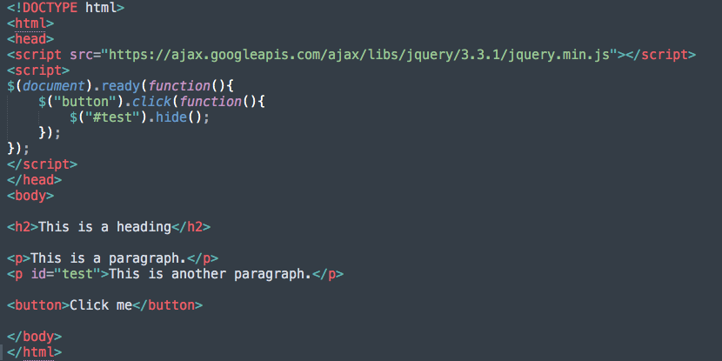
ID Selector example
Notes:
When a user clicks on a button, the element with id="test" will be hidden.

Slide 8

JQuery in another file
If your website contains a lot of pages, and you want your jQuery functions to be easy to maintain, you can put your jQuery functions in a separate .js file. When we demonstrate jQuery, the functions are added directly into the <head> section. However, sometimes it is preferable to place them in a separate file, like this (use the src attribute to refer to the .js file)

Slide 9
JQuery events
All the different visitor's actions that a web page can respond to are called events. An event represents the precise moment when something happens. The term "fires/fired" is often used with events. Example: "The keypress event is fired, the moment you press a key". Some examples are moving a mouse over an element, selecting a radio button, or clicking on an element.
To assign a click event to all paragraphs on a page, you can do this:
$("p").click();
The next step is to define what should happen when the event fires. You must pass a function to the event:
$("p").click(function(){
// action goes here!!
});
Notes:
It’s like if there was a “when” statement.

Slide 10
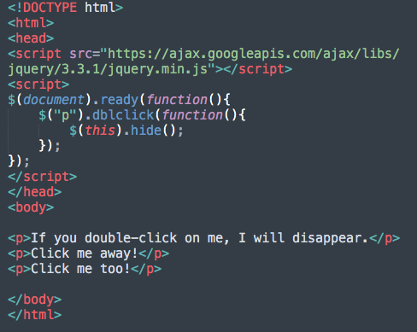
Example - double clicking event
When each <p> element has been double-clicked, it will disappear using the JQuery hide() function.
Hide() is the response provided to the “double-clicking” event.

Slide 11
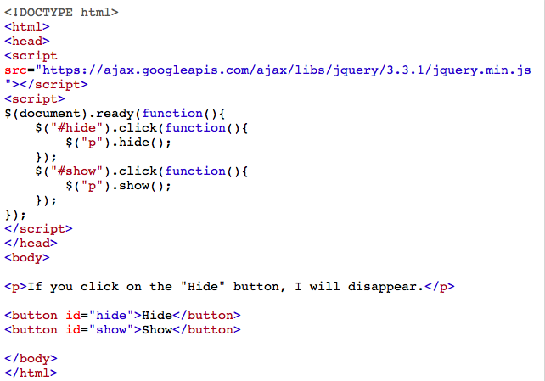
Jquery hide and show methods example
With jQuery, you can hide and show HTML elements with the hide() and show() methods.
You can’t accomplish this with just HTML, unless you are okay with simply reloading the page.

Slide 12
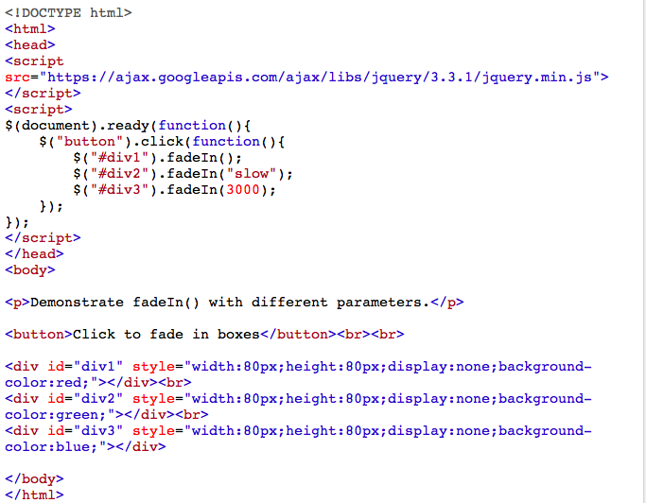
FAde method
The fade method, is not technically an animation.
Fade() is a great visual effect to add to your site.
We’ll get into animating in the next slide.

Slide 13
Animating in jquery
The jQuery animate() method is used to create custom animations.
The required params parameter defines the CSS properties to be animated.
The optional speed parameter specifies the duration of the effect. It can take the following values: "slow", "fast", or milliseconds.
The optional callback parameter is a function to be executed after the animation completes.

Slide 14
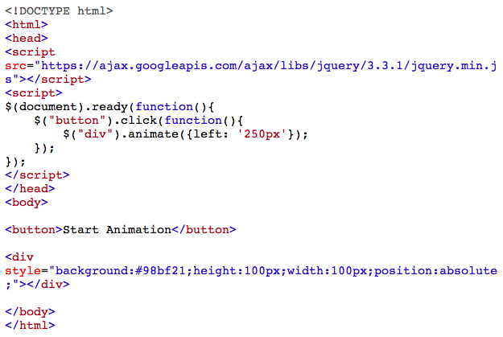
Animation example
The following example demonstrates a simple use of the animate() method; it moves a <div> element to the right, until it has reached a left property of 250px.
By default, all HTML elements have a static position, and cannot be moved. To manipulate the position, remember to first set the CSS position property of the element to relative, fixed, or absolute!

Slide 15
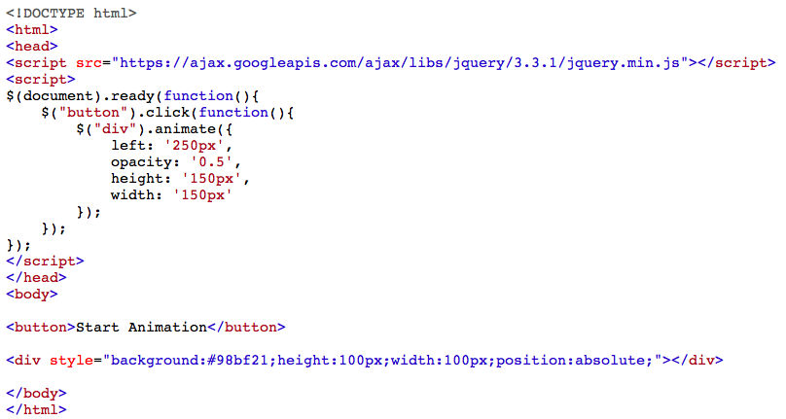
Same example, modified

Slide 16
Animation Rules
You can manipulate multiple CSS properties at once. However, there is one important thing to remember: all property names must be “camel-cased” when used with the animate() method.
You will need to write paddingLeft instead of padding-left, marginRight instead of margin-right, and so on.
Also, color animation is not included in the core jQuery library. If you want to animate color, you need to download the Color Animations plugin from jQuery.com.
Let’s check up on our JQuery Progress - define the purpose of JQuery and its functions in your own words, and send it to our chat!

Slide 17
HTTP and JQuery
The jQuery get() and post() methods are used to request data from the server with an HTTP GET or POST request. Two commonly used methods for a request-response between a client and server are: GET and POST.
GET - Requests data from a specified resource
POST - Submits data to be processed to a specified resource
GET is basically used for just getting (retrieving) some data from the server. Note: The GET method may return cached data. POST can also be used to get some data from the server. However, the POST method NEVER caches data, and is often used to send data along with the request.
We have to use JQuery to use these two methods with APIs, which is what the focus of next week’s lesson will be. Any questions?

